Slide 1






Unit 1
What’s your address?
Lesson 2

Slide 2
VOCABULARY

Slide 3


Vocabulary
big
/big/
(a) to, lớn
small
/smɔːl/
(a) nhỏ, bé

Slide 4
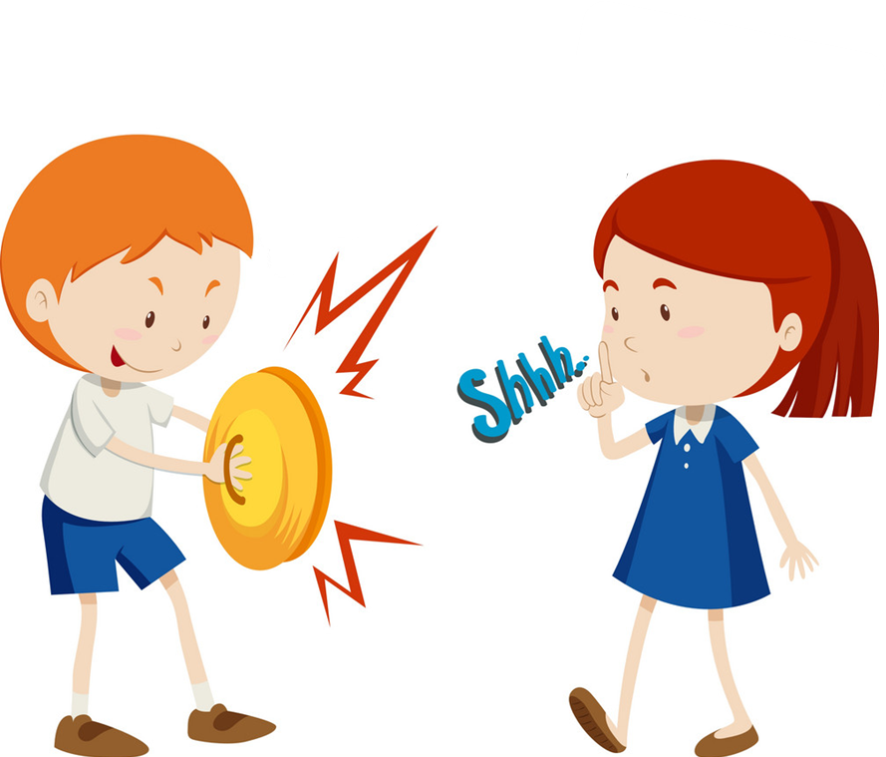
Vocabulary
noisy
/ˈnɔɪzi/
(a) ồn ào
quiet
/ˈkwaɪət/
(a) yên tĩnh

Slide 5
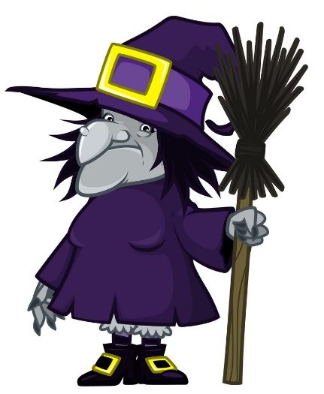

Vocabulary
beautiful
/ˈbjuːtɪfl/
(a) đẹp, xinh

Slide 6
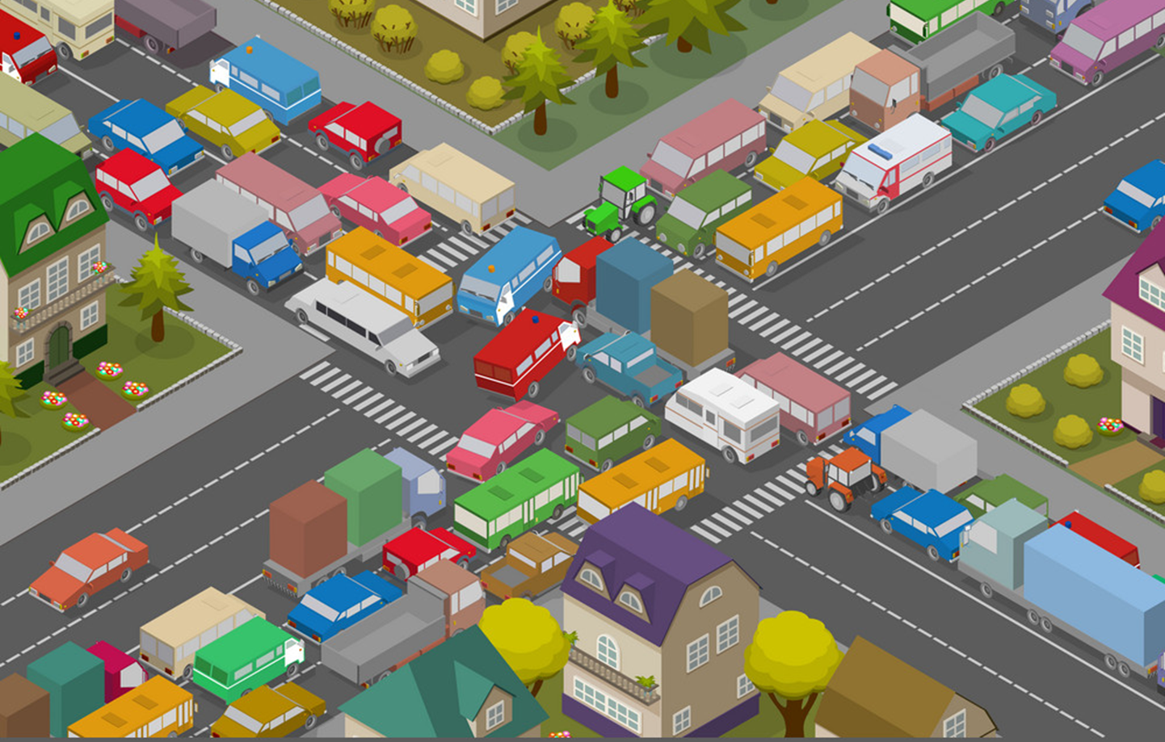
Vocabulary
crowded
/ˈkraʊdɪd/
(a) đông đúc

Slide 7

Vocabulary
busy
/ˈbɪzi/
(a) bận rộn

Slide 8

Vocabulary
large
/lɑːrdʒ/
(a) rộng

Slide 9

Vocabulary
far
/fɑː/
(a) xa

Slide 10


Vocabulary
hometown
/ˈhəʊmtaʊn/
(n) quê

Slide 11

Vocabulary
mountain
/ˈmaʊntən/
(n) núi

Slide 12

Vocabulary
island
ˈaɪlənd/
(n) hòn đảo

Slide 13




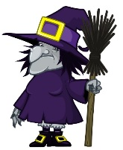

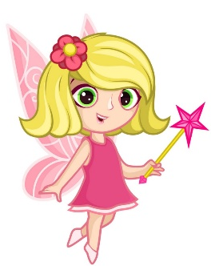
Vocabulary
island
mountain
hometown
far
noisy
big
large
quiet
small
beautiful
crowded

Slide 14
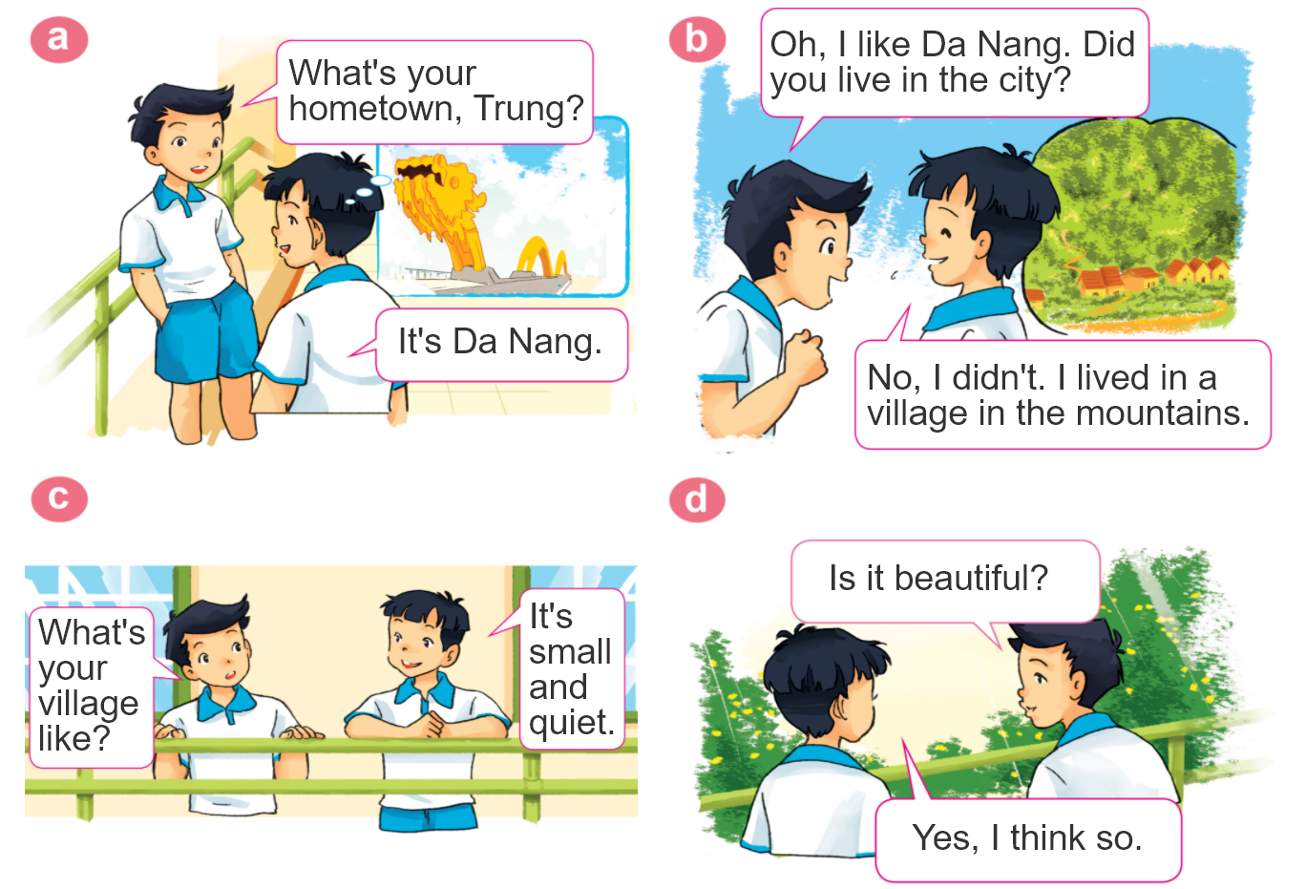

1. Look, listen and repeat.

Slide 15
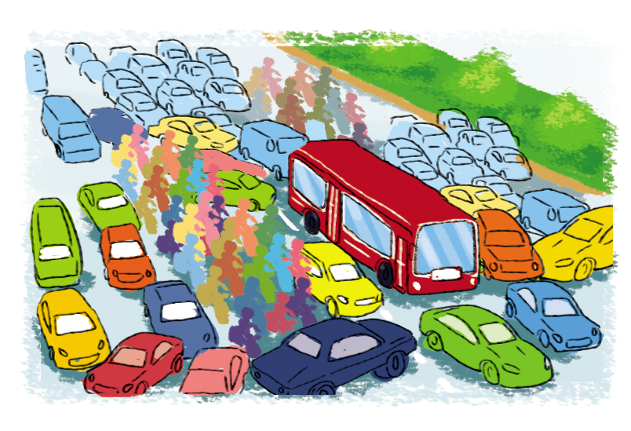

2. Point and say.
city,
big and busy
What's the ________ like?
city
It's __________________.
big and busy

Slide 16
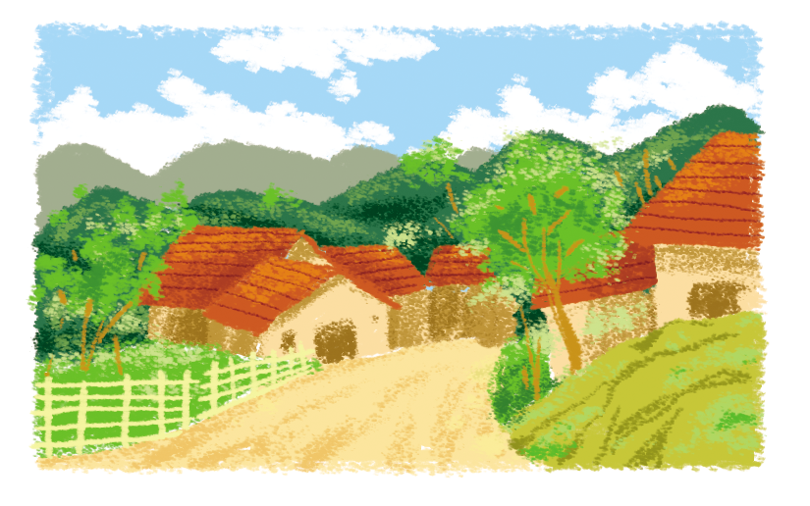
2. Point and say.
village,
far and quiet
What's the ________ like?
village
It's __________________.
far and quiet

Slide 17
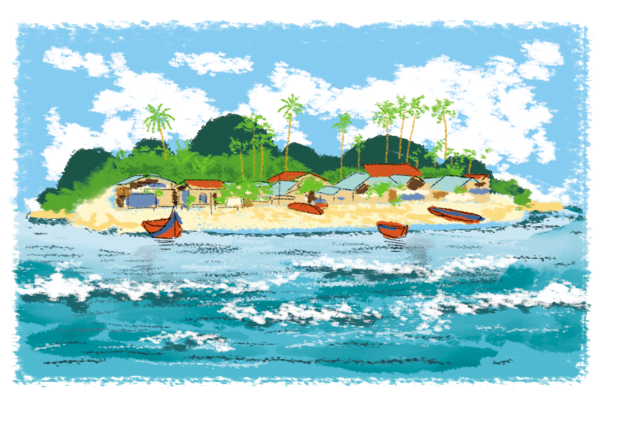
2. Point and say.
island,
small and pretty
What's the ________ like?
island
It's __________________.
small and pretty

Slide 18
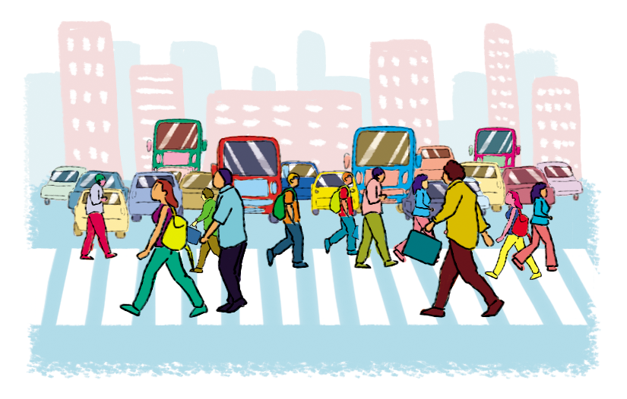
2. Point and say.
town,
large and crowded
What's the ________ like?
town
It's __________________.
large and crowded

Slide 19




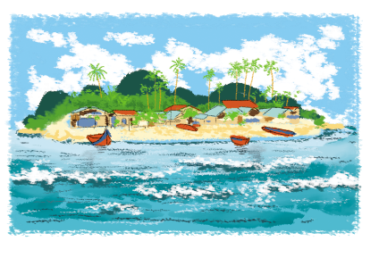
2. Point and say.
What's the ________ like?
It's ___________.
city,
big and busy
town,
large and crowded
village,
far and quiet
island,
small and pretty

Slide 20
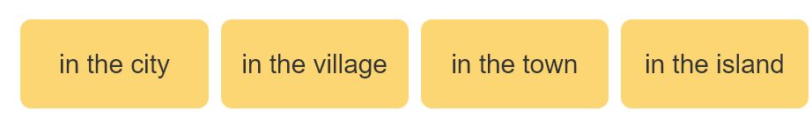
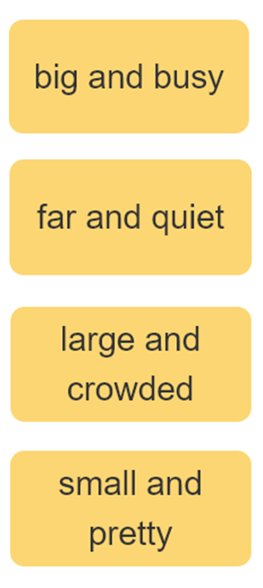

3. Let’s talk
I live ____________.
Where do you live?
What's it like?
It’s ______.
Who do you live with?
I live with ________.
parents
grandparents

Slide 21
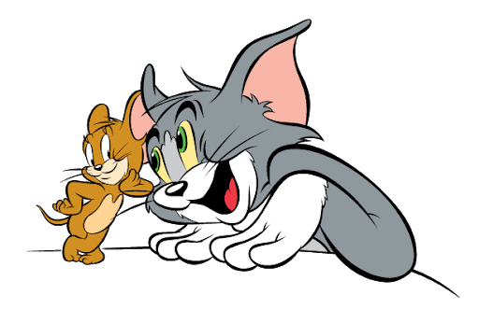
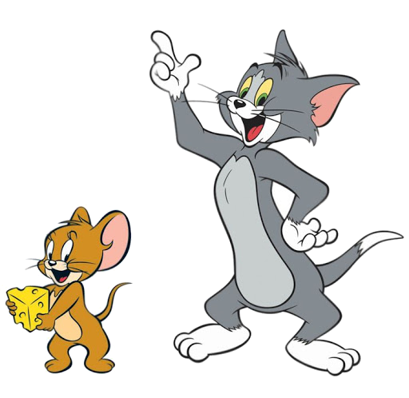


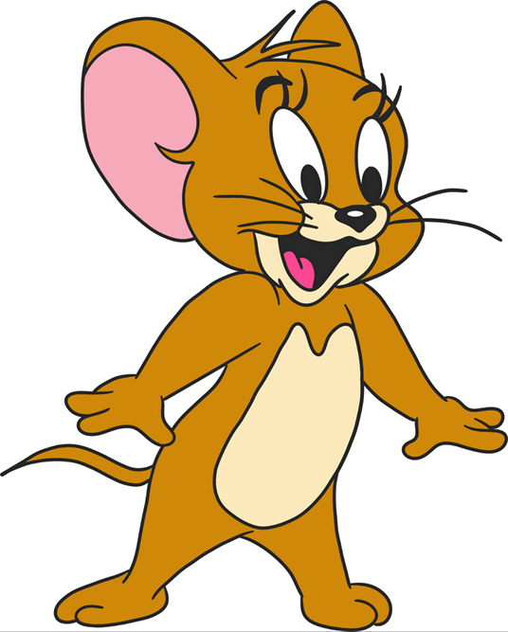
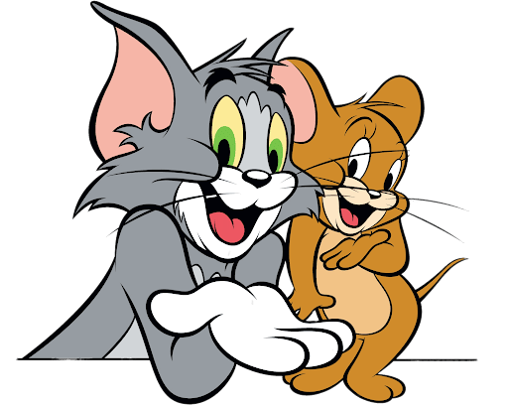

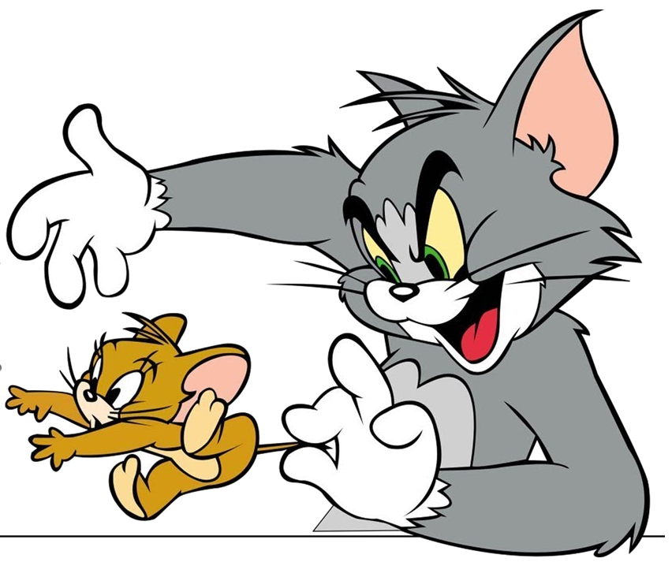

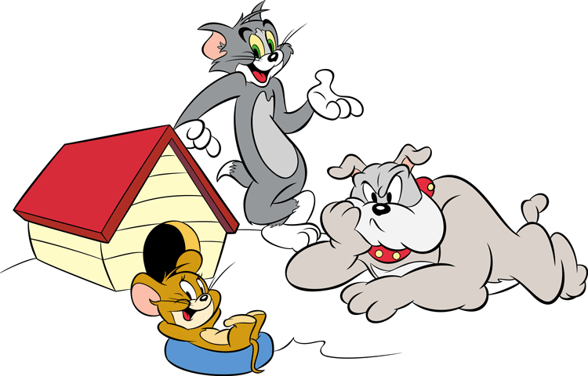
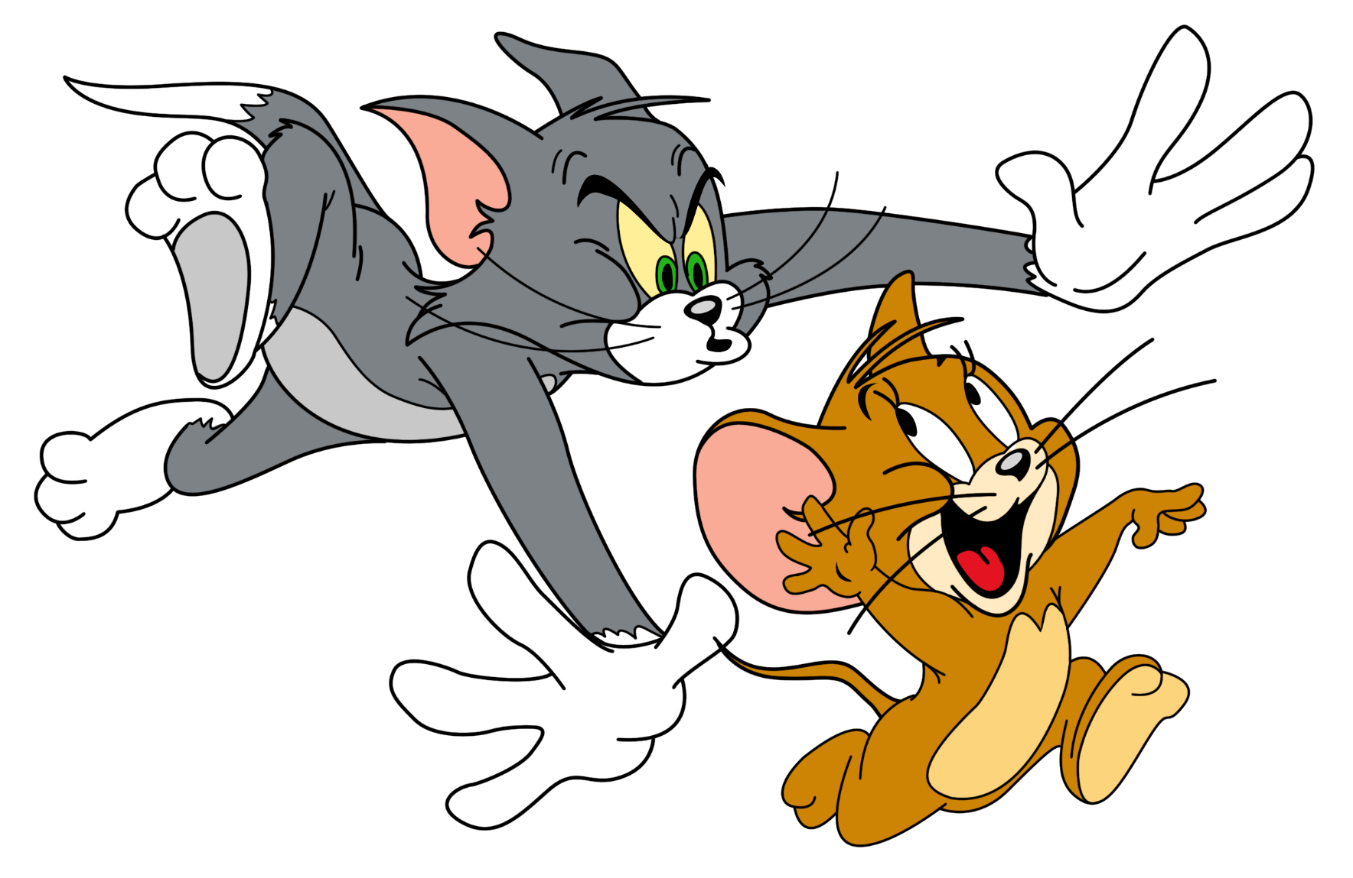

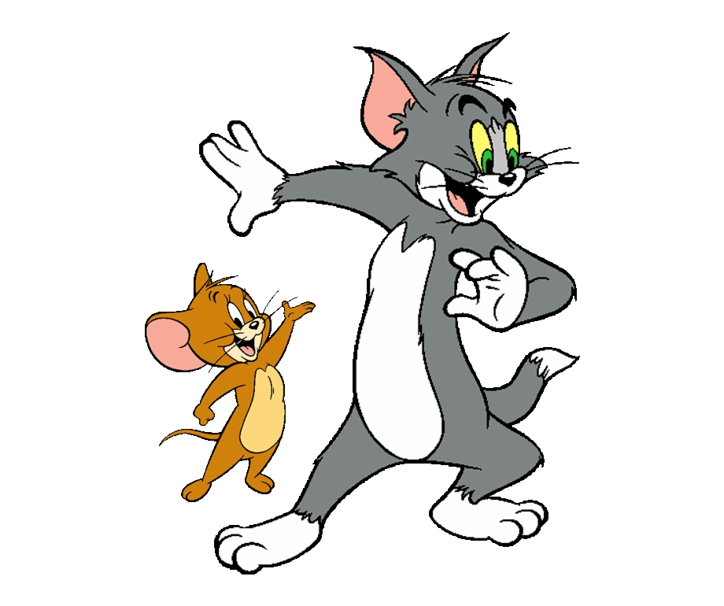
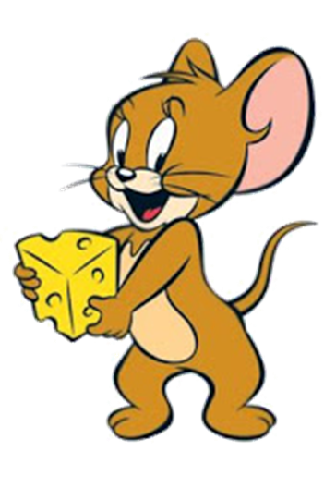
GAME
Notes:
Ms Huyền Phạm - 0936.082.789 – YOUTUBE: MsPham. Facebook: Dạy và học cùng công nghệ.

Slide 22

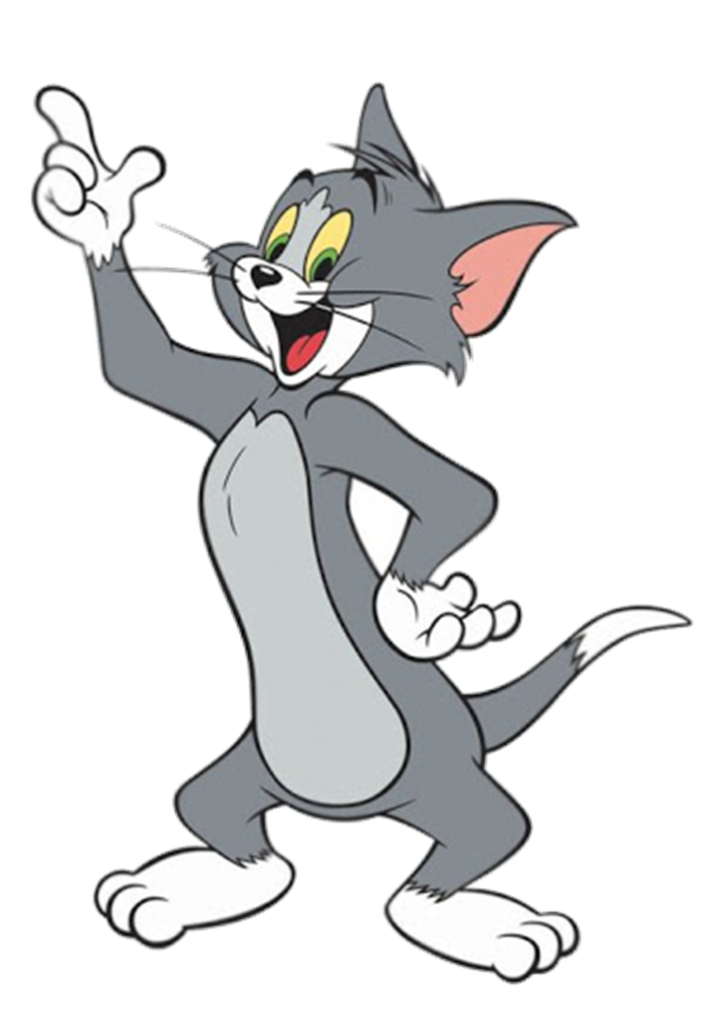

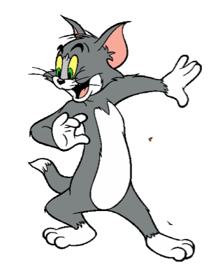






Where do you live?
I live in Quang Ninh.
I live ____________.
What's it like?
It’s ______.
Who do you live with?
I live with ________.
Notes:
Ms Huyền Phạm - 0936.082.789 – YOUTUBE: MsPham. Facebook: Dạy và học cùng công nghệ.

Slide 23
Mai: (1) your address?
Trung: (2) 81, Tran Hung Dao Street.
Mai: (3) do you live with?
Trung: My grandparents.
Mai: Do you (4) living in Ha Noi?
Trung: Yes, very much.
Mai: (5) your hometown like?
Trung: It's small and quiet.
What’s your hometown like?
It’s large and far.
I live ____________.
It’s ______.
I live with ________.
Notes:
Ms Huyền Phạm - 0936.082.789 – YOUTUBE: MsPham. Facebook: Dạy và học cùng công nghệ.

Slide 24
What’s your flat like?
It’s beautiful.
Notes:
Ms Huyền Phạm - 0936.082.789 – YOUTUBE: MsPham. Facebook: Dạy và học cùng công nghệ.

Slide 25
Check
Who do you live with?
I live in a village.
Where do you live?
Notes:
Ms Huyền Phạm - 0936.082.789 – YOUTUBE: MsPham. Facebook: Dạy và học cùng công nghệ.

Slide 26
Check
Where’s your address?
It’s 81, Orange street.
What’s
Notes:
Ms Huyền Phạm - 0936.082.789 – YOUTUBE: MsPham. Facebook: Dạy và học cùng công nghệ.

Slide 27
Check
How’s the village like?
It’s small and quiet.
What’s
Notes:
Ms Huyền Phạm - 0936.082.789 – YOUTUBE: MsPham. Facebook: Dạy và học cùng công nghệ.

Slide 28
Mai: Who do you live with?
Trung: My grandparents.
Notes:
Ms Huyền Phạm - 0936.082.789 – YOUTUBE: MsPham. Facebook: Dạy và học cùng công nghệ.

Slide 29
What’s the village like?
It’s small and pretty.
Notes:
Ms Huyền Phạm - 0936.082.789 – YOUTUBE: MsPham. Facebook: Dạy và học cùng công nghệ.

Slide 30
Where do you live?
It’s in Quang Ninh.
Check
I live
Notes:
Ms Huyền Phạm - 0936.082.789 – YOUTUBE: MsPham. Facebook: Dạy và học cùng công nghệ.

Slide 31


Good job!
Notes:
Ms Huyền Phạm - 0936.082.789 – YOUTUBE: MsPham. Facebook: Dạy và học cùng công nghệ.

Slide 32
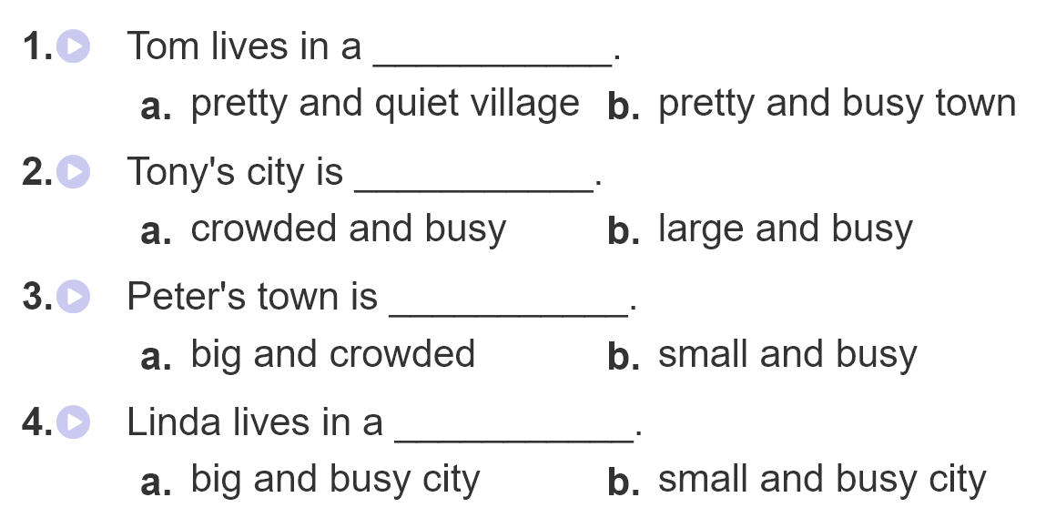
4. Listen and circle.

Slide 33
5. Write about you.
1. What's your address?
_________________________________.
2. What's your hometown like?
__________________________________.
3. Who do you live with?
__________________________________.
4. Do you like living there? Why?/Why not?
_____________________________________________.
__________________.
It's 28,Quang Trung street, Hanoi city.
It's big and busy.
I live with my parents.
Yes, I do. Because it has the modern life, high education,
and good health care

Slide 34
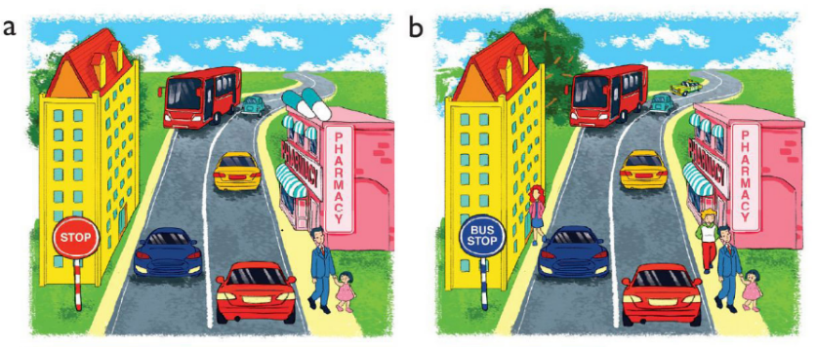
6. Let’s play.
Spot the difference
(Click the different spot)

Slide 35



THANK YOU!
Welcome to join with me!
MsPham Powerpoint
Mspham

