Slide 1






Unit 1 - English 5
What’s your address?
Lesson 1

Slide 2
VOCABULARY

Slide 3




Vocabulary
address
/əˈdres/
(n) địa chỉ

Slide 4
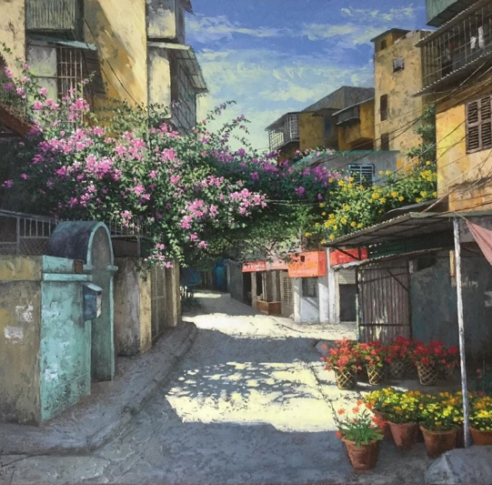
Vocabulary
lane
/leɪn/
(n) ngõ

Slide 5

Vocabulary
road
/rəʊd/
(n) đường

Slide 6

Vocabulary
street
/striːt/
(n) đường (phố)

Slide 7



Vocabulary
1
tower
2
/ˈtaʊər/
(n) tòa nhà, tòa tháp
3

Slide 8

Vocabulary
11
10
9
8
floor
7
6
/flɔːr/
5
4
(n) tầng
3
2
1

Slide 9
Vocabulary
flat
/flæt/
(n) Căn hộ

Slide 10

Vocabulary
town
/taʊn/
(n) thị trấn

Slide 11
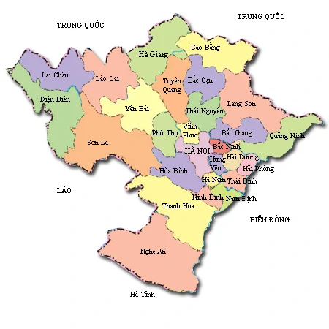
Vocabulary
province
/ˈprɒvɪns/
(n) tỉnh

Slide 12

Vocabulary
village
/ˈvɪlɪdʒ/
(n) làng, ngôi làng

Slide 13
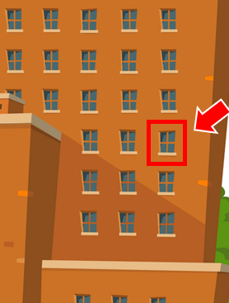
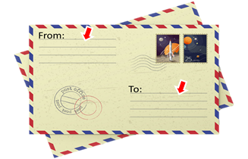
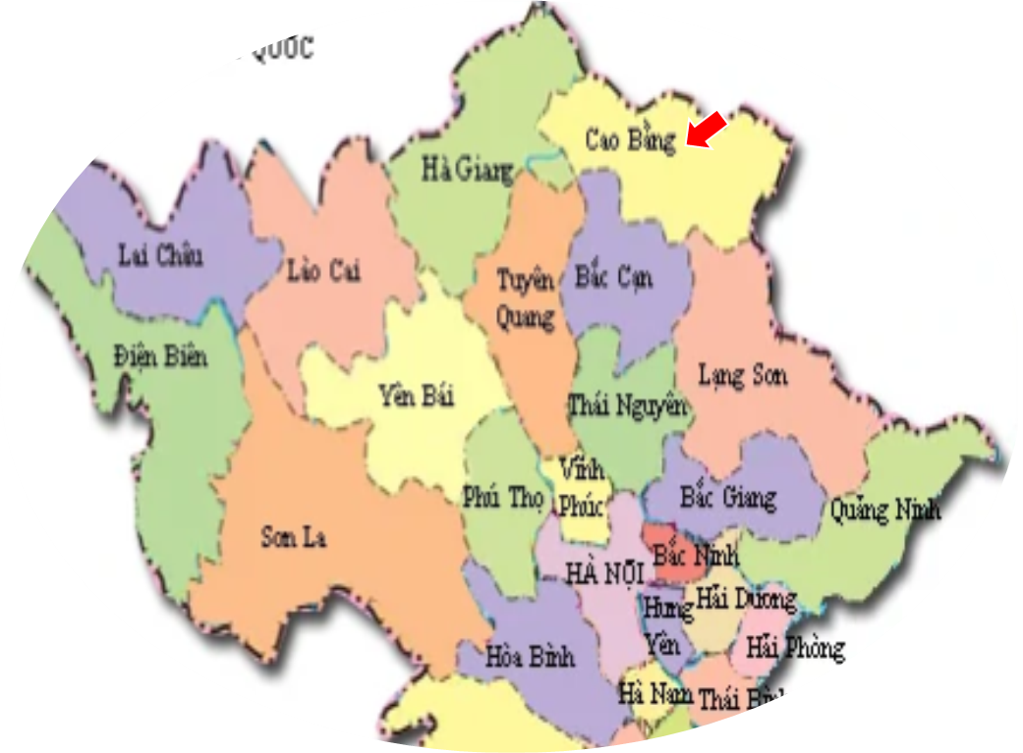


1
2
3
address

Slide 14

1
2
3
village

Slide 15

1
2
3
tower

Slide 16
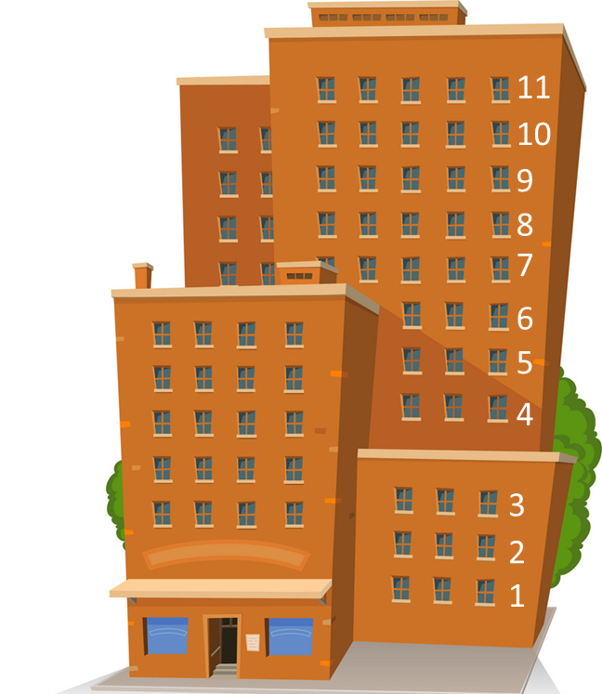
1
2
3
province

Slide 17
1
2
3
town

Slide 18
1
2
3
street

Slide 19
1
2
3
lane

Slide 20
1
2
3
floor

Slide 21
1
2
3
road

Slide 22
1
2
3
flat

Slide 23


START

Slide 24





look!
tower
Check
Next

Slide 25
look!
address
Check
Next

Slide 26
look!
floor
Check
Next

Slide 27
look!
lane
Check
Next

Slide 28
MsPham
look!
road
Check
Next

Slide 29
MsPham
look!
street
Check
Next

Slide 30
look!
province
Check
Next

Slide 31
MsPham
look!
village
Check
Next

Slide 32
MsPham
look!
flat
Check
Next

Slide 33
MsPham
look!
town
Check
Next

Slide 34
Good job!
End

Slide 35
GRAMMAR

Slide 36
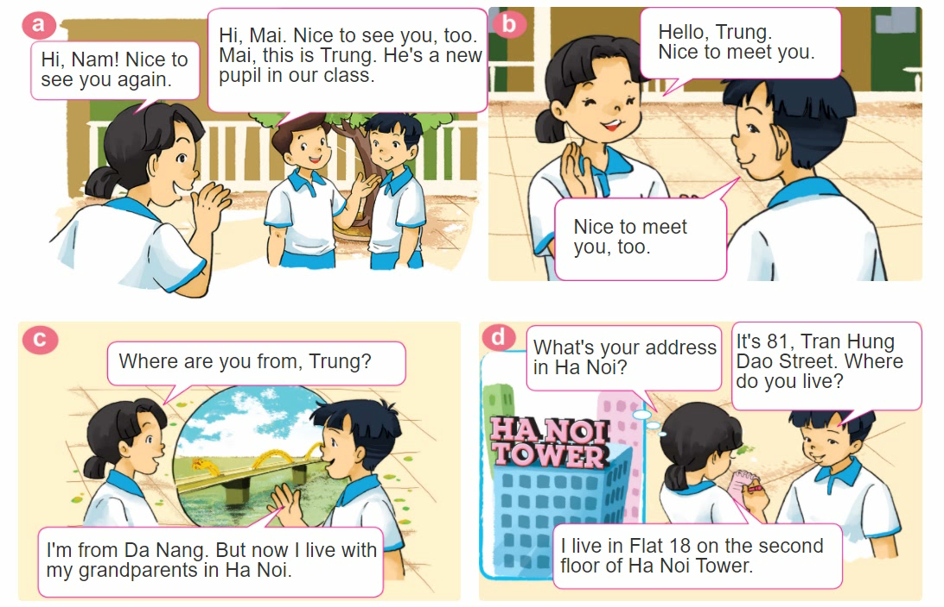
1. Look, listen and repeat.

Slide 37


GRAMMAR
Hỏi - đáp ai đó đến từ đâu:
Where are you from?
(Bạn đến từ đâu)
I’m from _____________.
+ address
(Tớ đến từ_________)
Hỏi - đáp về địa chỉ nhà:
What's your address?
It's _________.
+ address
(Địa chỉ của bạn là gì?)
(Đó là ___________.)

Slide 38
GRAMMAR
Hỏi - đáp ai đó sống ở đâu:
Where do you live?
(Bạn sống ở đâu?)
I live in/on/at _____________.
+ address
(Tớ sống ở_________)

Slide 39
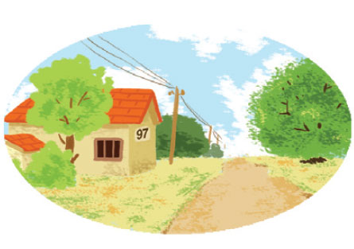

2. Point and say.
97, Village Road
It's __________________.
What's your address?
97, Village Road.

Slide 40
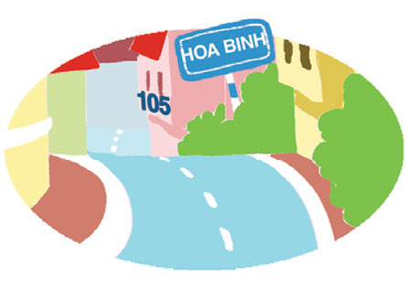
2. Point and say.
75, Hai Ba Trung Street
It's __________________.
What's your address?
75, Hai Ba Trung Street

Slide 41

2. Point and say.
flat 8, second floor, City Tower
It's ______________
_____________.
What's your address?
flat 8, second floor,
City Tower

Slide 42
3. Let’s talk.
Where are you from?
I’m from _______.
What’s your address?
It’s _______.
Where do you live?
I live in/at/on _______.

Slide 43




Slide 44



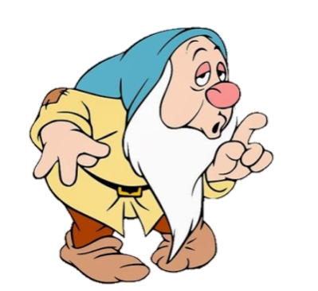


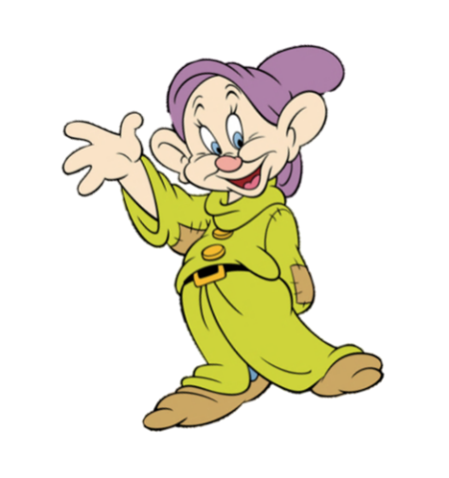

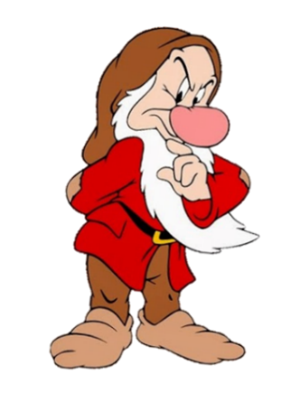


It’s flat 8, second floor,
City Tower
Where are you from?
What’s your address?

Slide 45
I’m from Hai Phong.
Where are you from?
What’s your address?

Slide 46
It’s 97, Village Road
What’s your address?
Where do you live?

Slide 47
Where do you live?
I live in Hai Phong.
I’m from Hai Phong.

Slide 48
I live in Flat 18 on the second floor of Ha Noi Tower.
Where are you from?
Where do you live?

Slide 49
What’s your address?
It’s 75, Hai Ba Trung Street.
I live at 75, Hai Ba Trung Street.

Slide 50
Where are you from?
It’s in Da Nang.
I’m from Da Nang.

Slide 51
What’s your address?
____ 105, Hoa Binh Lane.
I live at
It’s

Slide 52
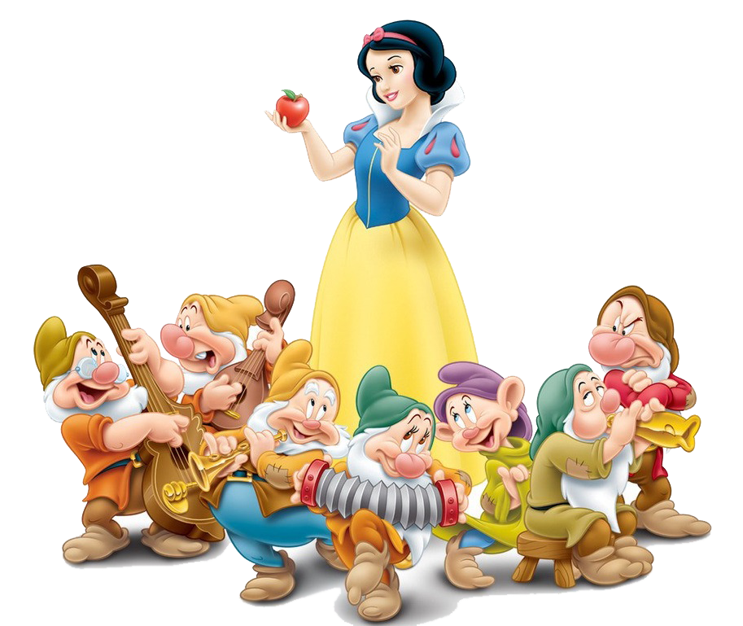
Good job!

Slide 53
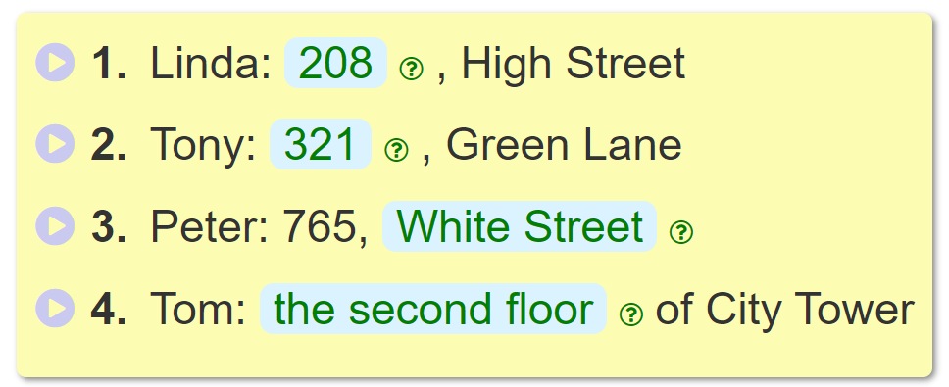
4. Listen and complete.
_________
208
_________
321
______________________.
White Street
___________________________
the second floor

Slide 54
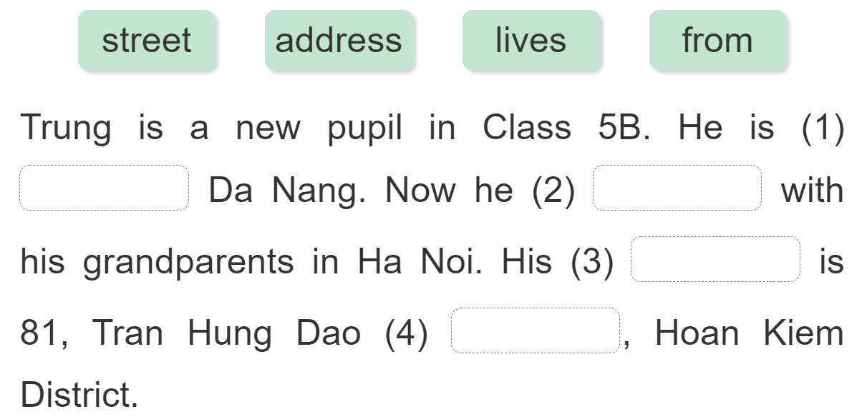
5. Read and complete.
from
lives
address
street

Slide 55
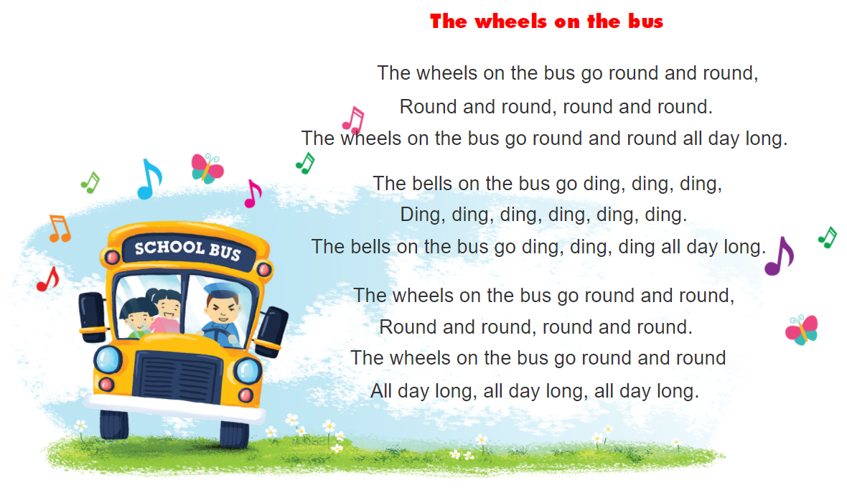


6. Let’s sing.
https://www.youtube.com/watch?v=KZU9aBsZwxE&t=1s

Slide 56



THANK YOU!
Welcome to join with me!
MsPham Powerpoint
Mspham

