Slide 1




















Notes:
Để nguyên trang bìa như này, chỉ thay đổi tên bài trong quá trình làm. Logo của sách Wonderful World

Slide 2

Unit 7
My Favourite Sport
FUN TIME AND PROJECT
Notes:
Lỗi trình bày

Slide 3


01
Warm Up
SWIMMING RACE

Slide 4








1
2
Exit
Notes:
Divide class into 2 teams, the team which swim to “ FINISH” will win.
Press “ Lifebuoy” to the question and answer. If sts answer correctly, press the boy to swim forward.

Slide 5
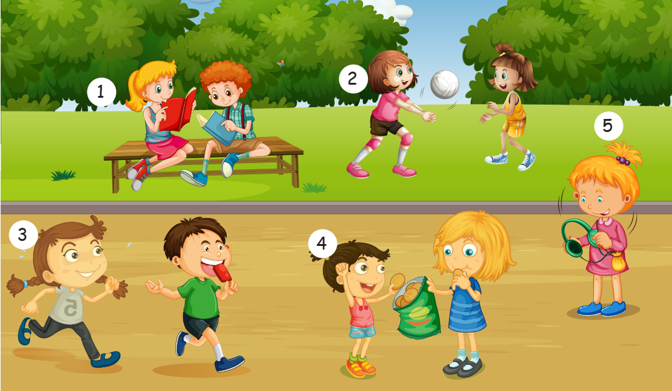
How many people are there in the picture ?
- Nine.
NEXT

Slide 6

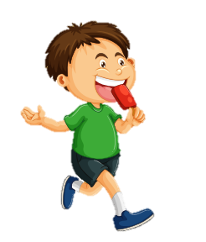
What is he eating ?
He is eating an ice cream.
NEXT

Slide 7
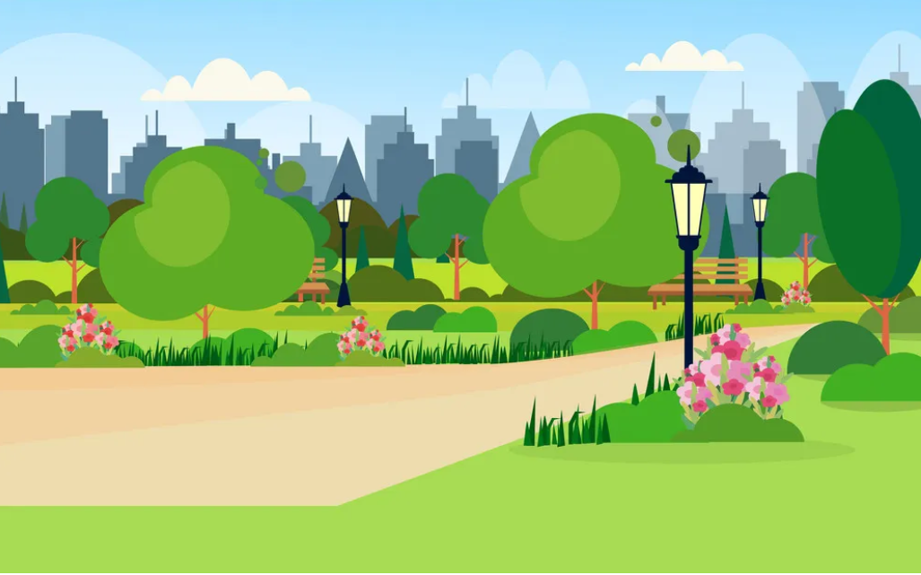

Is she swimming ?
A. No, she isn’t.
B. Yes, she is.
NEXT
Notes:
K có slide đáp án

Slide 8


Is she jumping ?
A. Yes, she is.
B. No, she isn’t.
NEXT

Slide 9
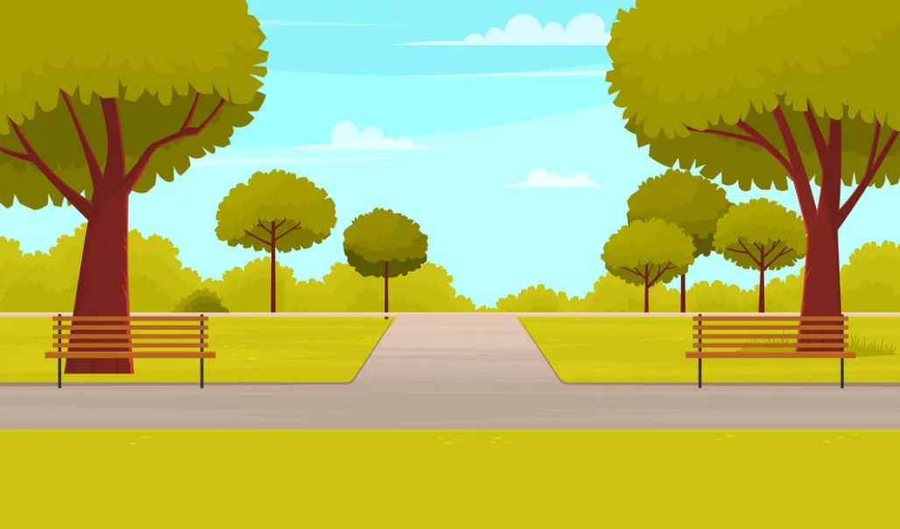
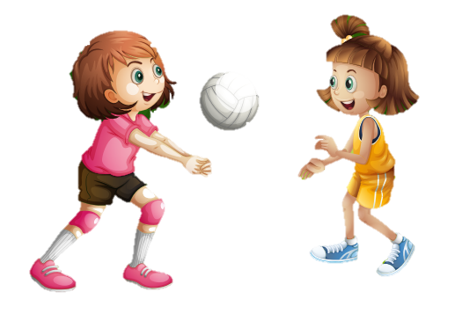
She ………...playing basketball.
isn’t
A. is
B. isn’t.
NEXT

Slide 10
Practice
02

Slide 11
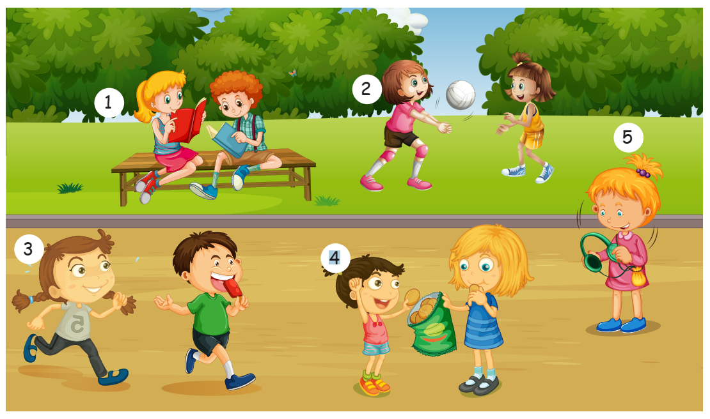

Look and describe the picture.
Notes:
Đảo lên trên trước khi viết

Slide 12
Task 1. Look and write
Notes:
HOẠT ĐỘNG TƯƠNG TÁC TỪ SLIDE 12 -> 17

Slide 13
She’s reading.
1. _______________(reading)

Slide 14
She isn’t kicking the ball.
2. ___________________(kicking the ball)

Slide 15
3. ___________________(running)
She is running.

Slide 16
She isn’t singing.
4. _______________(singing)

Slide 17
She isn’t dancing.
5. _______________(dancing)

Slide 18
Project
03

Slide 19
My favourite sports
PR JECT
Draw some sports you like.
Tell the class about them

Slide 20
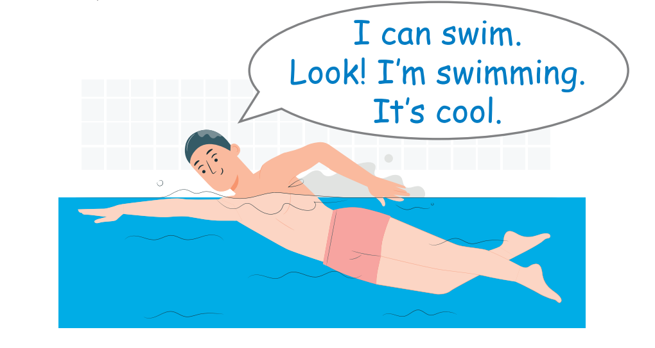

Slide 21
Assessment
04

Slide 22
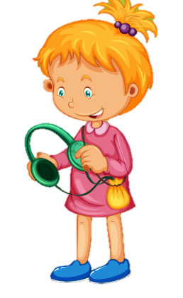
Look and write :
1. I ……………………a book with Peter.
2. He ……………………an ice cream.
3. Nhi……………………………………
4. She ……………………to music.
am reading
is eating
is running
is listening
4
2
1
3

Slide 23
Thank you

