Slide 1




















Notes:
Để nguyên trang bìa như này, chỉ thay đổi tên bài trong quá trình làm. Logo của sách Wonderful World

Slide 2
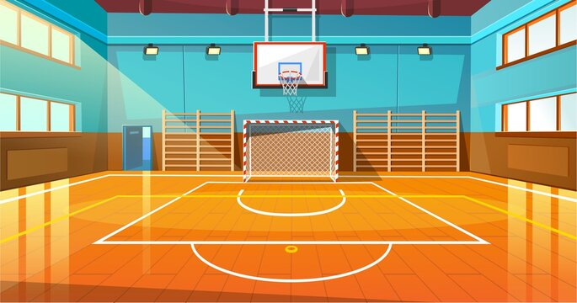

Unit 7
My Favourite Sport
Task 7,8,9

Slide 3

Warm Up
01
GAME: Wheel of fortune

Slide 4

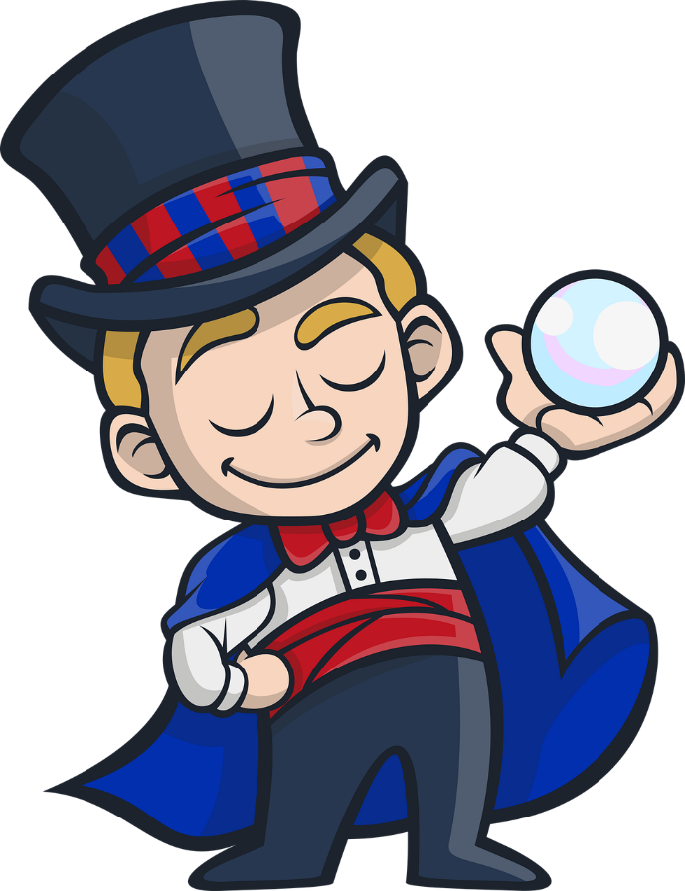
Next
WHEEL of FORTUNE
1 star
2 stars
1 star
1
2
2 stars
1 star
1 star
0 star
0 star
4 stars
3
4
3 stars
1 star
2 stars
Notes:
Choose the questions and answer, then spin the wheel to get the stars .

Slide 5
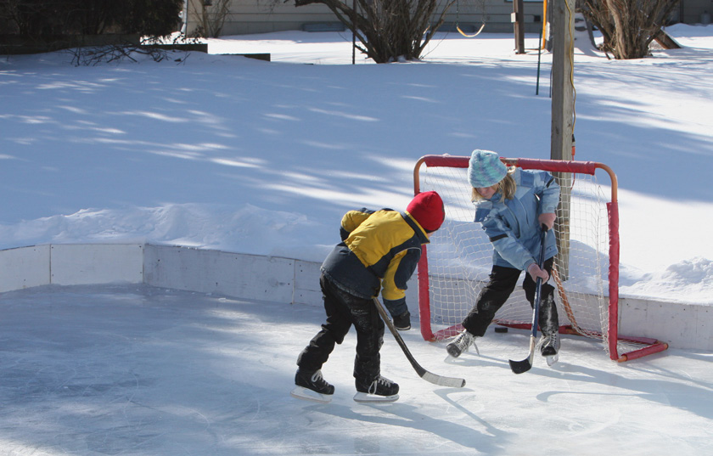

1. What is the missing letter ?
O
U
E
H
O
C
K
E
Y
Next

Slide 6
2. What is the missing letter ?
U
E
A
T
E
A
Next
E
M

Slide 7

3. Which word is pronounced differently?
A. sit
B. library
C. drink
Next

Slide 8
4. Which word is pronounced differently?
A. fun
B. museum
C. sun
Next

Slide 9
02
Presentation

Slide 10
/ɪ:/
team

Slide 11
/ɪ/
hockey

Slide 12
Let’s say :
Let’s listen !
team
hockey
Words
/ɪ:/
/ɪ/
Sounds

Slide 13

Task 7. Listen and Repeat.
team
hockey
I’m playing hockey with my team.

Slide 14
03
Practice

Slide 15
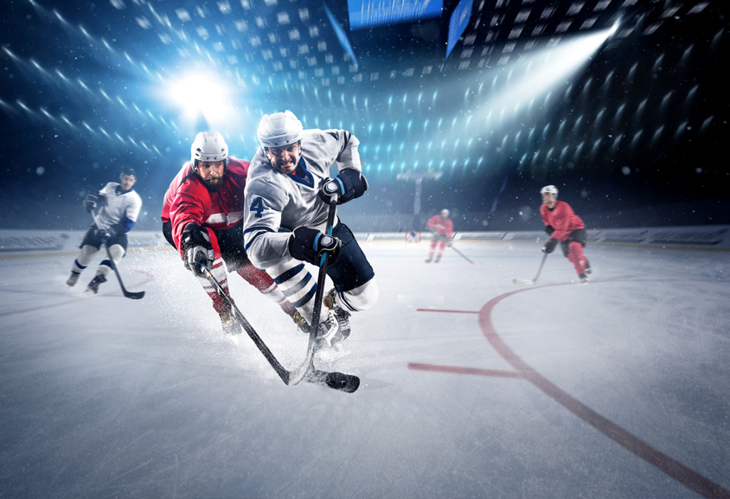
Task 8. Listen and chant.
Team team team!
Wear this T-shirt!
Come play hockey
with my team.
Team team team!
Wear that T-shirt!
Come play hockey
with his team.

Slide 16
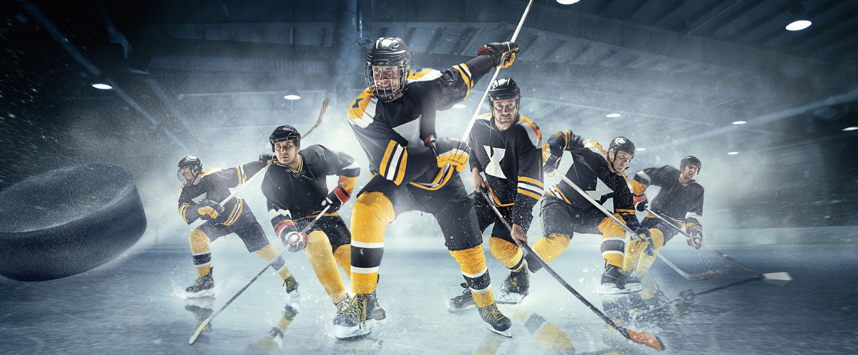
Task 9. Say it!
1. I’m wearing my uniform and playing hockey with my team.
2. My team is running and hitting the ball.
3. My hockey team and I can watch our match on TV.

Slide 17
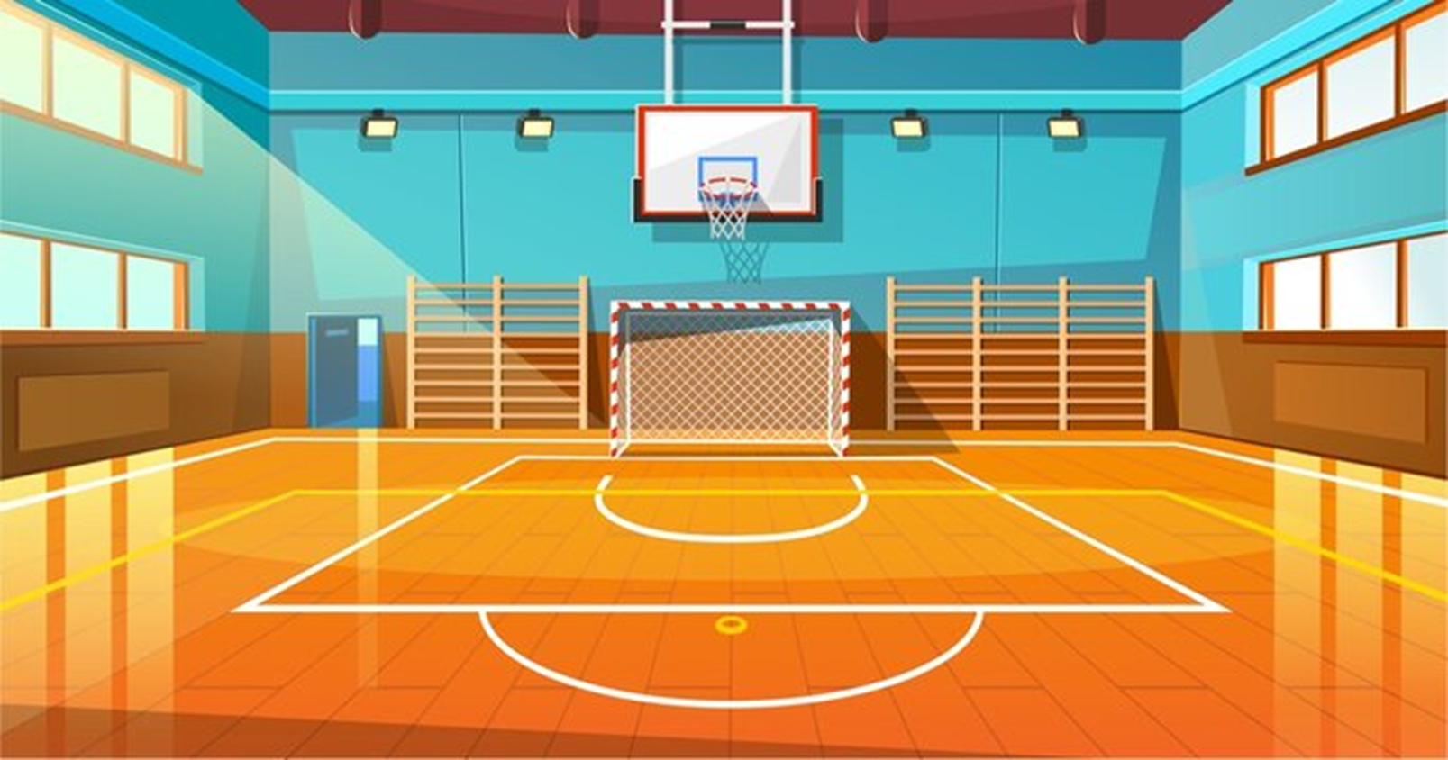
04
Production

Slide 18
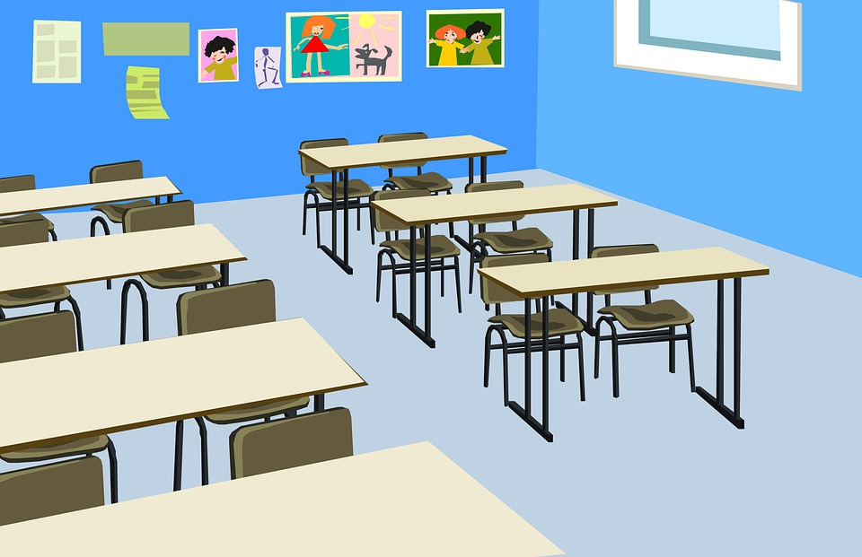


FREEZE MUSIC
Notes:
T turns on the music while the sts move around.
-Sts move around the class and ask their friends write more given words of “i” and ”i:” and write in the worksheet.
-Sts have to freeze when the music stops and continue when the music is on.
- Count the words and let the sts read their own’s word.
- Correct pronunciation if any.

Slide 19
04
Assessment
Listen and number from 1 to 5.

Slide 20
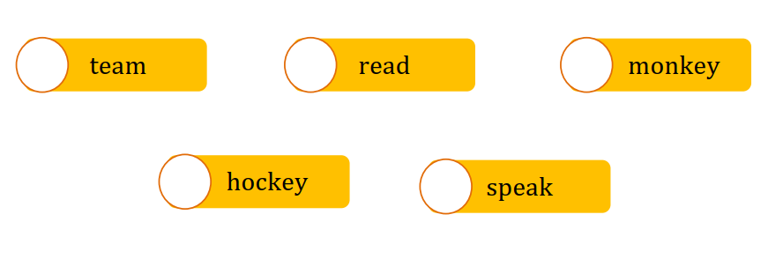
Listen and number from 1 to 5.
4
2
3
1
5

Slide 21
Thank You

