Slide 1








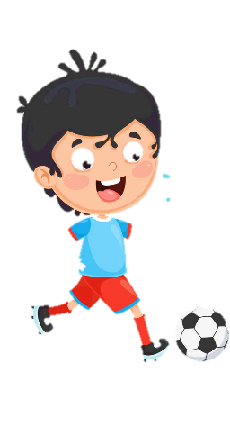












Notes:
Để nguyên trang bìa như này, chỉ thay đổi tên bài trong quá trình làm. Logo của sách Wonderful World

Slide 2



Unit 7.
My Favourite Sport
Lesson 3. Task 1,2,3

Slide 3

01
Warm Up

Slide 4


GAME:
SILENT BALL
Notes:
While the music plays, students pass the ball around the class. When the music stops, the student with the ball has to do something, such as answer a question from the teacher.

Slide 5







Notes:
watch the clip

Slide 6

GAME:
MATCHING
Match the picture with its word.
Notes:
-Divide class into 2 teams- Boys and girls
-Let the sts in each team take turn to choose the numbers to find the 2 matches picture and word

Slide 7
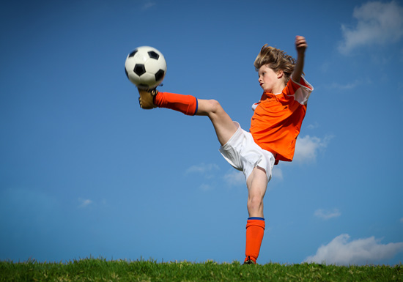

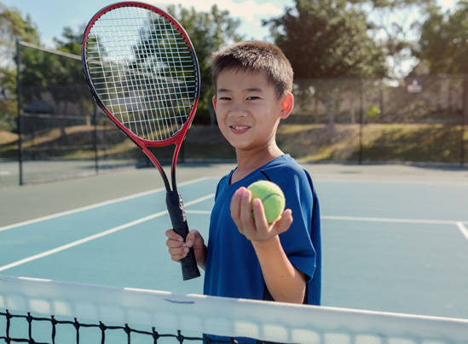


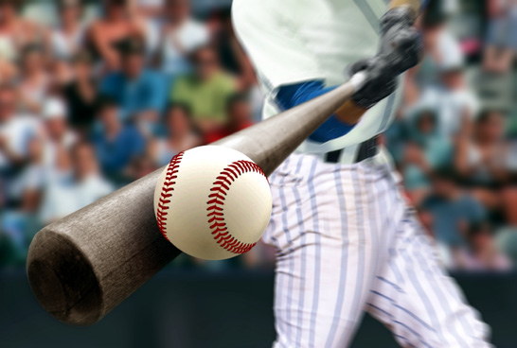
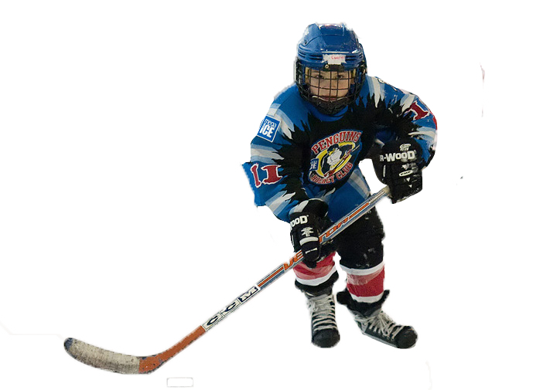
1
2
3
run
4
5
6
tennis
7
8
9
football
hockey
10
11
12
baseball
jump

Slide 8


Slide 9
02
Presentation
What is your hobby ?

Slide 10
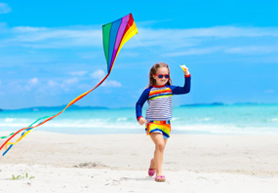
flying a kite
Notes:
Let the sts look at the picture and repeat

Slide 11
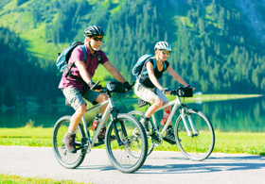
riding a bike
Notes:
Let the sts look at the picture and repeat

Slide 12
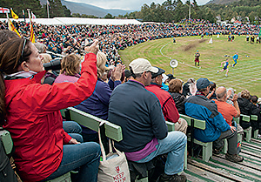
watching a match
Notes:
Let the sts look at the picture and repeat

Slide 13
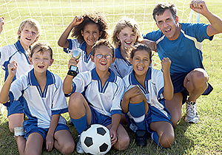
team
Notes:
Let the sts look at the picture and repeat

Slide 14



Task 1. Listen and point. Repeat. Tr: 7.8
flying a kite
riding a bike
watching a match
team
Notes:
Let the sts listen and point
Then repeat

Slide 15
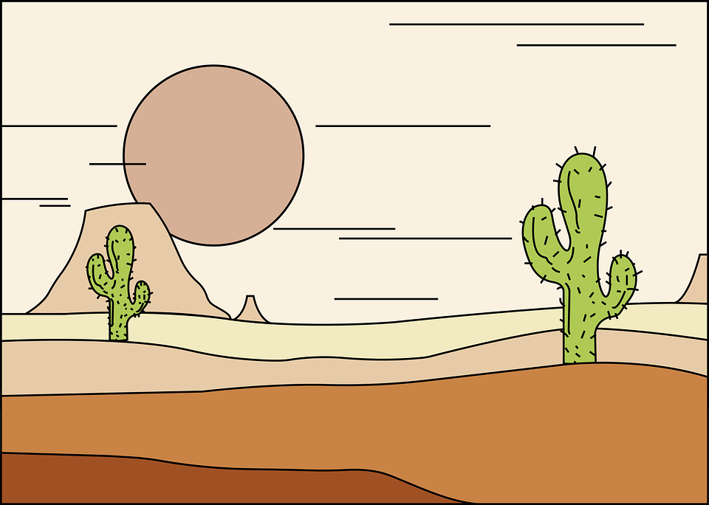
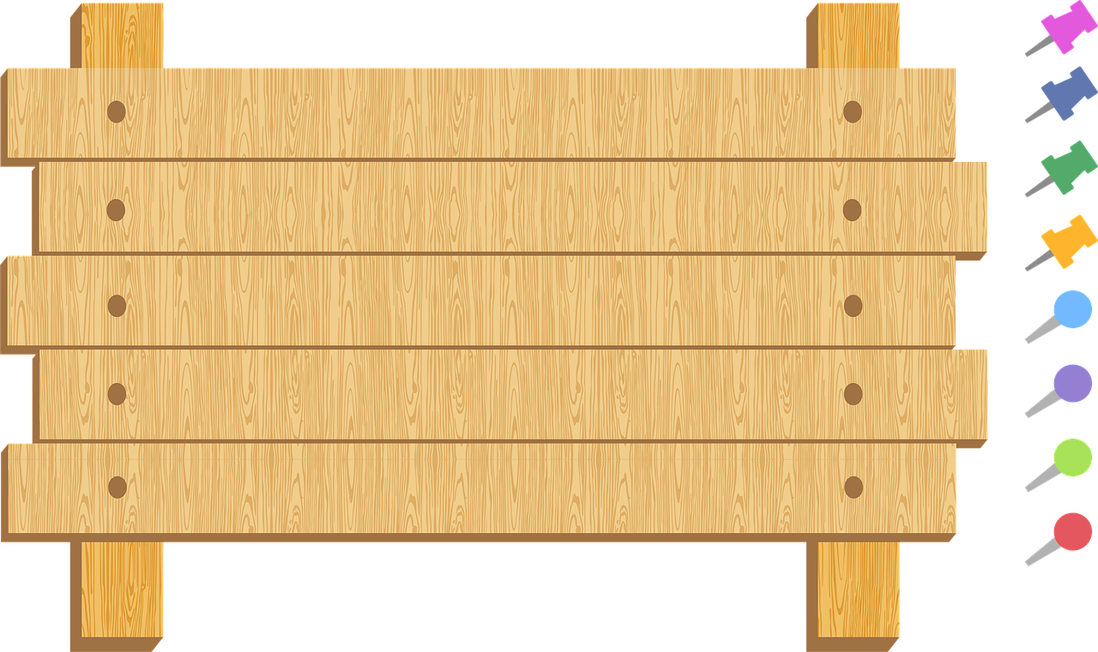


Vocabulary checking
COWBOY GAME
Notes:
+ Invite two Ss go to the board and back to back
+ Those two Ss will choose one picture ( keep secret )
+ T counts one,two three they will turn their back and read the opponent’s picture.
₋Who is faster will be the winner.

Slide 16
Practice
03
TASK 2. LISTEN AND MATCH
Notes:
Chỉnh lại theo giáo án

Slide 17

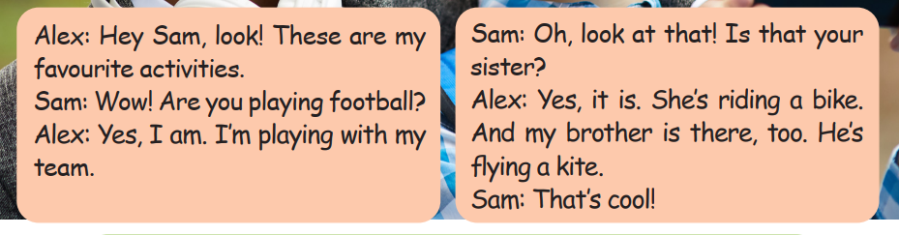
Notes:
Ask the sts some questions about the picture:
-Who are they?
-Where are they?
-What are they doing?
Let the sts listen for the first time

Slide 18

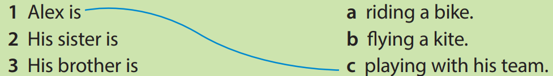
Yes, it is. She’s riding a bike.
And my brother is there, too. He’s flying a kite.
Yes, I am. I’m playing with my team.
Hey Sam, look! These are my favourite activities
Wow! Are you playing football?
Oh, look at that! Is that your sister?
That’s cool!
Sam
Alex
Notes:
Listen again and match :

Slide 19

Game:
Look and write
Notes:
Give picture to the pair of player.
Sts look at it and write the corrects Who can make it will get points.

Slide 20

1. Kim / flying a kite
Kim’s not flying a kite.
She’s riding a bike

Slide 21
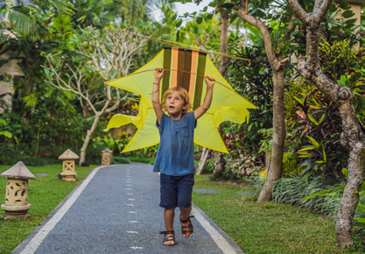
2. Tim / watching a match
Tim’s not watching a match. He’s flying a kite.

Slide 22
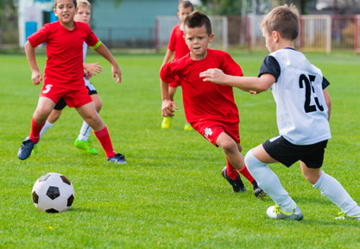
3. Jack/ riding a bike
Jack’s not riding a bike. He’s playing football.

Slide 23
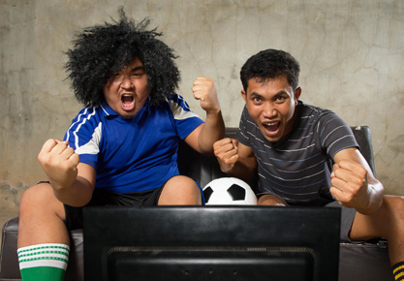
3. John/ playing football with his friend
John’s not playing football with his friend. He’s watching a football match.

Slide 24
Production
04
<
<

Slide 25




FINISH
4
3
2
START
1

Slide 26




What are you doing now ?
I’m drawing.

Slide 27
What is she doing now ?
She is riding a bike.

Slide 28
What is he doing ?
He is flying a kite.

Slide 29
Is he cooking ?
No, he isn’t.
He isn’t cooking.
He is playing football.

Slide 30
What are they doing ?
They are watching a football match.

Slide 31

What are you doing now ?
I’m playing the piano.

Slide 32
Assessment
05
<
<

Slide 33
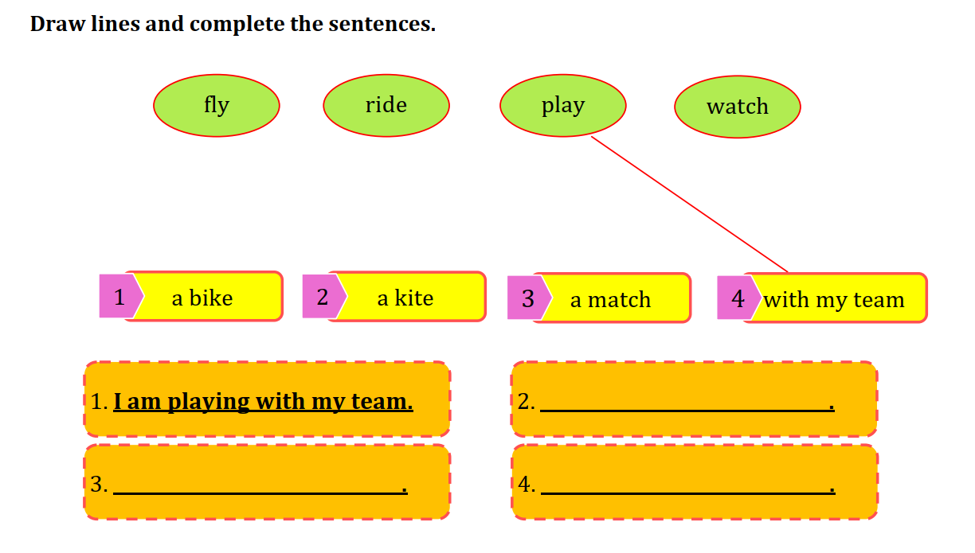
I am flying a kite
I am riding a bike
I am watching a match.
Notes:
HOẠT ĐỘNG TƯƠNG TÁC CÂU 2,3,4

Slide 34
THANK YOU

