Slide 1



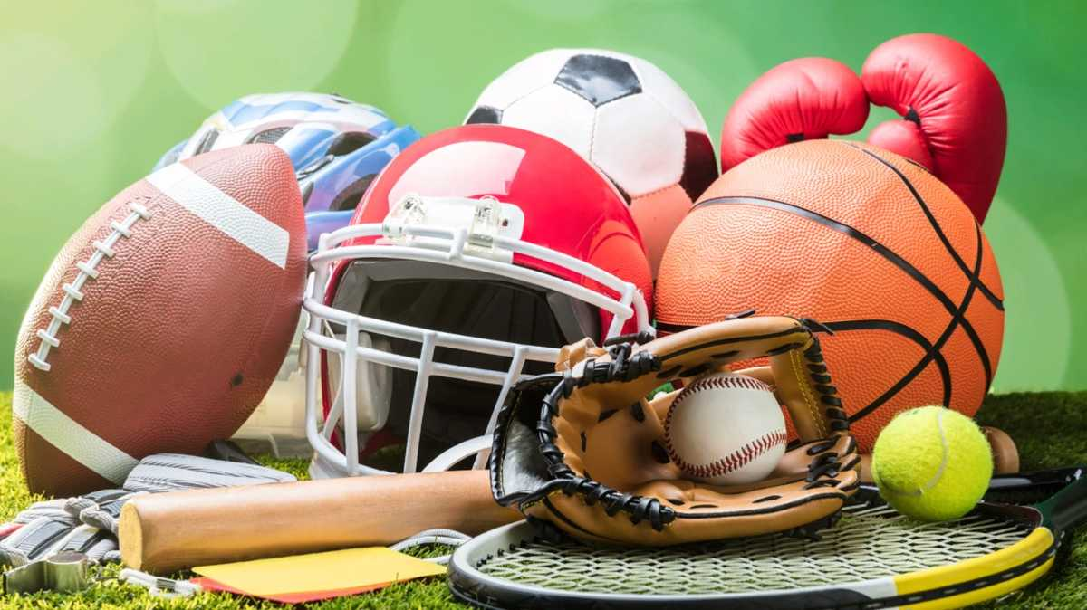
Unit 7:
My Favorite sport
Lesson 2- Task 1,2,3

Slide 2


1.Warm up
What are you doing ?

Slide 3


Slide 4
2.Presentation

Slide 5


catching

Slide 6

hitting

Slide 7
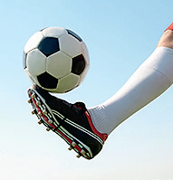
kicking

Slide 8
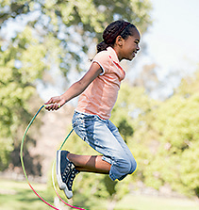
jumping

Slide 9
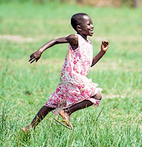
running

Slide 10


MINIGAME
VOCABULARY CHECKING
Listen the words and slap the board
Notes:
Slap the board

Slide 11




Task 1. Listen and point. Repeat

Slide 12

catching
hitting
kicking
jumping
running

Slide 13
3.Practice

Slide 14
Task 2. Listen and tick ( tr 7.5)
. TR: 7.
. TR: 7.
✓

Slide 15

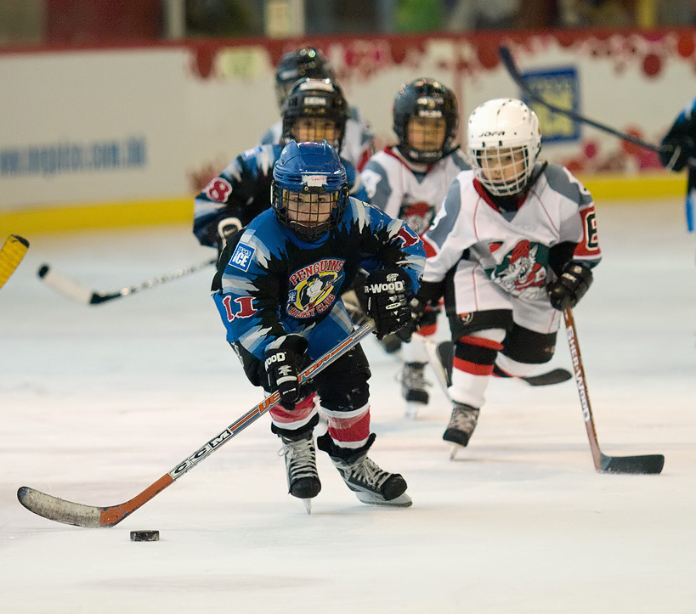
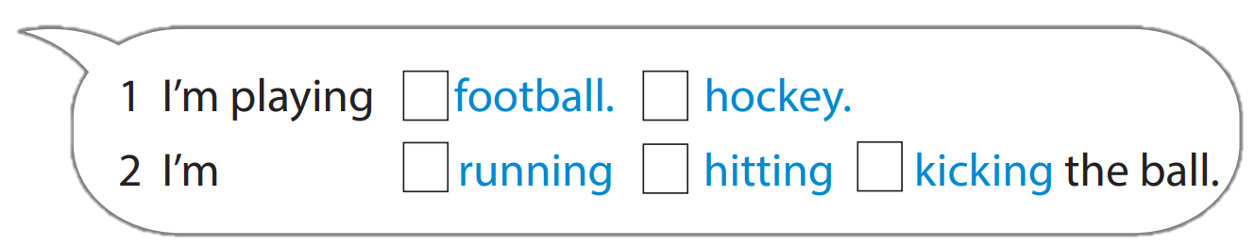
Hockey is a great sport.
Look at the photo.
I’m playing hockey with
my friends. I’m running fast. I’m hitting the ball. I’m not jumping. I’m not kicking the ball.
Hockey is cool!
✓
✓

Slide 16
4.Production

Slide 17


Task3. Ask and answer .
Use the words in 1
GUESS THE SPORT

Slide 18

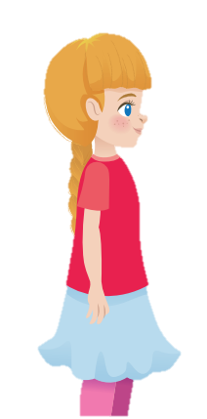

He’s catching the ball.
He’s playing baseball.

Slide 19


She’s kicking the ball .
She’s playing football.

Slide 20
He’s hitting the ball .
He’s playing baseball.

Slide 21
5.Assessment
Use the words to make sentences

Slide 22
Use the words to make sentences
1. I/ catch/ the ball.
2. She/ jump.
3. She/ run.
4. He/ hit/ the
ball .

Slide 23

Use the words to make sentences
1.I’m catching
the ball.
2. She’s jumping.
3. She’s
running.
4. He’s hitting the ball.

Slide 24





Thank you & goodbye!

