Slide 1
Unit 9: What are they doing?
Lesson 2
Teacher: Ngoc Khue

Slide 2
Objectives
- Use the words and phrases related to the topic action verbs.
- Ask and answer about what they are doing.
Mục đích bài học:
Sử dụng các từ liên quan đến các động từ chỉ sự hoạt động.
Hỏi và trả lời về họ đang làm gì.

Slide 3
Table of contents
01
02
New words
Model sentence
03
04
Practice
Homelink

Slide 4
Warm Up!

Slide 5
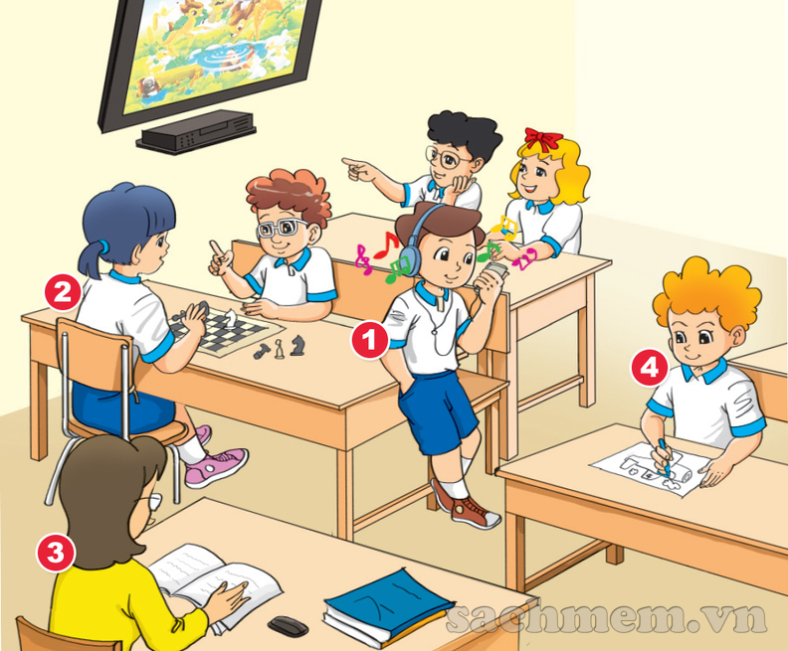

Slide 6

01
New words

Slide 7
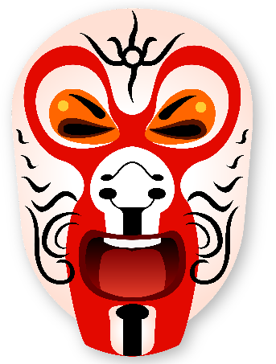


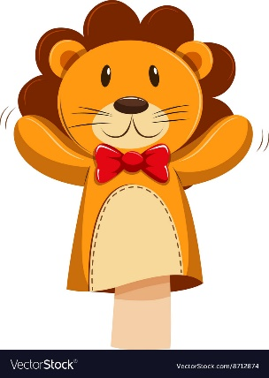
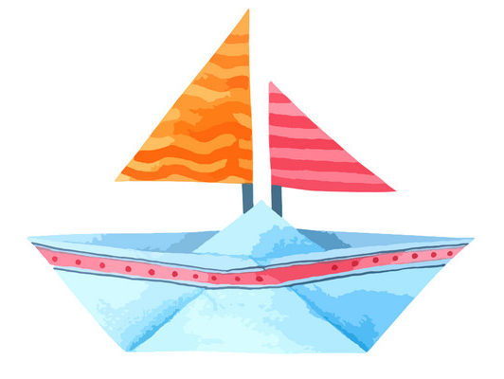
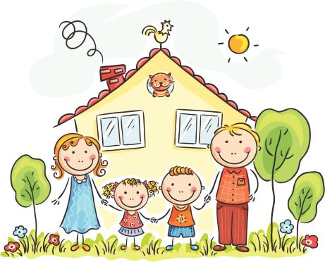

MsPham-0936082789
paper
puppet
mask
kite
/ˈpeɪpər/
/ˈpʌpɪt/
/mɑːsk/
/kaɪt/
Giấy
Con rối
Mặt nạ
Diều
picture
boat
plane
/ˈpɪktʃər/
/bəʊt/
/pleɪn/
Bức tranh
Con thuyền
Máy bay

Slide 8
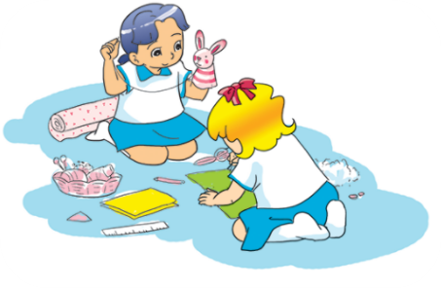
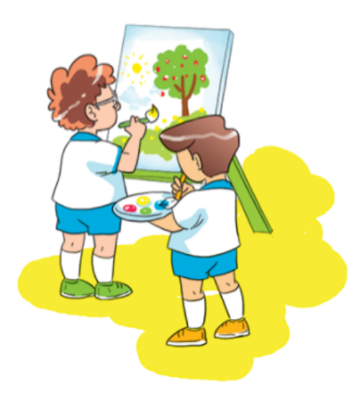
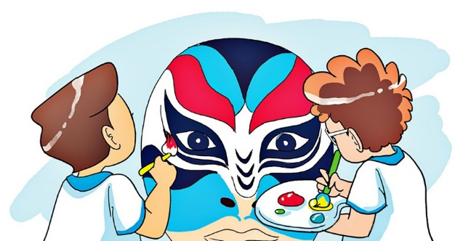
V
V-ing
make
/meɪk/
making
Làm, tạo ra
draw
/drɔː/
drawing
Vẽ
paint
/peɪnt/
painting
Sơn, tô, vẽ

Slide 9
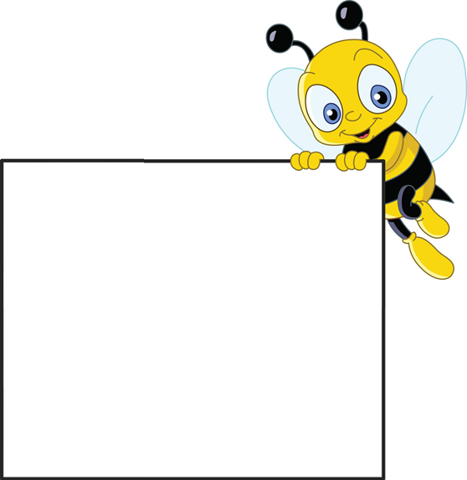

Tick the best answer
A
mask
B
puppet
C
kite

Slide 10
Tick the best answer
A
paper
B
plane
C
puppet

Slide 11
Tick the best answer
A
kite
B
plane
C
boat

Slide 12
Tick the best answer
A
puppet
B
paper
C
picture

Slide 13
Tick the best answer
A
plane
B
puppet
C
mask

Slide 14
Tick the best answer
A
boat
B
paper
C
mask

Slide 15
Tick the best answer
A
kite
B
puppet
C
picture

Slide 16
Tick the best answer
A
write
B
paint
C
read

Slide 17
Tick the best answer
A
make
B
puppet
C
take

Slide 18
Tick the best answer
A
make
B
draw
C
watch

Slide 19
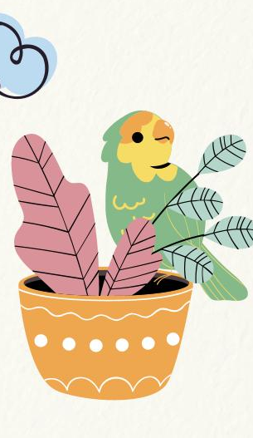
02
Model sentence

Slide 20

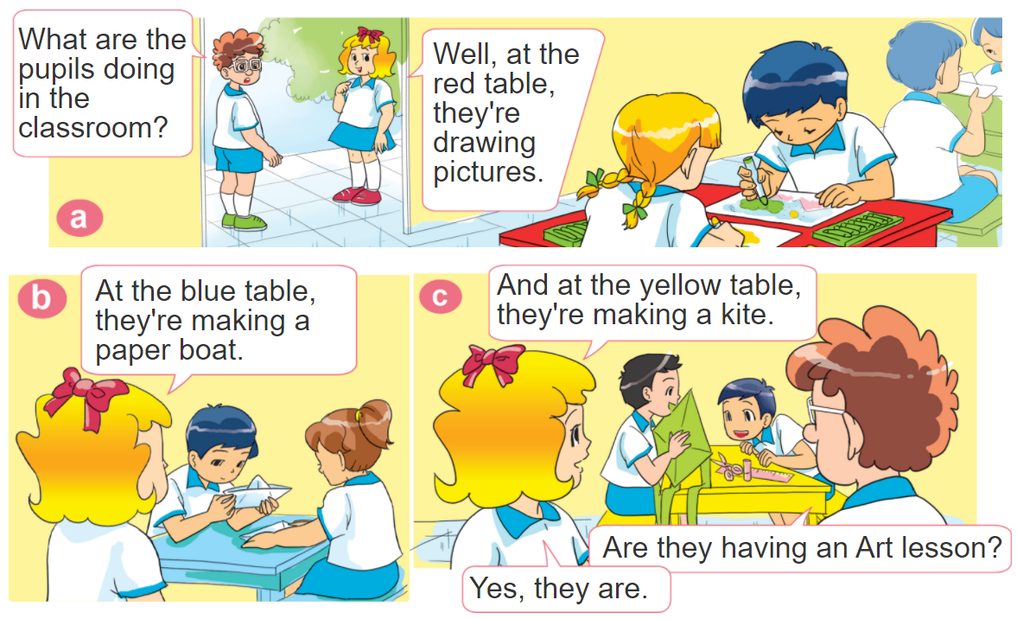
1. Look, listen and repeat.

Slide 21


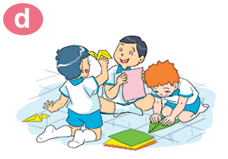
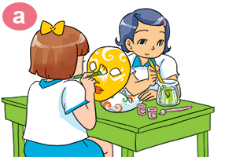
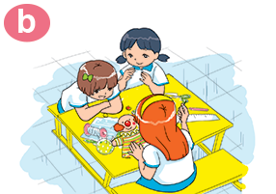
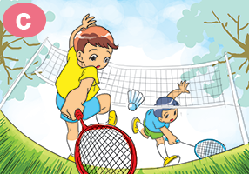
2. Point and say
What are they doing?
They’re _________.
making paper planes
painting
mask
making puppet
playing badminton

Slide 22


3. Let’s talk
He/she’s _________.
Where is he/she?
Where are they?
They’re _________.
What's he/she doing?
He/she’s ______.
What are they doing?
They’re _________.

Slide 23





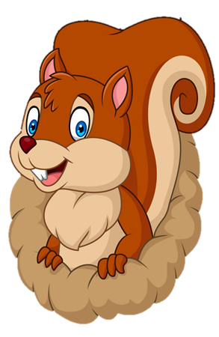
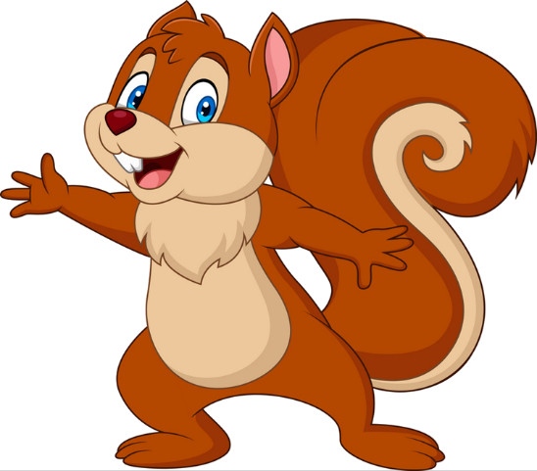
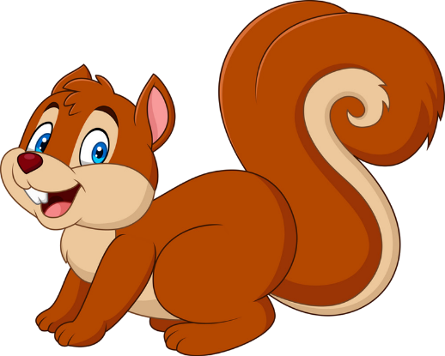
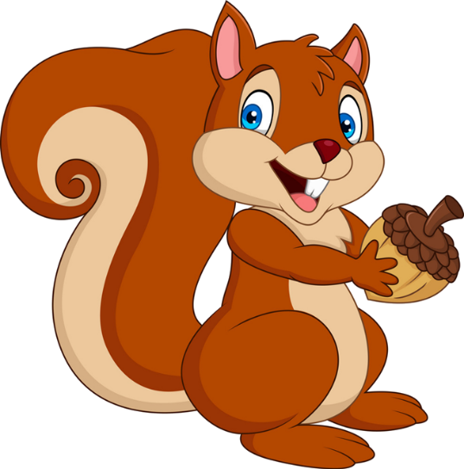


PLAY
NEXT
Brown squirrel
& acorn

Slide 24
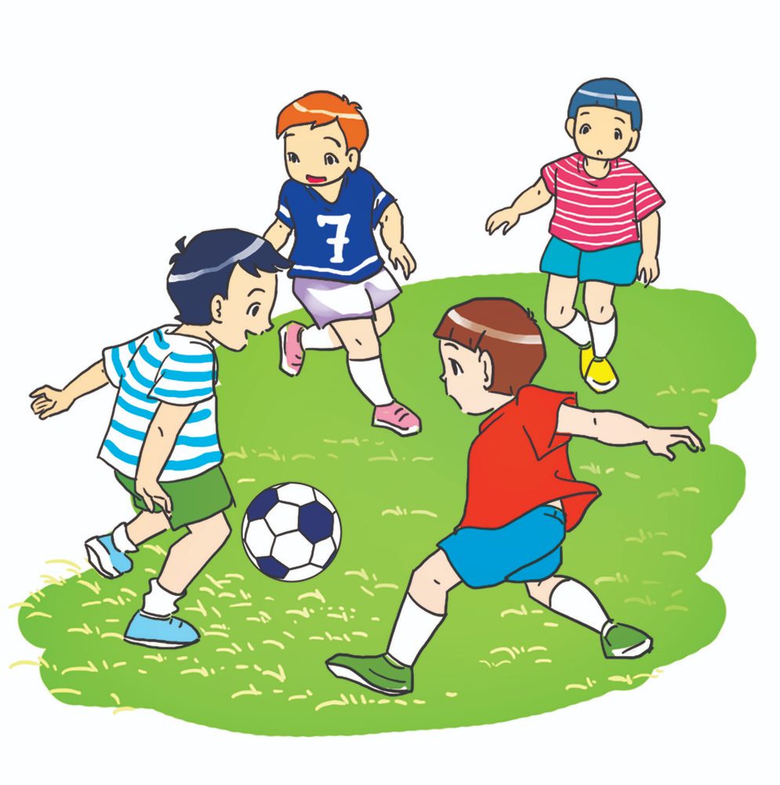


What are they doing?
They are playing football.
We are playing football.
farm
zoo

Slide 25
What are they doing?
They are painting masks.
They are painting pictures.
Next
farm
zoo

Slide 26
They are painting masks.
What are they doing?
Where are they doing?
Next
farm
zoo

Slide 27
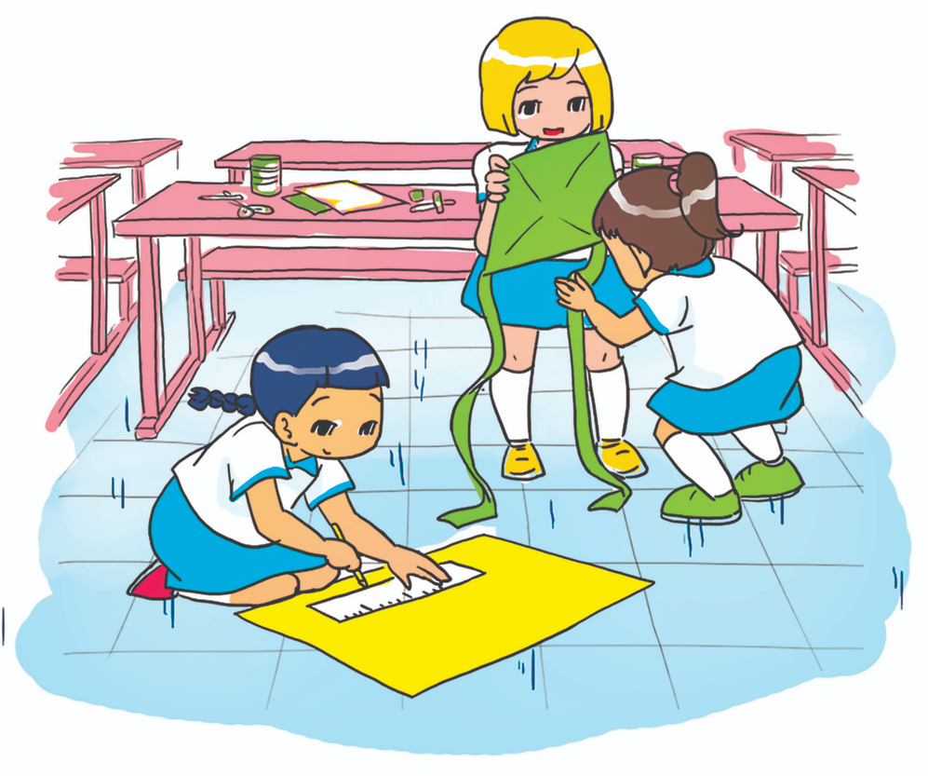
What are they doing?
They are making
paper kites.
She’s making
paper kites.
farm
zoo

Slide 28
What are they doing?
They are making
paper planes.
They are making
puppets.
farm
zoo

Slide 29
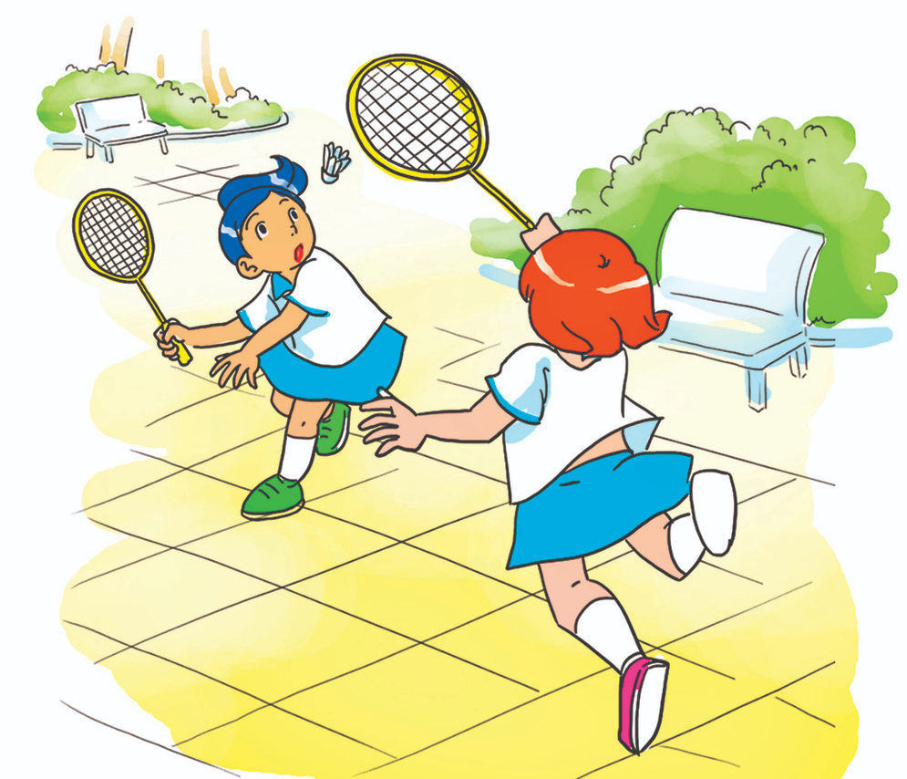
What are they doing?
They playing
badminton.
They are playing badminton.
farm
farm

Slide 30
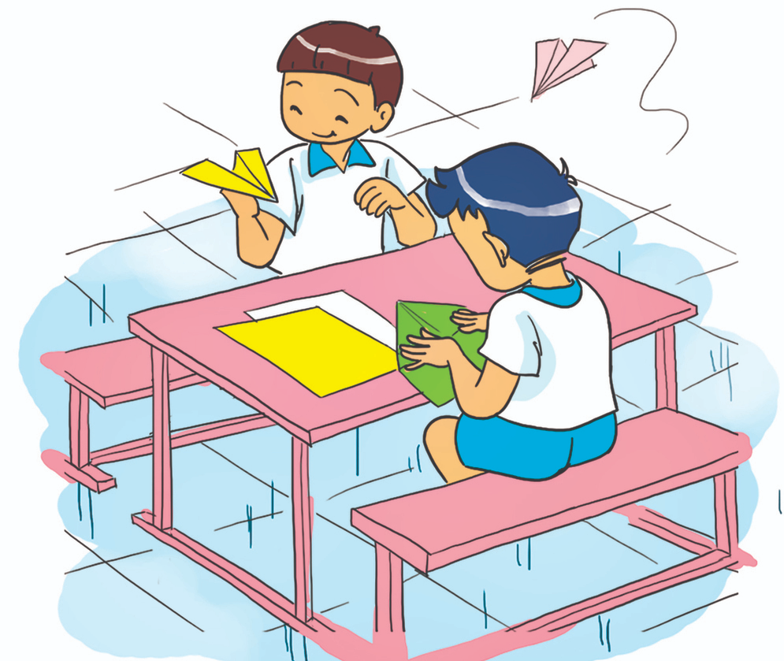
What are they doing?
They are make
paper planes.
They are making
paper planes.
farm
farm

Slide 31
They are making
paper planes.
What are you doing?
What are they doing?
farm
zoo

Slide 32


Good job!

Slide 33
03
Practice

Slide 34

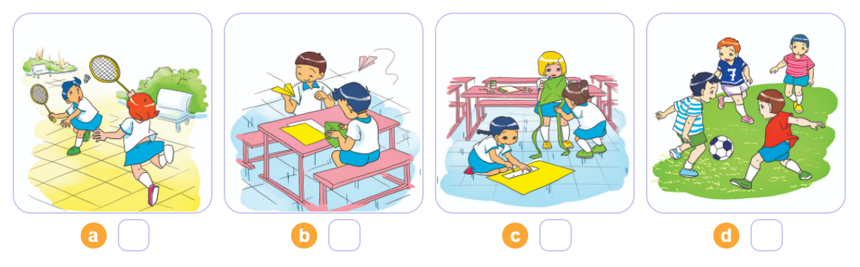
4. Listen and number
1
2
3
4
2
4
3
1

Slide 35
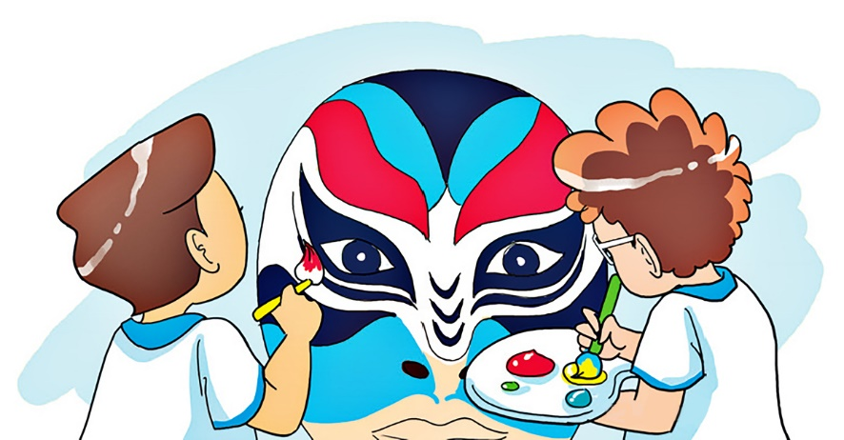
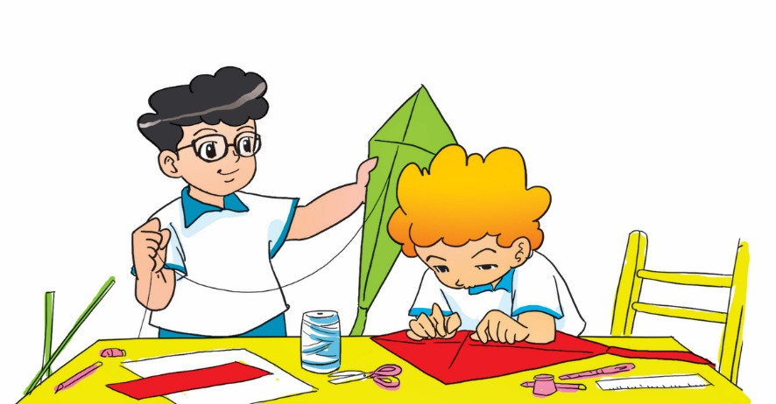
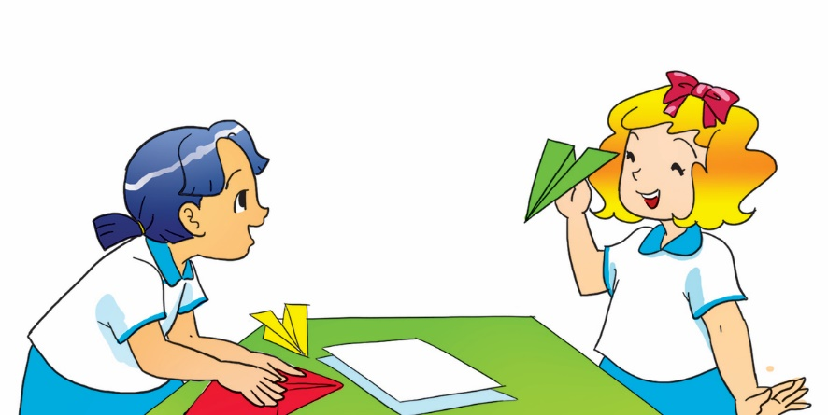
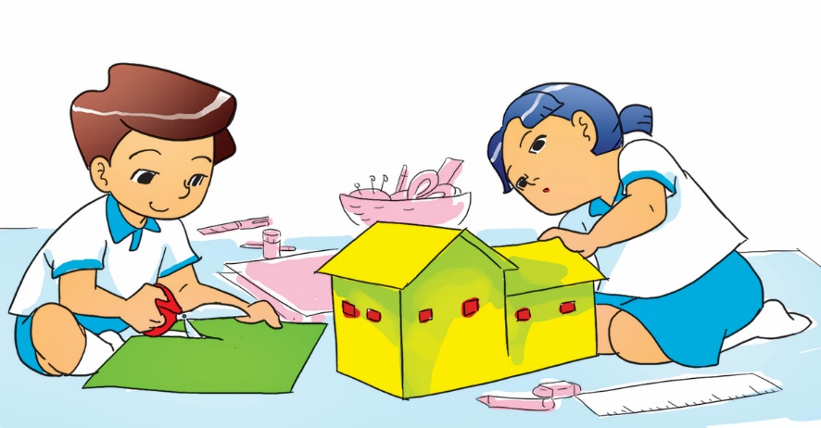
5. Look and write
1. What are Nam and Tom doing?
They are painting a mask. /
They're painting a mask.
2. What are Phong and Peter doing?
They are making kites /
They're making kites.
3. What are Mai and Linda doing?
They are making paper planes. /
They're making paper planes.
4. What are Mai and Nam doing?
They are making a paper house. /
They're making a paper house.

Slide 36
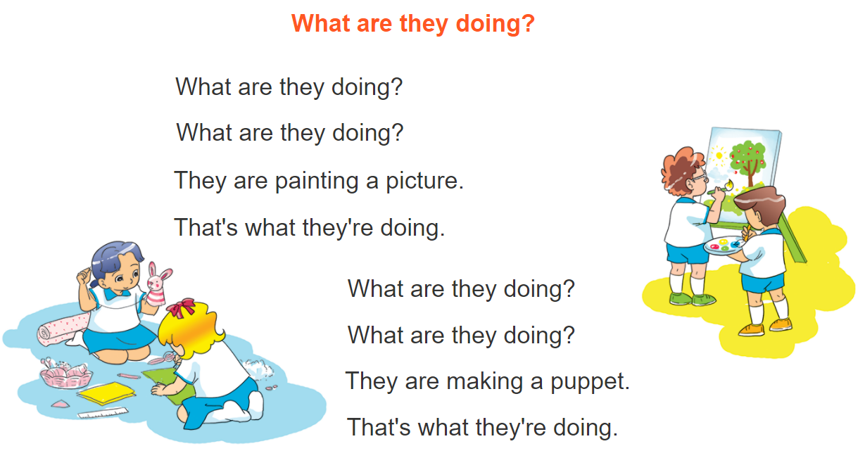



6. Let’s sing

Slide 37
04
Homelink

Slide 38
Monday, December 5th 2022
Unit 9: What are they doing?
Lesson 2
1. New words:
Plane: máy bay
Kite: cái diều
Boat: cái thuyền
Picture: bức tranh
Draw: vẽ
paper: giấy
Puppet: con rối
mask: mặt nạ
Paint: sơn, tô màu
2.Model sentence:
What are they doing?
They’re making paper boat.

Slide 39
Thanks!

Slide 40
Alternative resources

