Slide 1

Unit 8: Food
Lesson 1.1
Page 110

Slide 2
Lesson Outline
Warm-up
Vocabulary
Structure
Consolidation
Wrap-up

Slide 3
Objectives
By the end of this lesson, students will be able to…
Vocabulary: Pronounce and use the words related to the topic properly: apple, banana, carrot, cupcake, donut
Structure: Use There is an apple/There is a banana/There are eight cupcakes.

Slide 4

WARM UP

Slide 5

New words
apple
banana
carrot
cupcake
donut

Slide 6

Presentation

Slide 7


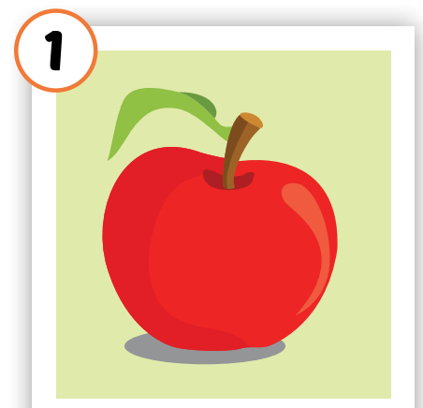

Click on each picture to hear the sound.
/ˈæpl/
quả táo
Notes:
Click vô từng hình để nghe tiếng

Slide 8
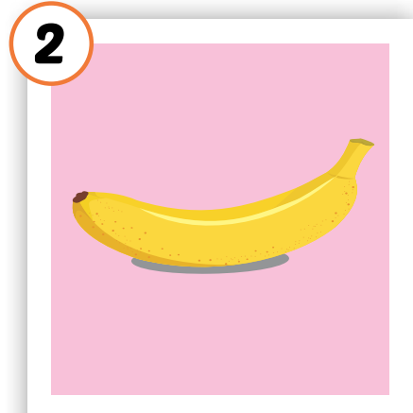

Click on each picture to hear the sound.
/bəˈnænə/
quả chuối
Notes:
Click vô từng hình để nghe tiếng

Slide 9
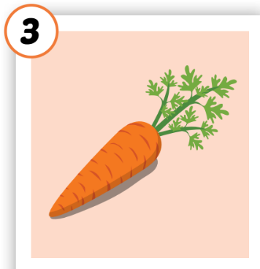

Click on each picture to hear the sound.
/ˈkærət/
củ cà rốt
Notes:
Click vô từng hình để nghe tiếng

Slide 10
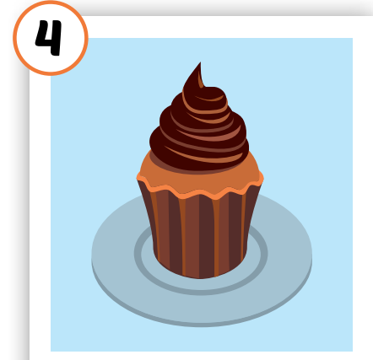

Click on each picture to hear the sound.
/ˈkʌpkeɪk/
bánh nướng nhỏ
Notes:
Click vô từng hình để nghe tiếng

Slide 11
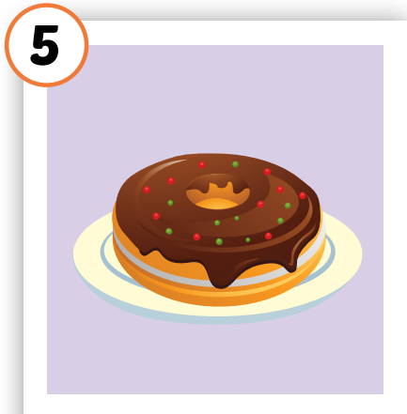

Click on each picture to hear the sound.
/ˈdəʊnʌt/
bánh vòng
Notes:
Click vô từng hình để nghe tiếng

Slide 12
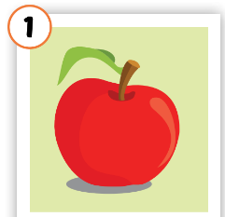
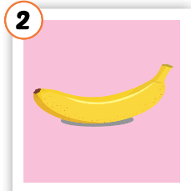
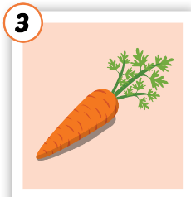



Click on each picture to hear the sound.
/bəˈnænə/
quả chuối
/ˈkærət/
củ cà rốt
/ˈkʌpkeɪk/
bánh nướng nhỏ
/ˈdəʊnʌt/
bánh vòng
/ˈæpl/
quả táo
Notes:
Click vô từng hình để nghe tiếng

Slide 13

Click A to hear the sound
Notes:
Click vào hình A. 1. Listen and point. Repeat để cho cả audio full chạy

Slide 14

Practice

Slide 15
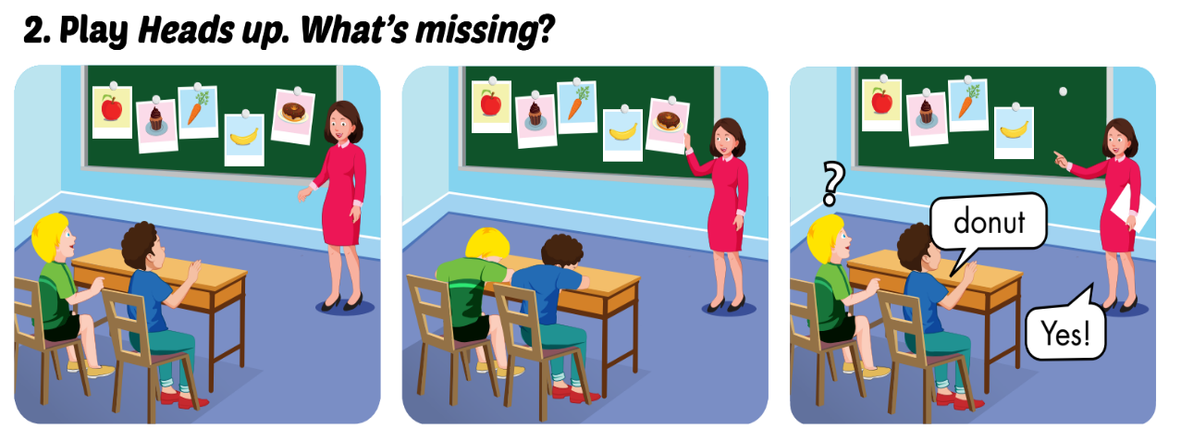

Slide 16
LOOK AND WRITE
o
carr_t
n
do_ut
e
appl_
b
_anana
c_pcake
u

Slide 17

Structures
There is an apple.
There is a banana. There are eight cupcakes.

Slide 18
Presentation

Slide 19


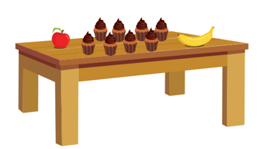
There is an apple.
There is a banana.
There are eight cupcakes.
Click on each sentence to listen

Slide 20
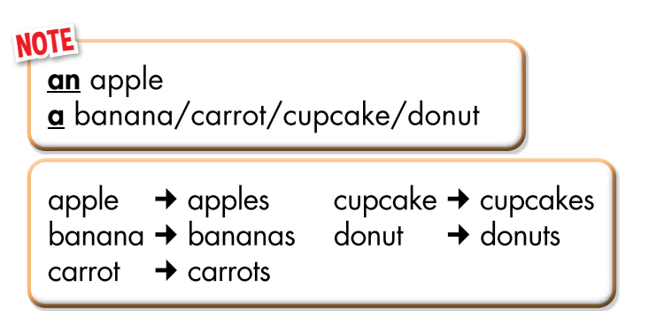

Slide 21

CONSOLIDATION

Slide 22

Production

Slide 23

WRAP-UP

Slide 24
Lesson 3
Today’s lesson
Vocabularies
apple, banana, carrot, cupcake, donut
Structures/ Sentence patterns
There is an apple/There is a banana/There are eight cupcakes.

Slide 25
Lesson 3
Homework
Practice vocabularies and structure. Make sentences using them.
Practice the vocabulary and structure in Tiếng Anh 3 i-Learn Smart Start Notebook (page 52)
Do the exercises in Tiếng Anh 3 i-Learn Smart Start Workbook (page 78)
Play the consolidation games in Tiếng Anh 3 i-Learn Smart Start DHA App on www.eduhome.com.vn
Prepare the next lesson (page 111)

Slide 26
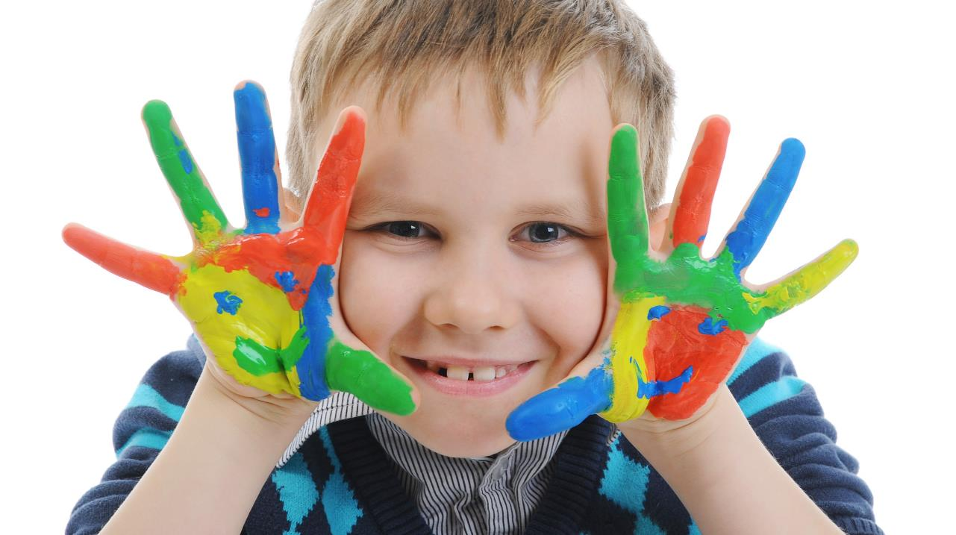
Enjoy your day!

