Slide 1


Ngo Gia Tu Primary School
Class 3A6
Teacher: Nguyen Thanh Tam

Slide 2

WARM UP

Slide 3

Unit 7: Toys
Lesson 4.1
Page 105

Slide 4
Objectives
By the end of this lesson, students will be able to…
Vocabulary: Pronounce and use the words related to the topic properly: eleven, twelve, thirteen, fourteen, fifteen, sixteen, seventeen, eighteen, nineteen, twenty
Model Sentences: Do simple math by using:
Seven plus twelve is nineteen.
Twenty minus six is fourteen.

Slide 5

It’s time to learn …

Slide 6

Vocabulary
eleven, twelve, thirteen, fourteen, fifteen, sixteen, seventeen, eighteen, nineteen, twenty

Slide 7

Presentation

Slide 8











Click A to hear the sound
eleven
/ɪˈlevn/
twelve
/twelv/
thirteen
/ˌθɜːˈtiːn/
fourteen
/ˌfɔːˈtiːn/
fifteen
/ˌfɪfˈtiːn/
sixteen
/ˌsɪksˈtiːn/
seventeen
/ˌsevnˈtiːn/
eighteen
/ˌeɪˈtiːn/
nineteen
/ˌnaɪnˈtiːn/
twenty
/ˈtwenti/
Click on each picture to hear the sound.
Notes:
Click vào hình A. 1. Listen and point. Repeat để cho cả audio full chạy

Slide 9
Click A to hear the sound
eleven
/ɪˈlevn/
twelve
/twelv/
thirteen
/ˌθɜːˈtiːn/
fourteen
/ˌfɔːˈtiːn/
fifteen
/ˌfɪfˈtiːn/
sixteen
/ˌsɪksˈtiːn/
seventeen
/ˌsevnˈtiːn/
eighteen
/ˌeɪˈtiːn/
nineteen
/ˌnaɪnˈtiːn/
twenty
/ˈtwenti/
Click on each picture to hear the sound.
Notes:
Click vào hình A. 1. Listen and point. Repeat để cho cả audio full chạy

Slide 10


Click on each picture to hear the sound.
/ɪˈlevn/
Notes:
Click vào hình A. 1. Listen and point. Repeat để cho cả audio full chạy

Slide 11


Click on each picture to hear the sound.
/twelv/
Notes:
Click vào hình A. 1. Listen and point. Repeat để cho cả audio full chạy

Slide 12


Click on each picture to hear the sound.
/ˌθɜːrˈtiːn/
Notes:
Click vào hình A. 1. Listen and point. Repeat để cho cả audio full chạy

Slide 13


Click on each picture to hear the sound.
/ˌfɔːrˈtiːn/
Notes:
Click vào hình A. 1. Listen and point. Repeat để cho cả audio full chạy

Slide 14


Click on each picture to hear the sound.
/ˌfɪfˈtiːn/
Notes:
Click vào hình A. 1. Listen and point. Repeat để cho cả audio full chạy

Slide 15


Click on each picture to hear the sound.
/ˌsɪksˈtiːn/
Notes:
Click vào hình A. 1. Listen and point. Repeat để cho cả audio full chạy

Slide 16


Click on each picture to hear the sound.
/ˌsevnˈtiːn/
Notes:
Click vào hình A. 1. Listen and point. Repeat để cho cả audio full chạy

Slide 17


Click on each picture to hear the sound.
/ˌeɪˈtiːn/
Notes:
Click vào hình A. 1. Listen and point. Repeat để cho cả audio full chạy

Slide 18


Click on each picture to hear the sound.
/ˌnaɪnˈtiːn/
Notes:
Click vào hình A. 1. Listen and point. Repeat để cho cả audio full chạy

Slide 19


Click on each picture to hear the sound.
/ˈtwenti/
Notes:
Click vào hình A. 1. Listen and point. Repeat để cho cả audio full chạy

Slide 20
Click A to hear the sound
eleven
/ɪˈlevn/
twelve
/twelv/
thirteen
/ˌθɜːˈtiːn/
fourteen
/ˌfɔːˈtiːn/
fifteen
/ˌfɪfˈtiːn/
sixteen
/ˌsɪksˈtiːn/
seventeen
/ˌsevnˈtiːn/
eighteen
/ˌeɪˈtiːn/
nineteen
/ˌnaɪnˈtiːn/
twenty
/ˈtwenti/
Click on each picture to hear the sound.
Notes:
Click vào hình A. 1. Listen and point. Repeat để cho cả audio full chạy

Slide 21

Practice

Slide 22





PLAY
Notes:
Ms Huyền Phạm - 0936.082.789 – YOUTUBE: MsPham. Facebook: Dạy và học cùng công nghệ.

Slide 23

Ms Huyền Phạm
0936.082.789
Notes:
Ms Huyền Phạm - 0936.082.789 – YOUTUBE: MsPham. Facebook: Dạy và học cùng công nghệ.

Slide 24







Slide 25


fifteen

Slide 26



Slide 27


Slide 28

fourteen

Slide 29

nineteen

Slide 32




EXIT
Notes:
Ms Huyền Phạm - 0936.082.789 – YOUTUBE: MsPham. Facebook: Dạy và học cùng công nghệ.

Slide 33
Structures
Seven plus twelve is nineteen.
Twenty minus six is fourteen.

Slide 34




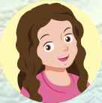


Slide 35
12 + 2 = 14
twelve plus two is fourteen
twelve …… two …… fourteen
18 – 3 = 15
eighteen minus three is fifteen
eighteen minus three is ……..
17 - 11 = 6
seventeen minus eleven is six
seventeen ….. eleven is six

Slide 36



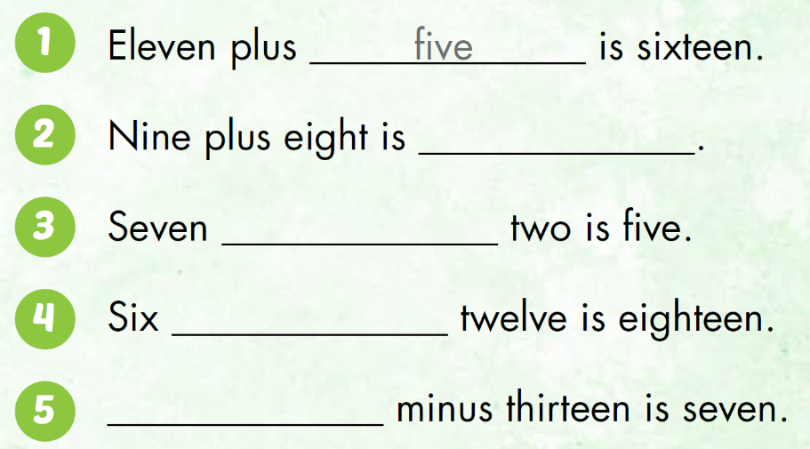

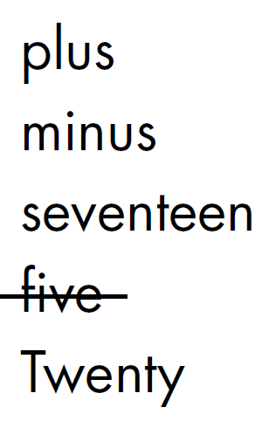
Now, work in pair to practice.
seventeen
minus
plus
Twenty

Slide 37

Production

Slide 38

If you see numbers => write words (20 => twenty)
If you see words => write numbers (twenty => 20)
After listening => write numbers

Slide 39
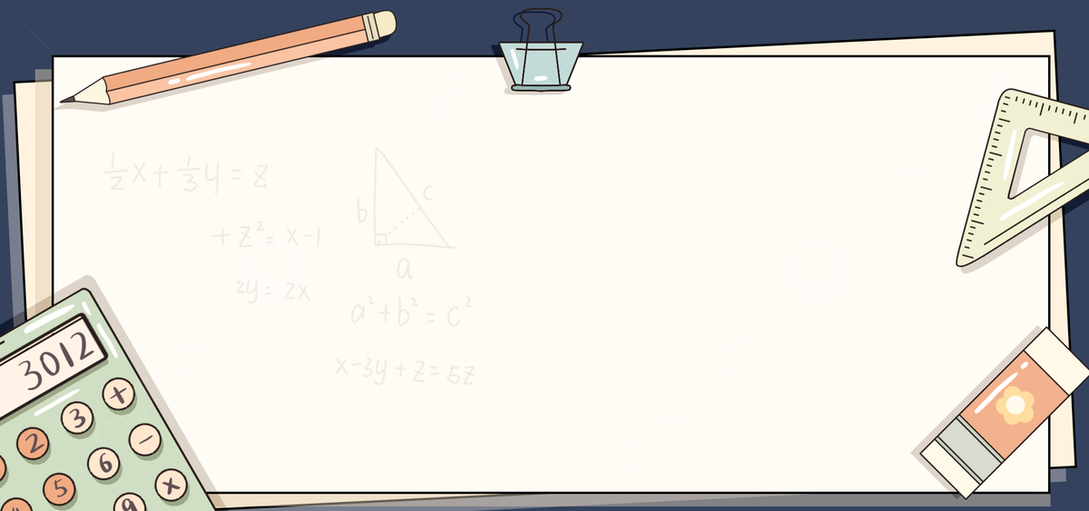

nineteen minus two
is seventeen
19 – 2 = 17

Slide 40

12 + 3 = 15
twelve plus three
is fifteen

Slide 41

“listen”
11 + 9 = 20

Slide 42
17 – 11 = 6
seventeen minus eleven is six

Slide 43

2 stars
twelve plus five
is seventeen
12 + 5 = 17

Slide 44
“listen”
19 – 6 = 13

Slide 45
16 – 6 = 10
sixteen minus six is ten

Slide 46
18 – 5 = 13
eighteen minus five is thirteen

Slide 47

CONSOLIDATION

Slide 48
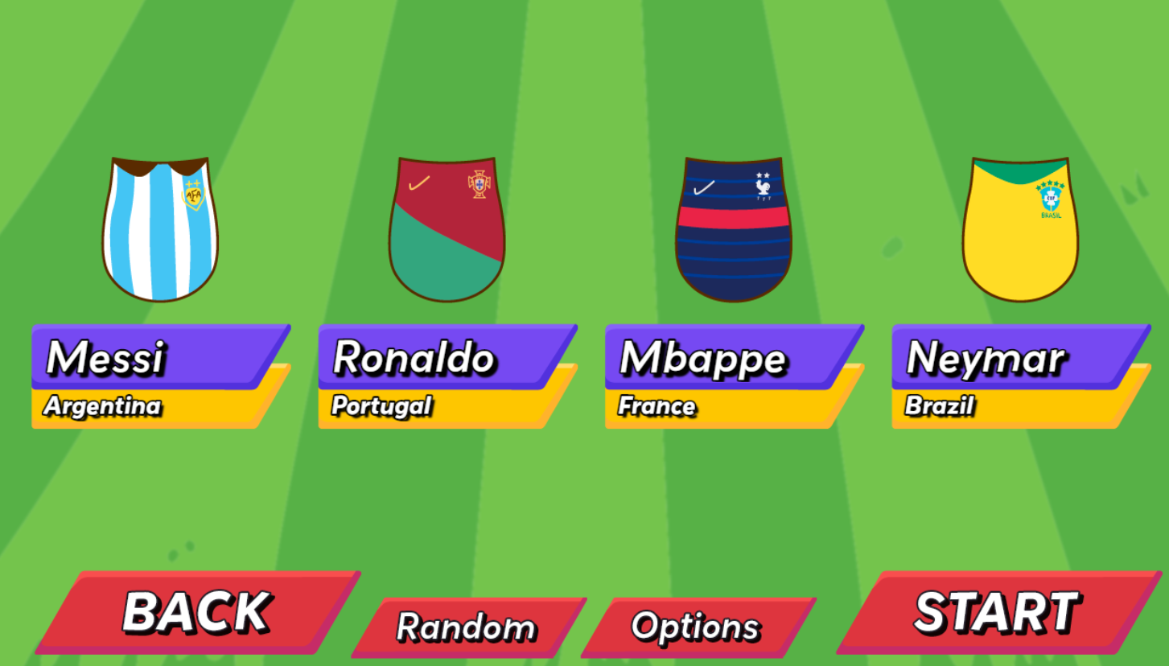

Slide 49

WRAP-UP

Slide 50
Today’s lesson
Vocabulary
eleven, twelve, thirteen, fourteen, fifteen, sixteen, seventeen, eighteen, nineteen, twenty
Model Sentences
Seven plus twelve is nineteen.
Twenty minus six is fourteen.

Slide 51
Homework
Practice the vocabularies and structure; and make sentences using them.
Do the exercises in Tiếng Anh 3 i-Learn Smart Start WB (page 74)

Slide 52

Thank you!

