Slide 1

Unit 6: Clothes
Review& Practice 2
Page 95

Slide 2
Objectives
By the end of this lesson, students will be able to review talking about what clothes they want, talking about what they're wearing, and asking and answering about their clothes.
Vocabulary: review all vocabularies learnt in Unit 6.
Speaking: Practice asking and answering questions about clothes, about what they are wearing.

Slide 3

WARM UP

Slide 4

It’s time to learn …

Slide 5

Speaking

Slide 6
PRE-SPEAKING
Rearrange these words to make a sentence.
do want what you ?
What do you want?

Slide 7
PRE-SPEAKING
Rearrange these words to make a sentence.
What you are wearing ?
What are you wearing?

Slide 8
PRE-SPEAKING
Rearrange these words to make a sentence.
those your Are jeans ?
Are those your jeans?

Slide 9
PRE-SPEAKING
Rearrange these words to make a sentence.
aren’t No, they
No, they aren’t.

Slide 10
PRE-SPEAKING
Rearrange these words to make a sentence.
want shorts I some
I want some shorts.

Slide 11
PRE-SPEAKING
Rearrange these words to make a sentence.
‘m a I T-shirt green wearing
I’m wearing a green T-shirt.

Slide 12

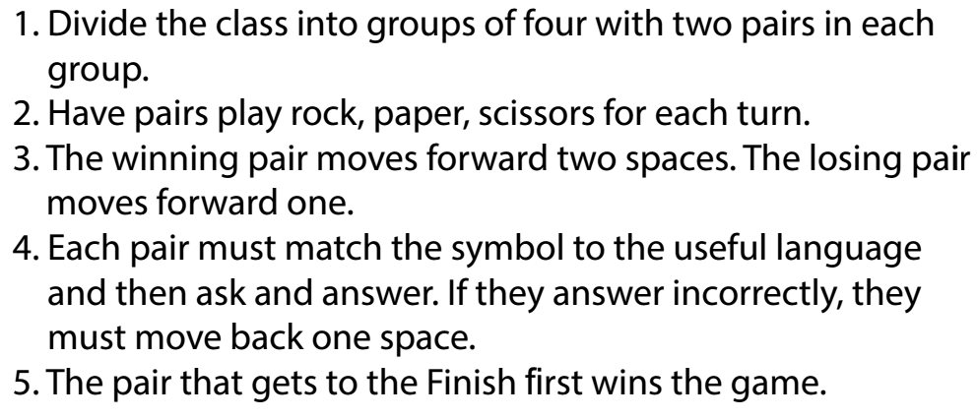
HOW TO PLAY?

Slide 13
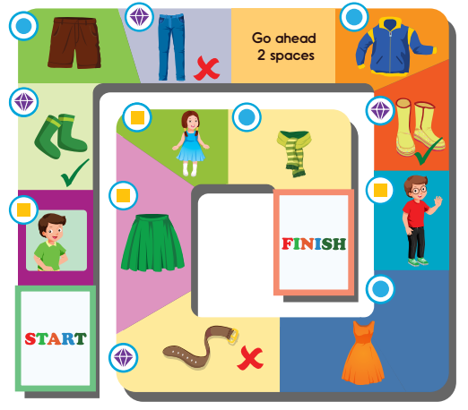



A: What are you wearing?
B: I’m wearing a green
T-shirt.
A: Are those your socks?
B: Yes, they are.
A: What do you want?
B: I want some shorts.

Slide 14
A: Are those your jeans?
B: No, they aren’t.

Slide 15
A: What do you want?
B: I want a jacket.
A: Are those your boots?
B: Yes, they are.
A: What are you wearing?
B: I’m wearing a red polo shirt and black jeans.

Slide 16
A: What do you want?
B: I want a dress.
A: Is that your belt?
B: No, it isn’t.
A: What are you wearing?
B: I’m wearing a green skirt.

Slide 17
A: What are you wearing?
B: I’m wearing a blue drees.
A: What do you want?
B: I want a scarf.

Slide 18



• I can talk about different clothes.
• I can say what clothes I want.
• I can say what clothes I’m wearing.

Slide 19

CONSOLIDATION

Slide 20

WRAP-UP

Slide 21
Lesson 3
Today’s lesson
Vocabulary
Review all vocabularies learnt in Unit 6
Speaking
Practice asking and answering questions by clothes

Slide 22
Lesson 3
Homework
Review the vocabularies and structure; and make sentences using them.
Do the exercises in Tiếng Anh 3 i-Learn Smart Start WB (page 67).
Do the exercises in Tiếng Anh 3 i-Learn Smart Start Notebook (page 45).
Prepare the next lesson (page 96 SB).
Play games in Tiếng Anh 3 i-Learn Smart Start DHA App on www.eduhome.com.vn

