Slide 1
Unit 13: Would you like some milk?
Lesson 1 (page 18+19)

Slide 2

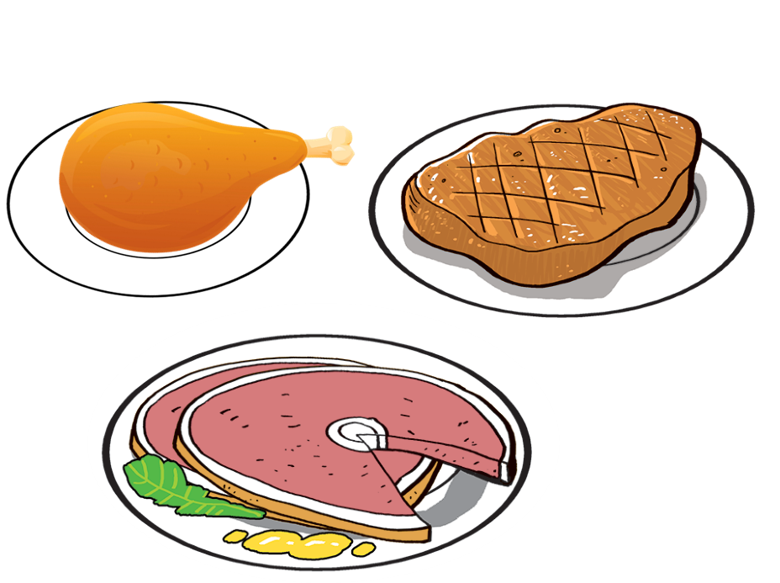
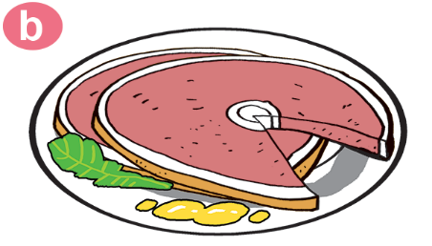

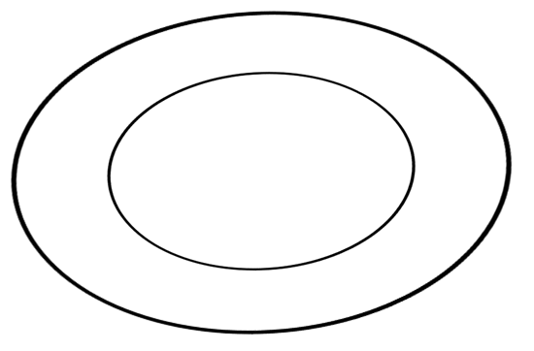
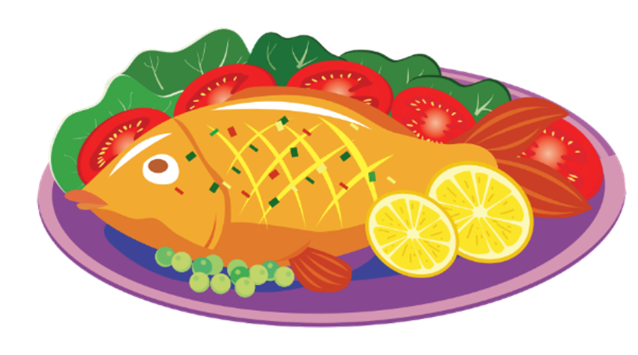
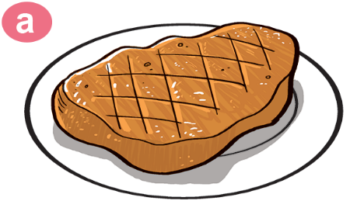


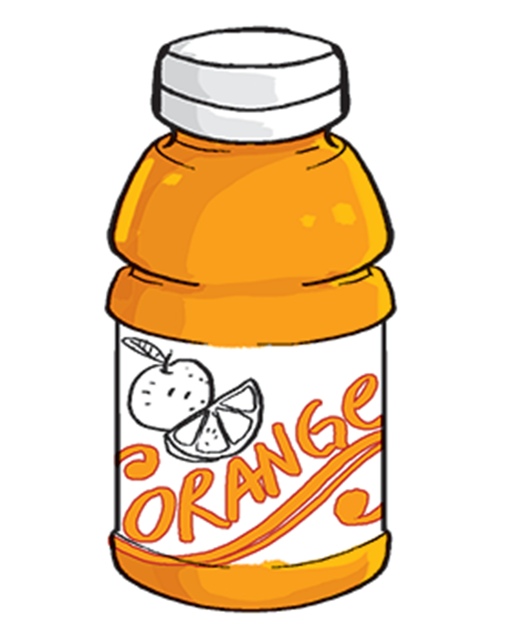
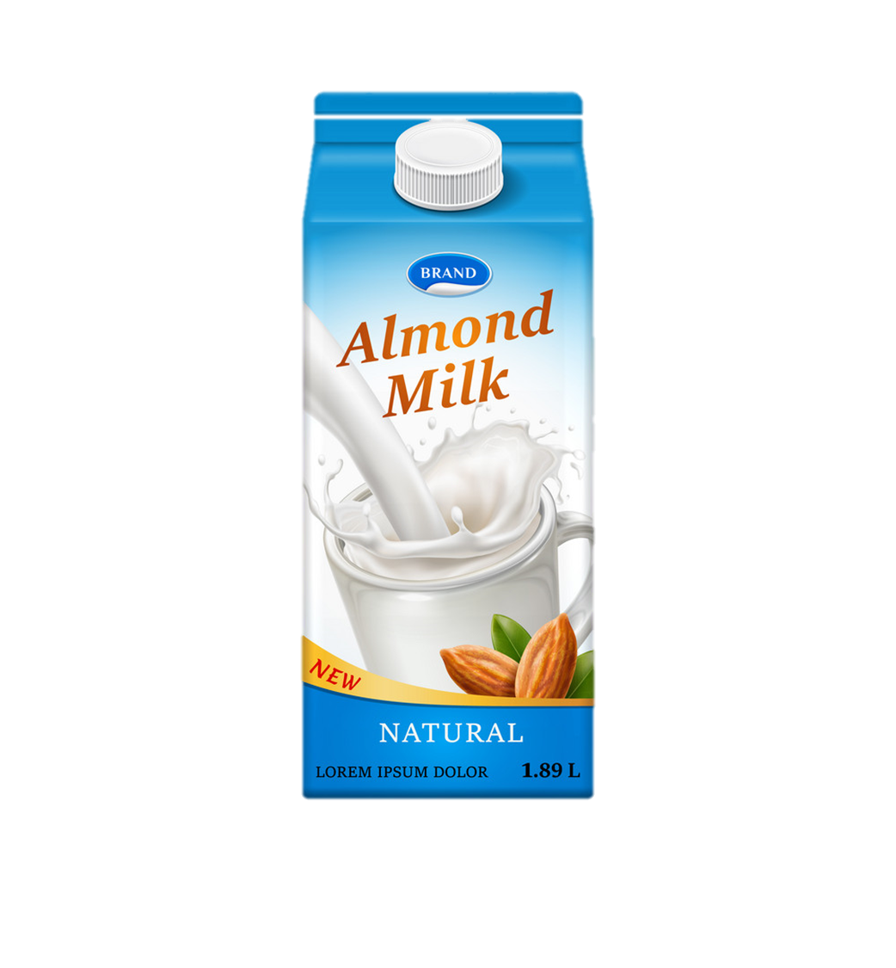
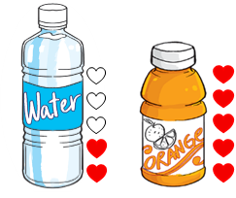
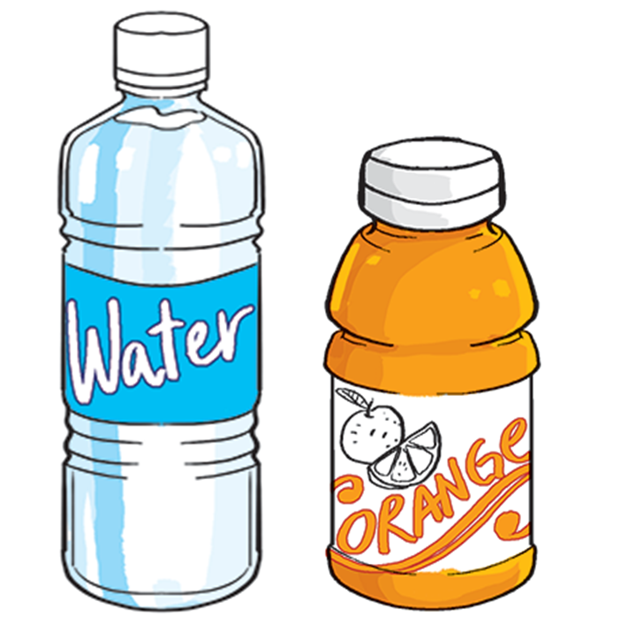
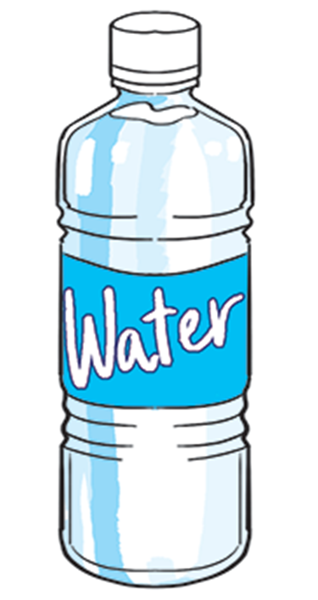
Vocabulary
1
2
3
4
5
food
thức ăn
pork
thịt lợn/heo
chicken
thịt gà
fish
cá
beef
thịt bò
6
7
8
9
10
favourite
yêu thích
drink
đồ uống
orange juice
nước cam
water
nước
milk
sữa

Slide 3

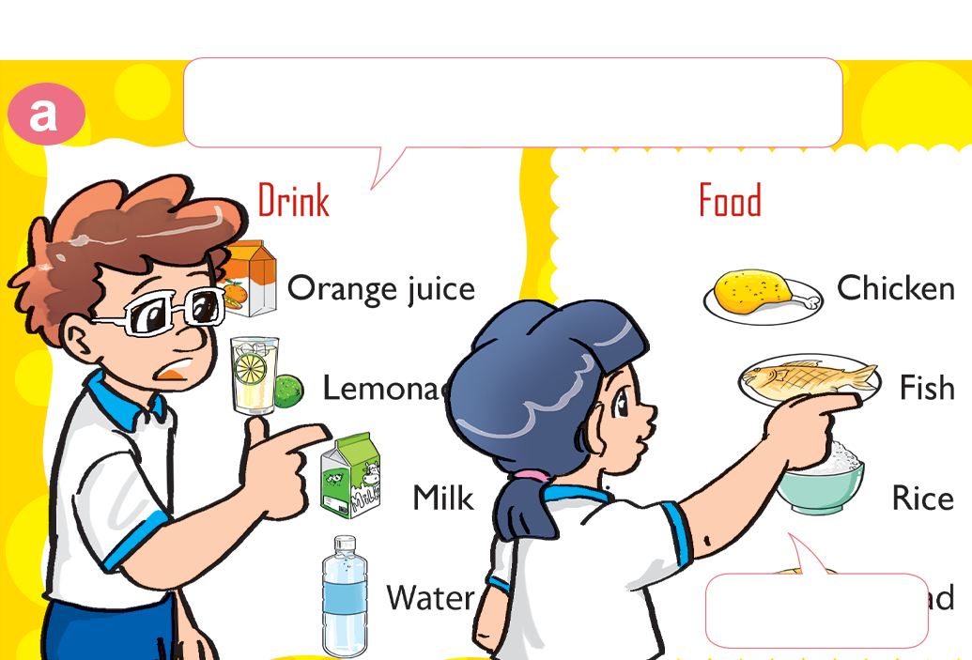
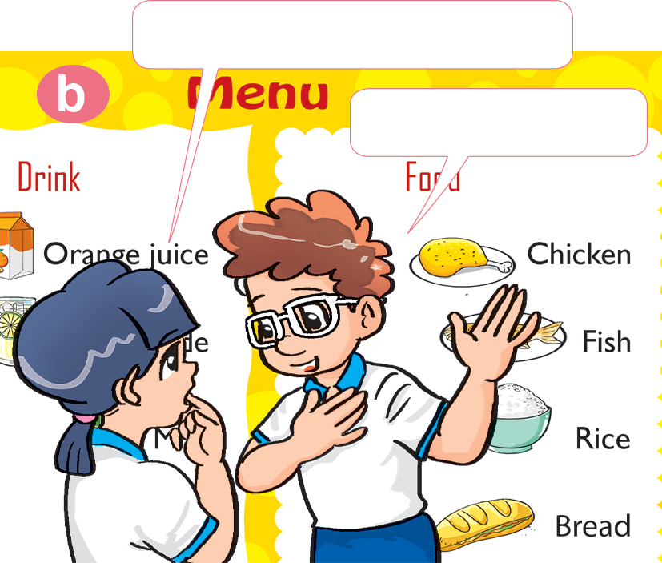

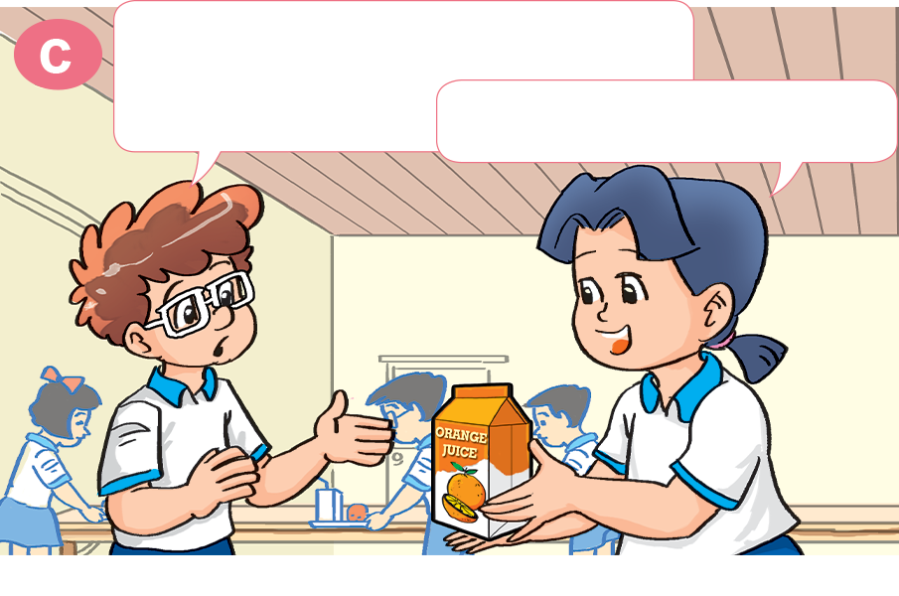
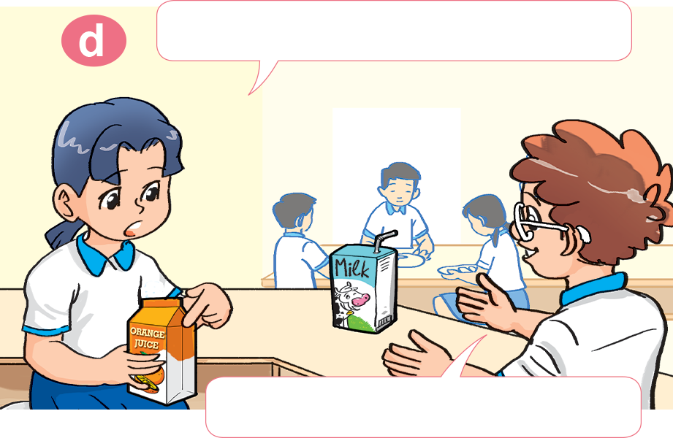
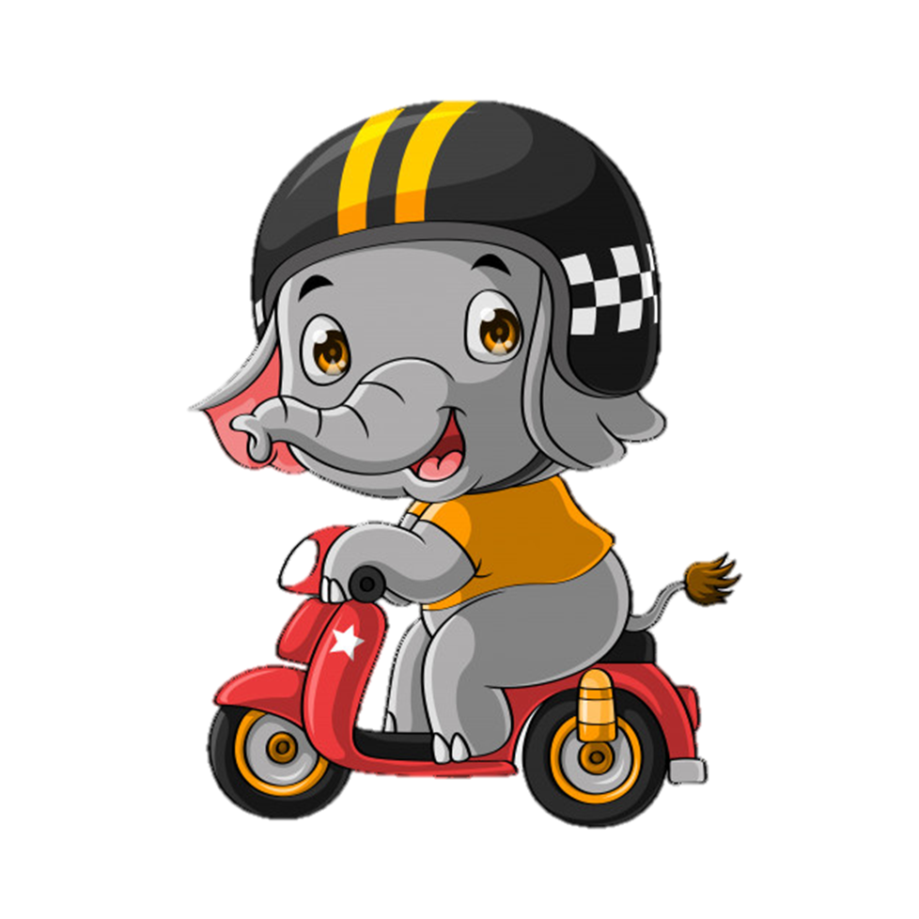
1. Look, listen and repeat.
How about you, Tom?
What's your favourite food?
I like chicken.
It's fish.
What's your favourite drink, Mai?
Do you like orange juice?
It's orange juice.
No, I don't. I like milk.

Slide 4

Model sentence
What's your favourite food/drink?
It's ___________.
orange juice
chicken
pork
water
beef
fish
milk

Slide 5

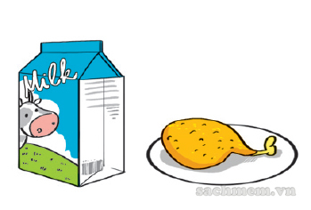
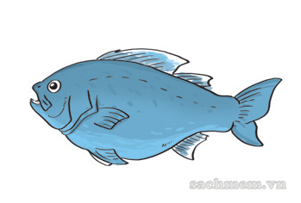
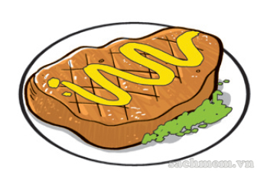
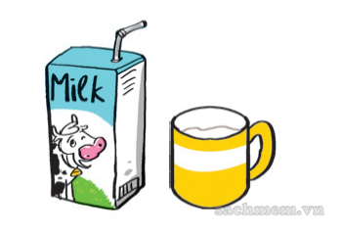
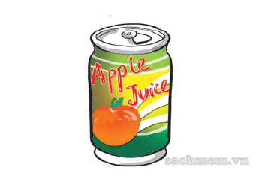
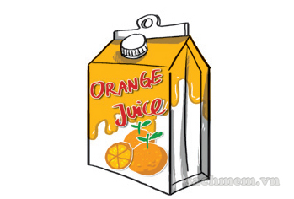
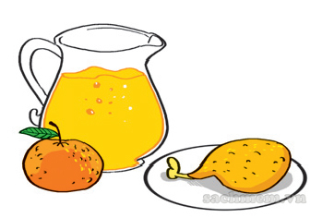
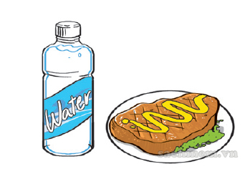
3. Listen and tick.
1. What's his favourite food?
a
b
c
✔
2. What's his favourite drink?
a
b
c
✔
3. What is her favourite food and drink?
a
b
c
✔

Slide 6
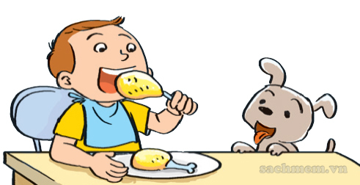
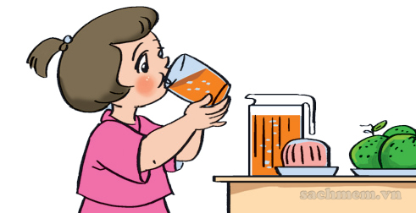
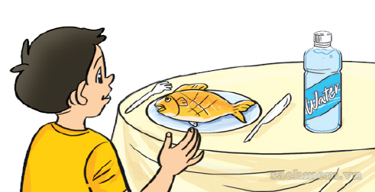
4. Look and write.(page 19)
1. A: What's his favourite food? B: _______________________.
It's chicken
2. A: What's her favourite drink? B: _______________________.
It's orange juice
3. A: What's his favourite food and drink? B: _______________________.
It's fish and water

