Slide 1

Unit 4: ACTIVITIES
Review and Practice
Page 60

Slide 2
Objectives
By the end of this lesson, students will be able to review the target language in the unit.
Vocabulary:
Activities: listen to music, watch television, play table tennis, do martial arts, skate, play chess, play a board game, do a puzzle, read a comic book, eat snacks, take photos, play video games.
Places: library, stadium, park, water park, market, swimming pool. studio, soccer field, arcade, skate park, coffee shop.
Structure:
What are you doing? What are they doing?
I’m swimming at the pool. They’re swimming at the pool.
What is he/she doing?
He/she swimming at the pool.

Slide 3

WARM UP

Slide 4

It’s time to learn …

Slide 5

Listening

Slide 6


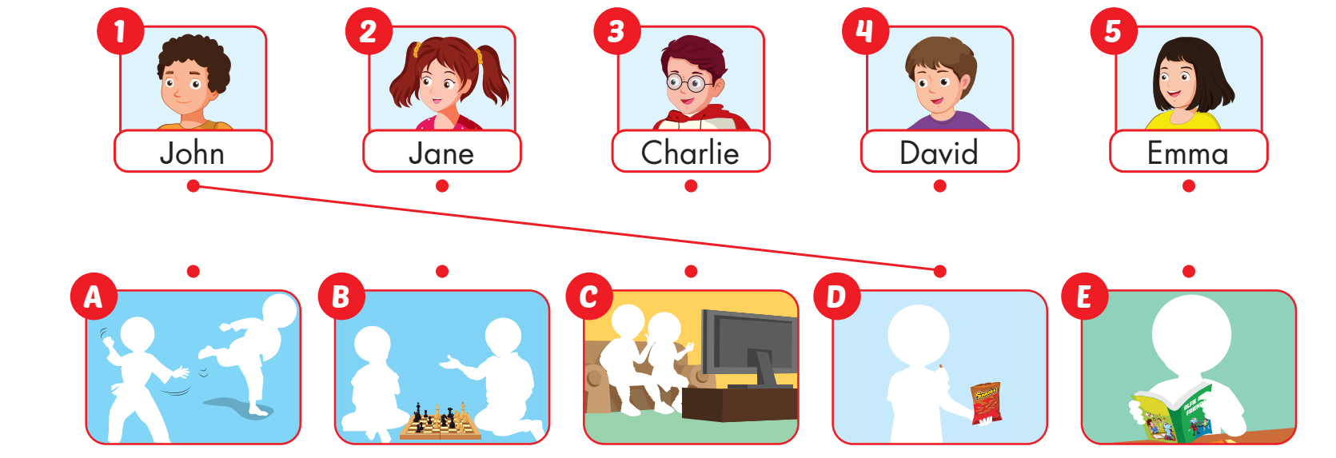

Slide 7

Reading

Slide 8







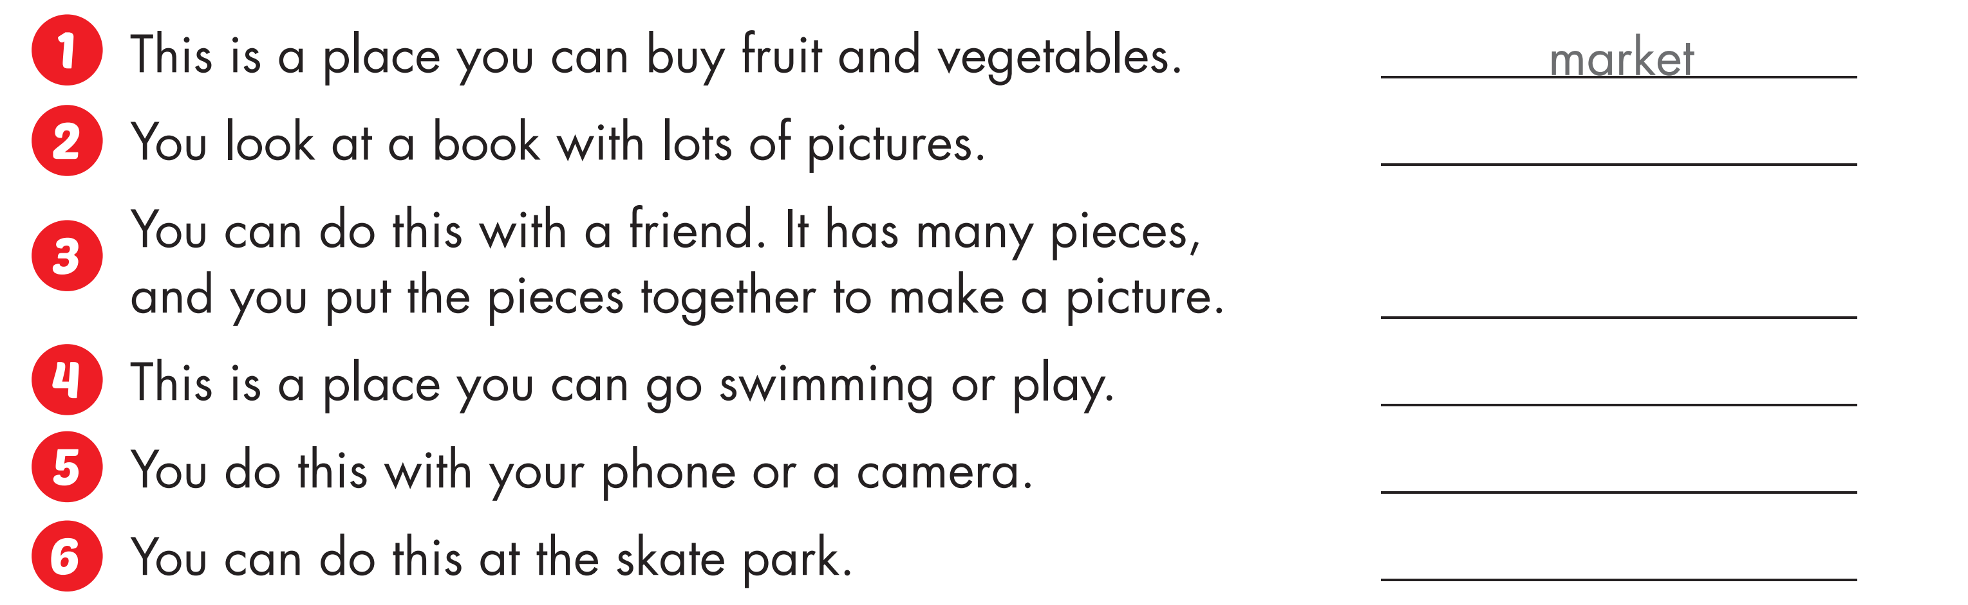
read a comic book
do a puzzle
water park
take photos
skate

Slide 9
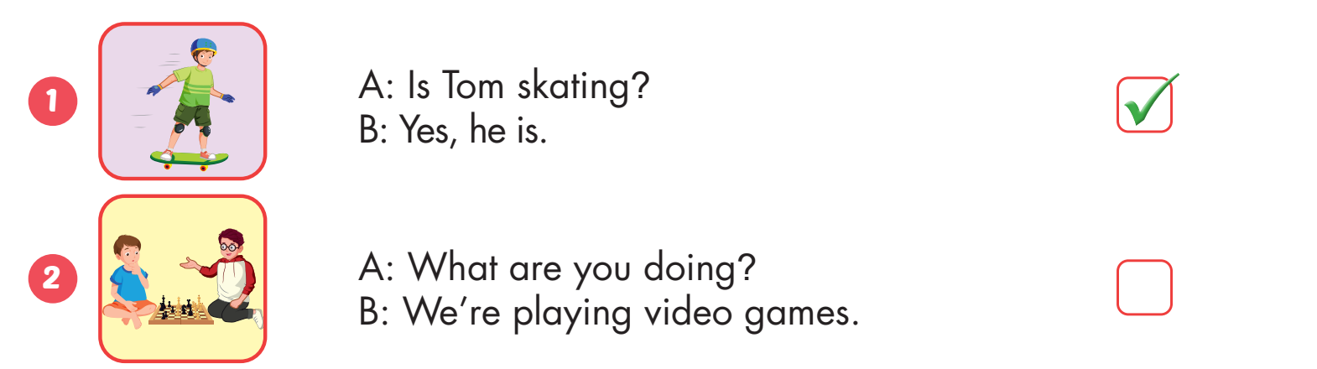


Slide 10
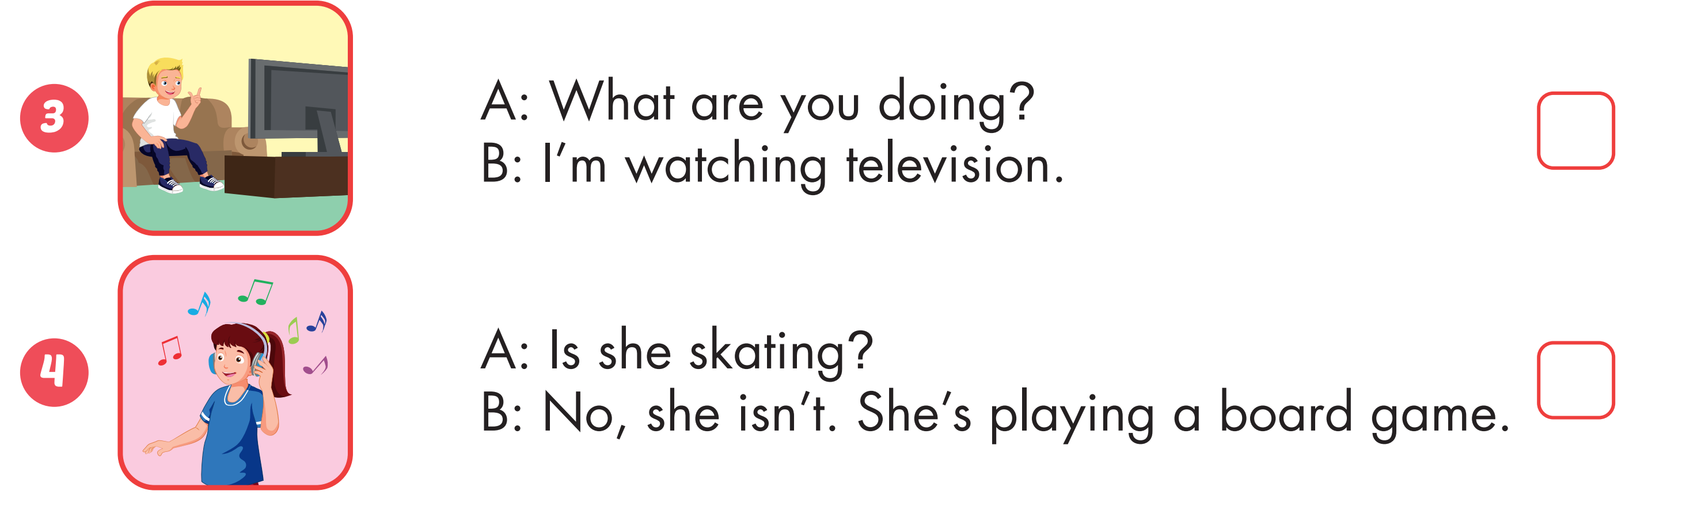



Slide 11
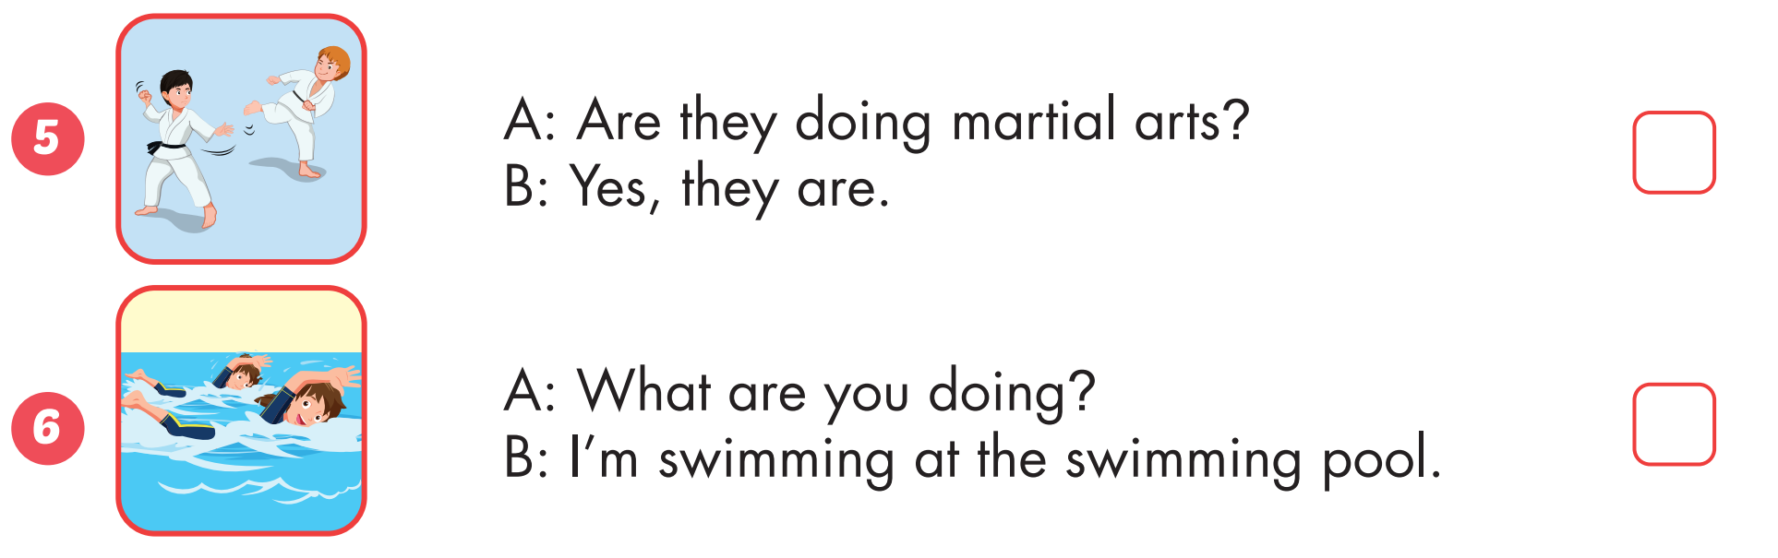

Slide 12
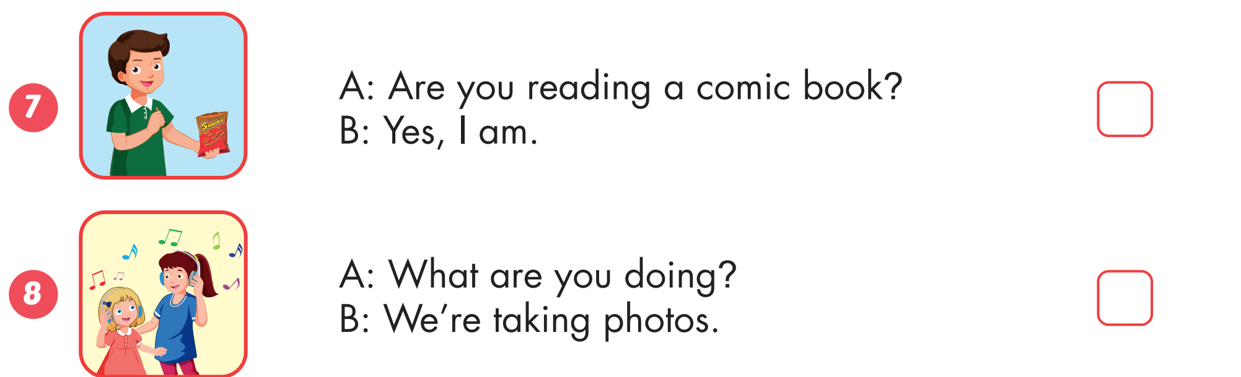

Slide 13
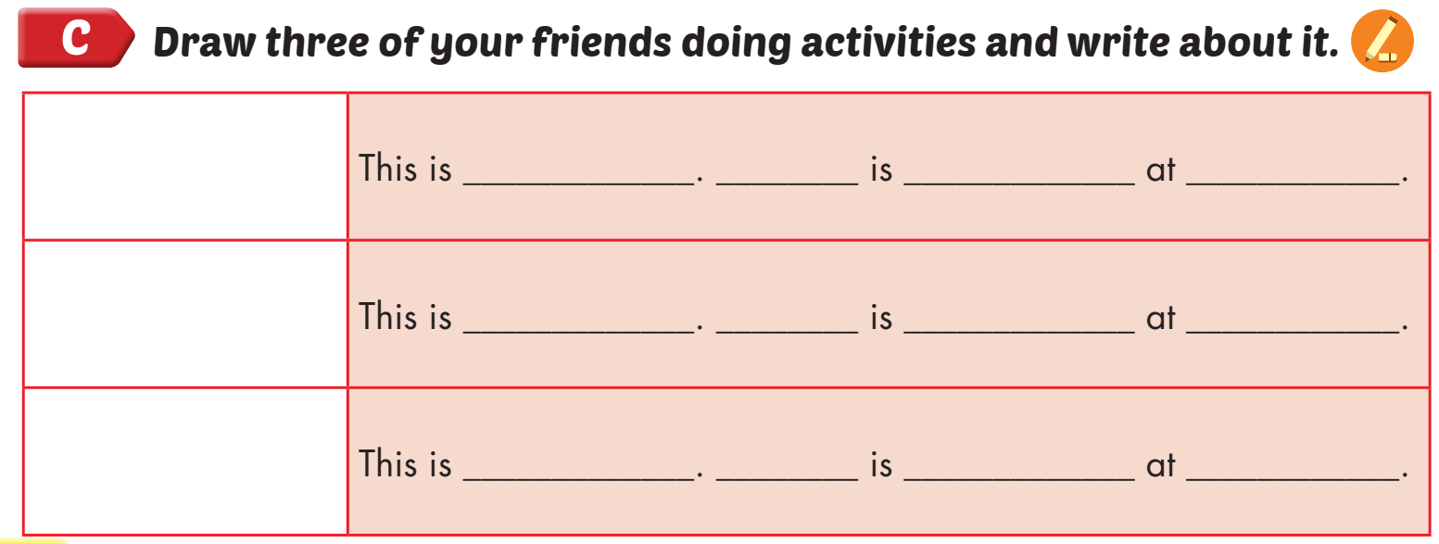

Nick
He
reading a comic book
home

Slide 14

Speaking

Slide 15



Slide 16
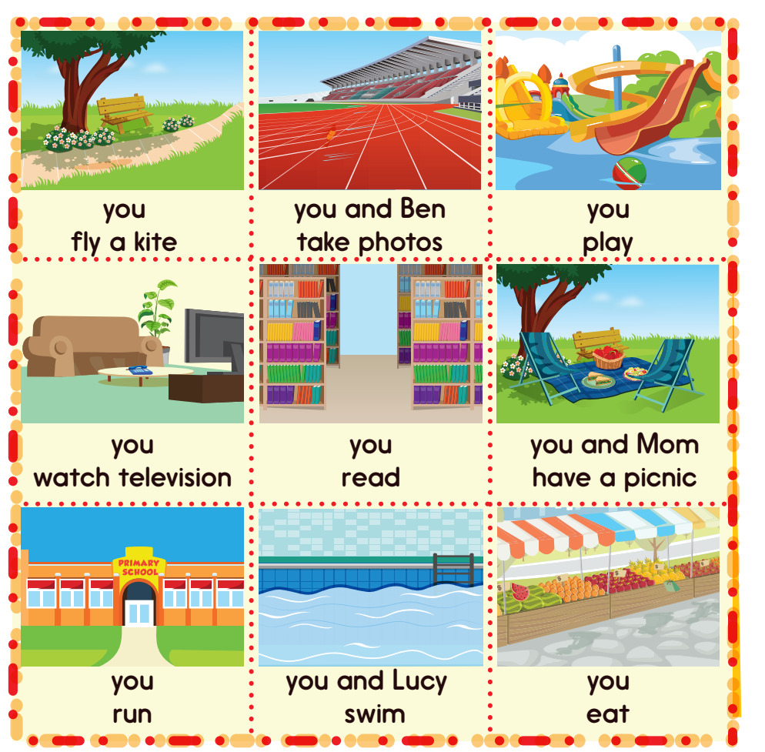

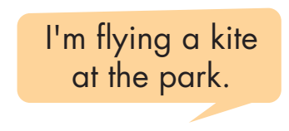
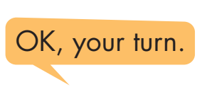

Slide 17

CONSOLIDATION

Slide 18

WRAP-UP

Slide 19
Today’s lesson
Vocabulary
Activities: listen to music, watch television, play table tennis, do martial arts, skate, play chess, play a board game, do a puzzle, read a comic book, eat snacks, take photos, play video games.
Places: library, stadium, park, water park, market, swimming pool. studio, soccer field, arcade, skate park, coffee shop.
Structures/ Sentence patterns
What are you doing?
I’m swimming at the pool.
What are they doing?
They’re swimming at the pool.
What is he/she doing?
He/she swimming at the pool.

Slide 20
Homework
Practice the vocabularies and structure; and make sentences using them.
Do the exercises in Tiếng Anh 4 i-Learn Smart Start WB (page 40)
Do the exercises in Tiếng Anh 4 i-Learn Smart Start Notebook (page 26).
Prepare the next lesson (page 61 SB)
Play the consolidation games in Tiếng Anh 4 i-Learn Smart Start DHA App on www.eduhome.com.vn

Slide 21

Enjoy your day!

