Slide 1

Unit 3: WEATHER
Lesson 4.2
Page 44

Slide 2
Objectives
By the end of this lesson, students will be able to the weather like today.
Vocabulary: Cold, Hot, Warm, Freezing, Cool, Stormy
Structure: What do you like doing when it's hot?
I like swimming.

Slide 3

WARM UP

Slide 4
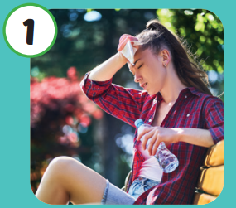



Click on the right word
Warm
Hot

Slide 5
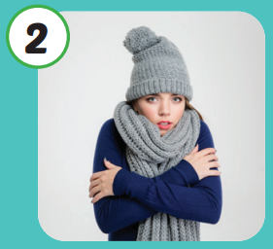
Click on the right word
Cold
Stormy

Slide 6

Click on the right word
Hot
Warm

Slide 7
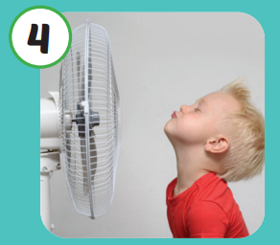
Click on the right word
Cool
Freezing

Slide 8

It’s time to learn …

Slide 9

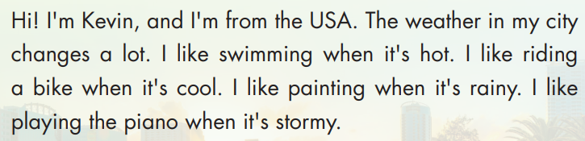
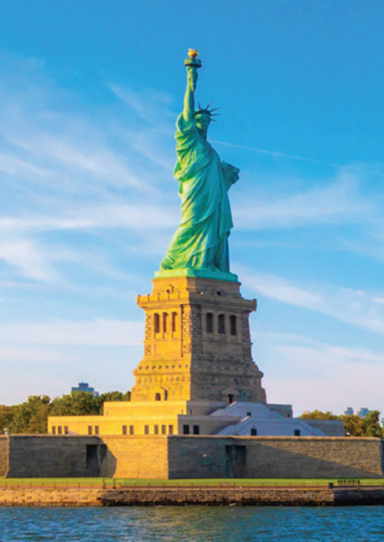
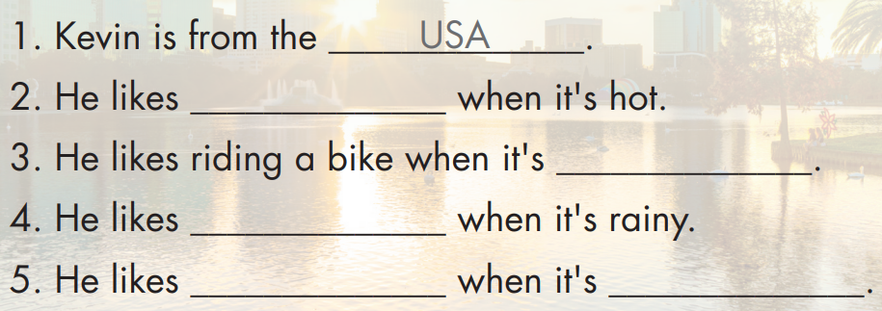
swimming
cool
painting
playing the piano
stormy

Slide 10


Hi! I’m Kevin, and I’m form the USA. The weather in my city changes a lot. I like swimming when it’s hot. I like riding a bike when it’s cool. I like painting when it’s rainy. I like playing the piano when it’s stormy.

Slide 11


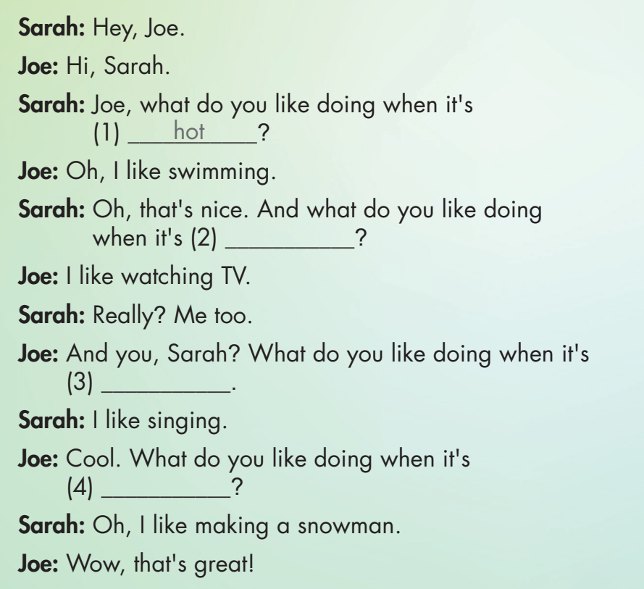

Slide 12

rainy
stormy
freezing

Slide 13

Practice

Slide 14



Hey, what do you like when it’s hot
Oh, I like swimming.
Really? Me too.

Slide 15
Hey, what do you like when it’s warm
Oh, I like go for a walk.
Really? I like playing soccer.

Slide 16
Hey, what do you like when it’s freezing
Oh, I like making a snowman.
That’s great

Slide 17
Hey, what do you like when it’s stormy
Oh, I like listening music
Cool! I like watching TV.

Slide 18
Hey, what do you like when it’s cold
Oh, I like sleeping.
That’s sound great.

Slide 19
Hey, what do you like when it’s cool
Oh, I like flying a kite
Really? Me too.

Slide 20

CONSOLIDATION

Slide 21

WRAP-UP

Slide 22
Today’s lesson
Vocabulary
Hot
Cold
Warm
Cool
Freezing
Stormy
Structures/ Sentence patterns
What do you like doing when it's hot?
I like swimming.

Slide 23
Homework
Practice the vocabularies and structure; and make sentences using them.
Do the exercises in Tiếng Anh 4 i-Learn Smart Start WB (page 29).
Do the exercises in Tiếng Anh 4 i-Learn Smart Start Notebook (page 19).
Prepare the next lesson (page 45 SB).
Play the consolidation games in Tiếng Anh 4 i-Learn Smart Start DHA App on www.eduhome.com.vn

Slide 24

Have a nice day!

