Slide 1

Unit 3: WEATHER
Lesson 4.1
Page 43

Slide 2
Objectives
By the end of this lesson, students will be able to the weather like today.
Vocabulary: Cold, Hot, Warm, Freezing, Cool, Stormy
Structure: What do you like doing when it's hot?
I like swimming.

Slide 3

WARM UP

Slide 4

Vocabulary

Slide 5

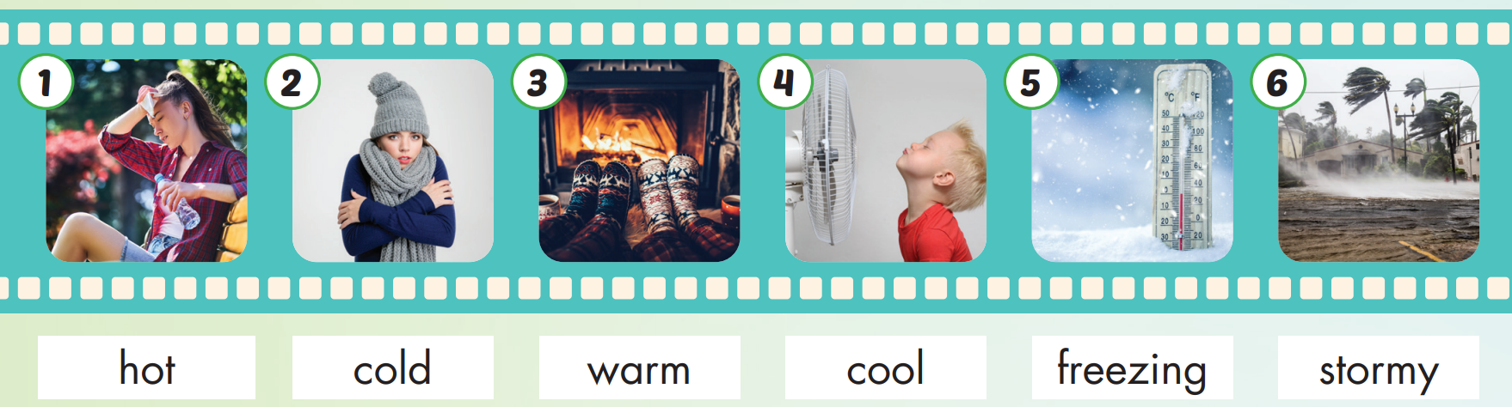

Slide 6

Practice

Slide 7

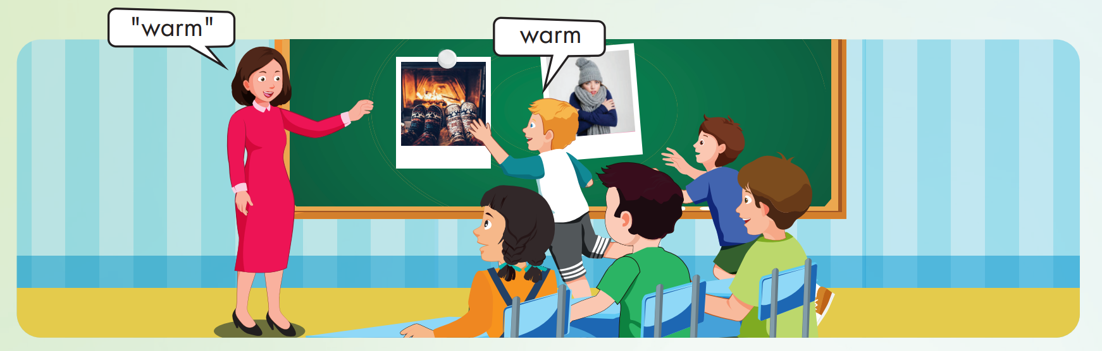

Slide 8
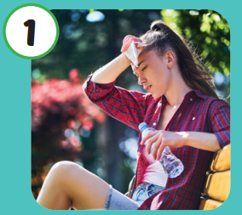

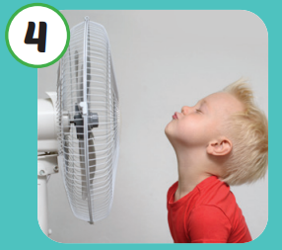
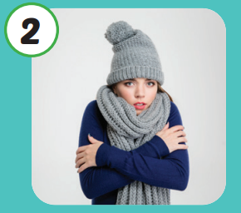
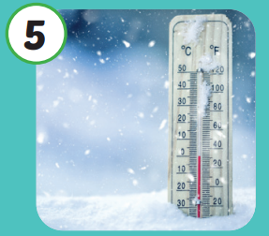

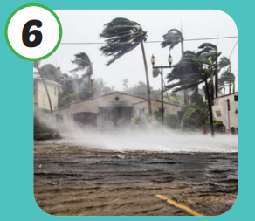
Hot
Cool
Cold
Freezing
Warm
Stormy

Slide 9

Structure

Slide 10

Structures
What do you like
doing when it's hot?
I like swimming.

Slide 11



What do you like doing when it's hot?
I like swimming.

Slide 12

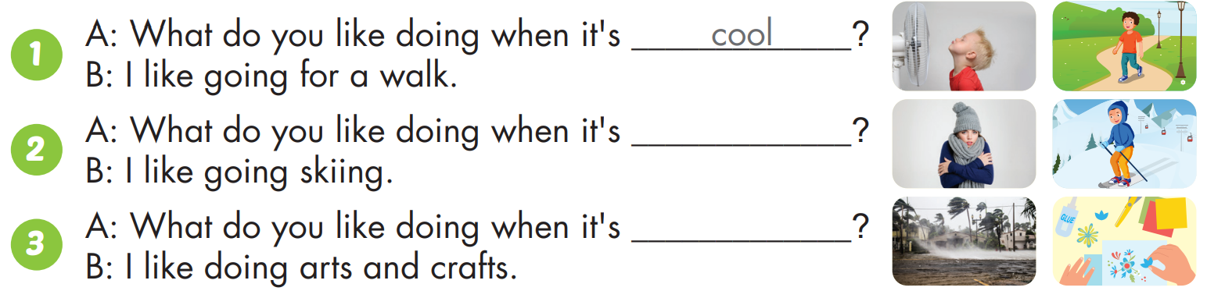
cold
stormy

Slide 13
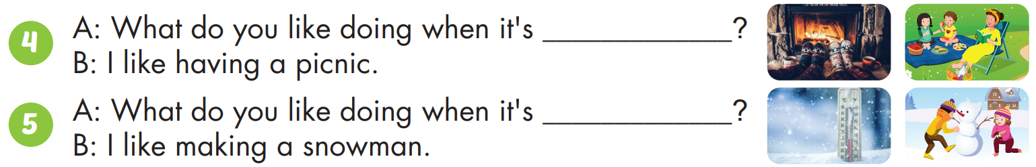
warm
freezing

Slide 14

CONSOLIDATION

Slide 15

WRAP-UP

Slide 16
Lesson 3
Today’s lesson
Vocabulary
Hot
Cold
Warm
Cool
Freezing
Stormy
Structures/ Sentence patterns
What do you like doing when it's hot?
I like swimming.

Slide 17
Homework
Practice the vocabularies and structure; and make sentences using them.
Do the exercises in Tiếng Anh 4 i-Learn Smart Start WB (page 28).
Do the exercises in Tiếng Anh 4 i-Learn Smart Start Notebook (page 19).
Prepare the next lesson (page 44 SB).
Play the consolidation games in Tiếng Anh 4 i-Learn Smart Start DHA App on www.eduhome.com.vn

Slide 18

Have a nice day!

