Slide 1
Unit 11: What’s the matter with you?
Lesson 2 (page 8+9)

Slide 2
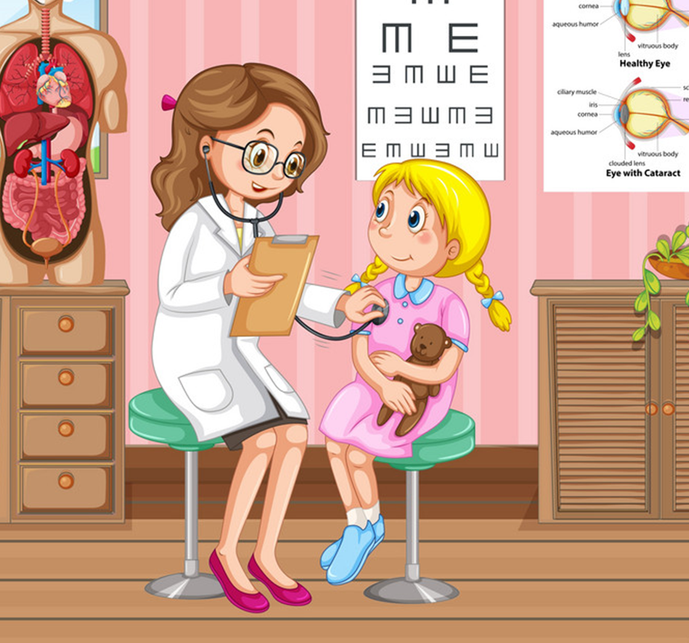
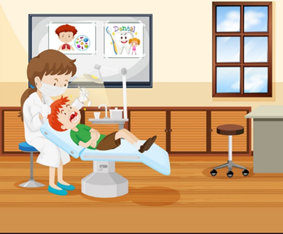
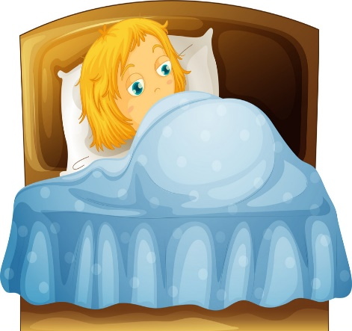
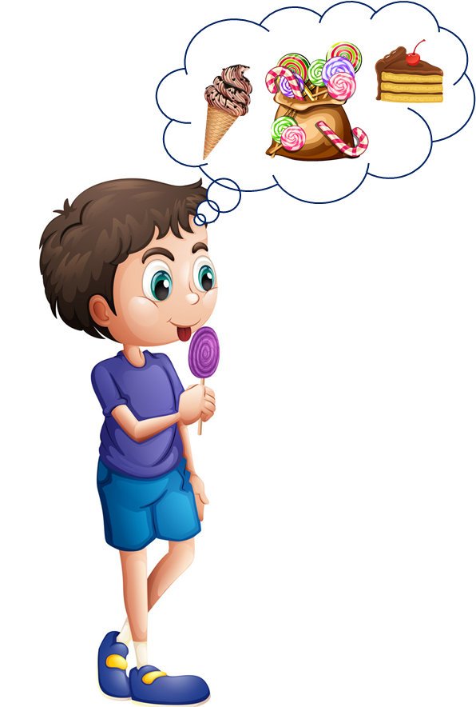
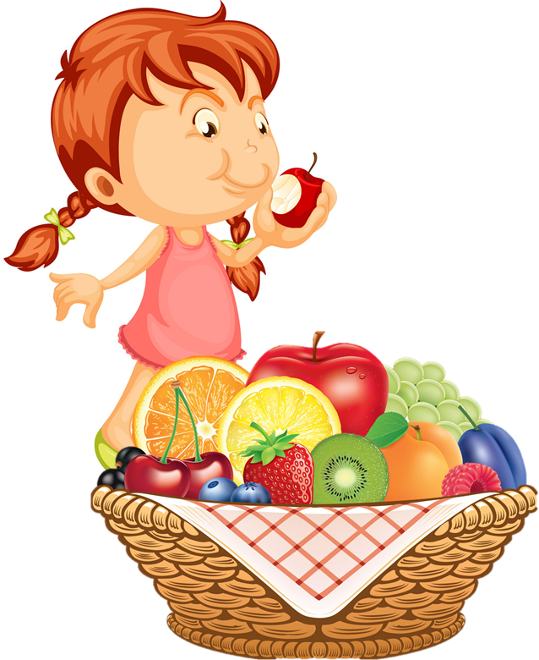
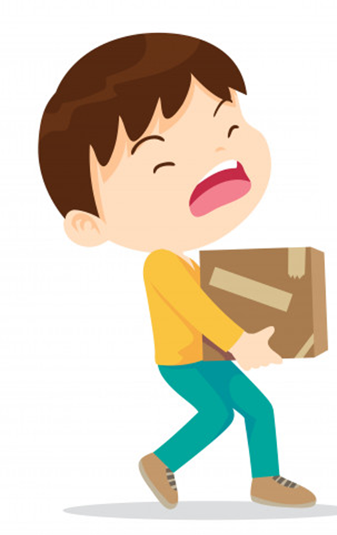
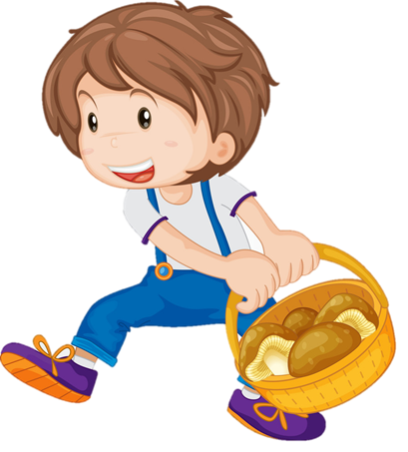
Vocabulary
1
2
3
go to the doctor
go to the dentist
take a rest
4
5
6
eat a lot of sweets
eat a lot of fruit
carry heavy things

Slide 3
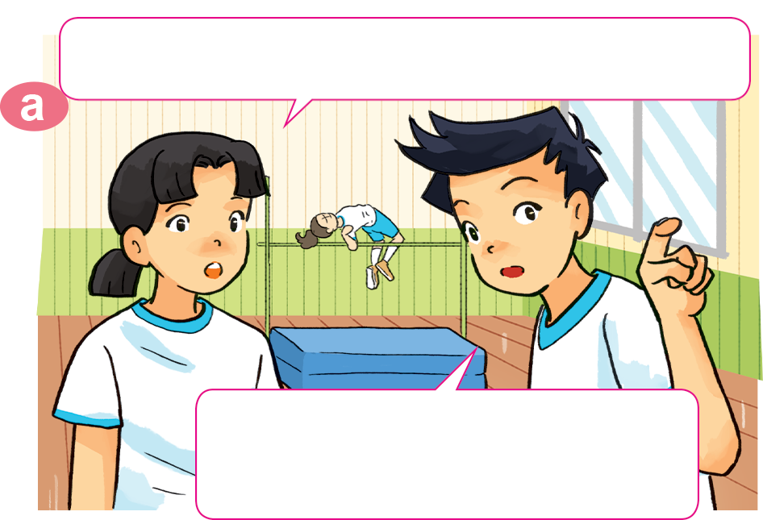
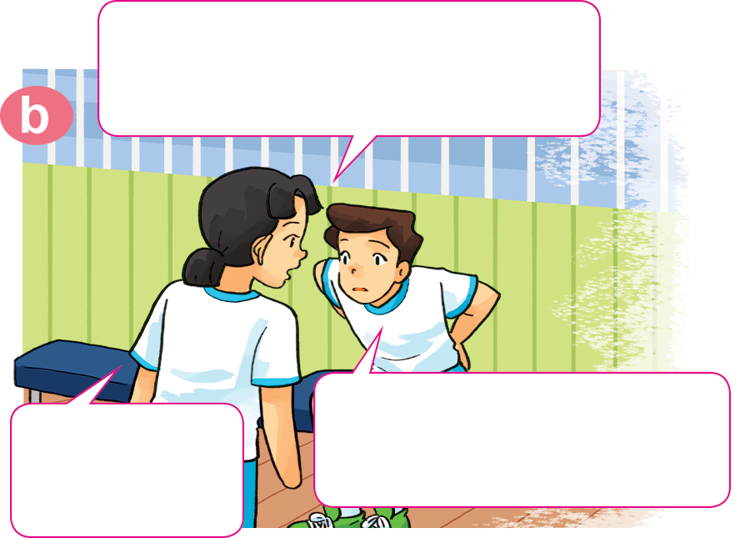
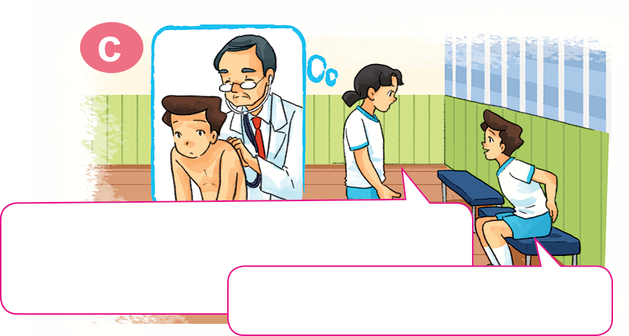
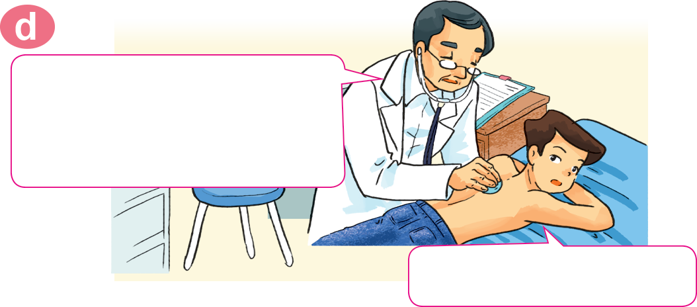
1. Look, listen and repeat.
Where's Nam? I can't see him here.
Hi, Nam. Why aren't you
practising karate?
I don't feel well.
I have a backache.
He's sitting over there,
in the corner of the gym.
Sorry to
hear that.
You should take a rest and shouldn't play
sports for a few days.
You should go to the doctor
now, Nam.
OK, I will. Thanks, Mai.
Thank you, doctor.

Slide 4

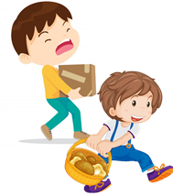
Temperature
/ˈtemprətʃər/
Model sentence
You should/shouldn’t _____________.
Yes, I will. Thanks.
OK, I won't. Thanks
go to the
doctor
take a rest
carry
heavy things
eat a lot of
sweets
go to the
dentist
eat a lot
of fruit
Earache
/ˈɪəreɪk/

Slide 5
2. Point and say.
A
go to the doctor
You should __________________.
Yes, I will. Thanks.

Slide 6
2. Point and say.
B
go to the dentist
You should __________________.
Yes, I will. Thanks.

Slide 7
2. Point and say.
C
take a rest
You should __________________.
Yes, I will. Thanks.

Slide 8
2. Point and say.
D
eat a lot of fruit
You should __________________.
Yes, I will. Thanks.

Slide 9
2. Point and say.
E
carry heavy things
You shouldn’t ____________________.
Ok, I won’t. Thanks.

Slide 10
2. Point and say.
F
You shouldn’t ____________________.
eat a lot of sweets
Ok, I won’t. Thanks.

Slide 11

4. Listen and complete.
 | Health problem | Should | Shouldn't
1. Quan
2. Tony
3. Phong
4. Mrs Green
go to
the doctor
stomach ache
fever
go to school
toothache
eat ice cream
carry
heavy things
backache

Slide 12
5. Read and complete, then say aloud (page 9).
Quan: Where's Phong?
Mai: He can't go to school today.
Quan: Why not? What's the (1) _________ with him?
Mai: He (2) _______ a bad cough and is going to see the (3) __________ this morning.
Quan: Oh, really? Poor him!
Mai: What's the matter with you, Tony?
Tony: I have a pain in my (4) __________ .
Mai: Oh, dear. You should take a (5) ______ now and go to the doctor later.
Tony: Yes, I will. Thanks, Mai.
stomach
doctor
matter
rest
has
matter
has
doctor
stomach
rest

