Slide 1
Unit 11: What’s the matter with you?
Period 37: Lesson 1 (page 6+7)

Slide 2
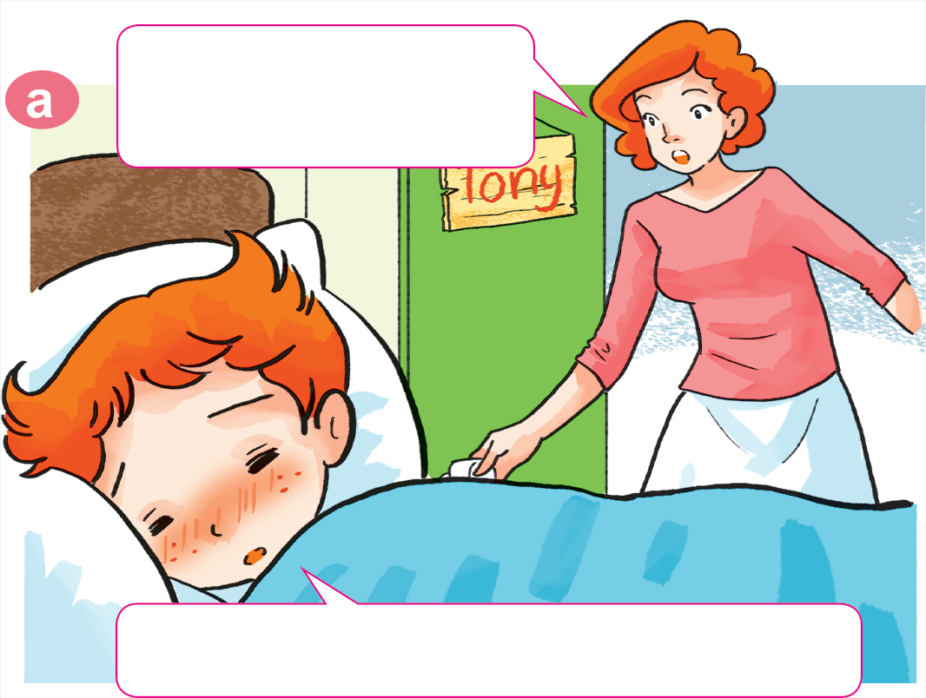
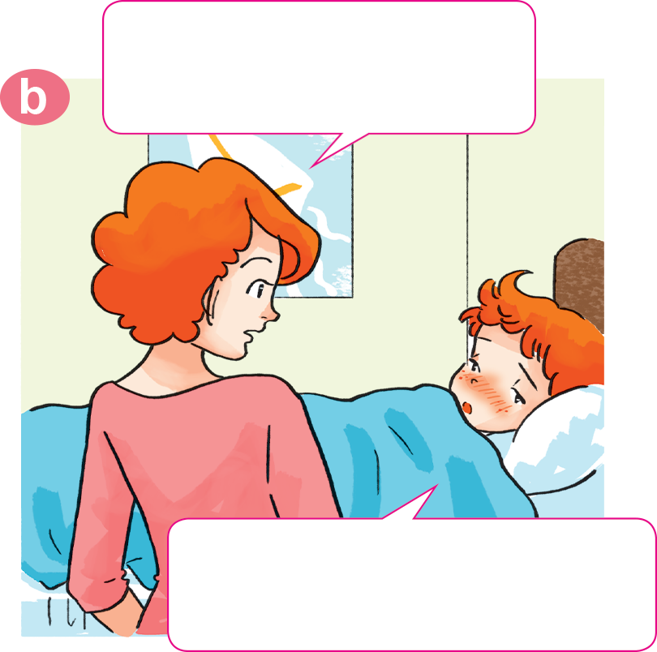
1. Look, listen and repeat.
Why not? What's the
matter with you?
Tony, get up!
Breakfast's ready.
I don't feel well.
I have a headache.
Sorry, I can't have breakfast, Mum.

Slide 3
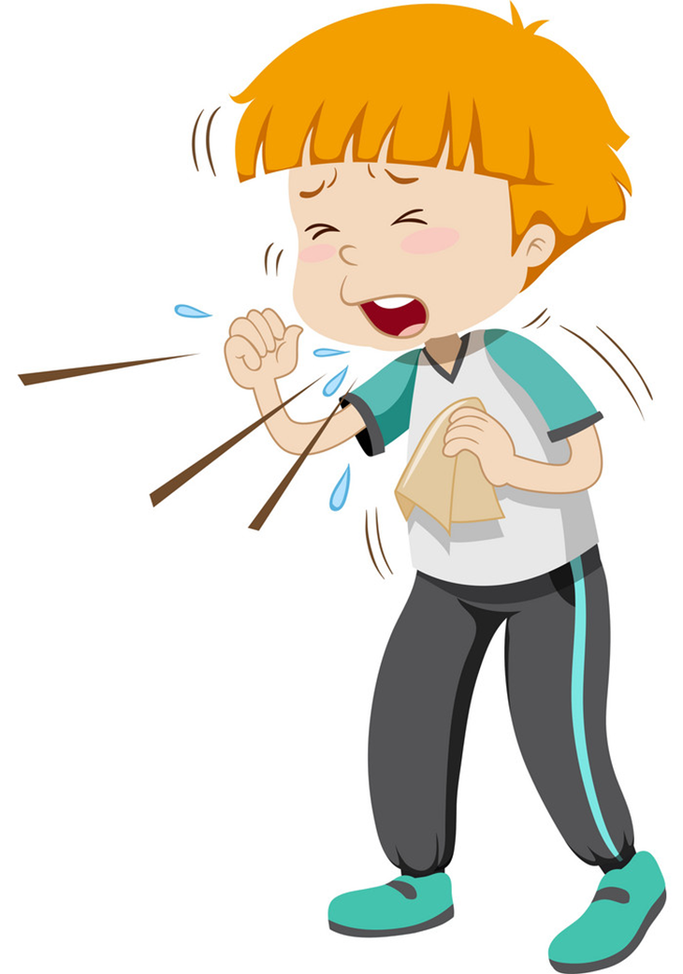
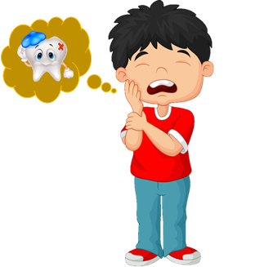
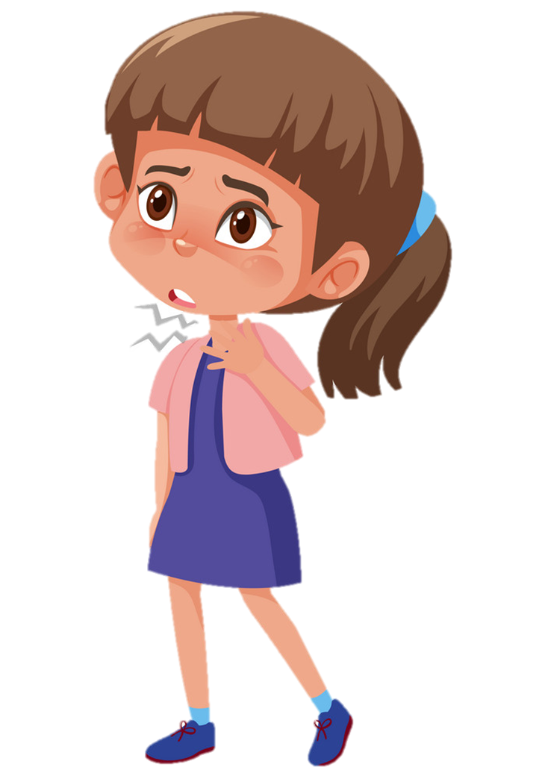
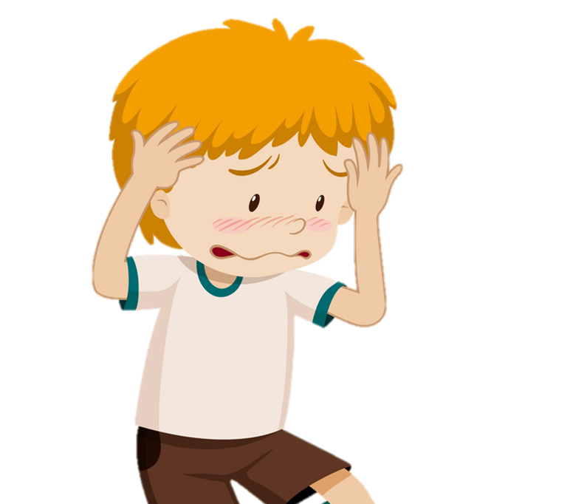
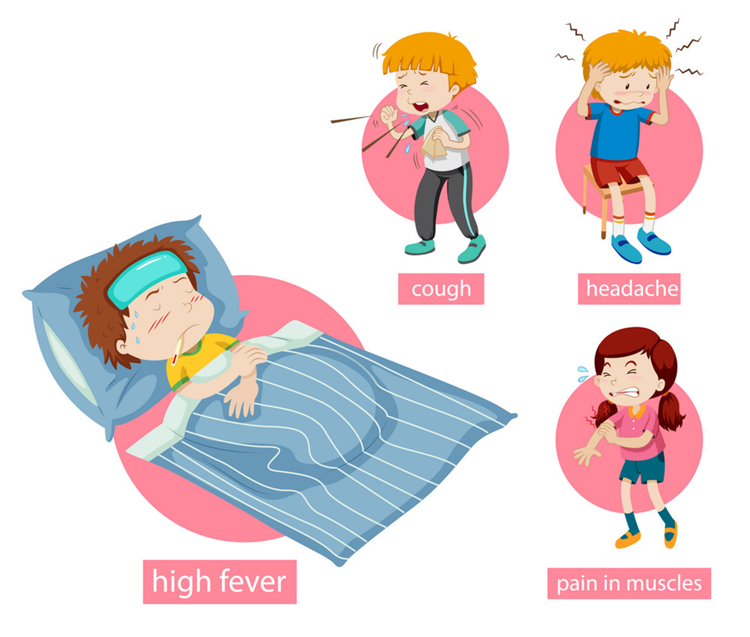
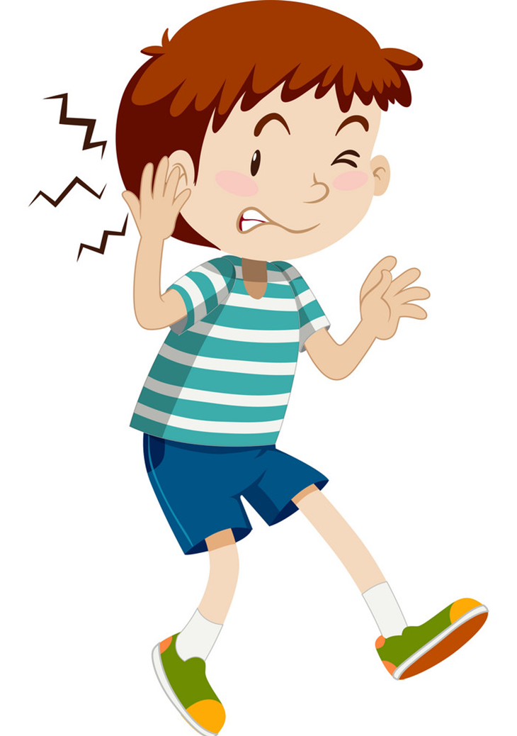
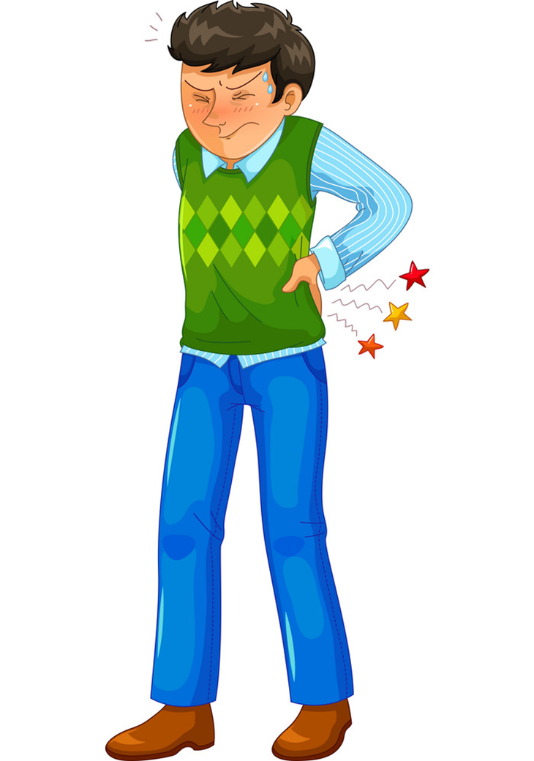
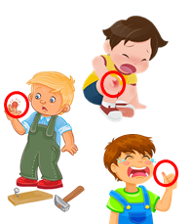
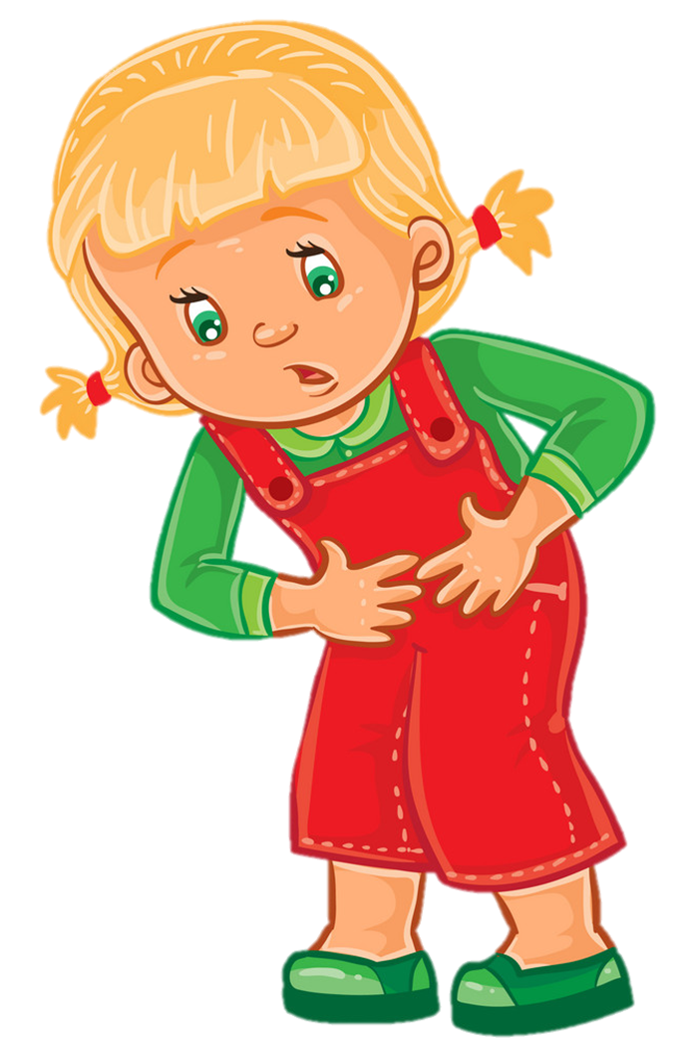
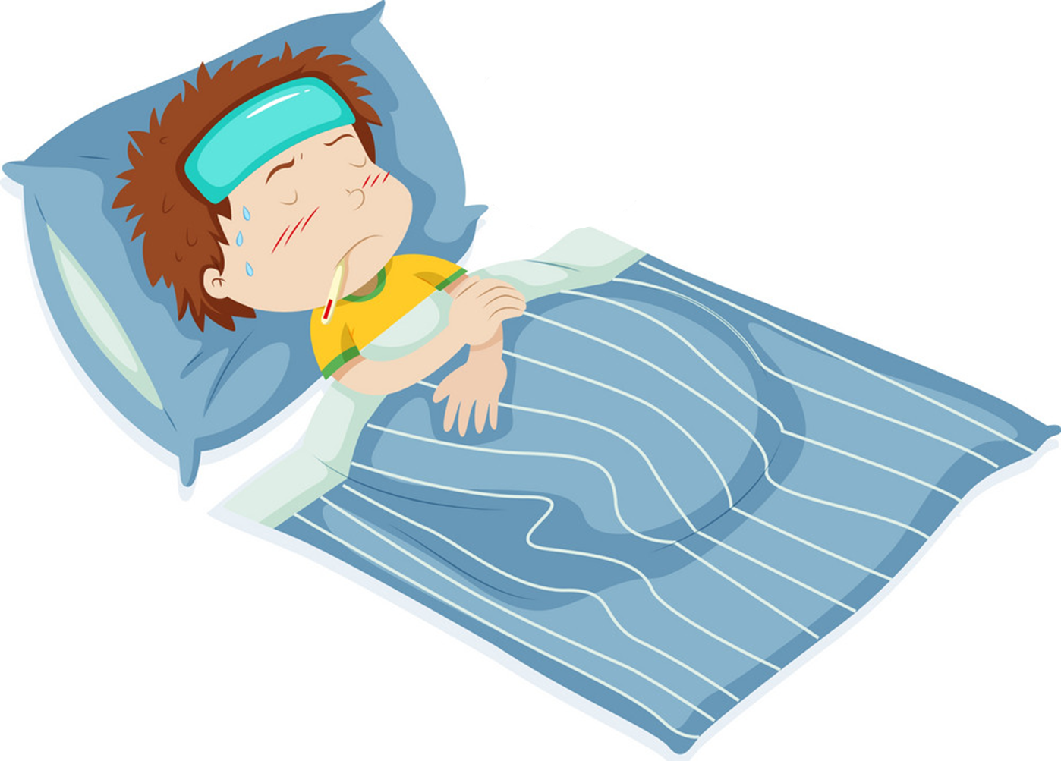
Temperature
/ˈtemprətʃər/
Model sentence
cough
toothache
sore throat
flu
headache
What's the matter with you?
I have a/an ______________.
earache
backache
pain
stomach ache
fever
Earache
/ˈɪəreɪk/

Slide 4
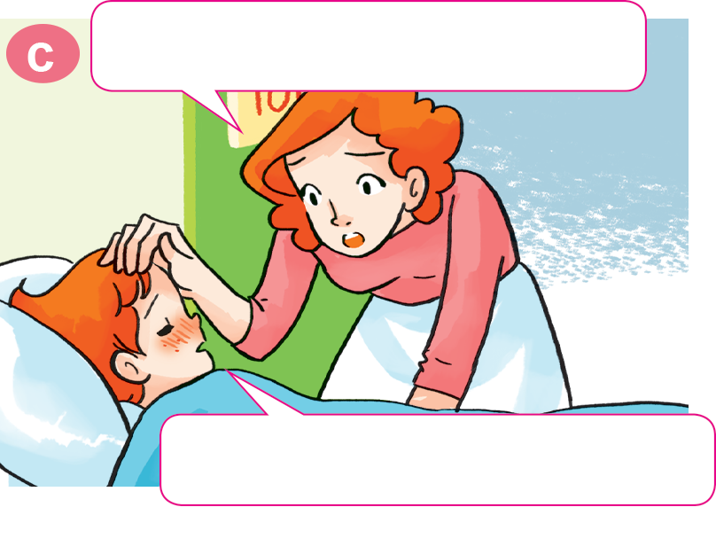
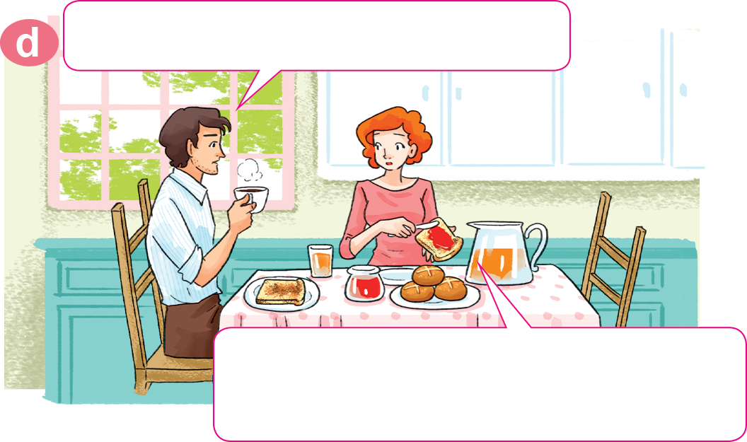
1. Look, listen and repeat.
Oh, you have a fever, too.
What's the matter with Tony?
He has a fever. I'll take him to
the doctor after breakfast.
Yes, Mum. I feel very hot.

Slide 5
2. Point and say.
What's the matter with you?
I have a toothache.
___________________

Slide 6
2. Point and say.
What's the matter with you?
I have an earache.
___________________.

Slide 7
2. Point and say.
What's the matter with you?
I have a sore throat.
___________________.

Slide 8
2. Point and say.
What's the matter with you?
I have a stomach ache.
___________________.

Slide 9


4. Listen and tick.
 | headache | sore throat | toothache | stomach ache
1. Nam
2. Peter
3. Linda
4. Tony

Slide 10
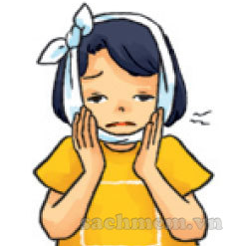
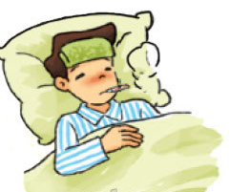
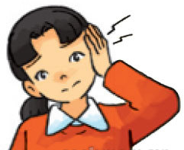
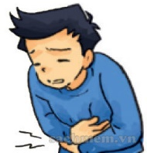
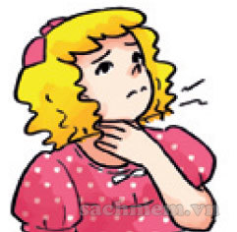
5. Read and complete.(page 7)
1. She has a pain in her tooth.
She has a toothache.
2. Nam has a high temperature.
He has a fever.
3. Mai has a pain in her ear.
She has an earache.
4. Quan has a pain in his stomach.
He has a stomach ache.
5. Linda has a pain in her throat.
She has a sore throat.
________________
a stomach ache
a toothache
a sore throat
a fever
an earache
_______
_______________
_______________
_______________

