Slide 1
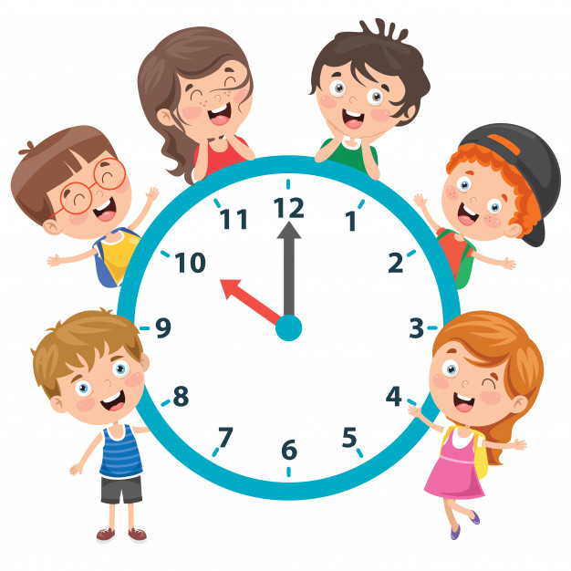
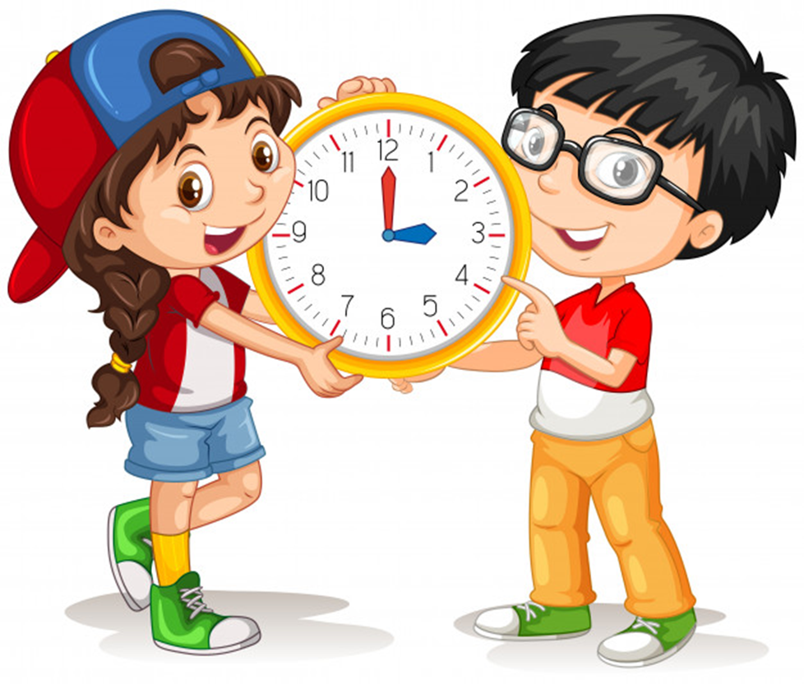
Unit 11: What time is it?
Period 37: Lesson 1 (page 6+7)

Slide 2
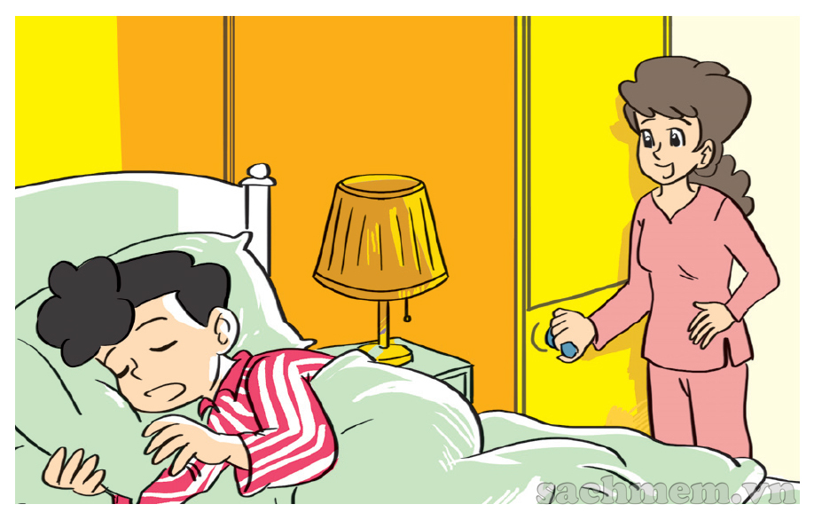
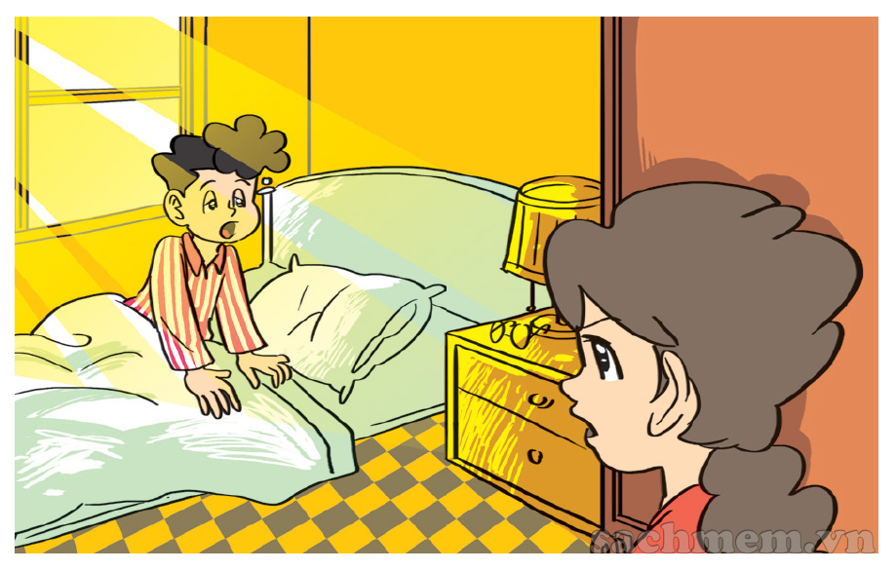
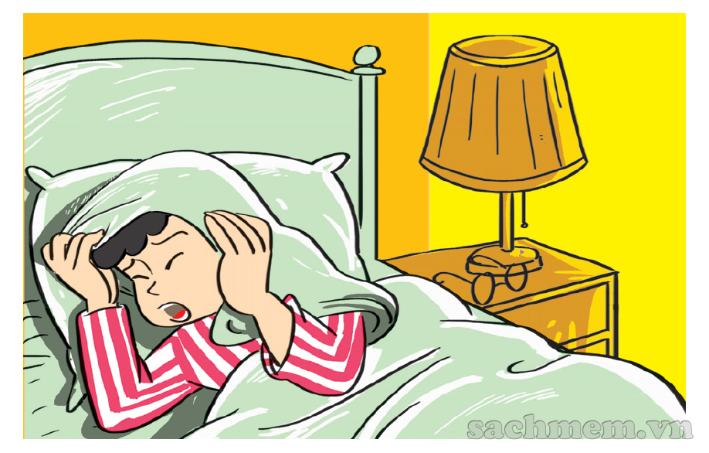
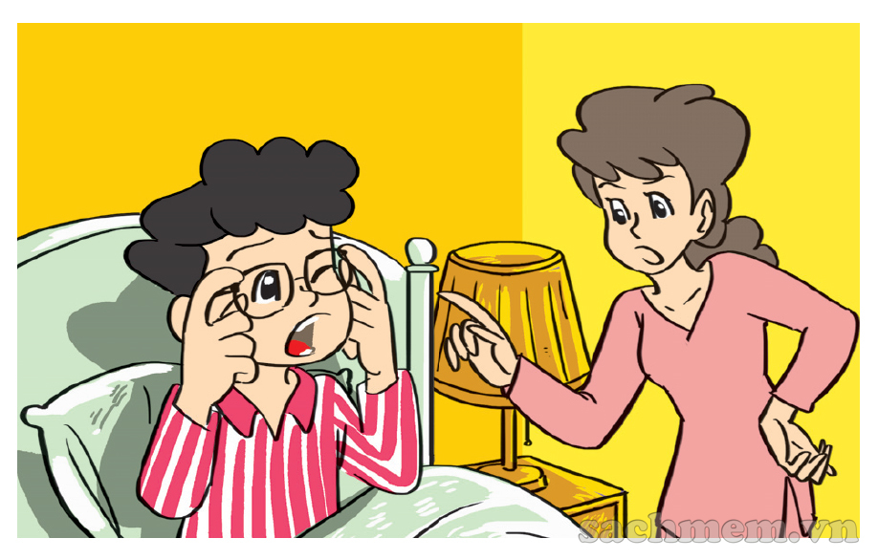

1. Look, listen and repeat.
What time is it, Mum?
It's time to get up, Phong.
It's seven o'clock.
Today's Sunday and I
don't have to go to school.
But it's time
for breakfast.
Oh, yes, Mum.

Slide 3
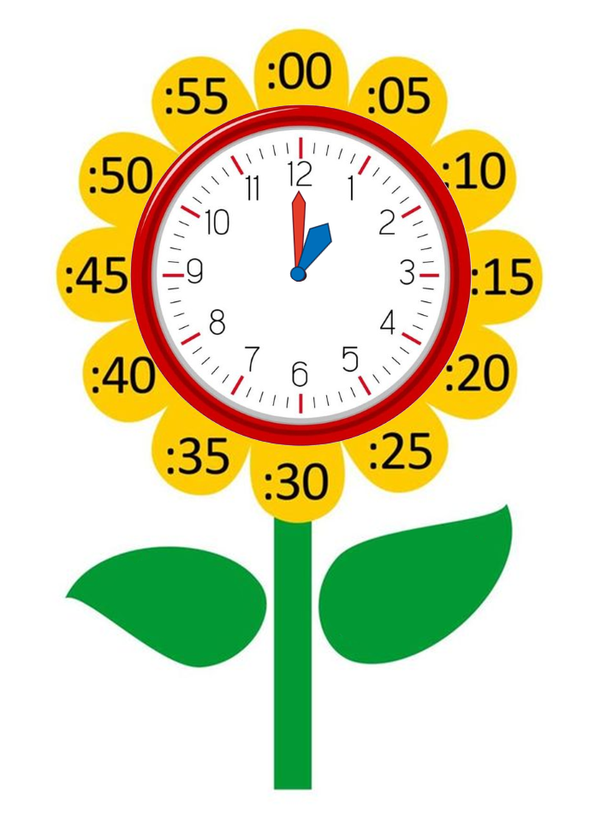
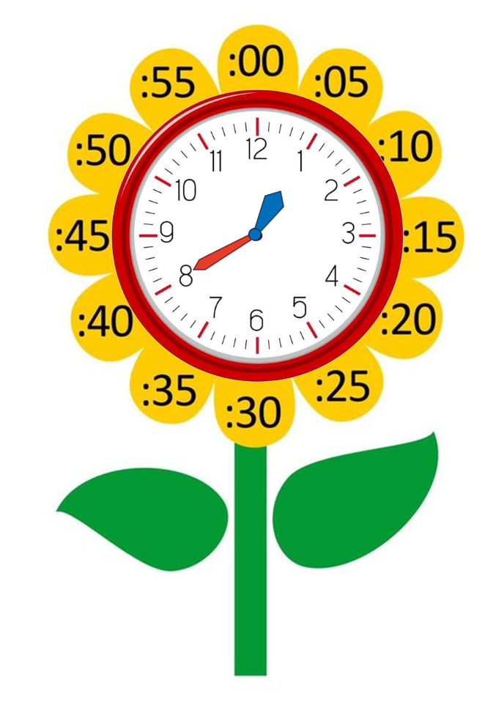
Model sentence
What time is it?
It's + số giờ + o’clock.
It's one o’clock.
It's + số giờ + số phút.
It's one forty.

Slide 4
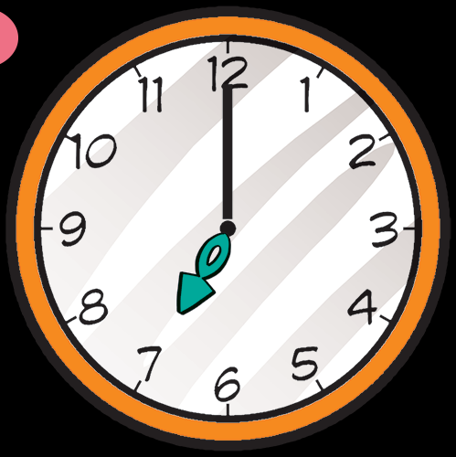
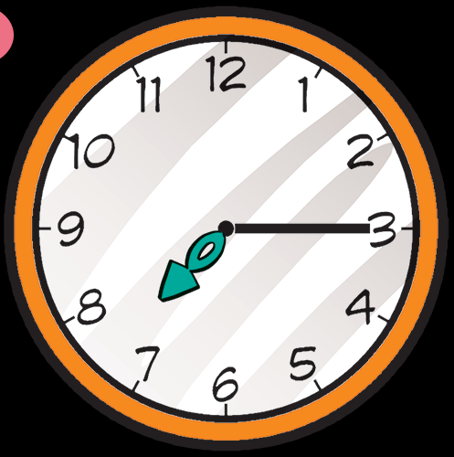
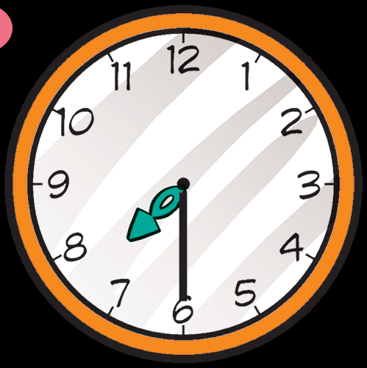
2. Point and say.
What time is it?
It's __________
It's __________
It's __________
seven o’clock.
seven fifteen.
seven thirty.

Slide 5
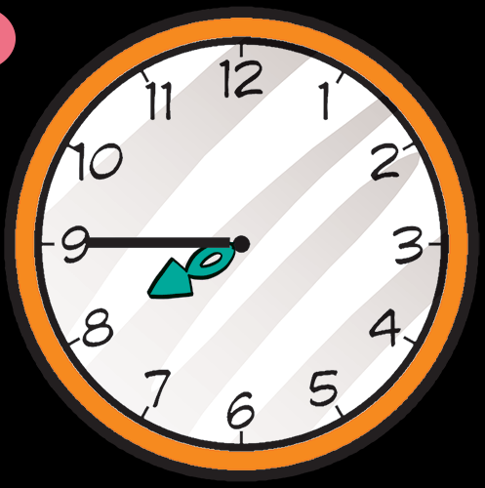
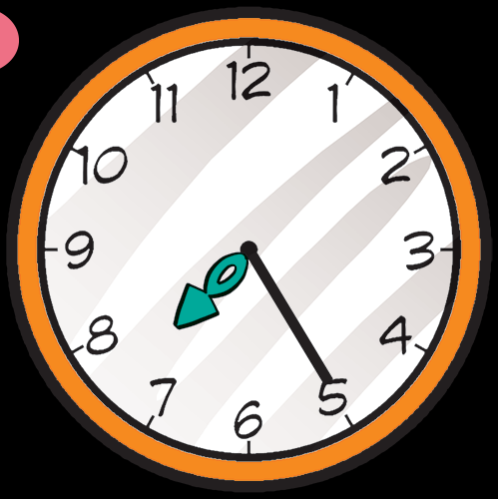
2. Point and say.
What time is it?
It's ____________.
It's ______________.
seven forty-five
seven twenty-five

Slide 6
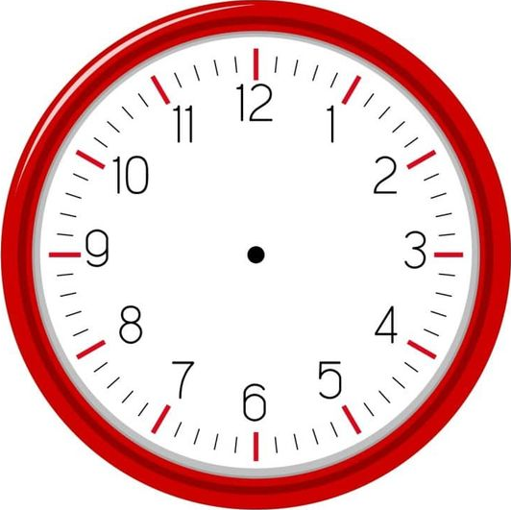


3. Listen and tick.
a
b
c
1

Slide 7
3. Listen and tick.
a
b
c
2

Slide 8
3. Listen and tick.
a
b
c
3

Slide 9
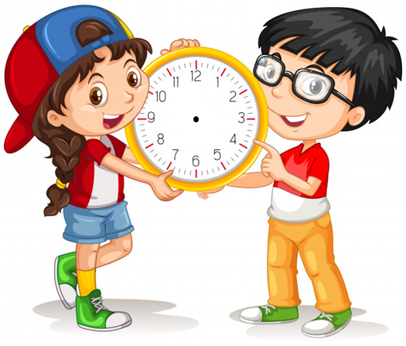
4. Look and write.(page 7)
1. What time is it?
2. What time is it?
It's four o’clock.
It's ten twenty.

Slide 10
4. Look and write
3. What time is it?
4. What time is it?
It's ten thirty.
It's eleven fifty.

