Slide 1

Unit 2: Family
Lesson 2.2
Page 28

Slide 2
Lesson Outline
Warm-up
Listening
Consolidation
Wrap-up

Slide 3
Objectives
By the end of this lesson, students will be able to introduce family members.
Phonics: /ð/
Structure: Who's he?
        He’s my brother.
        What's his name?
        His name’s Alex.

Slide 4
Let’s chant!

Slide 5
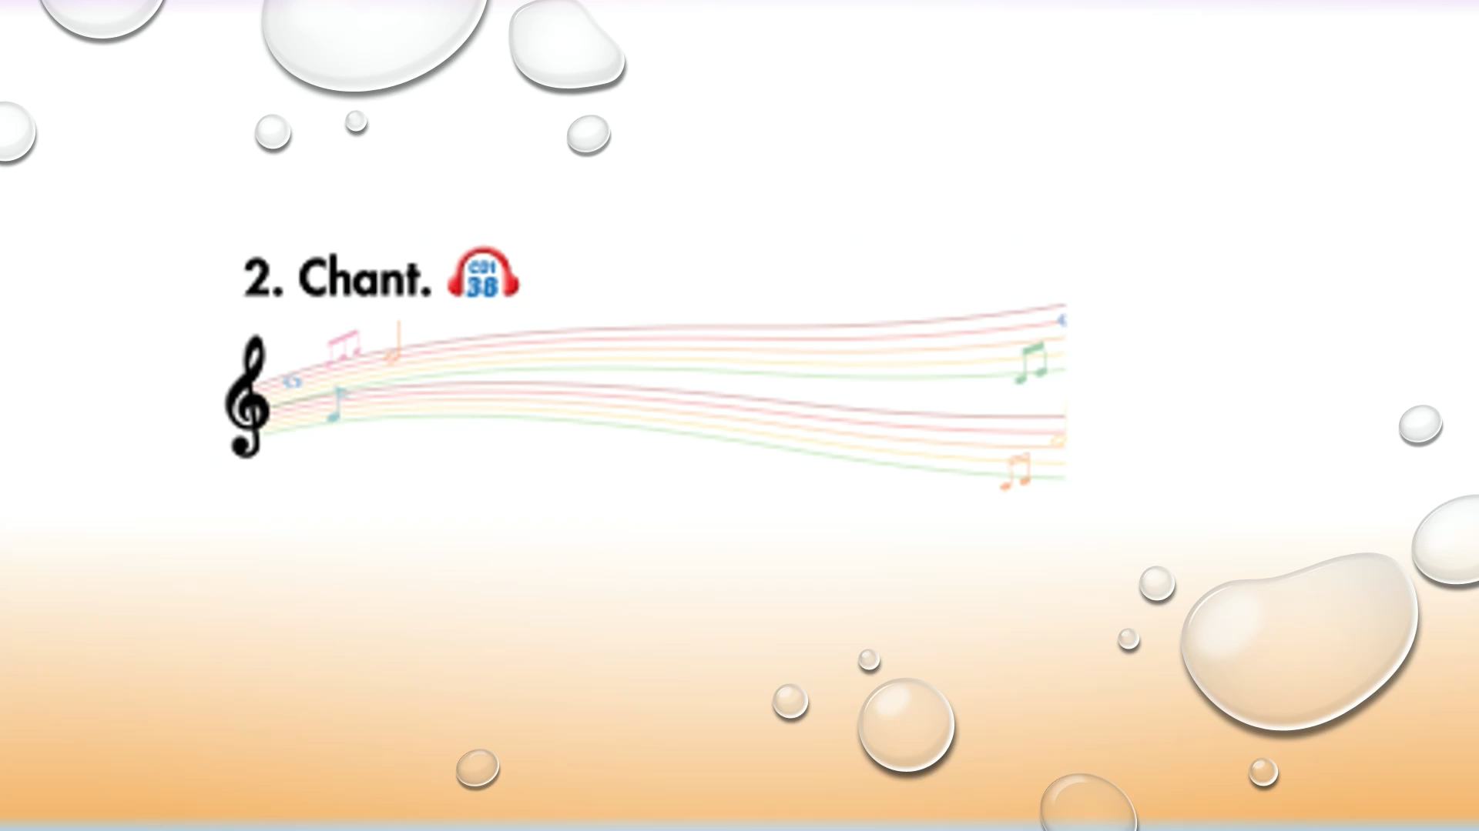

Slide 6

WARM UP

Slide 7
Let’s play!

Slide 8
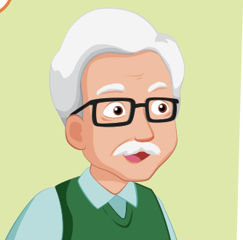
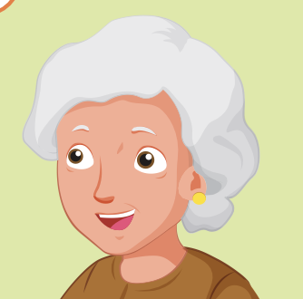
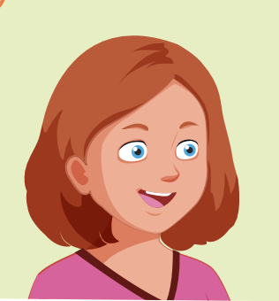
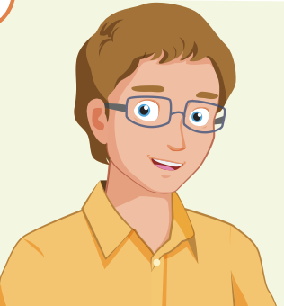
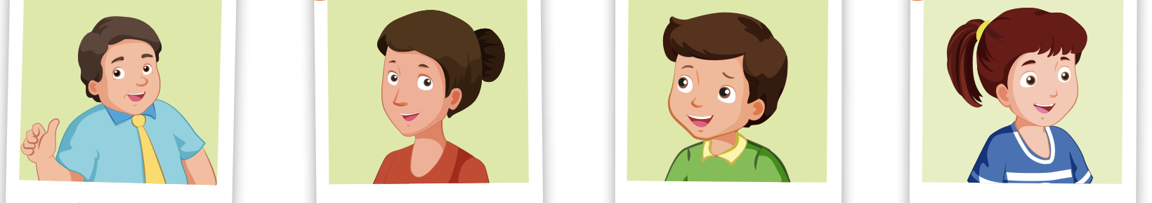

FAMILY

Slide 9
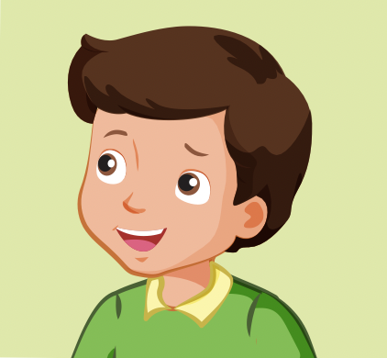


Who is he?
GREAT
brother
father
sister

Slide 10
Who is he?
GREAT
father
grandfather
uncle

Slide 11
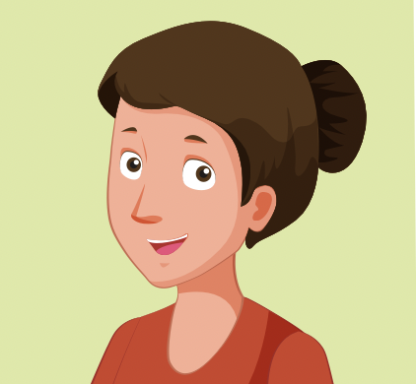
Who is she?
GREAT
father
sister
mother

Slide 12
Who is she?
GREAT
aunt
sister
mother

Slide 13
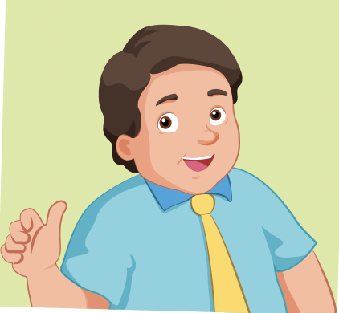
Who is he?
GREAT
brother
father
sister

Slide 14
Who is she?
GREAT
aunt
grandmother
father

Slide 15
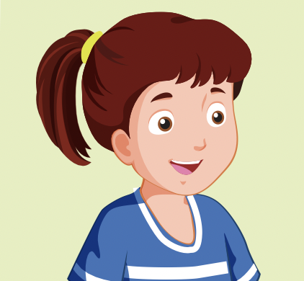
Who is she?
GREAT
father
mother
sister

Slide 16
Who is he?
GREAT
uncle
brother
father

Slide 17

Presentation

Slide 18

Phonics
/ð/

Slide 19
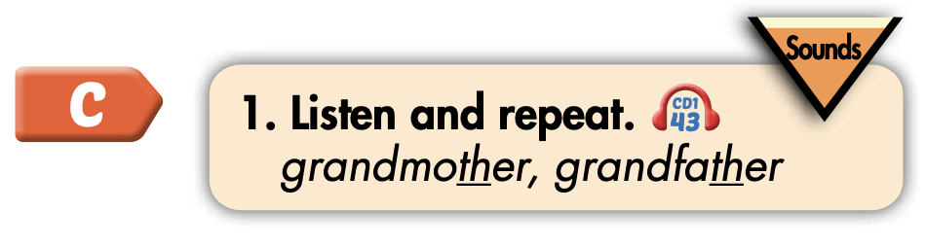
Click on the icon to hear the sound
grandmother
grandfather
/ð/
/ð/

Slide 20

Practice

Slide 21
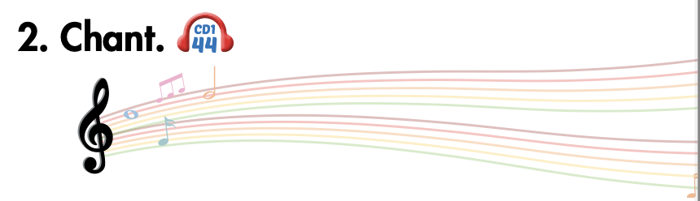
Listen and point
Listen and clap
Listen and chant

Slide 22
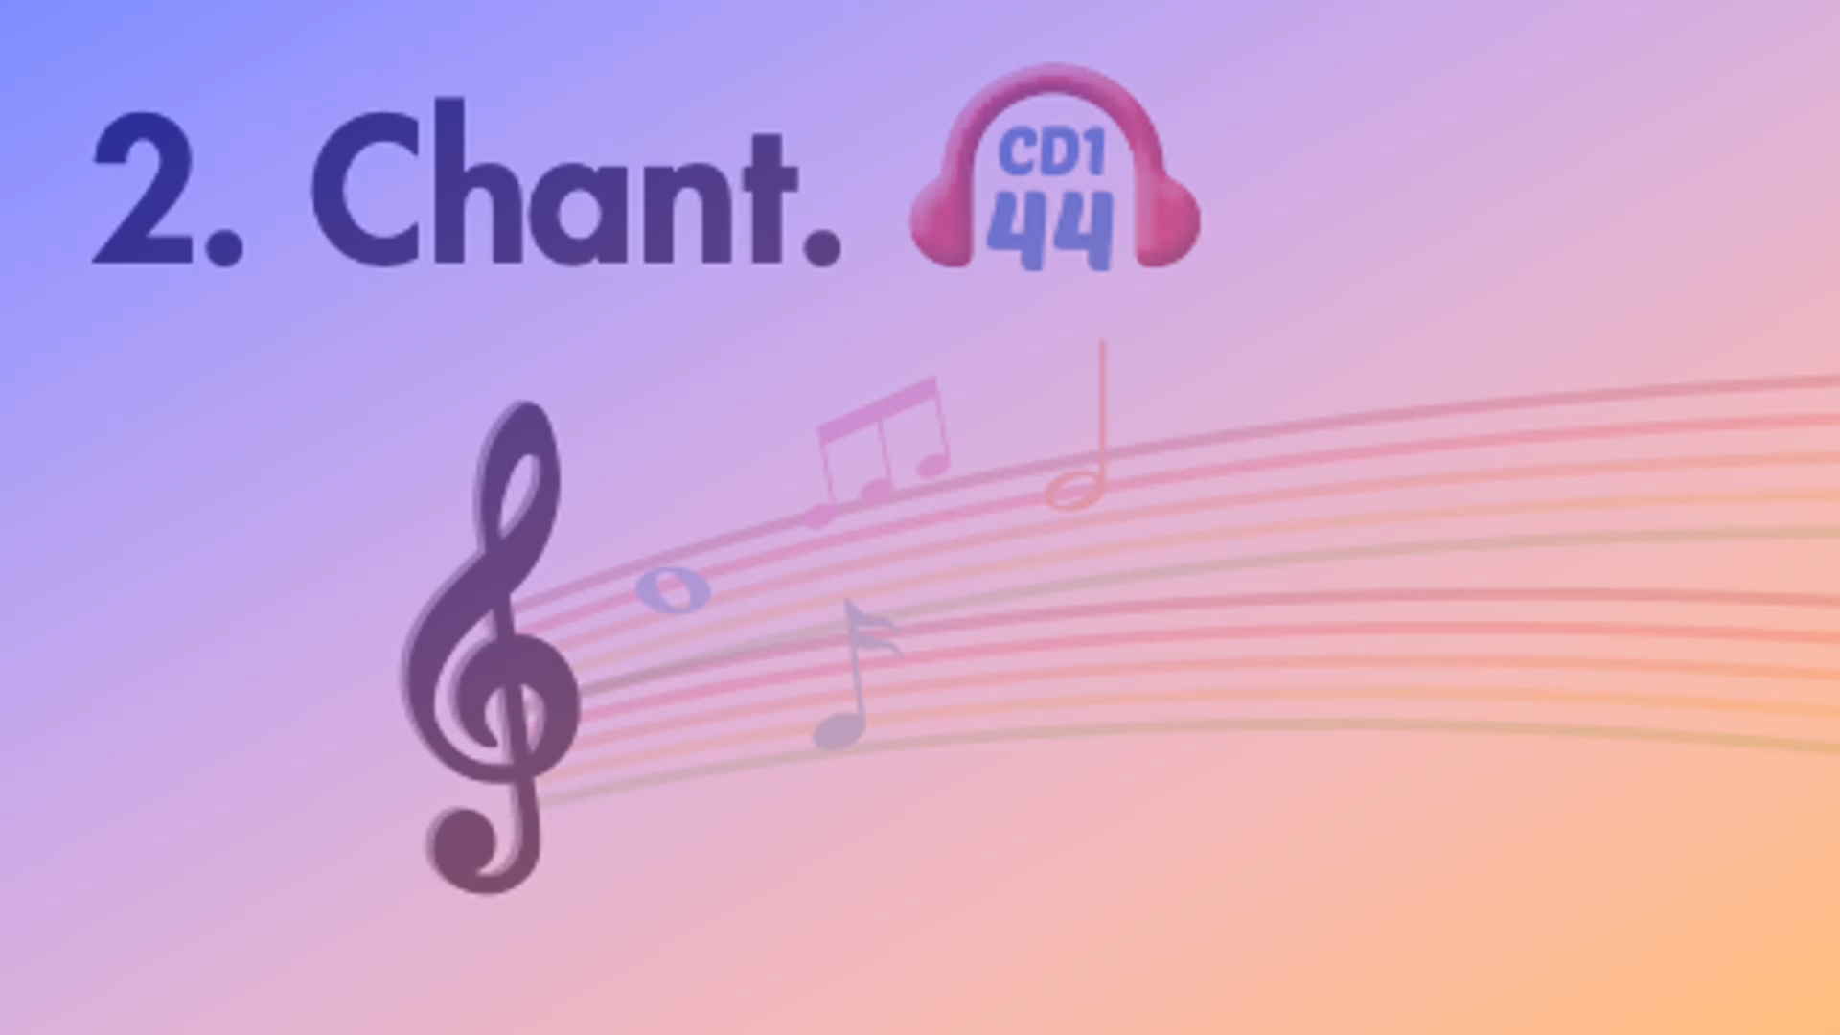

Slide 23

Listening

Slide 24
Pre-Listening
Look at the pictures and answer these questions.

Slide 25
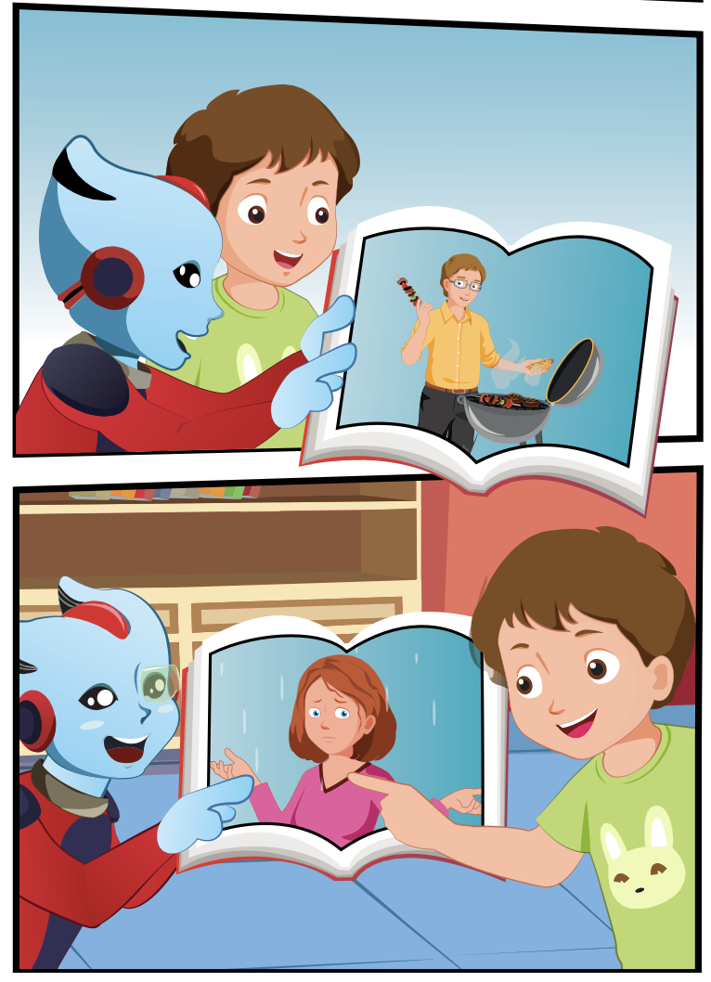
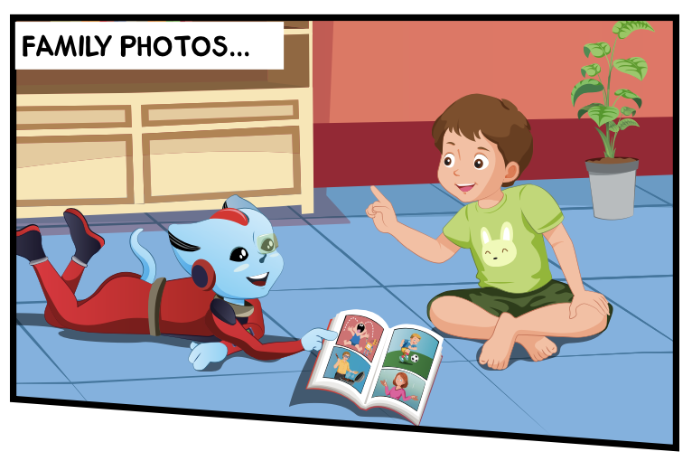
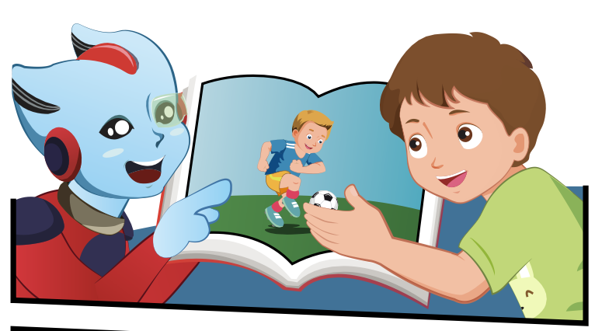
Who are the people in the photos?
What photos do they look at?
Who can you see?
3.
1.
4.
2.

Slide 26


While-Listening
3.
1.
4.
2.

Slide 27

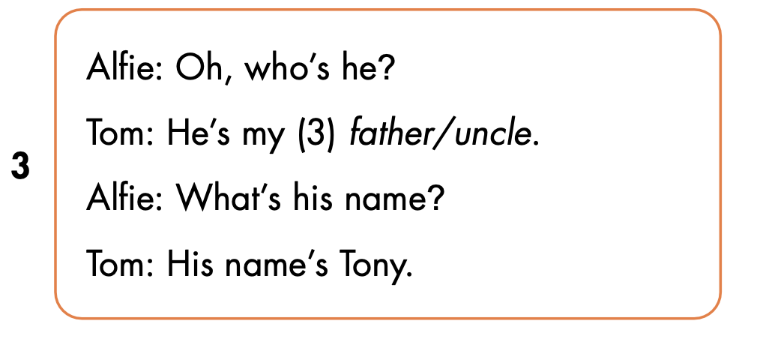
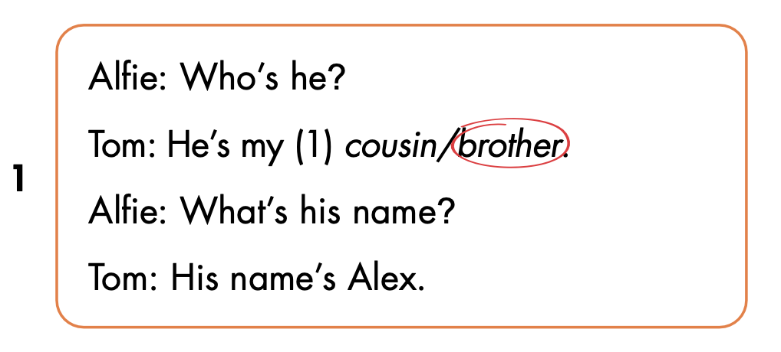
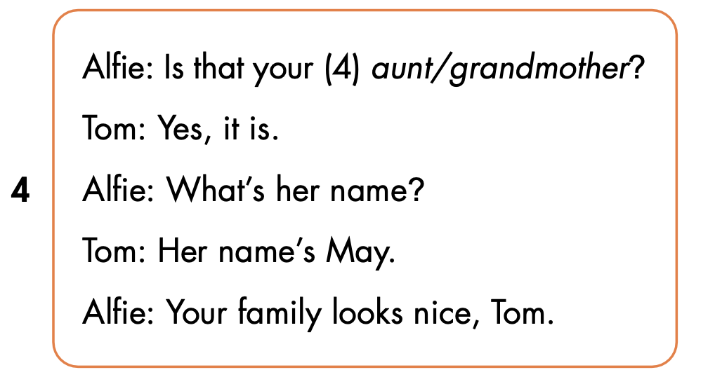
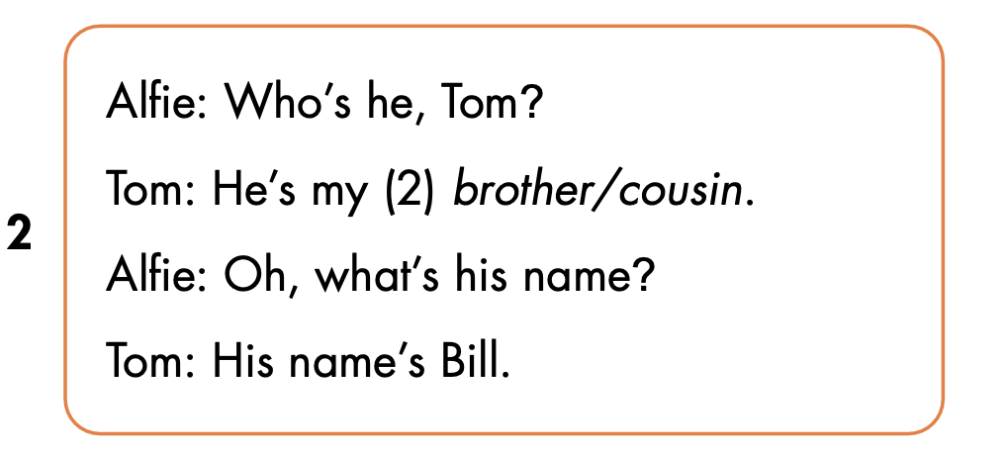

Slide 28
Let’s check!

Slide 31

Speaking

Slide 32
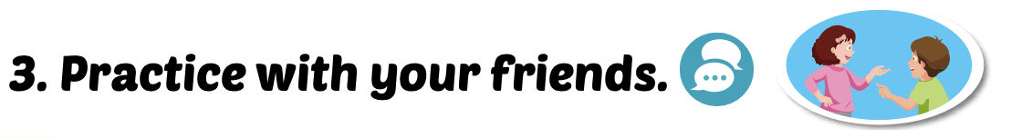

Slide 33

CONSOLIDATION

Slide 34
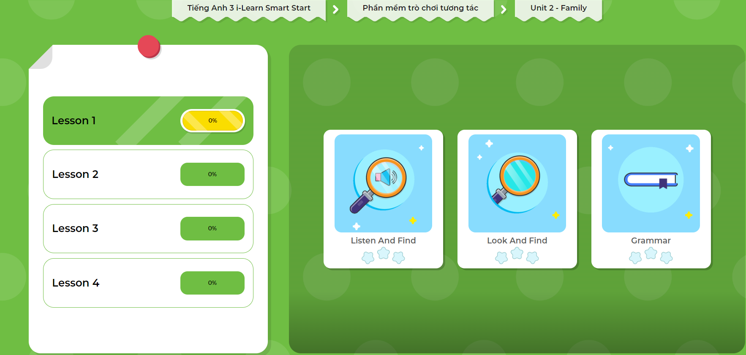
Extra Practice
DHA App
Let’s play!
Click on the picture below

Slide 35

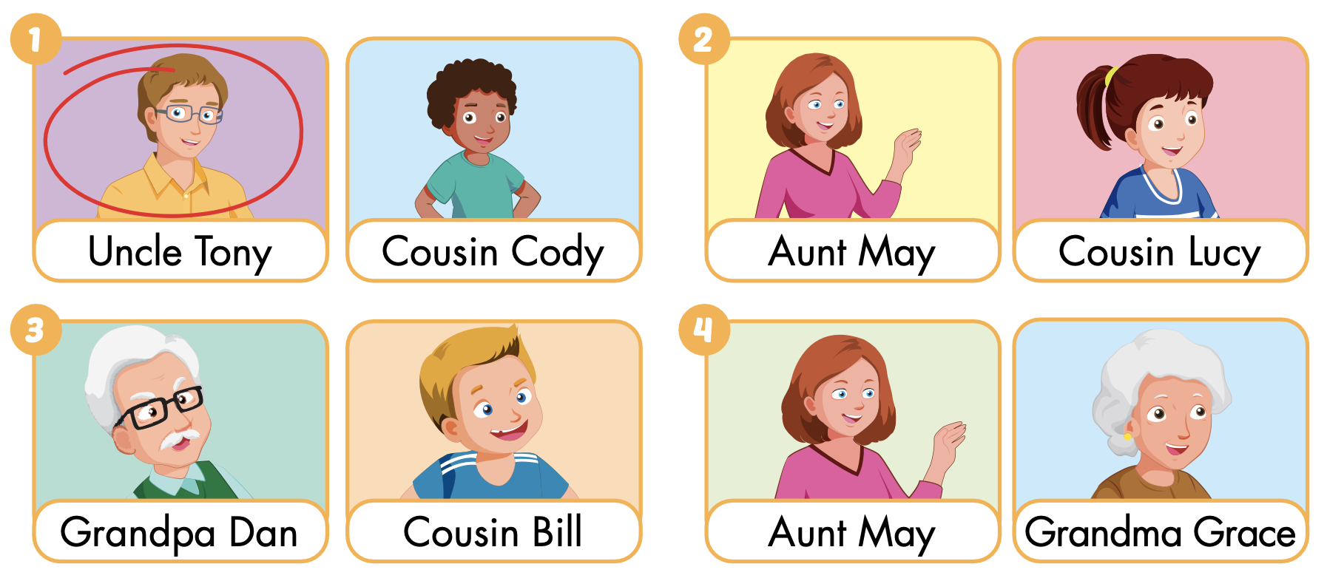
Extra Practice
WB p.21
Click on the icon to hear the sound

Slide 36

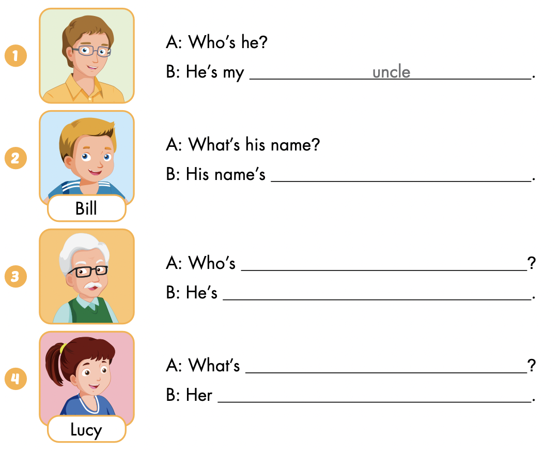

Slide 37
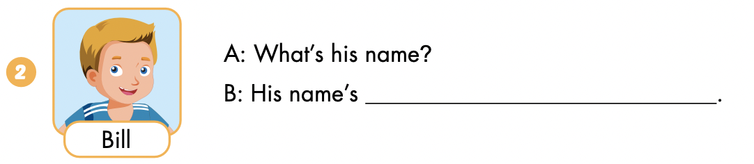
Bill

Slide 38
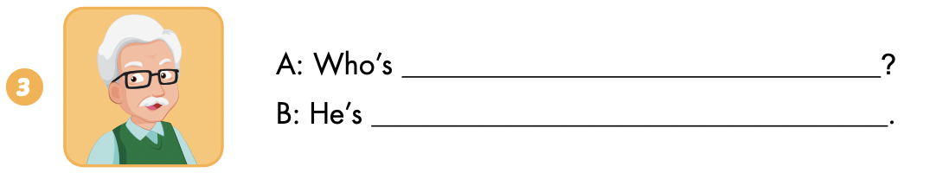
he
my grandfather

Slide 39
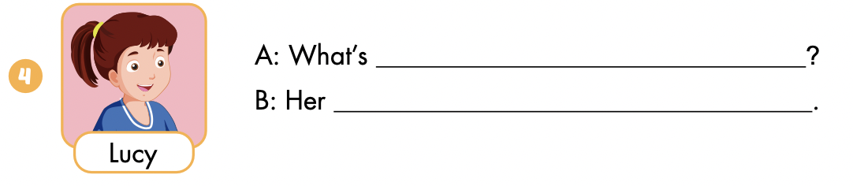
her name
name is Lucy

Slide 40

Let’s draw.
Draw your family tree
Work in pairs
Tell your partner about your family

Slide 41

WRAP-UP

Slide 42
Lesson 3
Today’s lesson
Phonics
/ð /
Structures/ Sentence patterns
Who's he?
He’s my brother.
What's his name?
His name’s Alex.

Slide 43
Lesson 3
Homework
Learn by hearts vocabularies and make sentences using them.
Do the exercises on page 21 WB.
Do exercises in Tiếng Anh 3 i-Learn Smart Start Notebook on page 17.
Prepare the next lesson (page 29 SB).

Slide 44
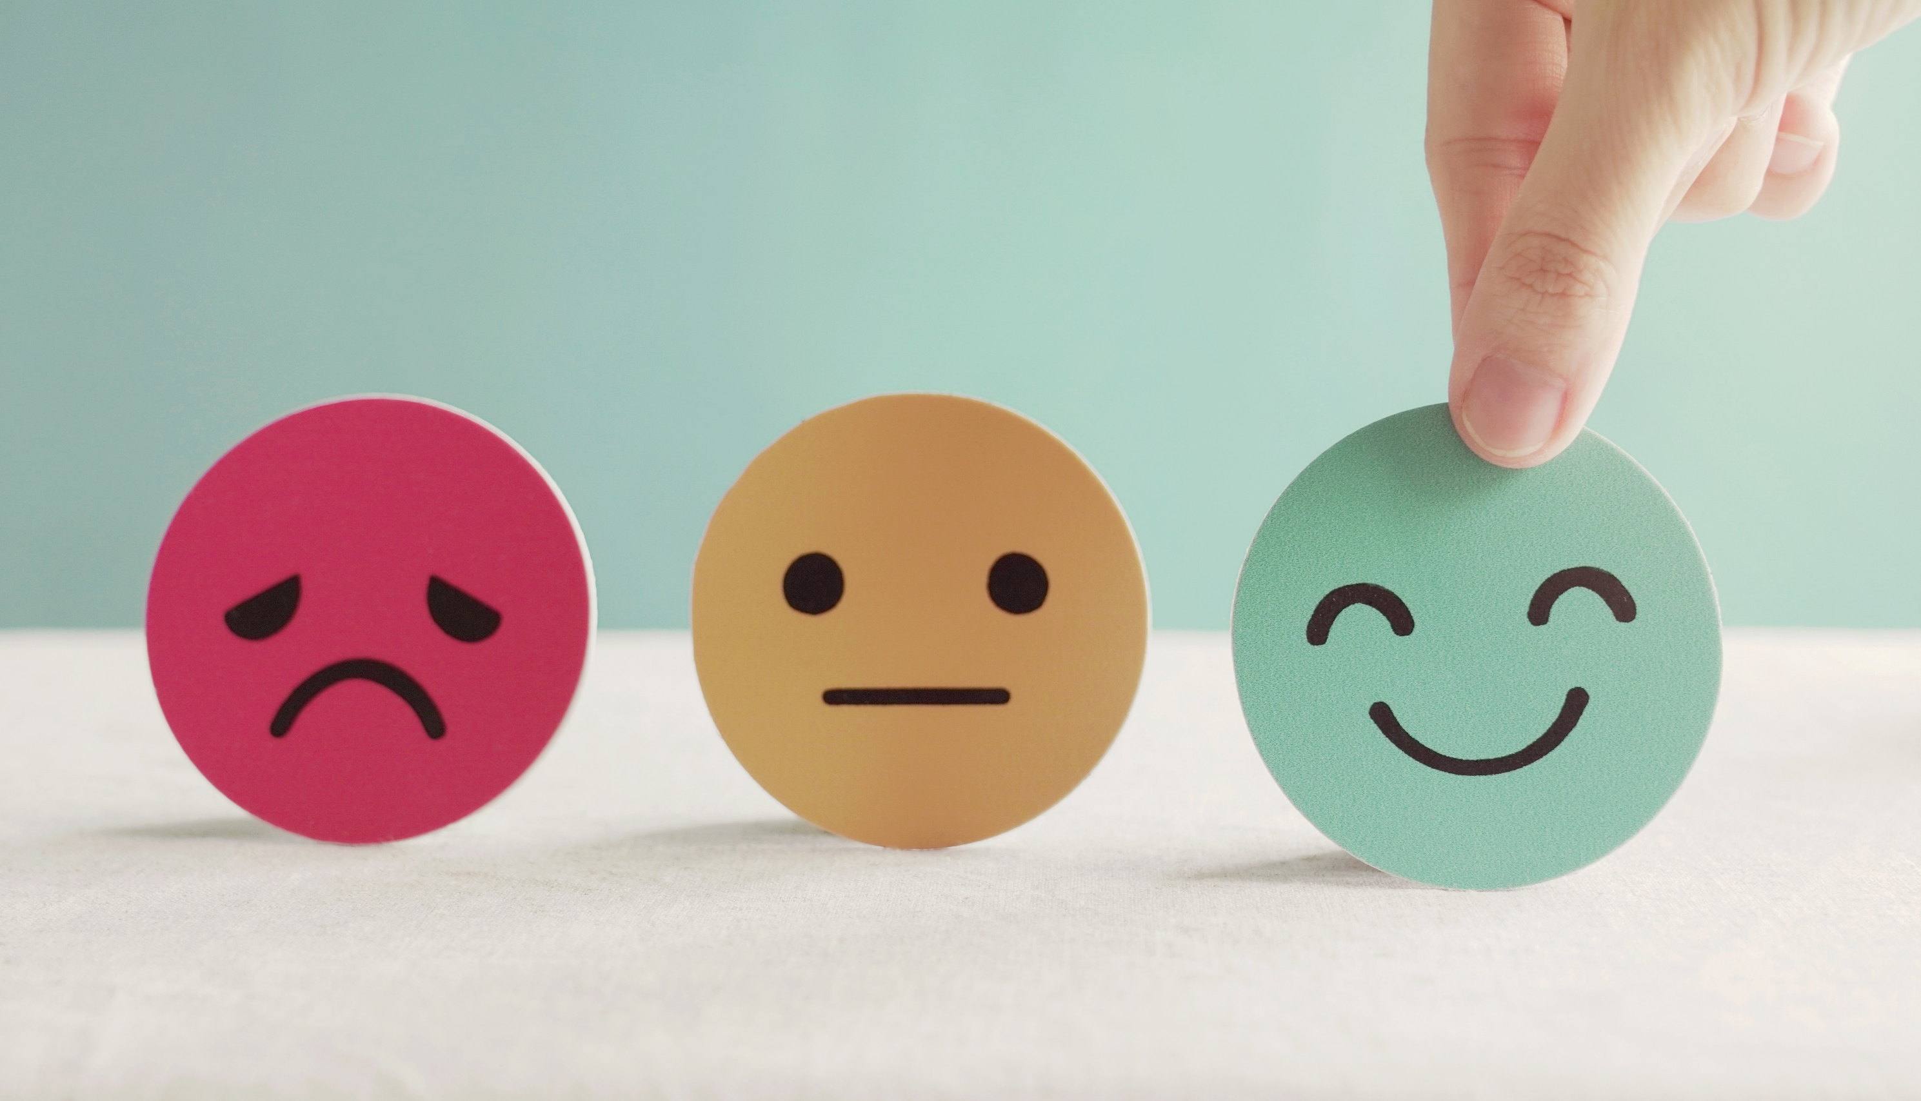
Lesson 3
Stay positive and have a nice day!

