Slide 1

Unit 1: MY FRIENDS
Lesson 4.3
Page 21

Slide 2
Lesson Outline
Warm-up
Practice
Speaking
Consolidation
Wrap-up

Slide 3
Objectives
By the end of this lesson, ﻿students will be able to use polite greetings and improve their reading and speaking skills.
Vocabulary: hi, great, good.
Sentence patterns:
1. How are you?
=> I’m good.
2. It’s nice to meet you.
=> It’s nice to meet you, too.
﻿3. Thank you.
=> You're welcome.

Slide 4

WARM UP

Slide 5

Activity 1
TEACHER SAYS
Notes:
Kết hợp các hành động “sit down”, “stand up”, “touch your nose”, “touch your shoulders”, …
Kết hợp “Traffic lights” – green light/go fast, yellow light/go slow, red light/stop
Stand-up
Sit down
Touch your nose
Touch your shoulders
Walk in circle
Touch your friends’ knee
Dance
Jump
Hop
Tip-toe
Green light➔ ss run fast
Yellow light => ss walk slowly
Red light => ss stop walking

Slide 6



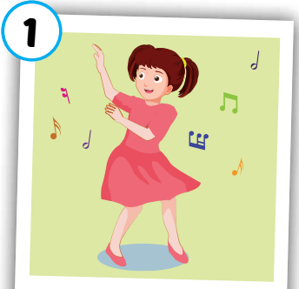
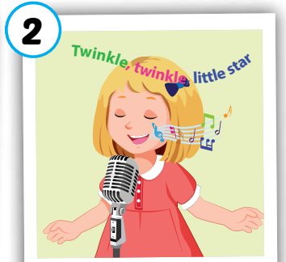
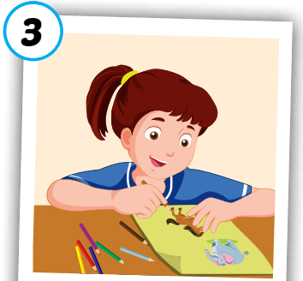
Click on numbers to open the pics and words
Activity 2
1
2
3
4
5
6
7
Hi
8
Good
Great
9
10
12
Dancing
11
Drawing
Singing
Click on ”No” icon to hide pics and words.
Notes:
Memory game.
Divide class into 3 teams. Tic-tac-toe to choose 2 numbers. Get points if ss can choose correct picture with word

Slide 7

It’s time to learn …

Slide 8

Structures
How are you?
I’m good, and you?
It’s nice to meet you.
It’s nice to meet you, too.
Thank you.
You’re welcome.

Slide 9
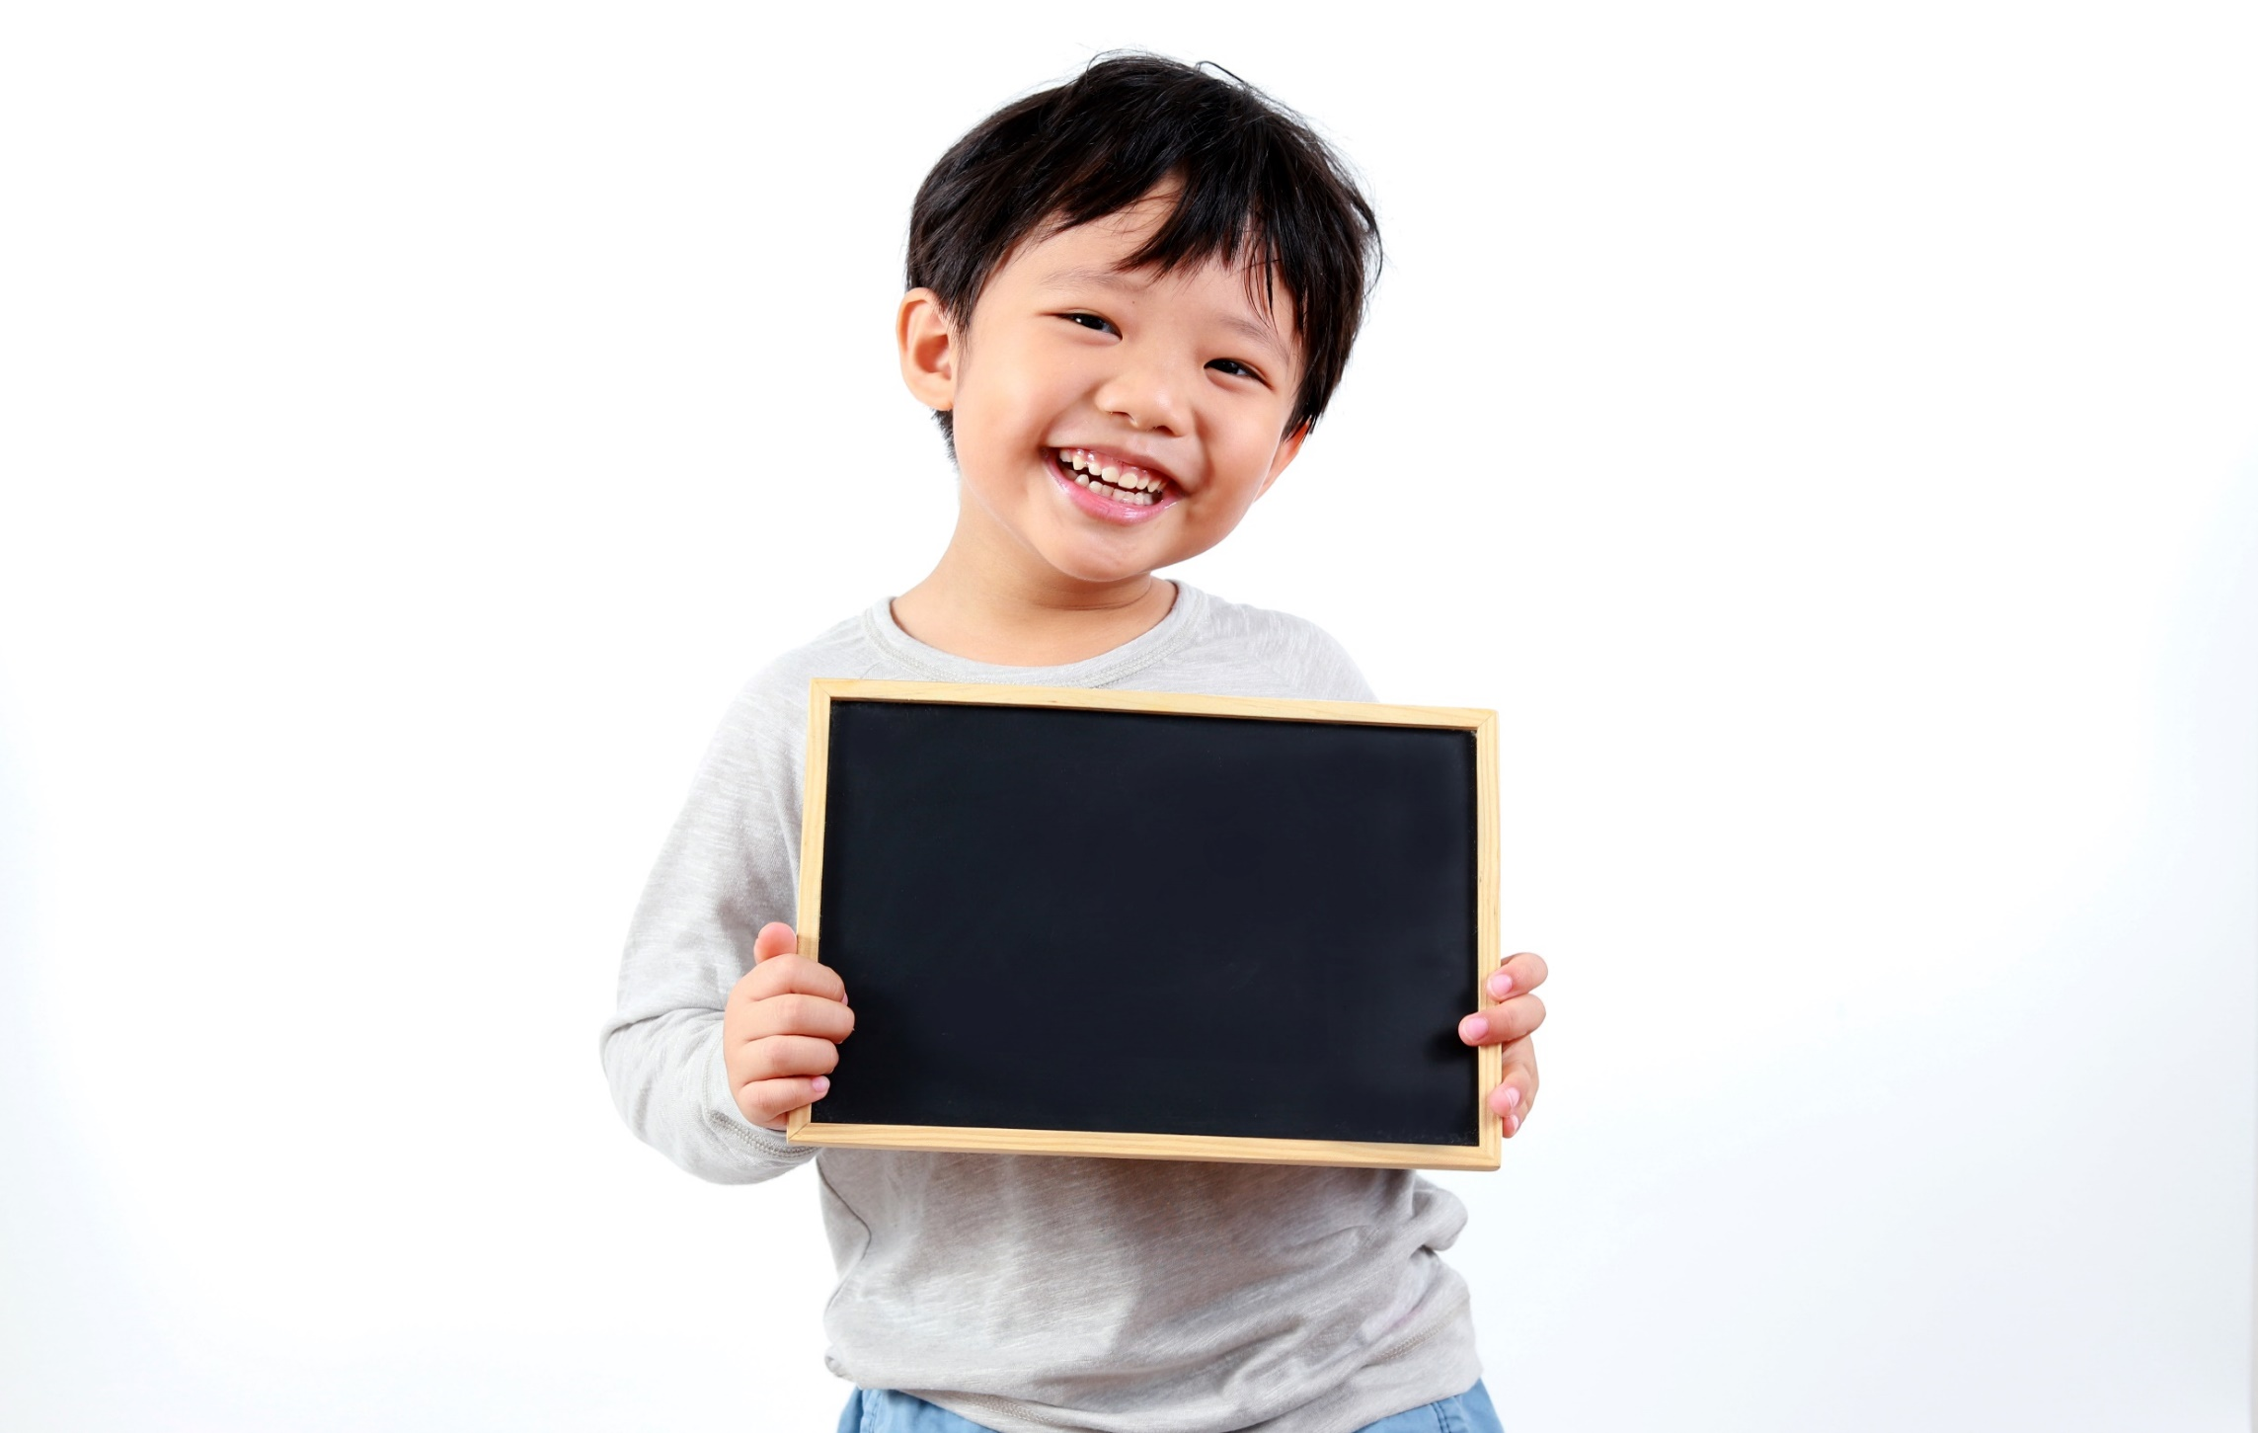
Practice

Slide 10
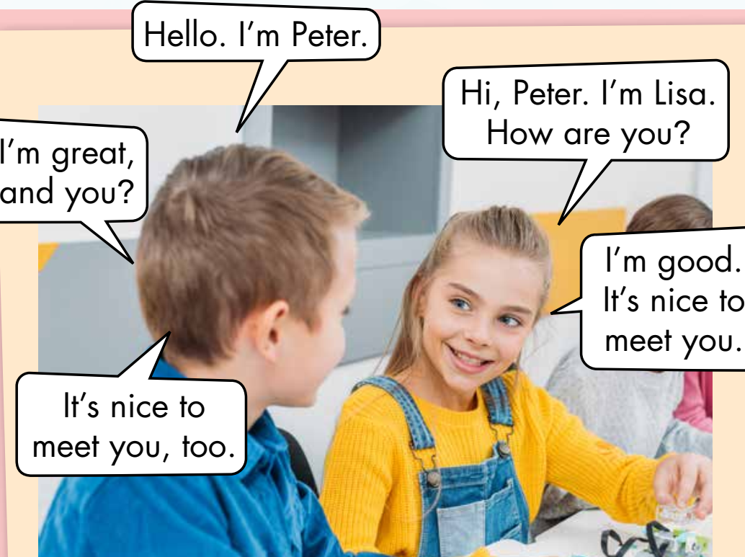
Activity 1
Look, read and guess.
1. The boy is Lisa.
True/ False
2. The girl is Peter.
True/ False
3. The girl says,
”Thank you.”
True/ False
4. The boy says,
“I’m good”
True/ False
Notes:
Set context (analyze the picture)
Show sentence by sentence, ask ss to make a guess

Slide 11
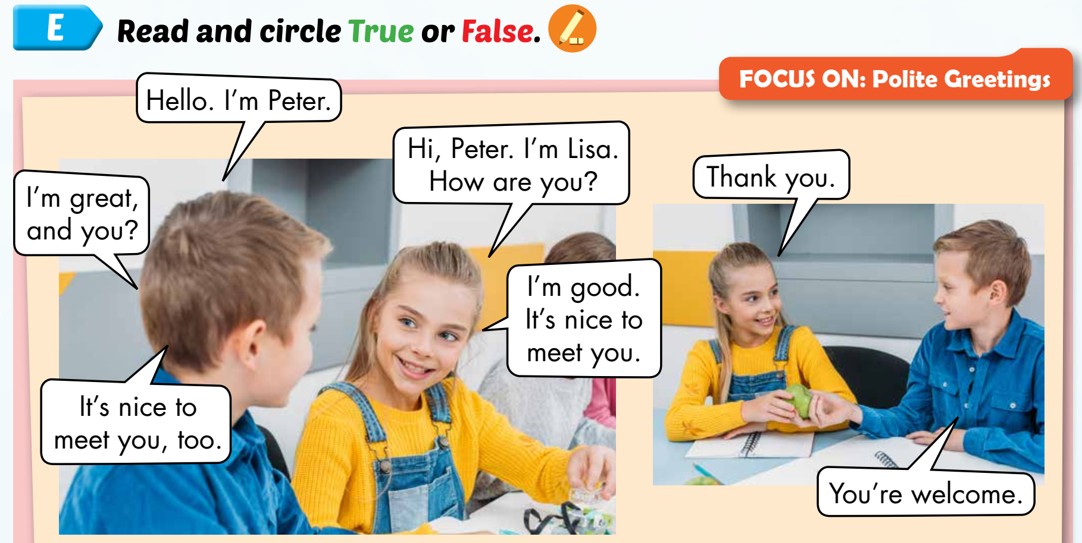
Activity 2
Click on each number to show the sentence.
1
2
3
4
5
6
7
Notes:
- Ask ss to guess who will say 1st, what will they say?

Slide 12
Activity 2
1. The boy is Lisa.
True/ False
3. The girl says, ”Thank you.”
True/ False
2. The girl is Peter.
True/ False
4. The boy says, “I’m good”
True/ False
Notes:
Read and circle True or False
Check the answer

Slide 13
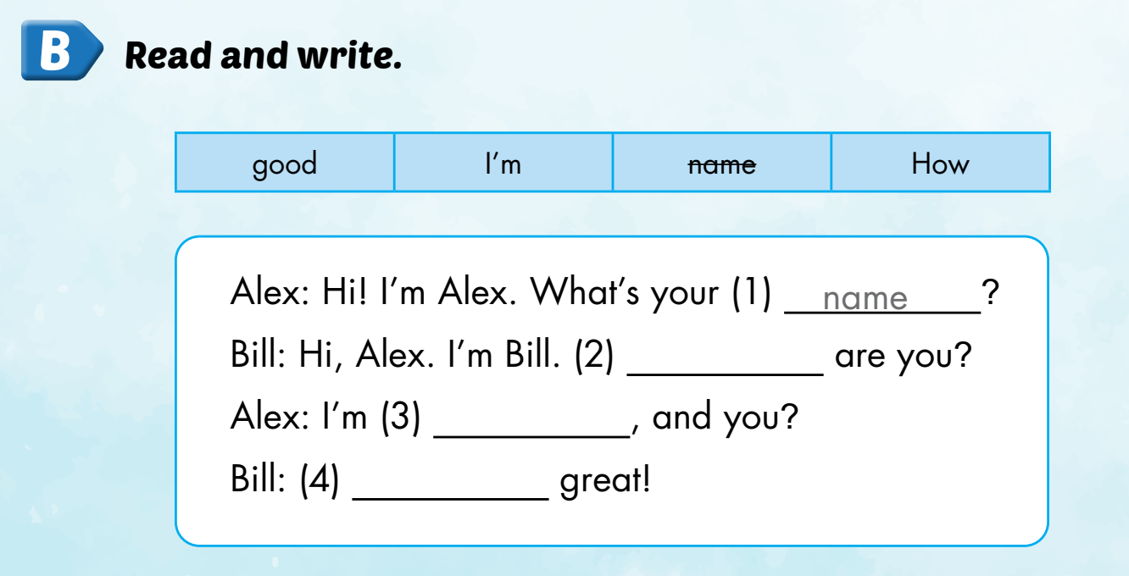
Extra activity
WB P. 15
How
good
I’m

Slide 14
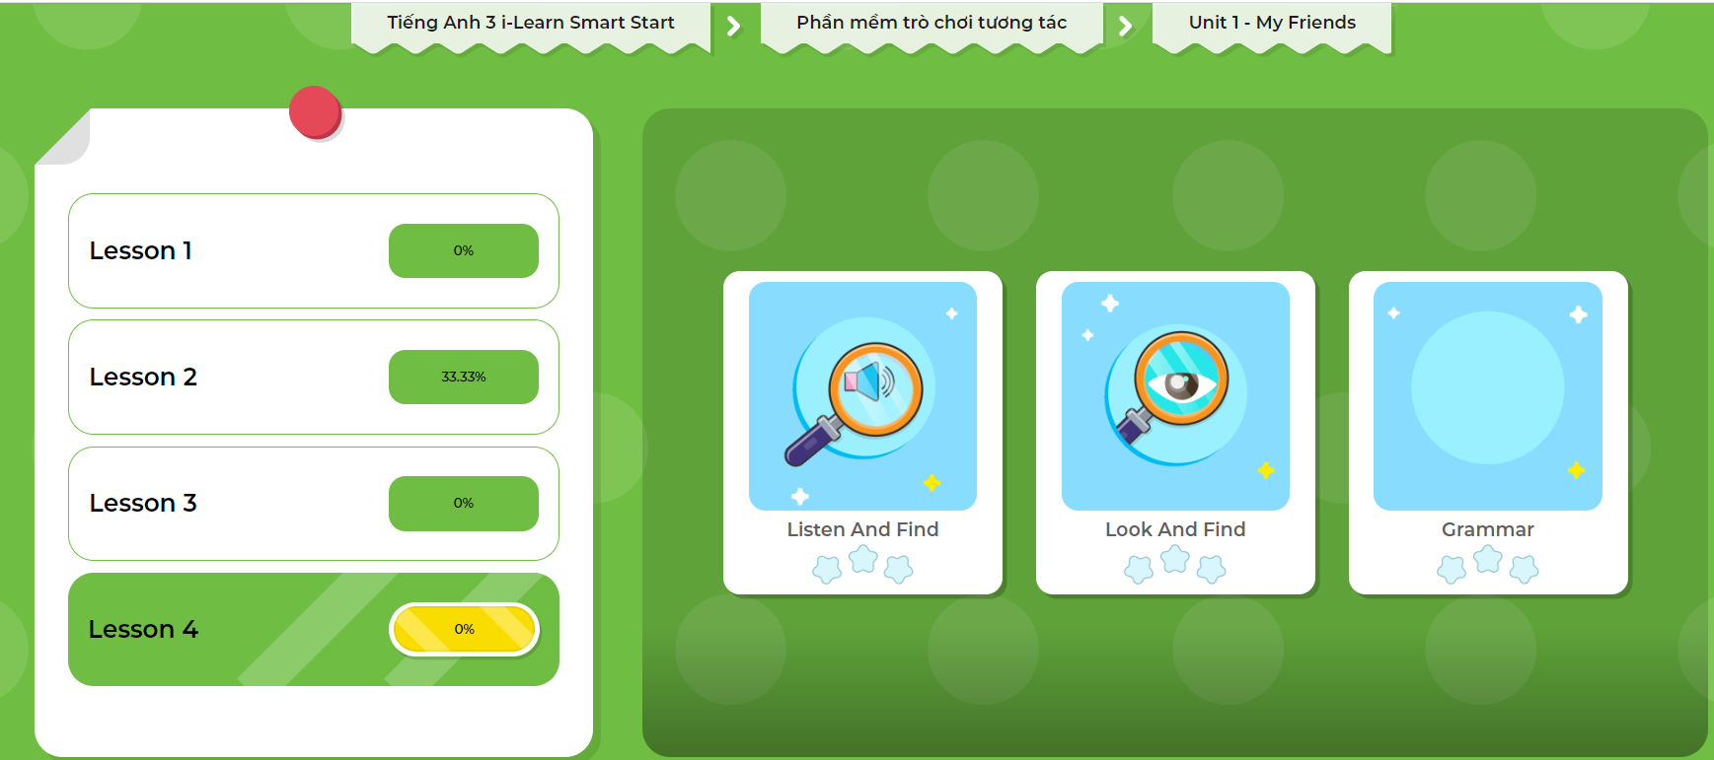
Extra Practice
DHA App
LET’S PLAY!
Click on the picture below

Slide 15

Production

Slide 16
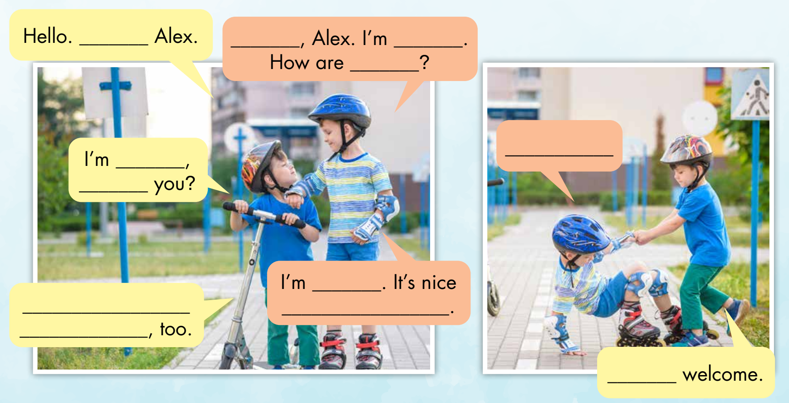
Activity 1
Look and read. Then write the correct words
1
I’m
2
Hi
3
John
4
you
10
Thank you.
5
fine
6
and
7
great
9
It’s nice to
meet you
8
you
11
You’re
Notes:
In groups, ask ss to write the correct answers to complete the “Polite greetings”
Show answers and check. Accept suitable answers

Slide 17
Activity 2
Write and draw your own story.
Hello. I’m …
It’s nice to meet you, too.
Hi. I’m …
Where are you from?
A few minutes later
I’m from …, and you?
Thank you.
I’m from …
How are you?
You’re welcome.
I’m …, and you?
I’m …. It’s nice to meet you.
Notes:
Ask ss to write and draw their own story in groups based on the given outline.
Encourage ss to be creative

Slide 18

Speaking

Slide 19
Gallery walk
Notes:
After finishing the story, ask ss to do the gallery walk.
Ask and take note about their friends’ story
Helps ss when necessary

Slide 20

CONSOLIDATION

Slide 21
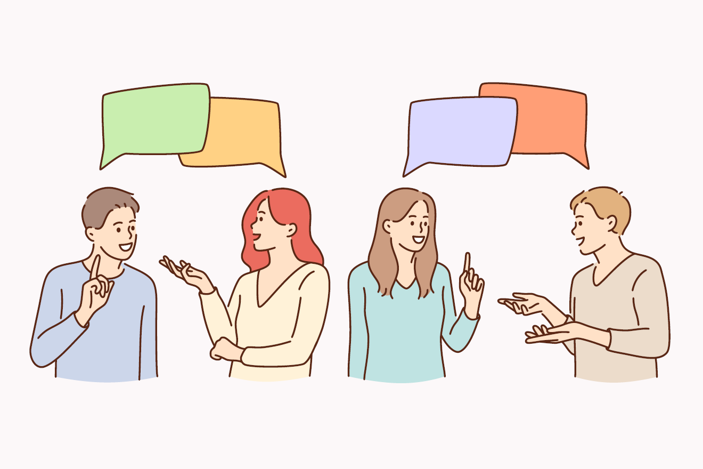
Role-play. Act out the story
Notes:
Give time for ss to practice
Each group comes to in front of the class. Act out their story

Slide 22
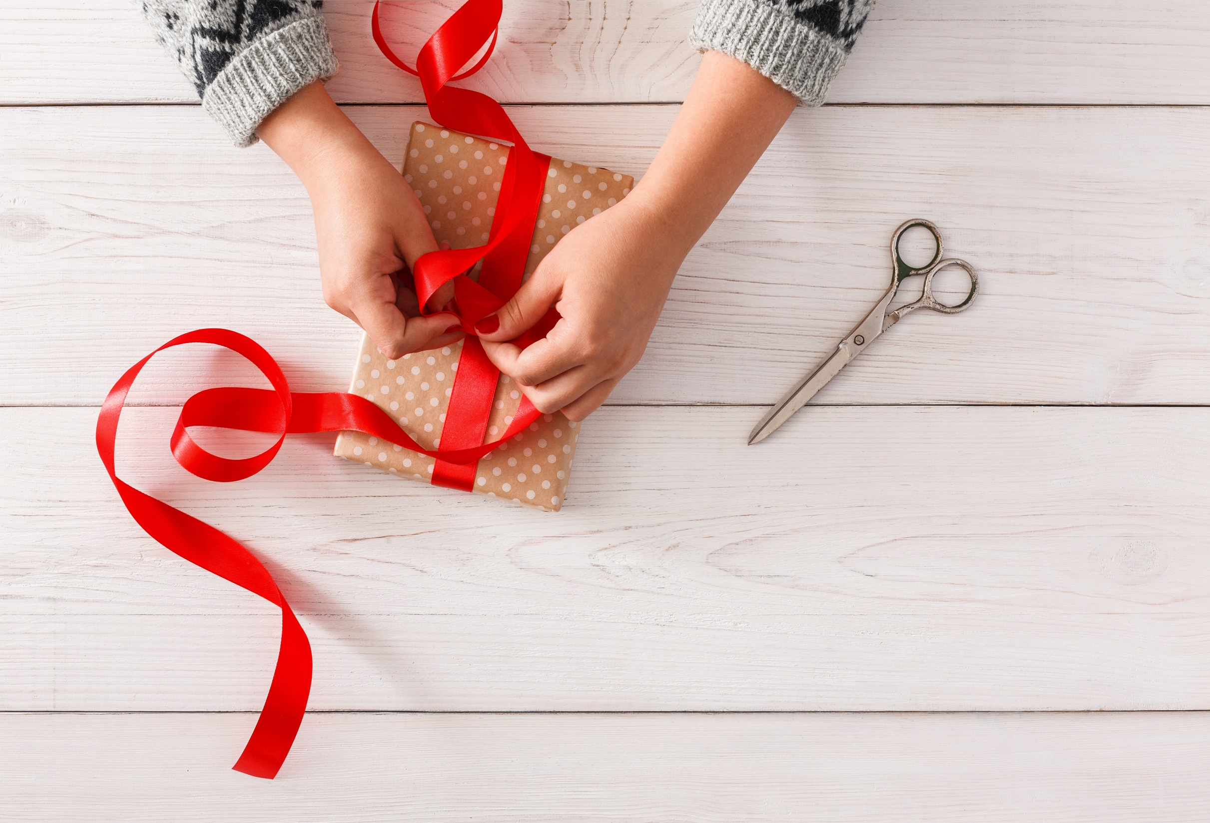
WRAP-UP

Slide 23

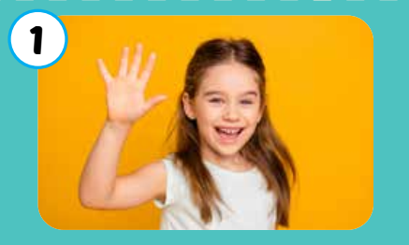
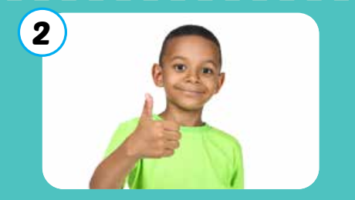
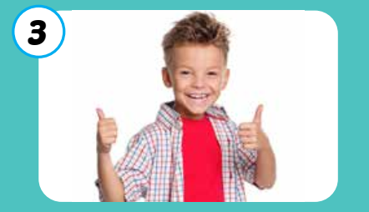
Vocabulary
hi
good
great

Slide 24
Sentence patterns
How are you?
I’m good, and you?
It’s nice to meet you.
It’s nice to meet you, too.
Thank you.
You’re welcome.

Slide 25
Lesson 3
Homework
Practice the vocabularies and structure; and make sentences using them.
Do the exercises in Tiếng Anh 3 i-Learn Smart Start WB (page 15)
Review all the exercises in Tiếng Anh 3 i-Learn Smart Start Notebook (page 13)
Prepare the next lesson (page 22 SB)
Play the consolidation games in Tiếng Anh 3 i-Learn Smart Start DHA App on www.eduhome.com.vn

Slide 26
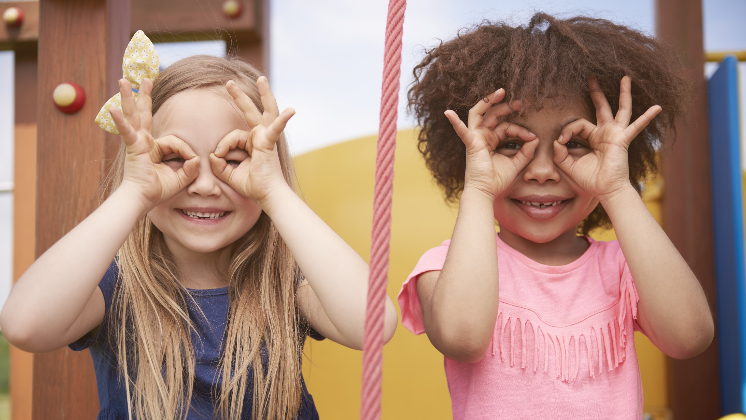
Enjoy your day!

