Slide 1


Welcome to our class
Teacher: Luong Thanh Lam

Slide 2


Let's play a game

Slide 3

Kim's game

Slide 4


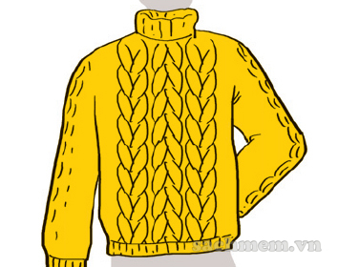
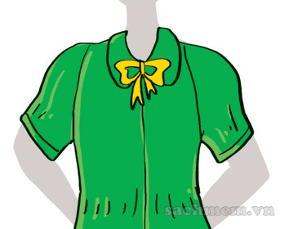
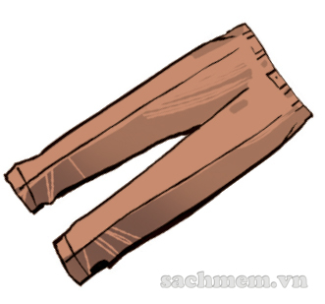
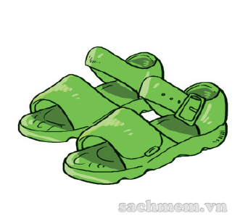
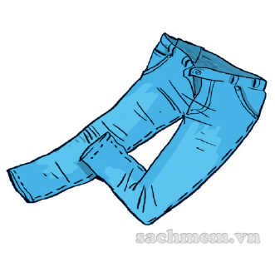
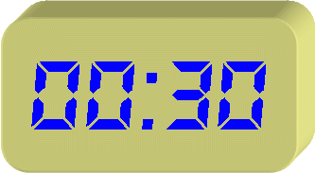
Kim's game
Scarf
Jumper
Blouse
Trousers
Sandals
Jeans

Slide 5

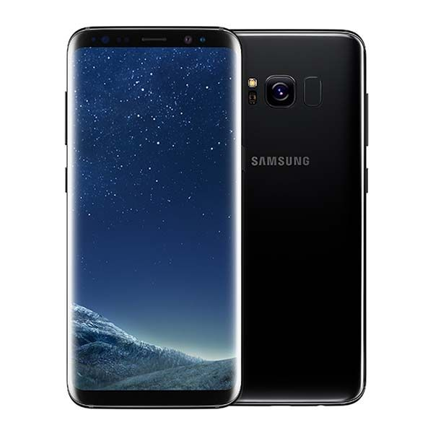
GUESS
A mobile phone

Slide 6
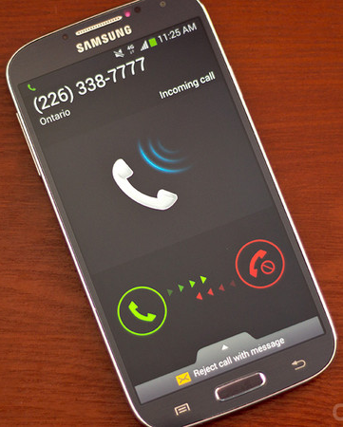
Phone number

Slide 7


Unit 18 What’s your phone number?
Lesson 1
* New words:
- A mobile phone: điện thoại di động
Phone number: số điện thoại

Slide 8
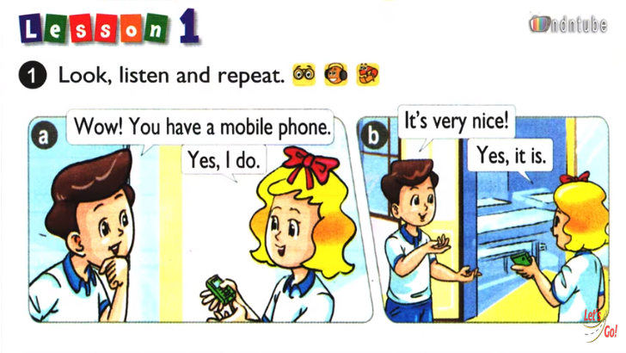

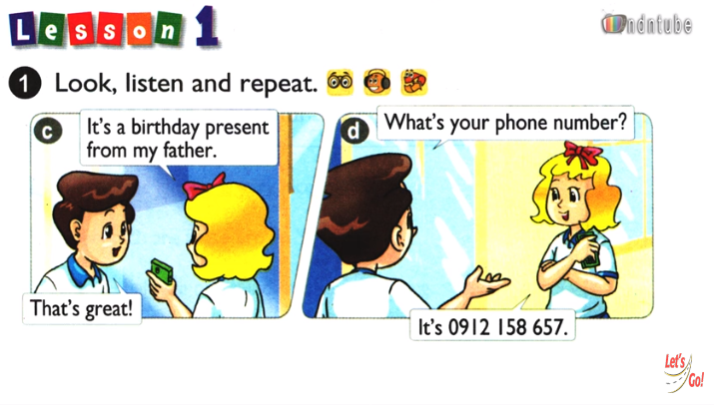

Slide 9

Pair - work

Slide 10
* Structure:
A: What’s Linda’s phone number?
B: It’s 0912 158 657.

Slide 11
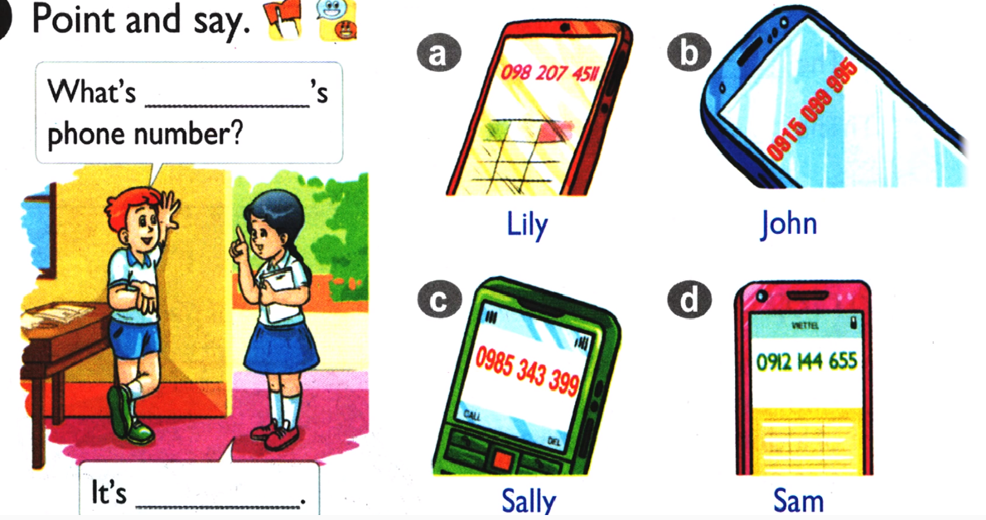



2.

Slide 12
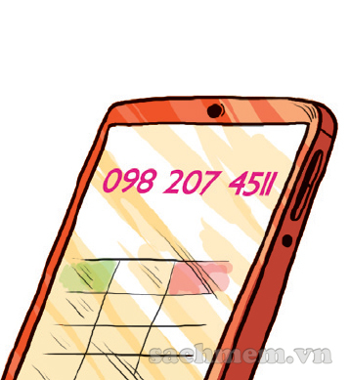

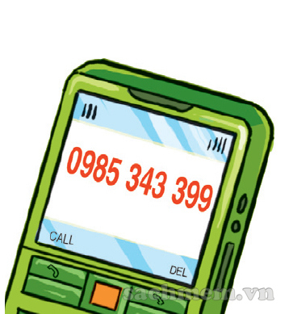
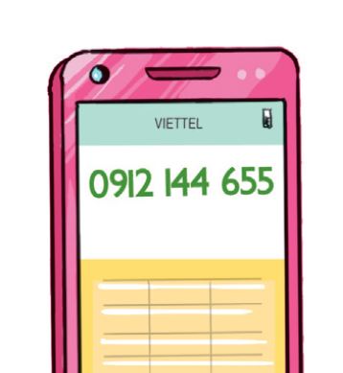
What’s ……’s phone number?
a.
b.
Lily
John
c.
d.
It’s ………………..
Sally
Sam

Slide 13

Talk about your phone number

Slide 14

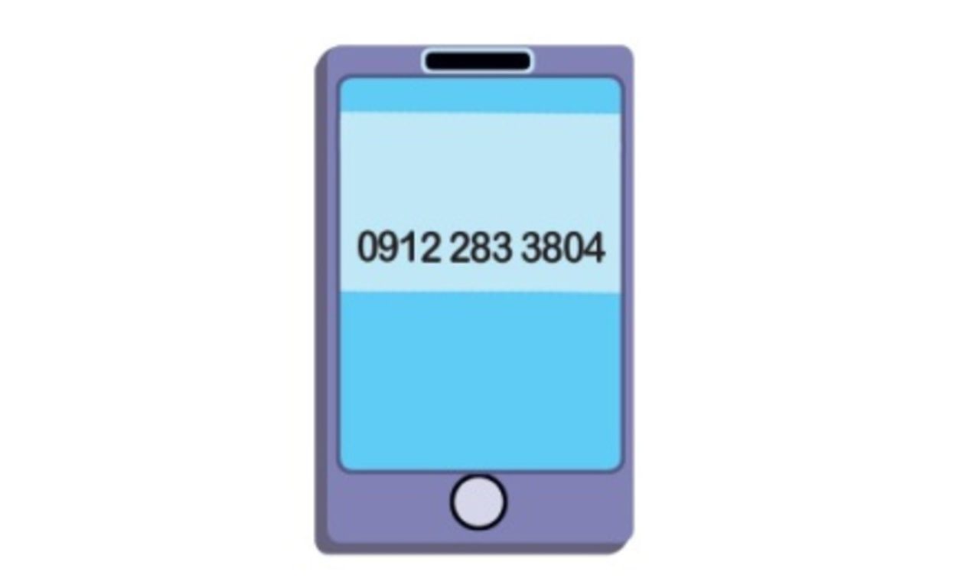
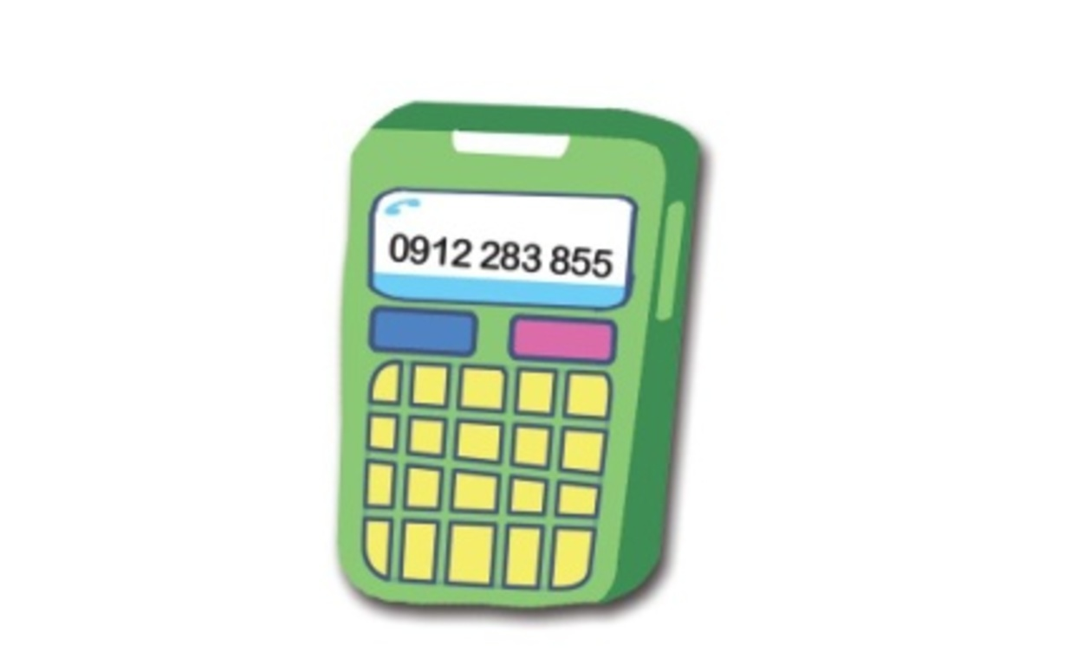
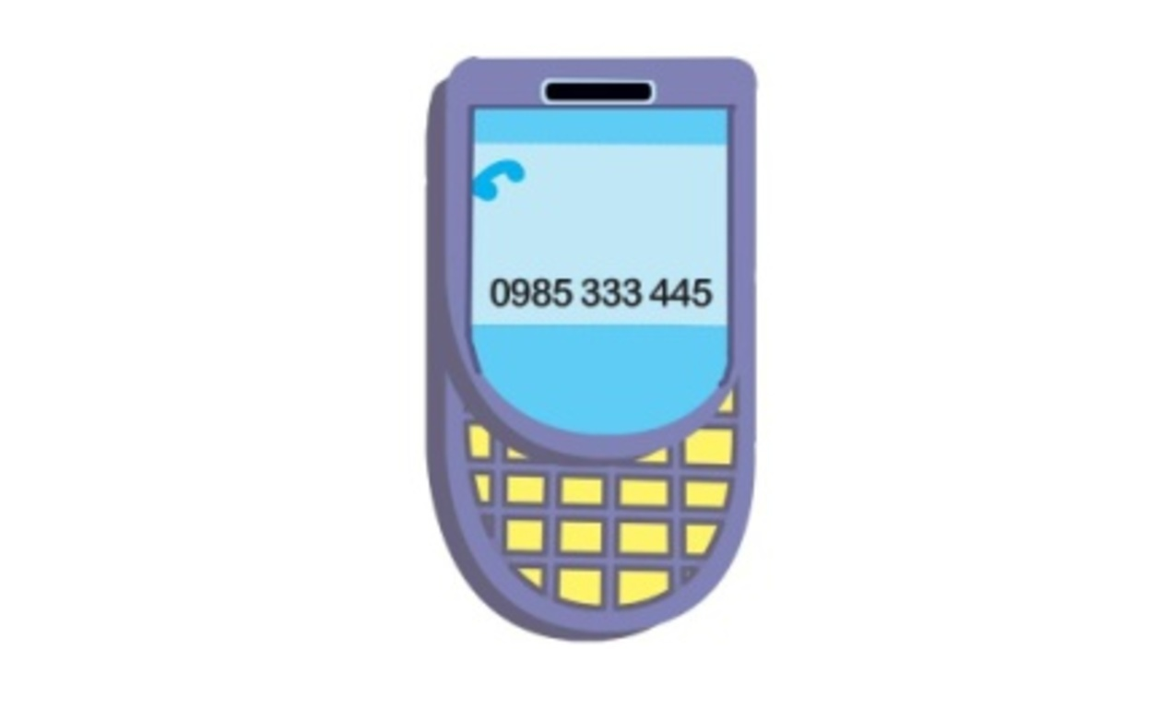

Slide 15
Who’s Faster?
1.
2.
3.

Slide 16

It’s oh – nine – one – two, two – eight – three, three – eight – oh – four.
It’s oh – nine – one – two, two – eight – three, eight – five – five.
It’s oh – nine – eight – five, three – three – three, four – four – five.

Slide 17

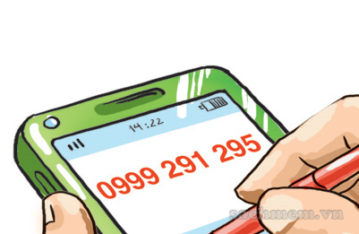
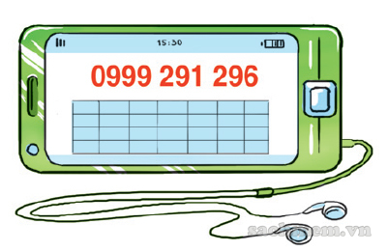
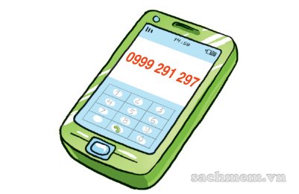
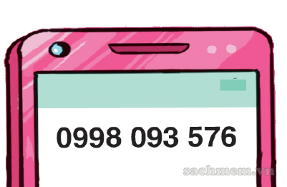
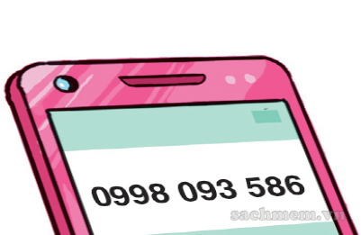
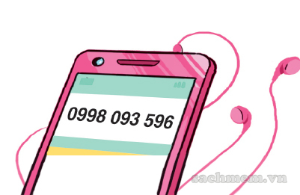
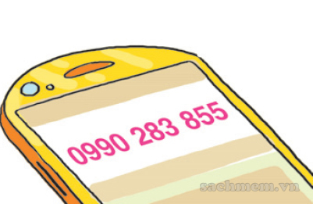
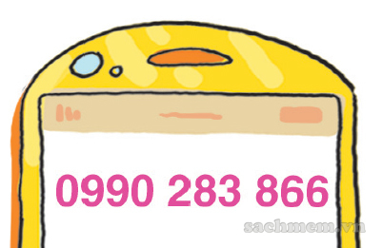
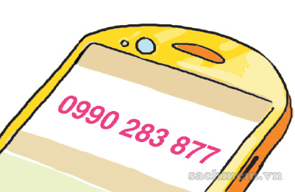
3. LISTEN AND TICK
1
What’s Tom’s phone number?
2
What’s Mai’s phone number?
3
What’s Mr Loc’s phone number?

Slide 18


3. LISTEN AND TICK
1
What’s Tom’s phone number?
a
b
c

Slide 19

3. LISTEN AND TICK
2
What’s Mai’s phone number?
a
b
c

Slide 20
3. LISTEN AND TICK
3
What’s Mr Loc’s phone number?
a
b
c

Slide 21

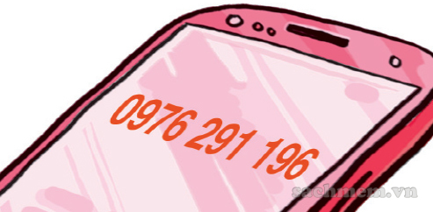
4. LOOK & WRITE
1
What’s Joe’s phone number?
It's oh-nine-seven-six, two-nine-one, one-nine-six.

Slide 22

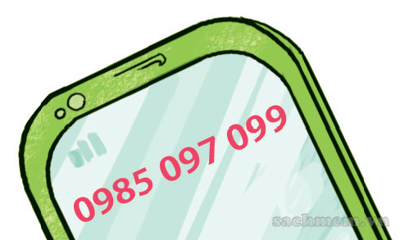
4. LOOK & WRITE
2
What’s Ann’s phone number?
..........................................................................
It's oh-nine-eight-five, oh-nine-seven, oh-nine-nine.

Slide 23

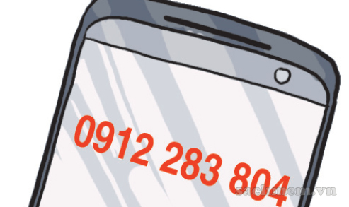
4. LOOK & WRITE
3
What’s Ben’s phone number?
........................................................................
It's oh-nine-one-two, two-eight-three, eight-oh-four

Slide 24


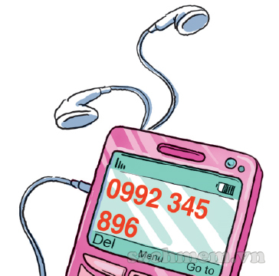
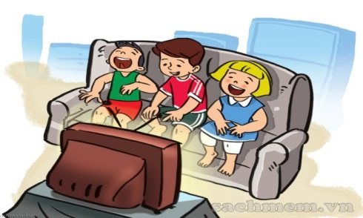
What's your phone number?
What’s your phone number?
What’s your phone number?
It’s oh-nine-nine-two, three-four-five,
eight-nine-six.
What’s your phone number?
What’s your phone number?
Oh-nine-nine-two, three-four-five,
eight-nine-six.
Hey ho, hey ho, it’s my phone number.

Slide 25

Reinforcement:
Learn the vocabularies and structure by heart.
Prepare Lesson 2 for the next period.

Slide 26








