Slide 1
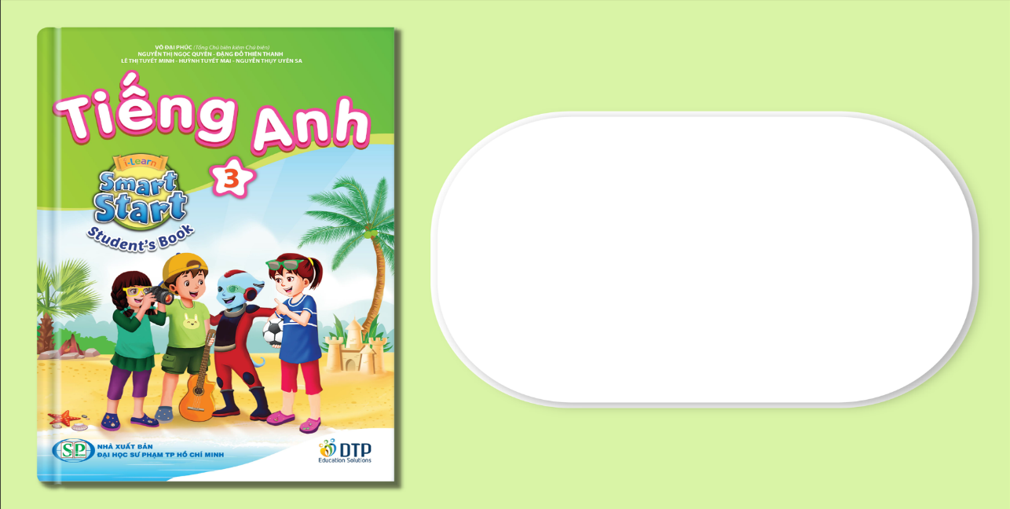
Unit 7: Toys
Lesson 2.1
Page 99

Slide 2
Lesson Outline
Warm-up
Vocabulary
Structure
Consolidation
Wrap-up

Slide 3
Objectives
By the end of this lesson, students will be able to…
Vocabulary: Pronounce and use the words related to the topic properly: card, block, dice, marble
Structure: Ask about the quantity of certain items that someone has by using:
How many marbles do you have?
I have five marbles.

Slide 4
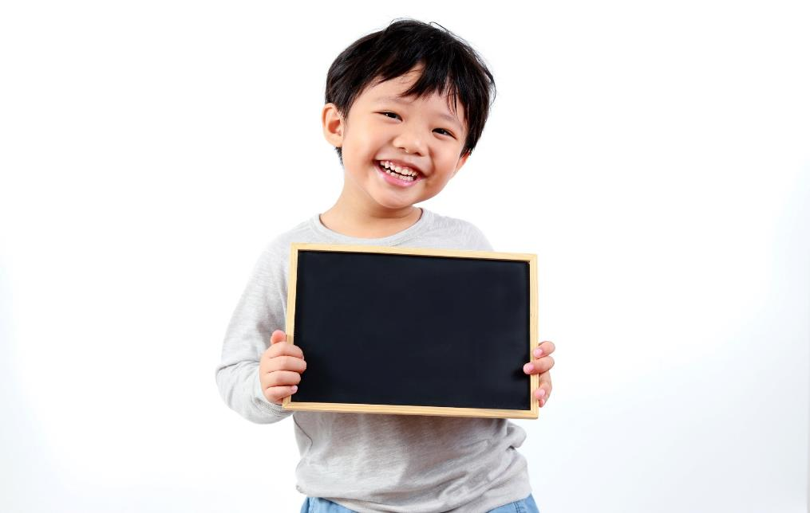
Practice

Slide 5


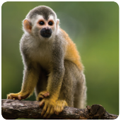
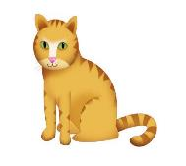
Matching Rocket
PLAY
Monkey
Notes:
Ms Huyền Phạm - 0936.082.789 – YOUTUBE: MsPham. Facebook: Dạy và học cùng công nghệ.

Slide 6

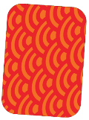


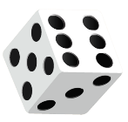




A
B
C
D
marble
Notes:
Ms Huyền Phạm - 0936.082.789 – YOUTUBE: MsPham. Facebook: Dạy và học cùng công nghệ.

Slide 7

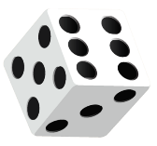

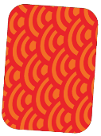


A
B
C
D
card
Notes:
Ms Huyền Phạm - 0936.082.789 – YOUTUBE: MsPham. Facebook: Dạy và học cùng công nghệ.

Slide 8
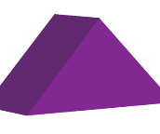
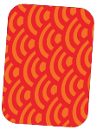
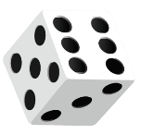


A
B
C
D
block
Notes:
Ms Huyền Phạm - 0936.082.789 – YOUTUBE: MsPham. Facebook: Dạy và học cùng công nghệ.

Slide 9
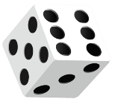

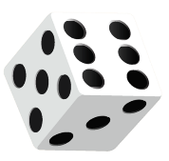
A
B
C
D
dice
Notes:
Ms Huyền Phạm - 0936.082.789 – YOUTUBE: MsPham. Facebook: Dạy và học cùng công nghệ.

Slide 10
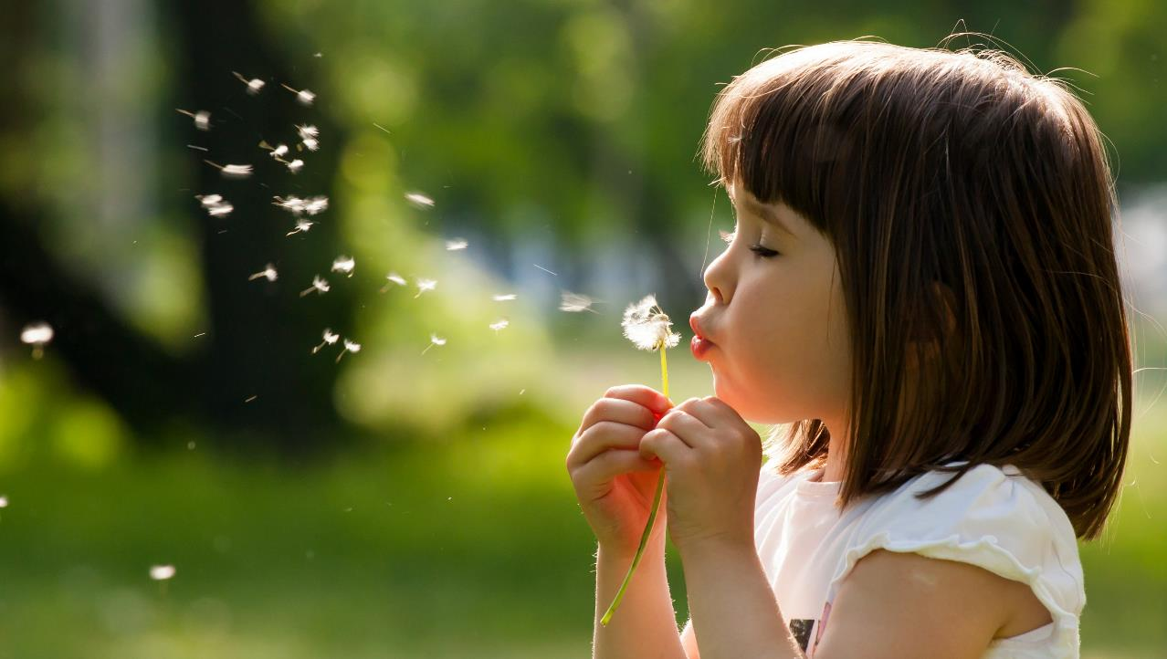
Enjoy your day!

