Slide 1
Unit 10
When will
Sports Day be?
Lesson 1

Slide 2
PRONUNCIATION

Slide 3
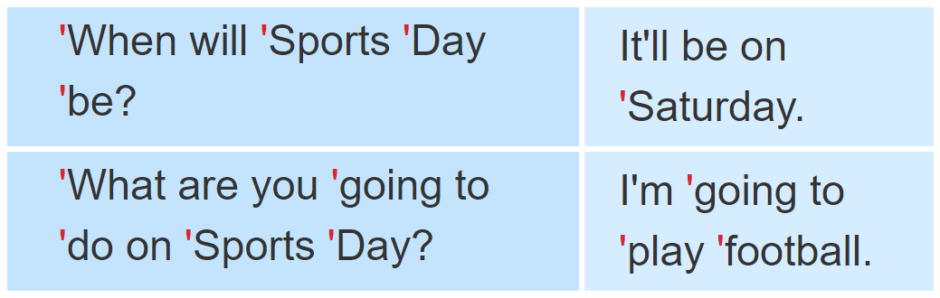

1. Listen and repeat.

Slide 4
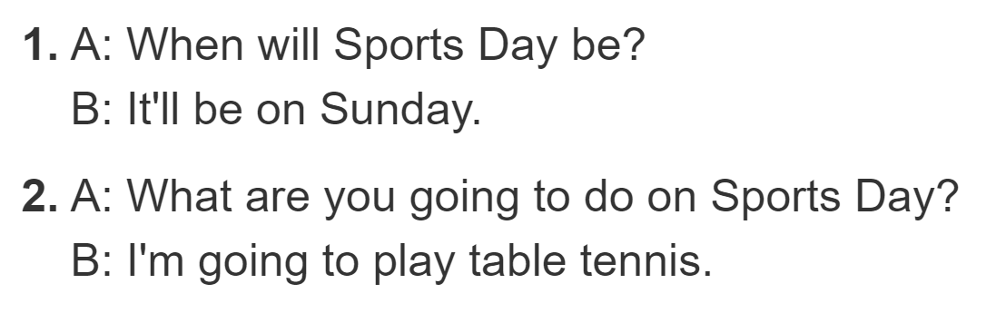

2. Listen and underline the stressed words. Then say the sentences aloud.

Slide 5
PRACTISE

Slide 6
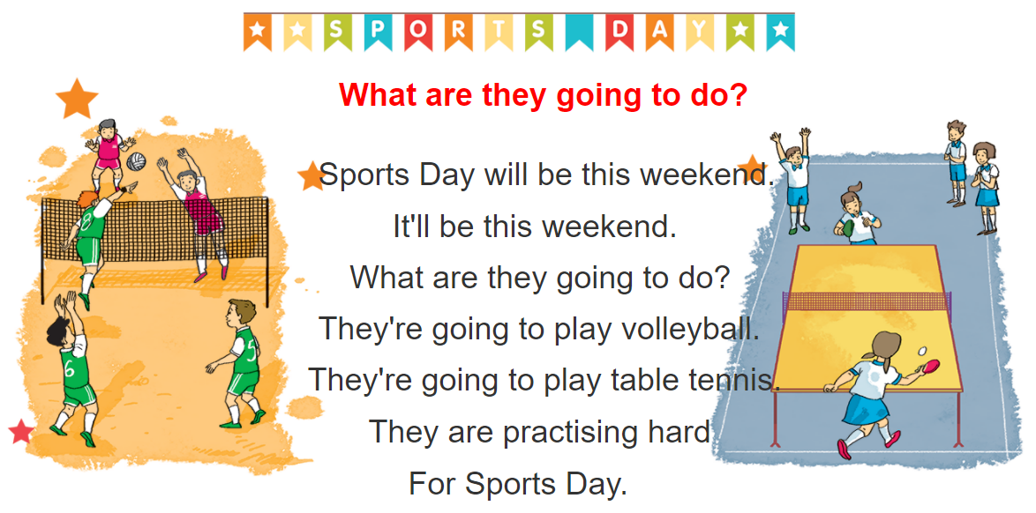
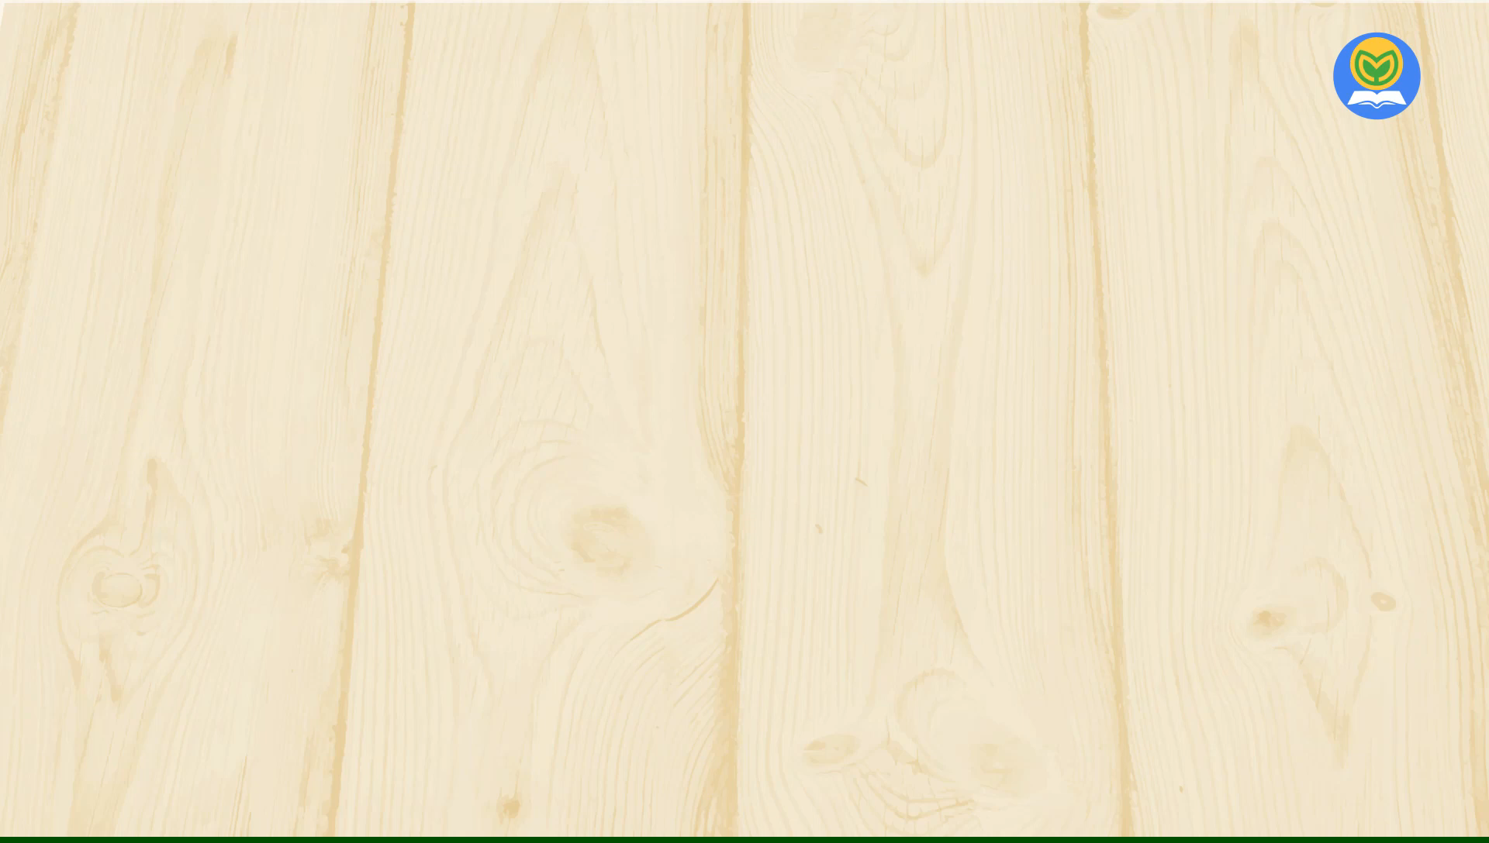


3. Let’s chant

Slide 7
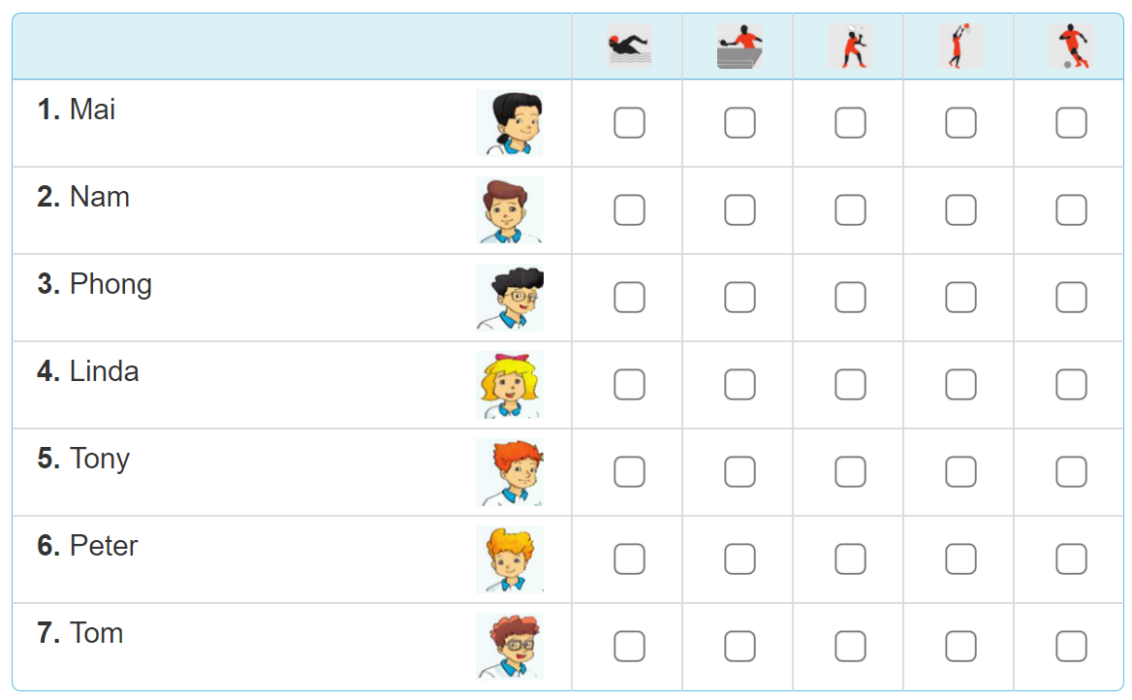
4. Read and tick

Slide 8
4. Read and tick
Our school Sports Day will be next Saturday. Everyone in my class is going to take part in it. Mai and Linda are going to play table tennis. Tony's going to play basketball and Peter's going to play badminton. Phong and Nam are going to play in a football match. Tom's going to swim. My classmates are practising hard for the events. We hope that we will win the competitions.

Slide 9

4. Read and tick

Slide 10
5. Write about Sport Day
Sports Day is going to be _______________.
Some of the boys are going to____________.
Some of the girls are going to_____________.
I am going to__________________________.
I hope that we will______________________.

