Slide 1
Unit 11
What’s the matter with you?
Lesson 2

Slide 2
Vocabulary

Slide 3
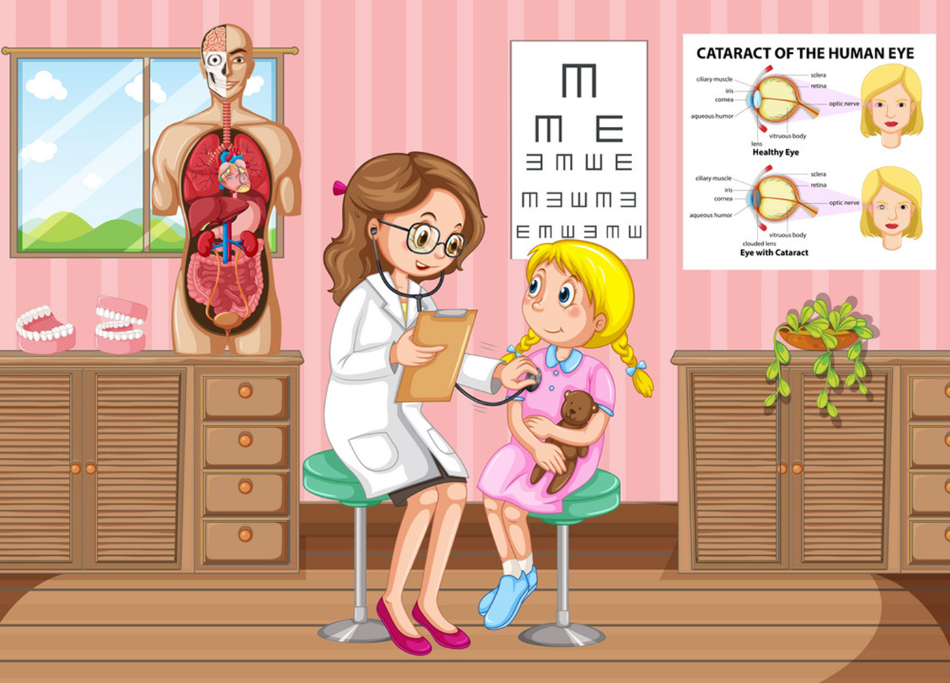
go to the doctor
/gəʊ tə ðə ˈdɒktər/

Slide 4
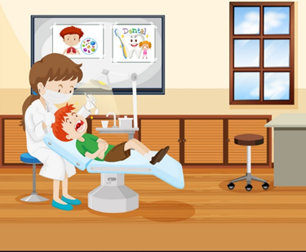
go to the dentist
/goʊ tə ðə ˈdɛntəst/

Slide 5
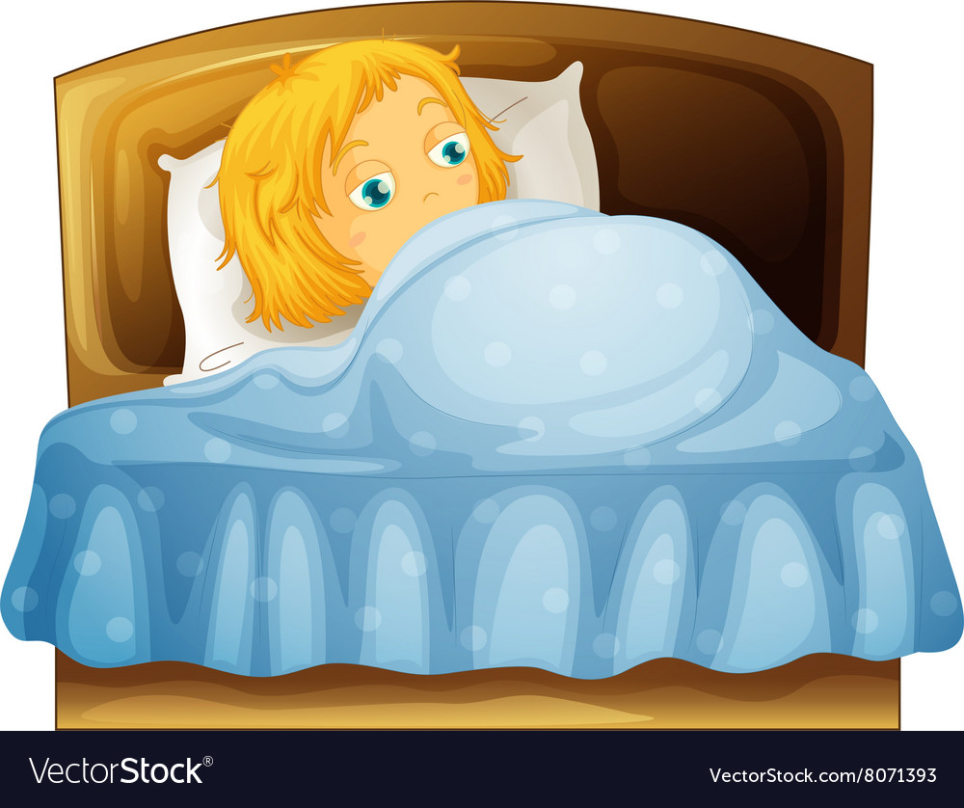
take a rest
/teɪk ə rɛst/

Slide 6
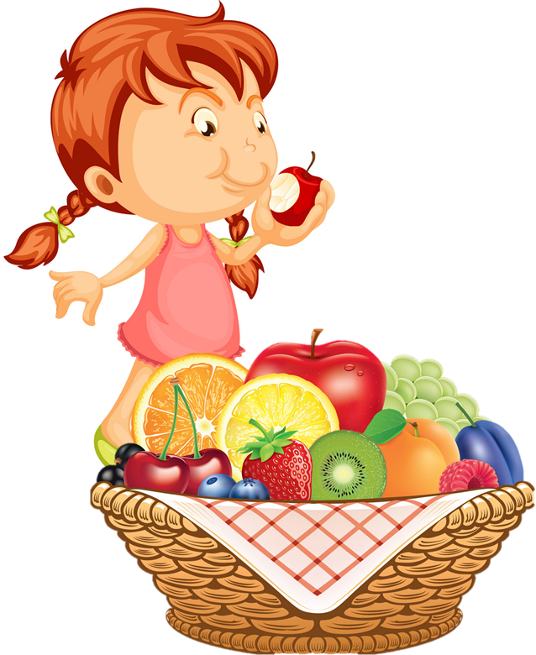
eat a lot of fruit
/iːt ə lɑ:t əv frut/

Slide 7
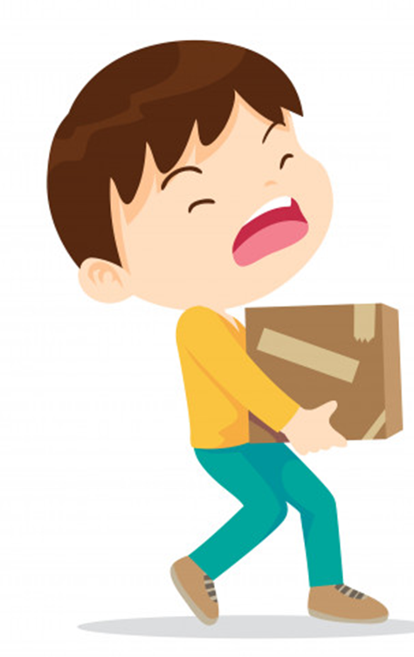
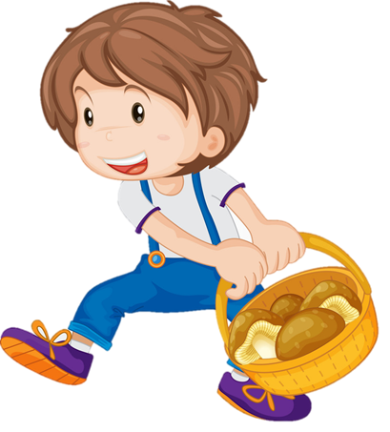
carry heavy things
/ˈkæri ˈhɛvi θɪŋz/

Slide 8
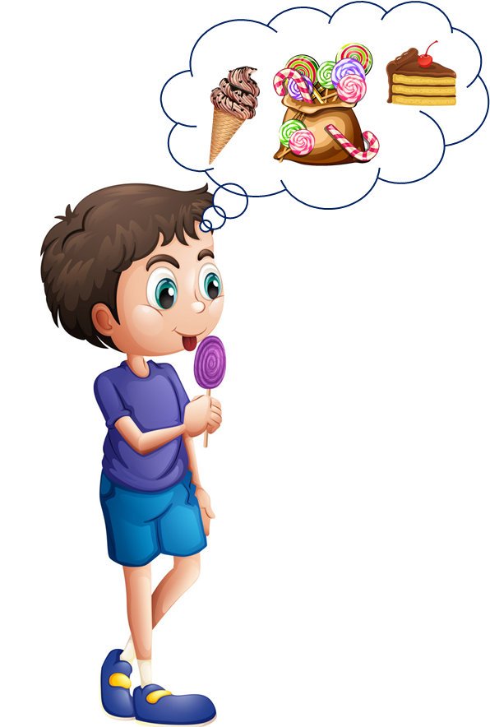
eat a lot of sweets
/i:t ə lɑ:t əv swi:ts/

Slide 9
Grammar

Slide 10
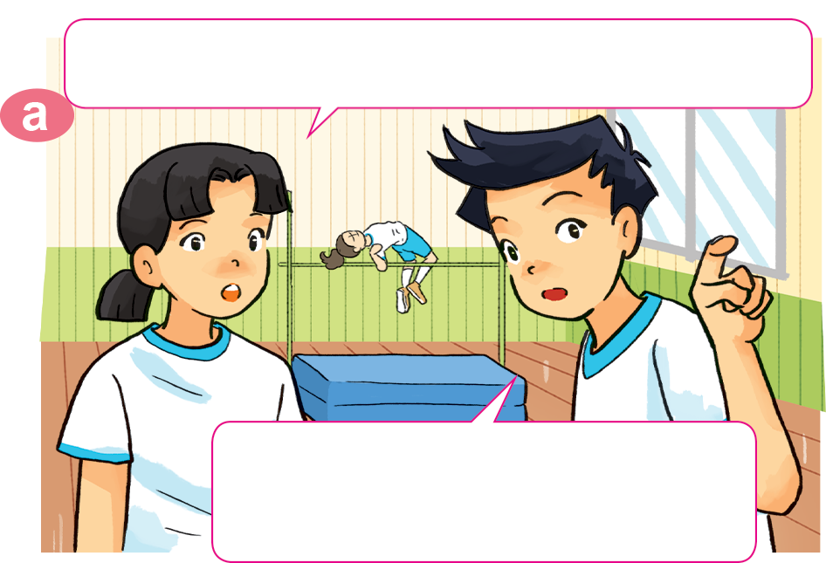
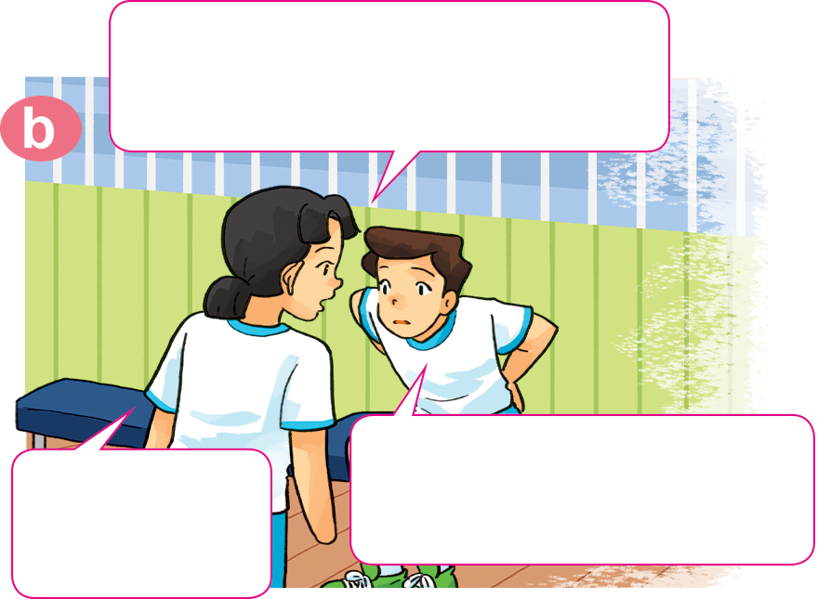

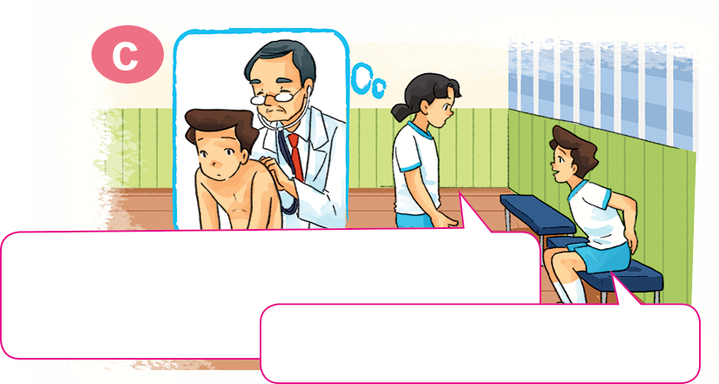
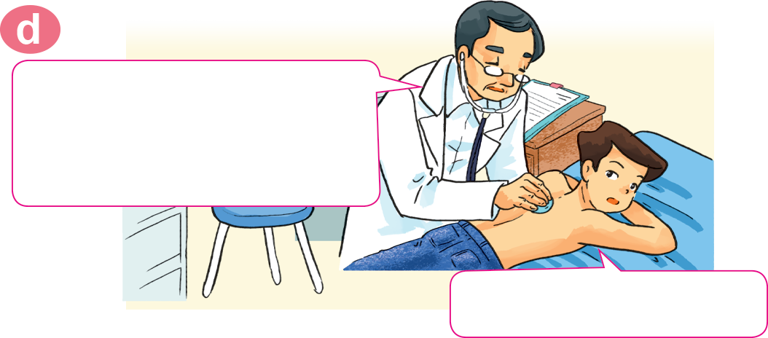
1. Look, listen and repeat.
Where's Nam? I can't see him here.
Hi, Nam. Why aren't you
practising karate?
I don't feel well. I have a backache.
He's sitting over there,
in the corner of the gym.
Sorry to
hear that.
You should take a rest and shouldn't play
sports for a few days.
You should go to the doctor
now, Nam.
OK, I will. Thanks, Mai.
Thank you, doctor.

Slide 11
2. Point and say.
eat a lot of fruit
You should __________________.
Yes, I will. Thanks.

Slide 12
2. Point and say.
go to the doctor
You should __________________.
Yes, I will. Thanks.

Slide 13

2. Point and say.
take a rest
You should __________________.
Yes, I will. Thanks.

Slide 14
2. Point and say.
go to the dentist
You should __________________.
Yes, I will. Thanks.

Slide 15
2. Point and say.
You shouldn’t ____________________.
eat a lot of sweets
Ok, I won’t. Thanks.

Slide 16
2. Point and say.
carry heavy things
You shouldn’t ____________________.
Ok, I won’t. Thanks.

Slide 17

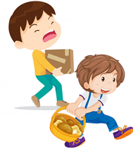
Temperature
/ˈtemprətʃər/
Model sentence
You should/shouldn’t _____________.
Yes, I will. Thanks.
OK, I won't. Thanks
go to the
doctor
take a rest
carry
heavy things
eat a lot of
sweets
go to the
dentist
eat a lot
of fruit
Earache
/ˈɪəreɪk/

Slide 18

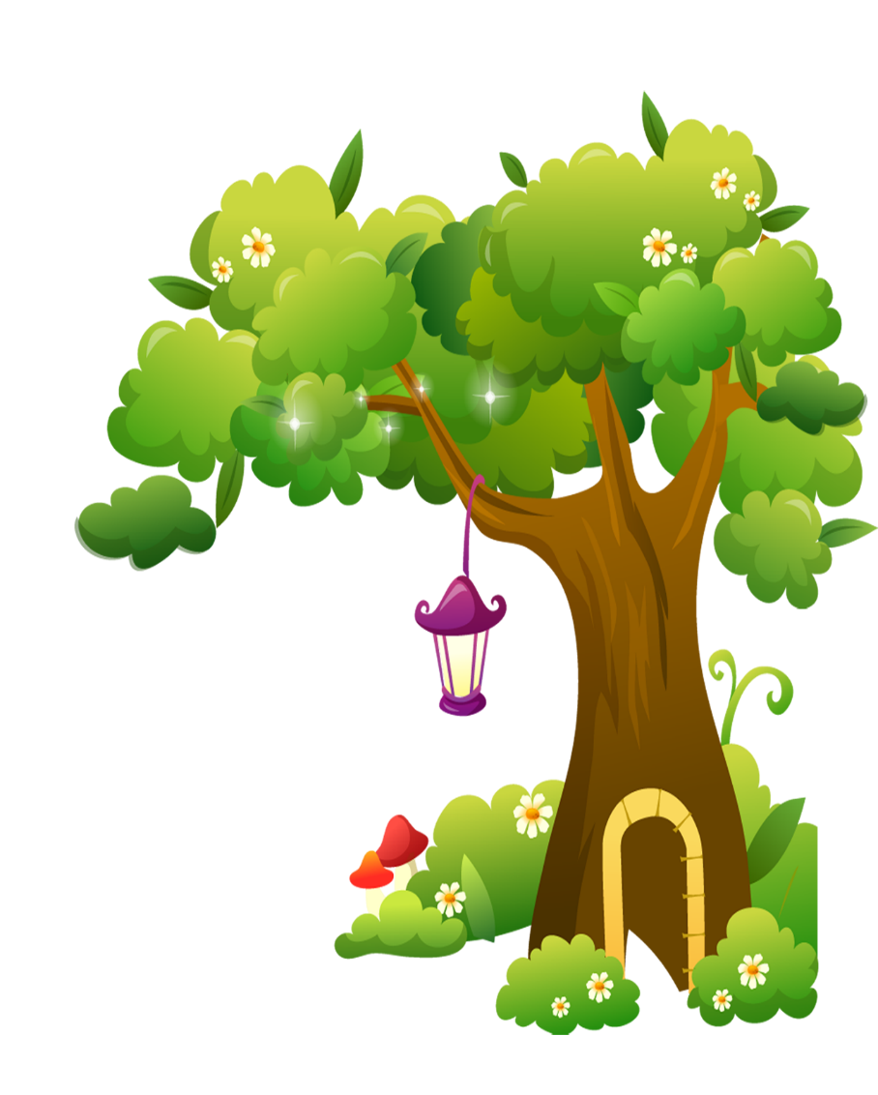
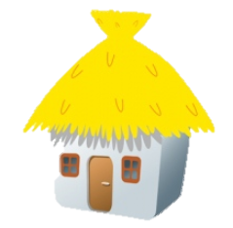

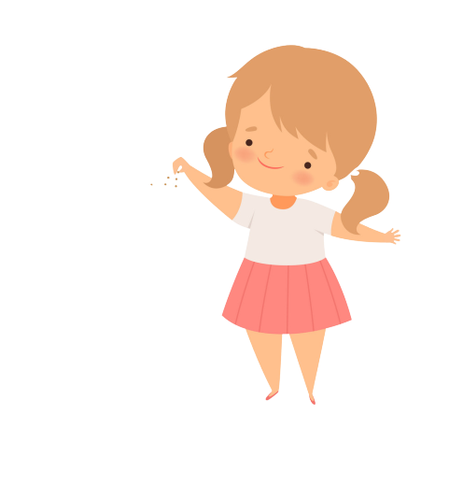

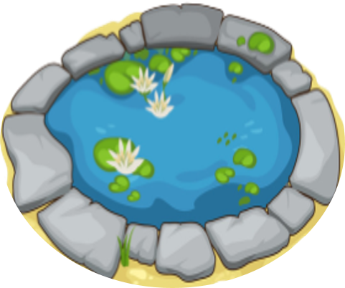
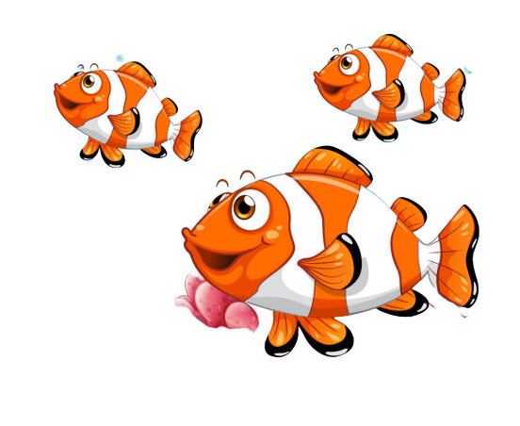
Bống bống bang bang
Mỗi câu trả lời đúng là
CÂU THẦN CHÚ giúp cá Vàng
ngoi lên mặt nước nhận thức ăn.
Nào chúng mình cùng giúp
bạn nhỏ cho cá Vàng ăn nhé!
START

Slide 19

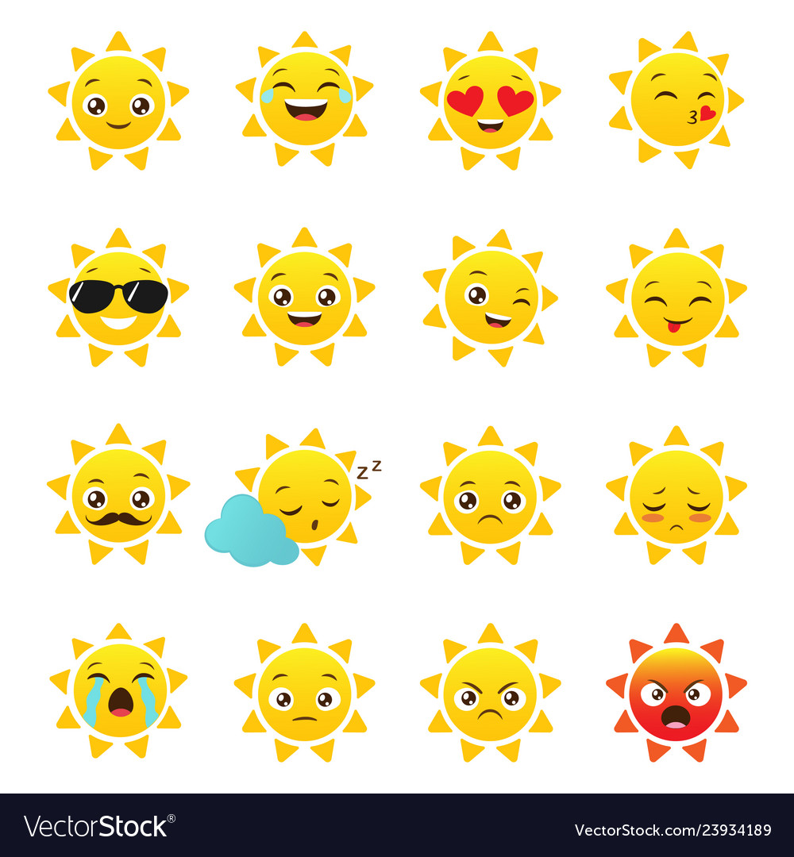
I have a toothache.
You _____ go to the dentist.
Next
Should
Shouldn’t
Sai
Notes:
YOUTUBE: MsPham.
Facebook: Dạy và học cùng công nghệ.

Slide 20
I have a backacke.
You _____ carry heavy things.
Next
Should
Shouldn’t
Sai

Slide 21
I have a toothache.
You _____ eat a lot of sweet.
Next
Should
Shouldn’t
Sai

Slide 22
I have a stomch ache.
You _____ go to the doctor.
Next
Should
Shouldn’t
Sai
Notes:
YOUTUBE: MsPham.
Facebook: Dạy và học cùng công nghệ.

Slide 23
I have a stomach ache.
You _____ eat a lot of sweet.
Next
Should
Shouldn’t
Sai

Slide 24
I have a fever.
You _____ go to school.
Next
Should
Shouldn’t
Sai
Notes:
YOUTUBE: MsPham.
Facebook: Dạy và học cùng công nghệ.

Slide 25
I have a flu.
You _____ take a rest.
Next
Should
Shouldn’t
Sai
Notes:
YOUTUBE: MsPham.
Facebook: Dạy và học cùng công nghệ.

Slide 26
Next
I have a flu.
You should
go to school
You should
take a rest
You should
go to the dentist
Notes:
YOUTUBE: MsPham.
Facebook: Dạy và học cùng công nghệ.

Slide 27
Next
I have a sore throat.
You should carry heavy things.
You shouldn’t
take a rest
You should
take a rest
Notes:
YOUTUBE: MsPham.
Facebook: Dạy và học cùng công nghệ.

Slide 28
Next
I have a backache.
You shouldn’t
carry heavy things.
You should
carry heavy things.
You shouldn’t
take a rest
Notes:
YOUTUBE: MsPham.
Facebook: Dạy và học cùng công nghệ.

Slide 29
Next
I have a toothache.
You shouldn’t
eat a lot of fruit.
You shouldn’t eat
a lot of sweet.
You should eat
a lot of sweet.
Notes:
YOUTUBE: MsPham.
Facebook: Dạy và học cùng công nghệ.

Slide 30
Next
You should
eat a lot of fruit.
I have an apple.
I have a pen.
I have a flu.
Notes:
YOUTUBE: MsPham.
Facebook: Dạy và học cùng công nghệ.

Slide 31
THANK YOU!
Next
Notes:
YOUTUBE: MsPham.
Facebook: Dạy và học cùng công nghệ.

Slide 32

4. Listen and complete.
 | Health problem | Should | Shouldn't
1. Quan
2. Tony
3. Phong
4. Mrs Green
go to
the doctor
stomach ache
fever
go to school
toothache
eat ice cream
carry
heavy things
backache

Slide 33
5. Read and complete.
Quan: Where's Phong?
Mai: He can't go to school today.
Quan: Why not? What's the (1) _________ with him?
Mai: He (2) _______ a bad cough and is going to see the (3) __________ this morning.
Quan: Oh, really? Poor him!
Mai: What's the matter with you, Tony?
Tony: I have a pain in my (4) __________ .
Mai: Oh, dear. You should take a (5) ______ now and go to the doctor later.
Tony: Yes, I will. Thanks, Mai.
stomach
doctor
matter
rest
has
matter
has
doctor
stomach
rest

