Slide 1
Unit 10
When will
Sports Day be?
Lesson 1

Slide 2
VOCABULARY

Slide 3


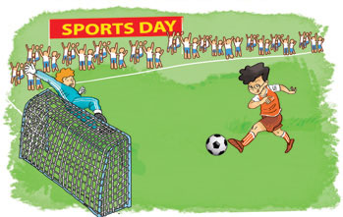
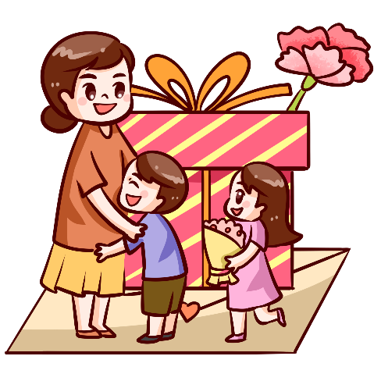

Verd – (v)
A. Vocabulary
Sports Day
Teachers' Day
Children's Day
Ngày hội thể thao
Ngày nhà giáo
Ngày thiếu nhi
Women’s Day
Independence Day
Ngày phụ nữ
Ngày Quốc Khánh

Slide 4

Verd – (v)
Match
Sports Day
Teachers' Day
Children's Day
Independence Day
Women’s Day

Slide 5
GRAMMAR

Slide 6
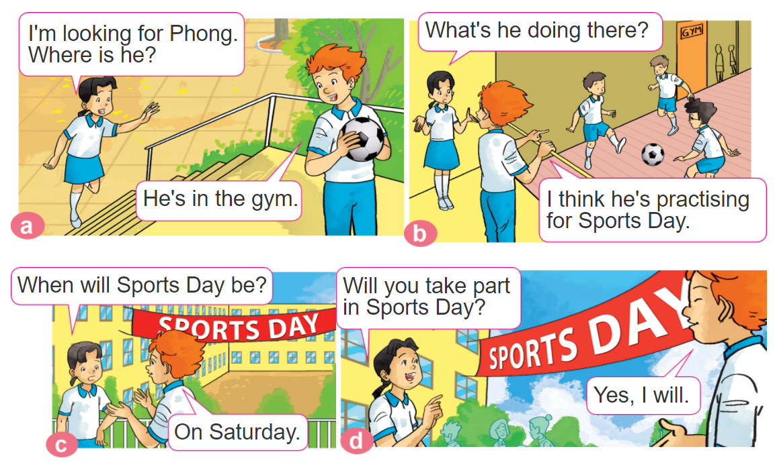

1. Look, listen and repeat.

Slide 7


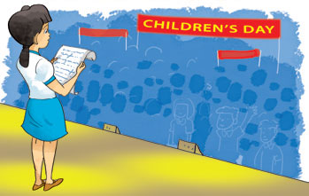


2. Point and say
When will ___________ be?
It'll be on ______.
Sports Day
Saturday
Children's Day
Teachers' Day
Friday
Sunday
Independence Day
Thursday

Slide 8

B. Grammar
Hỏi và đáp ngày nào đó sẽ diễn ra vào ngày nào:
(Khi nào sẽ đến ngày ______?)
+ ngày lễ
When will ___________ be?
It'll be on ______.
+ thứ
(Nó vào thứ ____.)

Slide 9


3. Let’s talk
When will______be?
It'll be on _______.

Slide 10
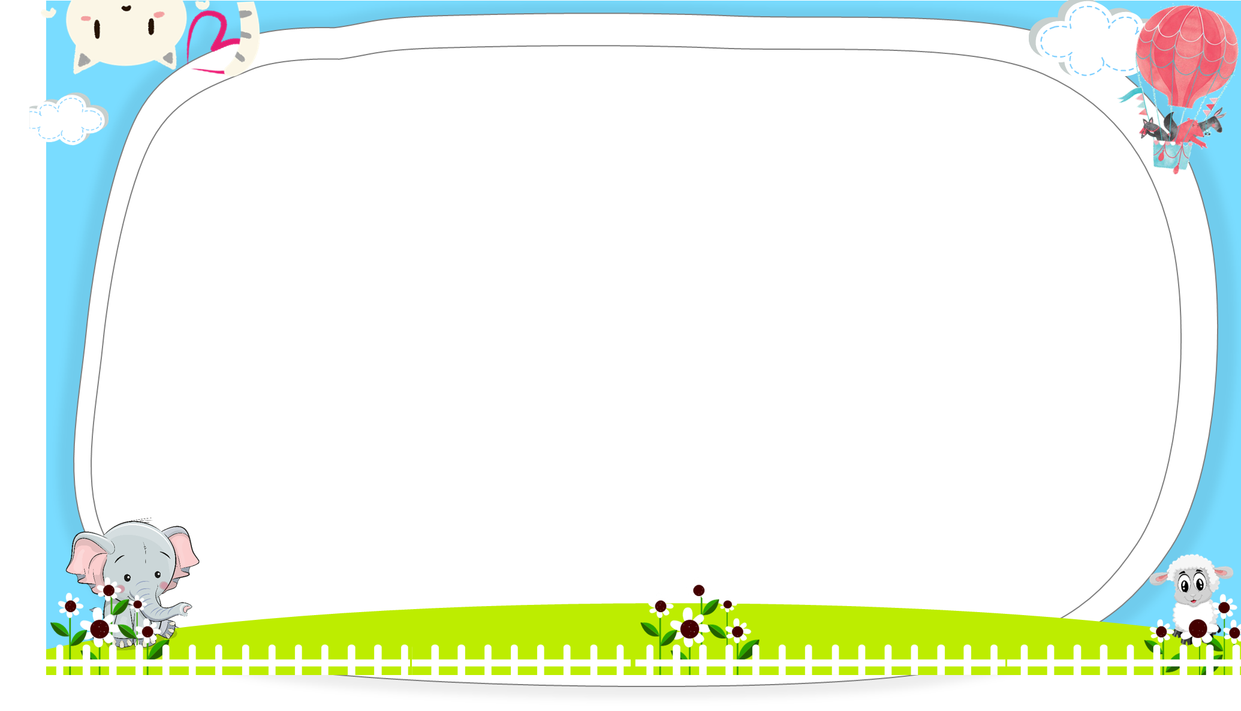
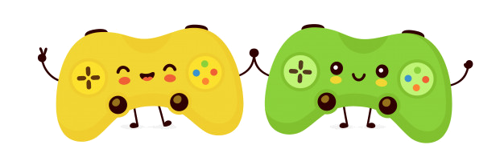



AND
GAME
PLAY

Slide 11



It'll on
Sunday.
It’ll be on
Sunday.
When will Women’s Day be?
Next

Slide 12
It be on
Monday.
It’ll be on
Monday.
When will Independence Day
be?
Next

Slide 13
It'll be on
Sunday.
It'll on
Sunday.
When will Teachers’ Day be?
Next

Slide 14
What will
When will
_____ ______ Independence Day be?
It'll be on Friday.
Next

Slide 15
be
is
What will Children’s Day ____?
It'll be on Saturday.
Next

Slide 16

Next

Slide 17

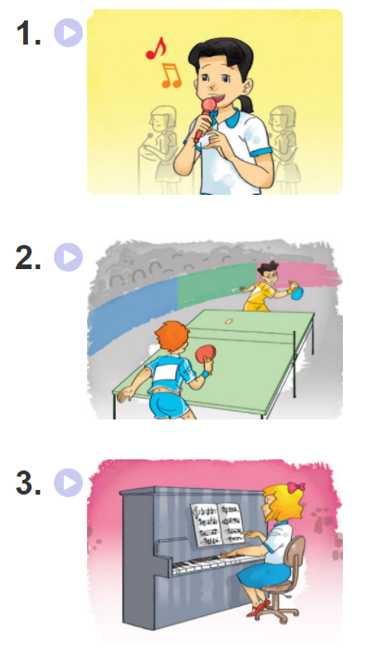
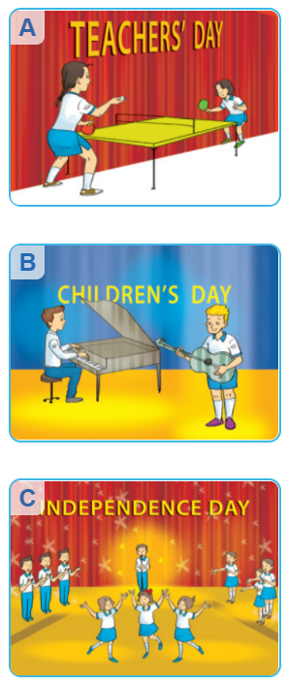
4. Listen and match

Slide 18
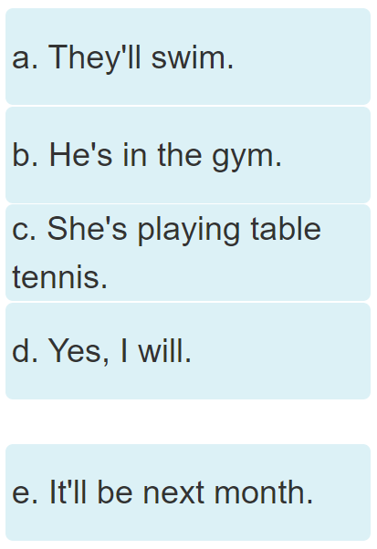
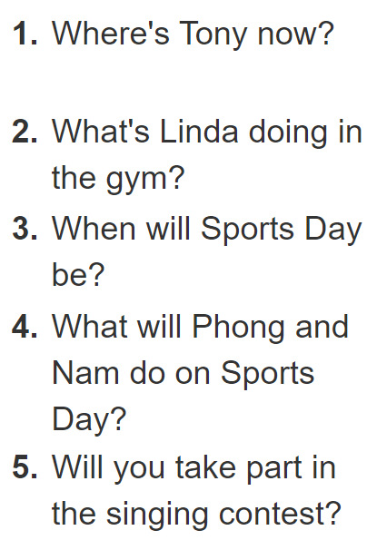
5. Read and complete

Slide 19
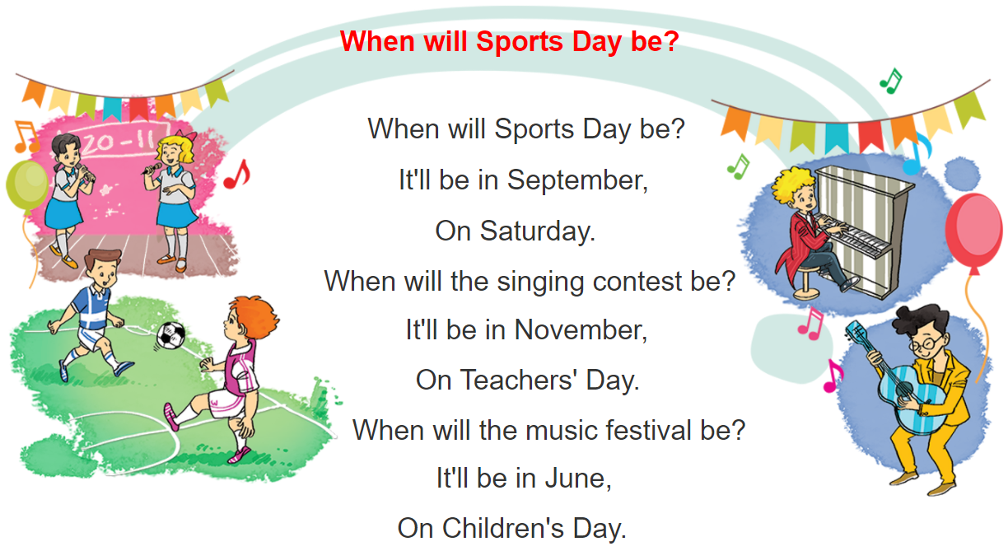

6. Let’s sing

