Slide 1
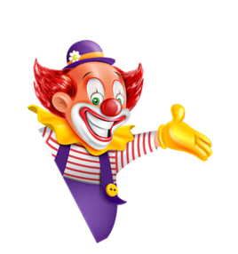

I always get up early.
How about you?
Unit
02
Lesson 1

Slide 2
Vocabulary

Slide 3
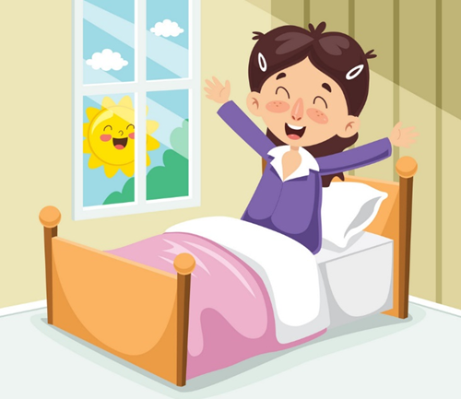
Get up

Slide 4
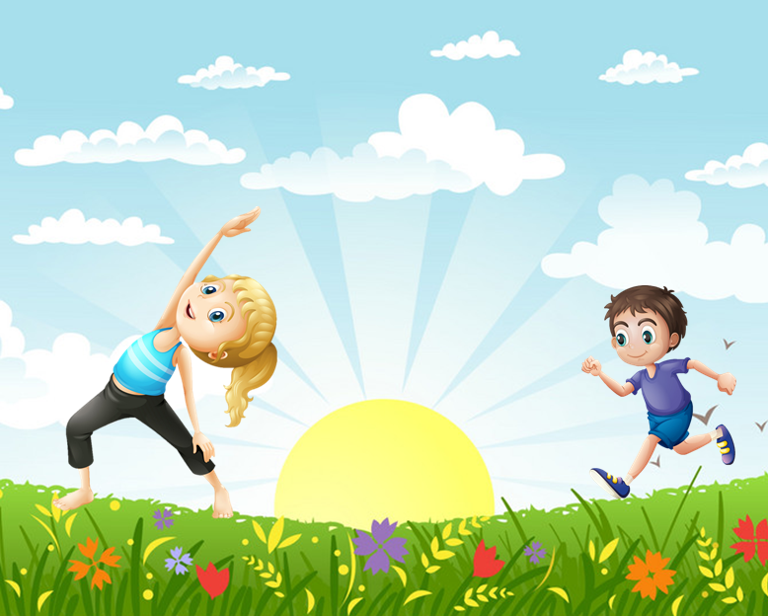
Do morning exercise

Slide 5
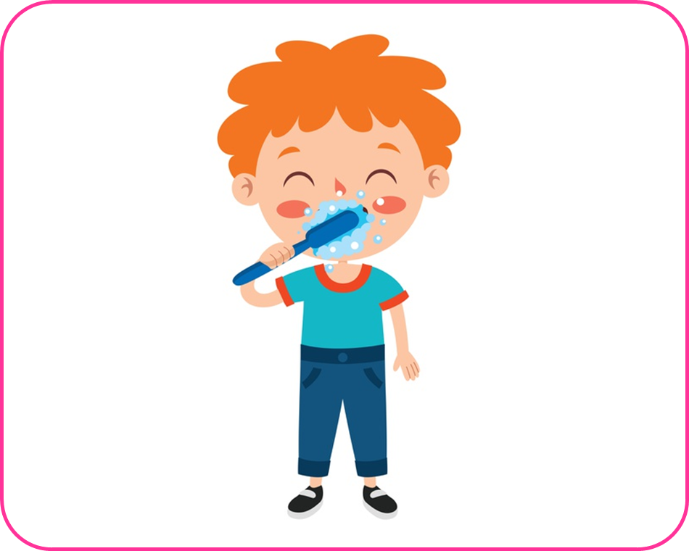
Brush my teeth

Slide 6
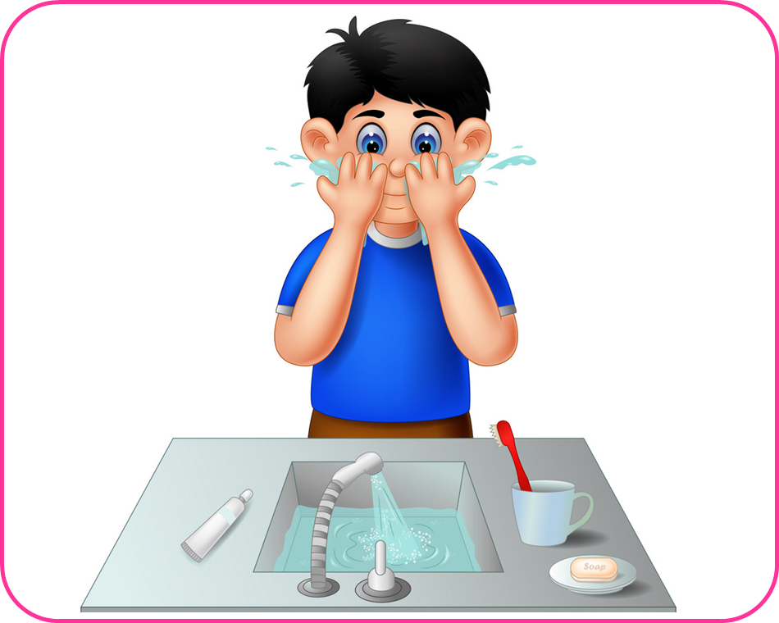
Wash my face

Slide 7
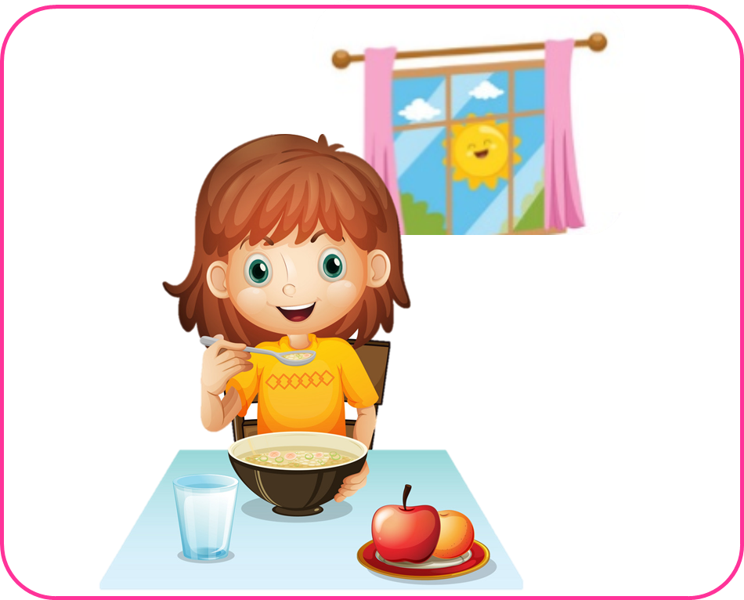
Have breakfast

Slide 8
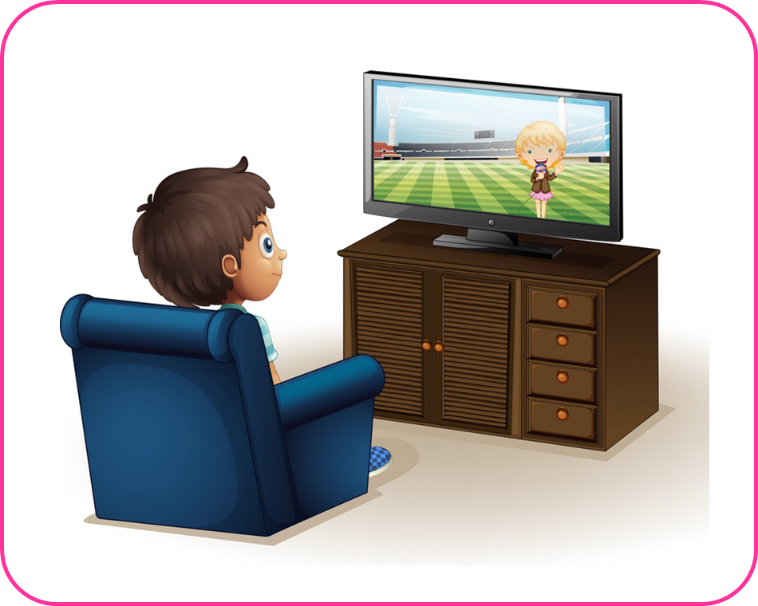
Watch TV

Slide 9
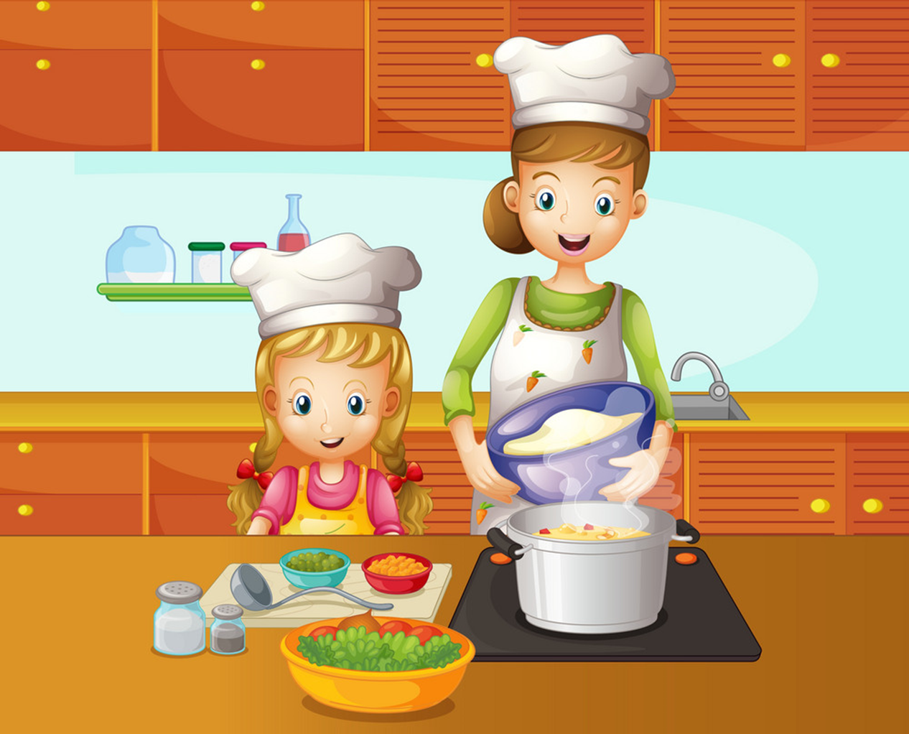
Cook dinner

Slide 10
1
2
3
Have breakfast
Do morning exercise
Brush my teeth
4
5
6
7
Wash my face
Get up
Cook dinner
Watch TV

Slide 11
1
2
3
✔
Cook dinner

Slide 12
1
2
3
✔
Brush my teeth

Slide 13
1
2
3
✔
Get up

Slide 14
1
2
3
✔
Wash my face

Slide 15
1
2
3
✔
Watch TV

Slide 16
1
2
3
✔
Do morning exercise

Slide 17
1
2
3
✔
Have breakfast

Slide 18
1
2
3
Nấu ăn
Ăn sáng
Tập thể dục
buổi sáng
Have breakfast
Do morning exercise
Brush my teeth
Get up
Wash my face
Do morning exercise
Cook dinner
Have breakfast
Watch TV

Slide 19
4
5
6
7
Thức dậy
Đáng răng
Xem TV
Rửa mặt
Wash my face
Brush my teeth
Watch TV
Have breakfast
Have breakfast
Brush my teeth
Wash my face
Get up
Watch TV
Get up
Do morning
exercise
Cook dinner

Slide 20











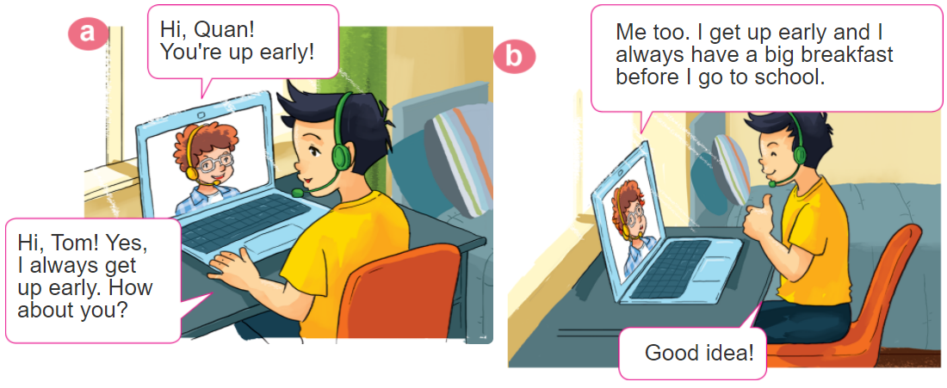
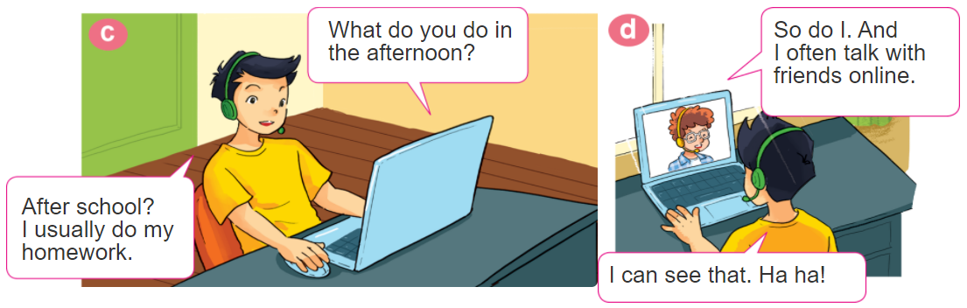
1. Look, listen and repeat

Slide 21
2. Point and say
What do you do in the _________?
I usually _____________________.
morning
do morning exsercise

Slide 22
2. Point and say
What do you do in the _________?
I often ____________.
afternoon
cook dinner

Slide 23
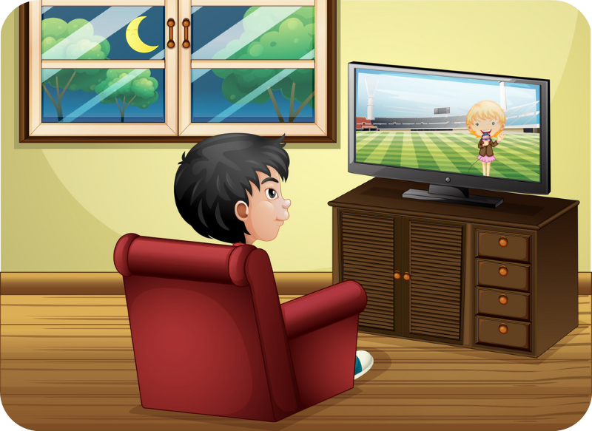
2. Point and say
What do you do in the _________?
I sometimes ____________.
evening
watch TV

Slide 24
2. Point and say
What do you do in the _________?
I usually _____________________.
morning
do morning exsercise

Slide 25
2. Point and say
What do you do in the _________?
I often ____________.
afternoon
cook dinner

Slide 26
2. Point and say
What do you do in the _________?
I sometimes ____________.
evening
watch TV

Slide 27
Sentences:
What do you do in the morning?
I always brush my teeth.
What do you do in the afternoon?
I sometimes get up early.
What do you do in the evening?
I usually wash my face.

Slide 28
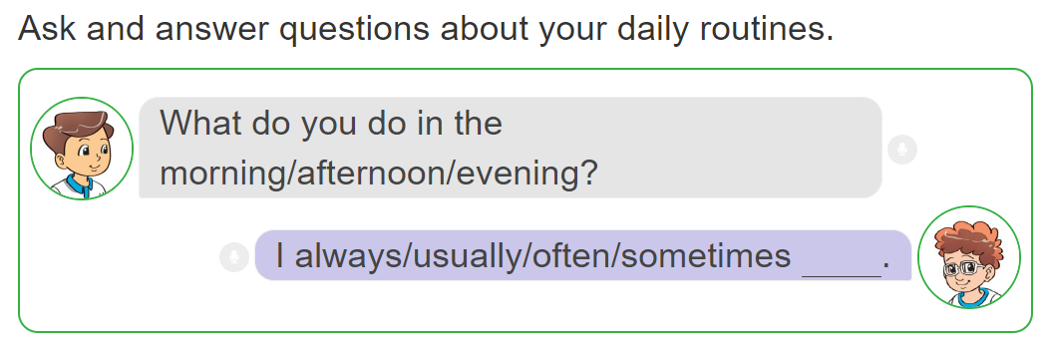
3. Let’s talk.

Slide 29
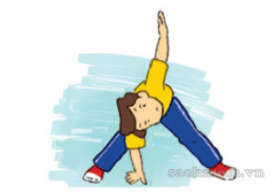
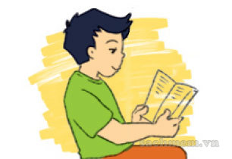
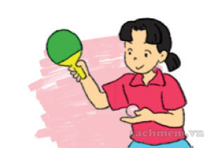
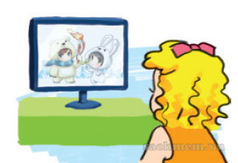
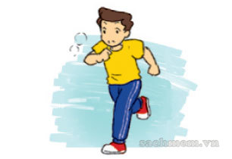
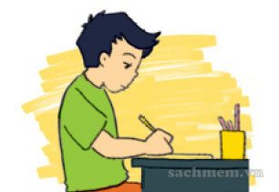
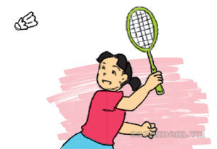
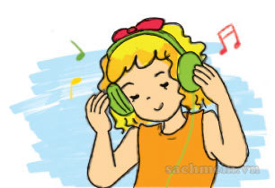
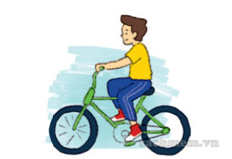
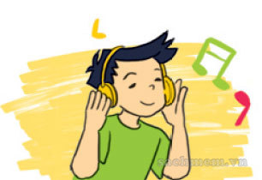
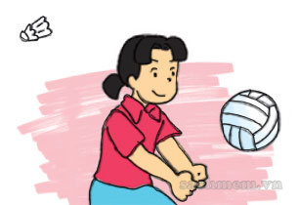
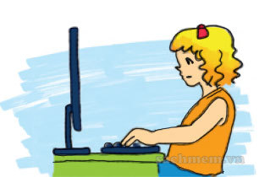
4. Listen and tick
1
2
3
4
a
a
a
a
✔
✔
b
b
b
b
✔
✔
c
c
c
c

Slide 30
5. Read and complete.
play do TV like usually
Hi. My name is Nam. Every morning, I get up early. I (1) do morning exercise, have breakfast and then go to school. After school, I (2) usually do homework with my classmates. Then I often go to the sports centre and (3) play football. In the evening, I sometimes watch (4) TV . I (5) like watching films after dinner.
_______
__________
______
______
______

Slide 31
Extra sentences:
What does she do in the morning?
She always gets up.
What does he do in the evening?
He usually washes his face.

Slide 32

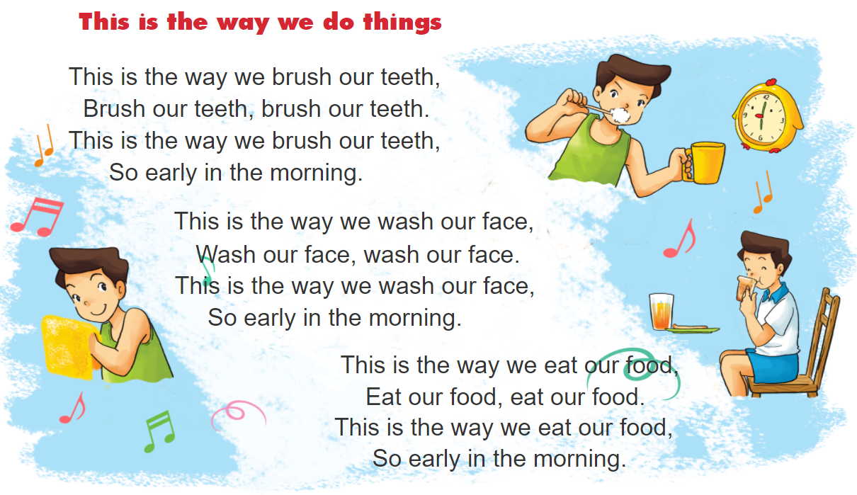

6. Let’s sing.

