Slide 1



Unit 1
What’s your address?
Lesson 2
Teacher: Ms. Hoa

Slide 2

Vocabulary
Big
/big/
Small
/smɔːl/
(a) nhỏ

Slide 3
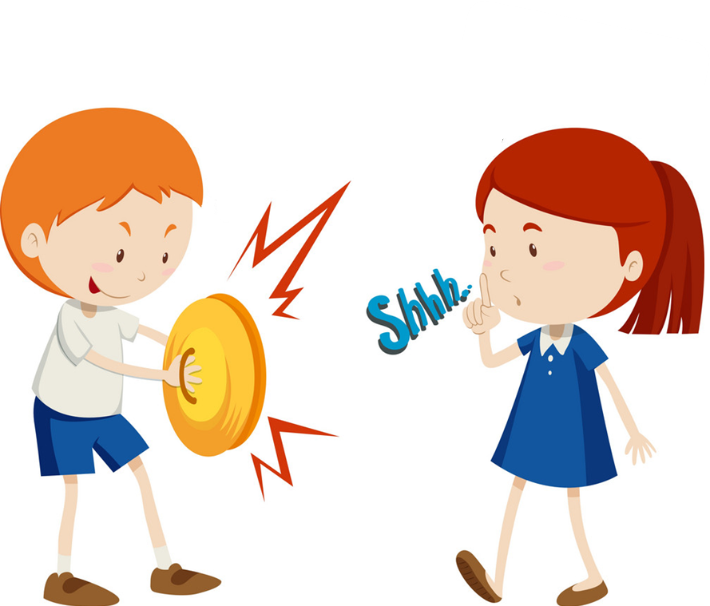
Vocabulary
Noisy
/ˈnɔɪzi/
(a) Ồn ào
quiet
/ˈkwaɪət/
(a) Yên tĩnh

Slide 4
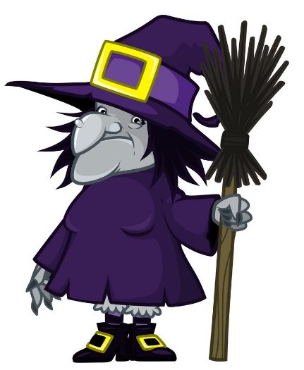

Vocabulary
beautiful
/ˈbjuːtɪfl/
(a) đẹp, xinh

Slide 5
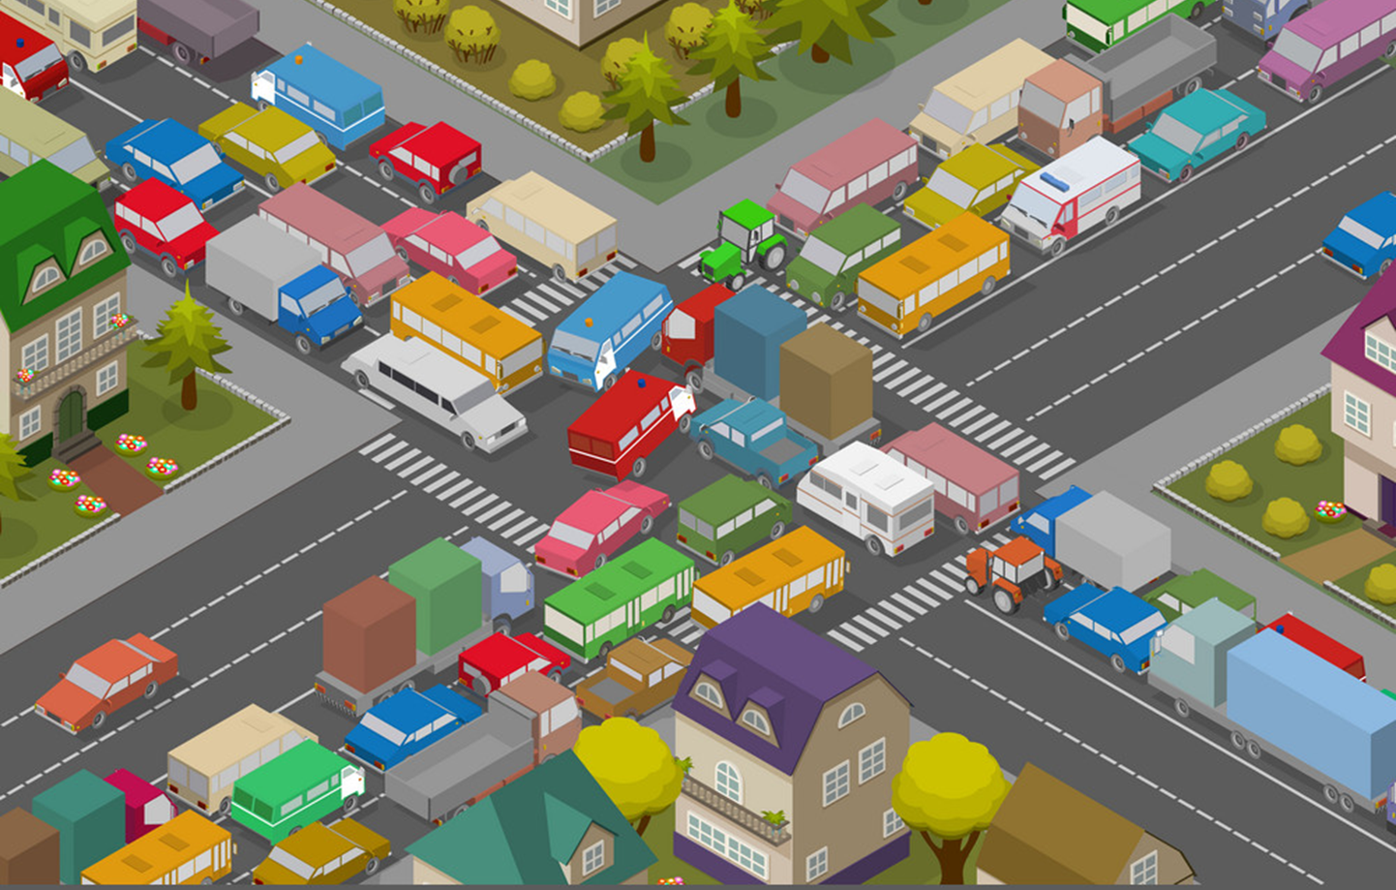
Vocabulary
crowded
/ˈkraʊdɪd/
(a) Đông đúc

Slide 6

Vocabulary
busy
/ˈbɪzi/
(a) bận rộn

Slide 7

Vocabulary
large
/lɑːrdʒ/
(a) rộng

Slide 8

Vocabulary
far
/fɑː/
(a) xa

Slide 9


Vocabulary
hometown
/ˈhəʊmtaʊn/
(n) quê

Slide 10

Vocabulary
mountain
/ˈmaʊntən/
(n) núi

Slide 11

Vocabulary
island
ˈaɪlənd/
(n) Hòn đảo

Slide 12




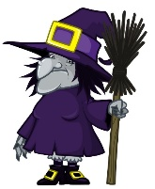


Vocabulary
island
mountain
hometown
far
noisy
big
large
quiet
small
beautiful
crowded

Slide 13
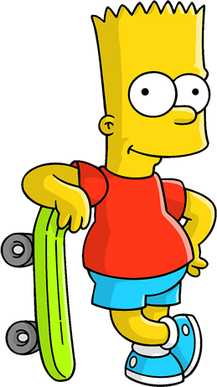

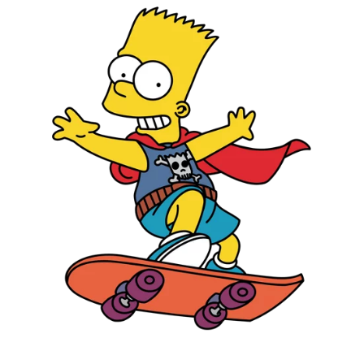

WHERE IS
BART
?

Slide 14





TIME’S UP
NEXT
A
I live on an village.
B
I live on an Island.
C
I live on an mountain.

Slide 15

TIME’S UP
NEXT
A
Hai Phong is my mountain.
B
Hai Phong is my island.
C
Hai Phong is my hometown.

Slide 16
TIME’S UP
NEXT
A
Near
B
Far
C
Small

Slide 17

TIME’S UP
NEXT
A
moutain
B
city
C
village

Slide 18


TIME’S UP
NEXT
A
Crowded
B
Beautiful
C
Quiet

Slide 19

TIME’S UP
NEXT
A
Large
B
Small
C
Noisy

Slide 20
TIME’S UP
NEXT
A
Noisy
B
Busy
C
Quiet

Slide 21
TIME’S UP
NEXT
A
Noisy
B
Small
C
Big

Slide 22
TIME’S UP
NEXT
A
Crowded
B
Quiet
C
Moutain

Slide 23
TIME’S UP
NEXT
A
Big
B
Small
C
Noisy

Slide 24
Welldone!
END

Slide 25

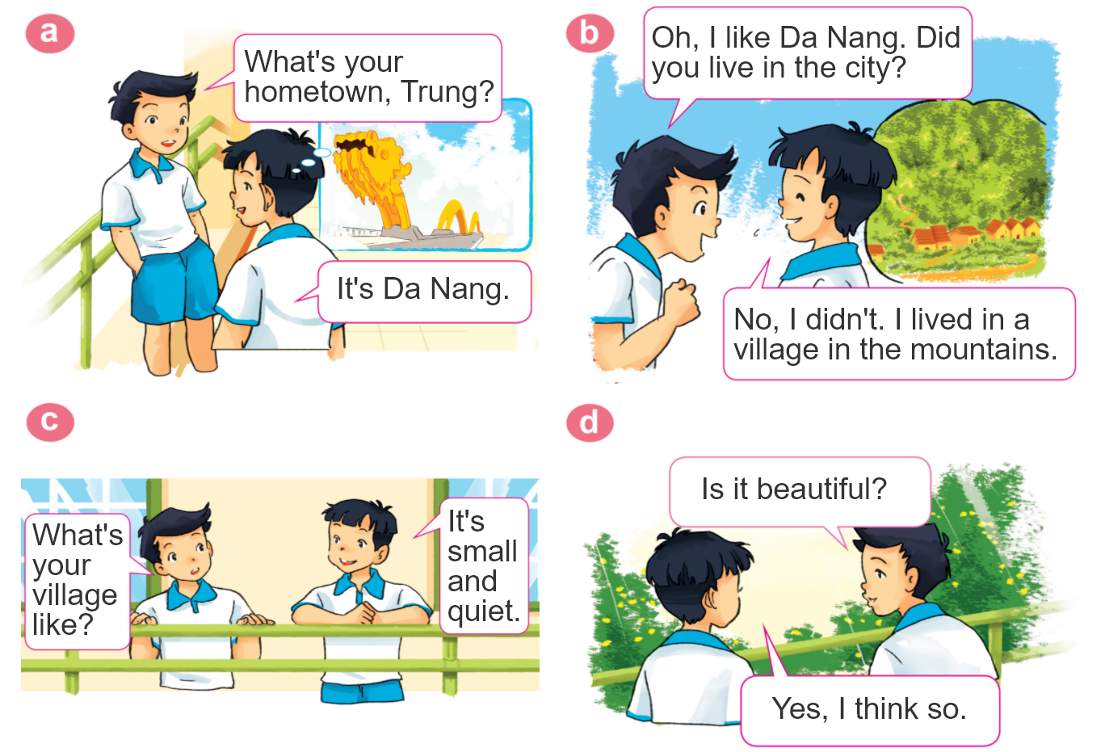
1. Look, listen and repeat.

Slide 26
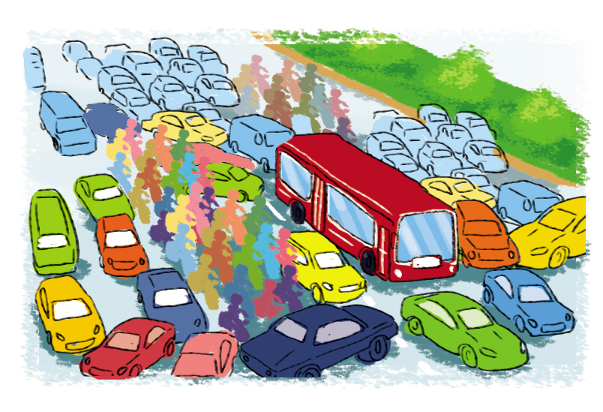

2. Point and say
city,
big and busy
What's the ________ like?
city
It's __________________.
big and busy

Slide 27
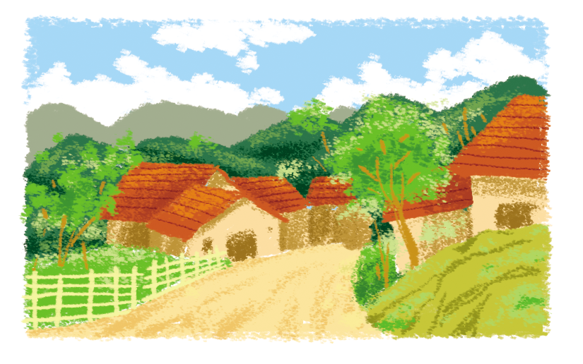
2. Point and say
village,
far and quiet
What's the ________ like?
village
It's __________________.
far and quiet

Slide 28
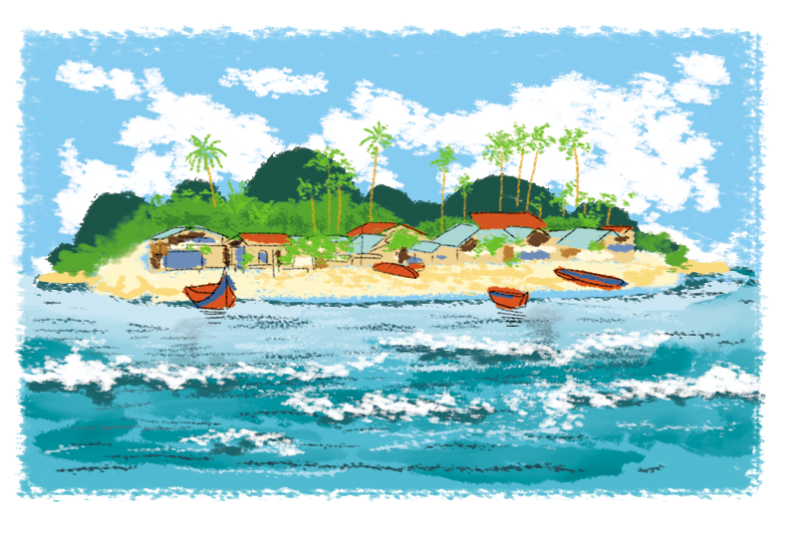
2. Point and say
island,
small and pretty
What's the ________ like?
island
It's __________________.
small and pretty

Slide 29
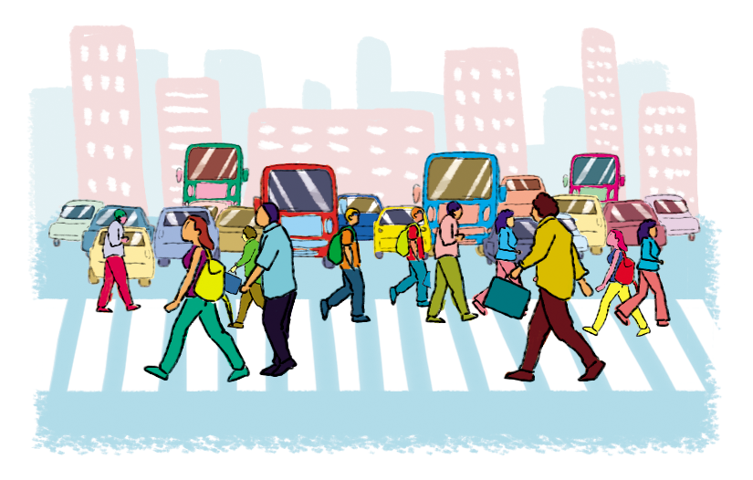
2. Point and say
town,
large and crowded
What's the ________ like?
town
It's __________________.
large and crowded

Slide 30




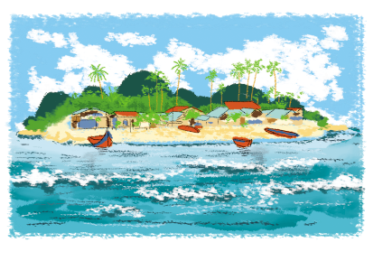
2. Point and say
What's the ________ like?
It's ___________.
city,
big and busy
town,
large and crowded
village,
far and quiet
island,
small and pretty

Slide 31
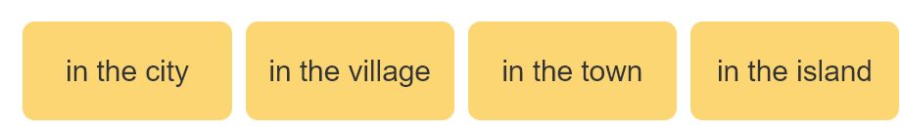
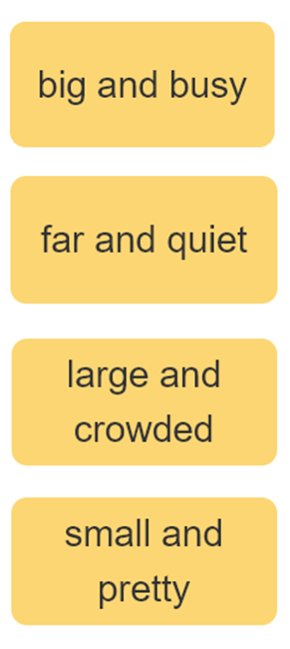

3. Let’s talk
I live ____________.
Where do you live?
What's it like?
It’s ______.
Who do you live with?
I live with ________.
parents
grandparents

Slide 32

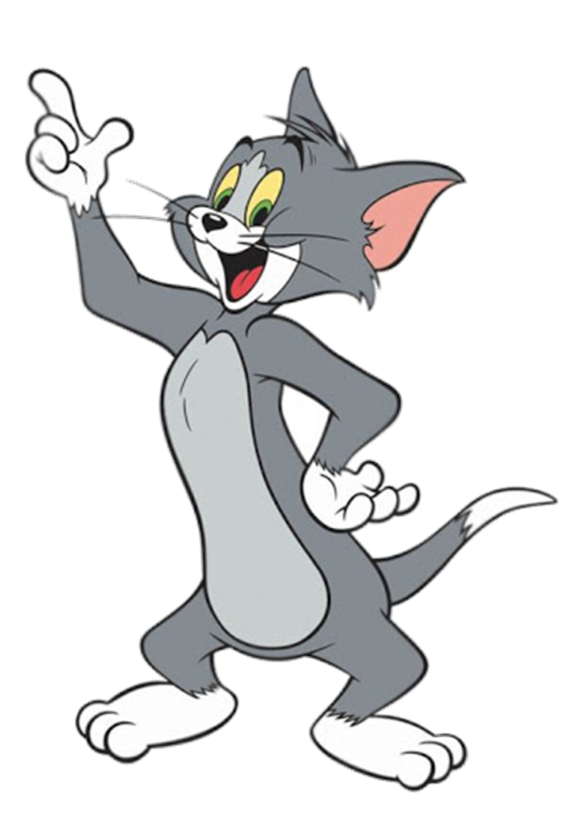

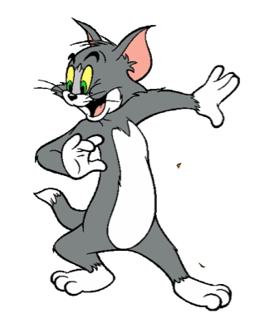


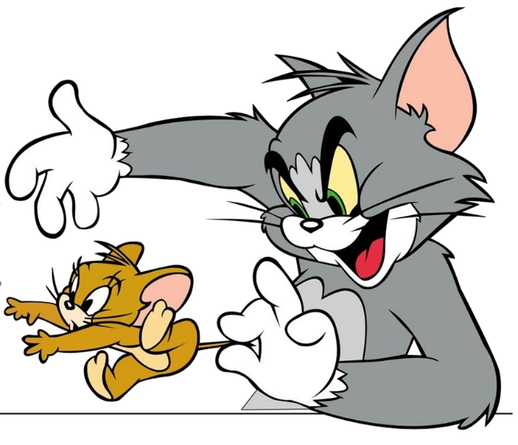
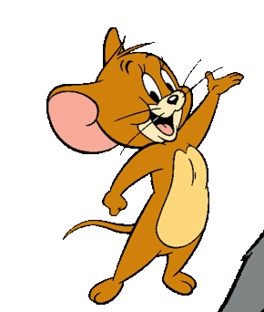

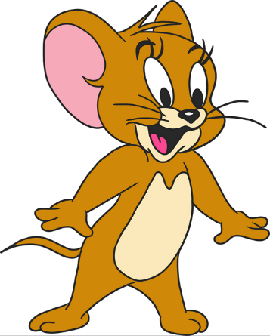


Mai: Who do you live with?
Trung: My grandparents
Notes:
Ms Huyền Phạm - 0936.082.789 – YOUTUBE: MsPham. Facebook: Dạy và học cùng công nghệ.

Slide 33
What’s the like?
It’s small and pretty.
Notes:
Ms Huyền Phạm - 0936.082.789 – YOUTUBE: MsPham. Facebook: Dạy và học cùng công nghệ.

Slide 34
Where do you live?
It’s in Quang Ninh.
Check
I live
Notes:
Ms Huyền Phạm - 0936.082.789 – YOUTUBE: MsPham. Facebook: Dạy và học cùng công nghệ.

Slide 35


Good job!
Notes:
Ms Huyền Phạm - 0936.082.789 – YOUTUBE: MsPham. Facebook: Dạy và học cùng công nghệ.

Slide 36
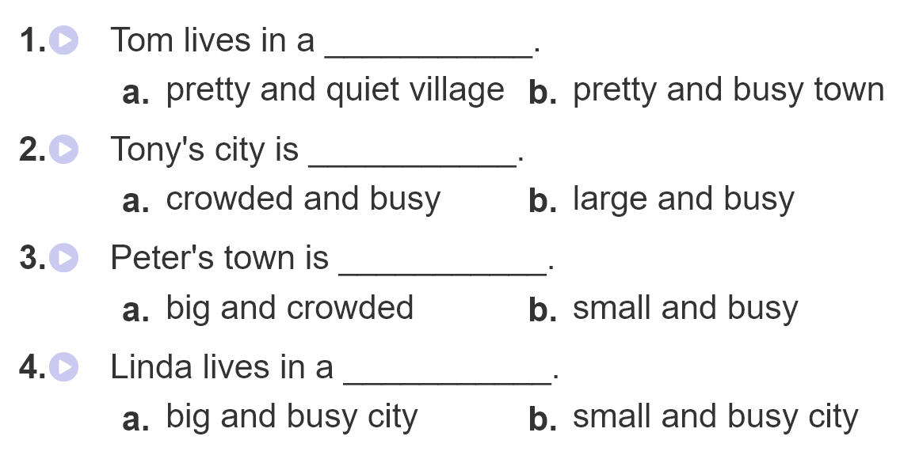
4. Listen and circle

Slide 37
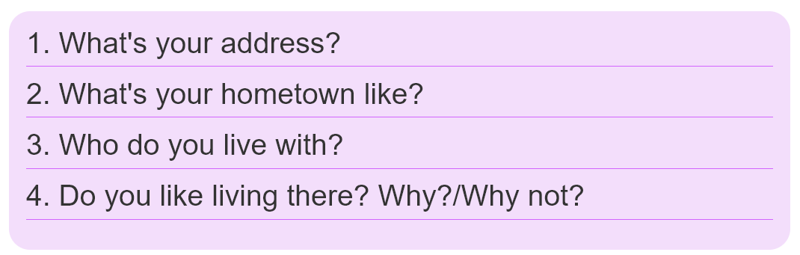
5. Write about you.

Slide 38
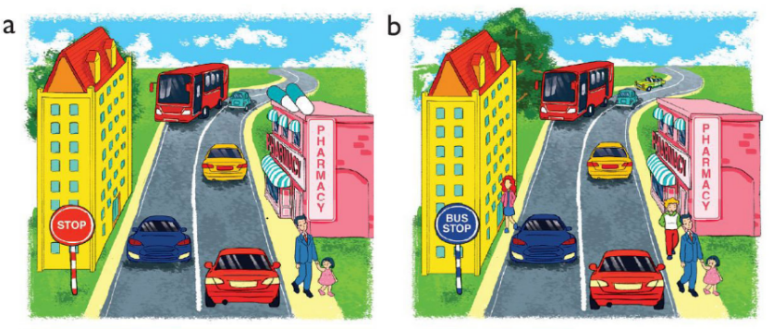
6. Let’s play
Spot the difference
(Click the different spot)

Slide 39



THANK YOU!
Welcome to join with me!
MsPham Powerpoint
Mspham

