Slide 1
Unit 6
HOW MANY LESSONS
DO YOU HAVE TODAY?
Lesson 1

Slide 2
VOCABULARY

Slide 3
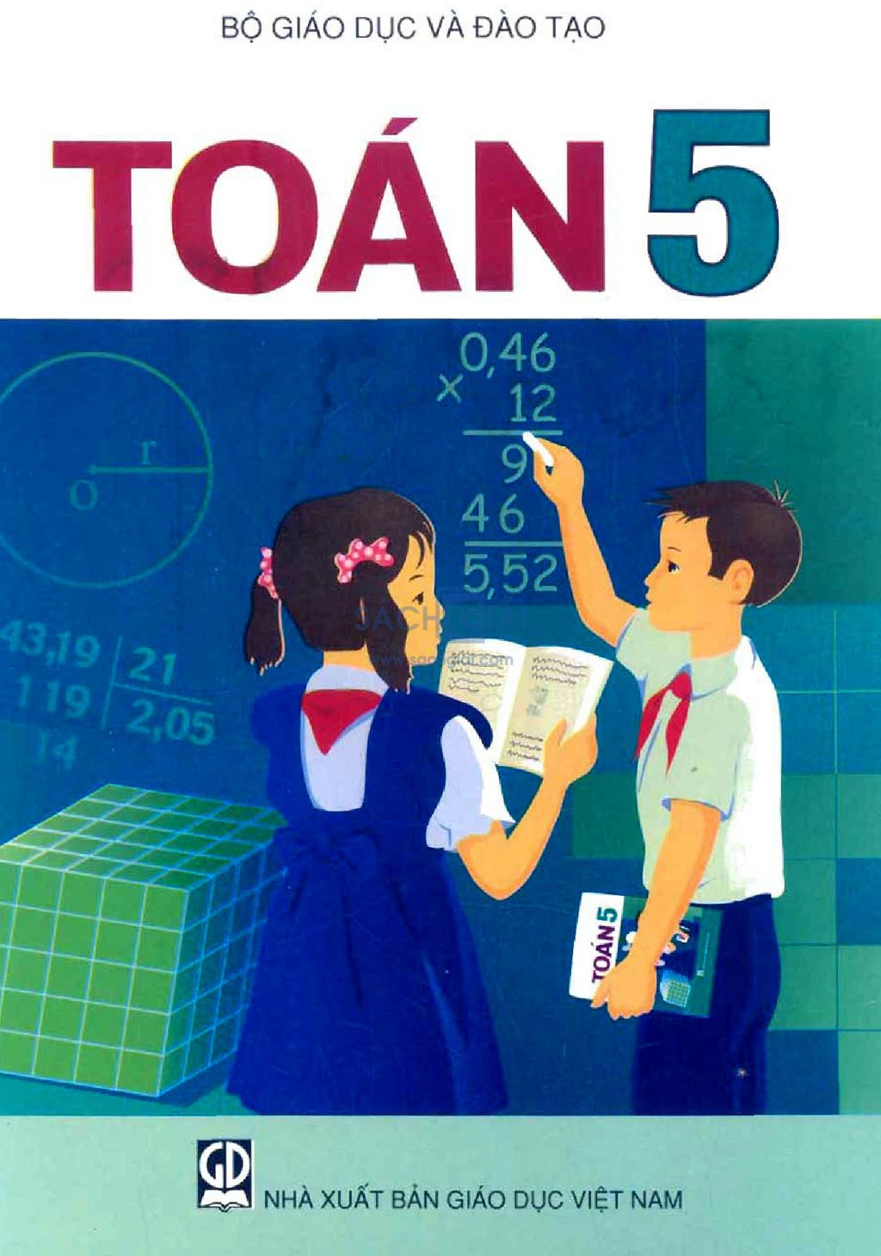


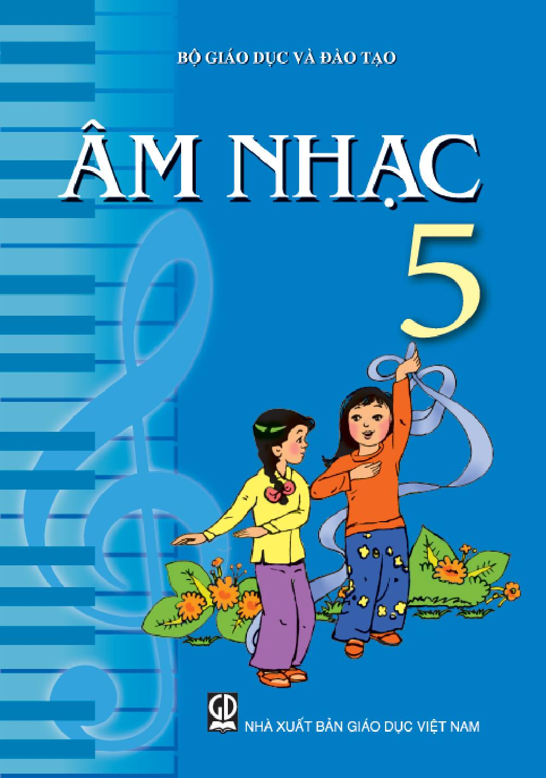
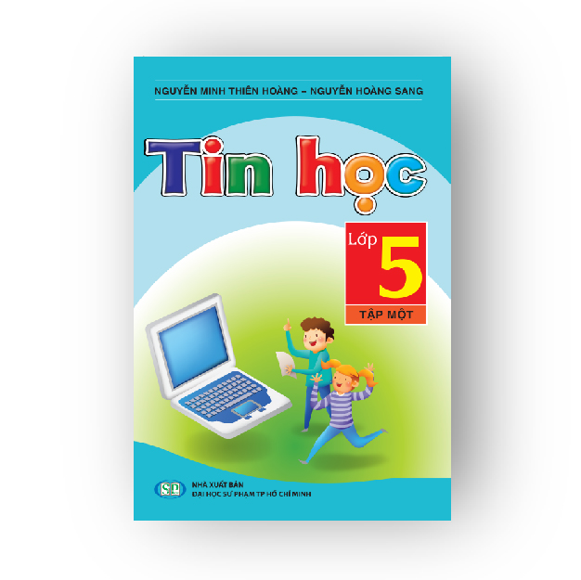


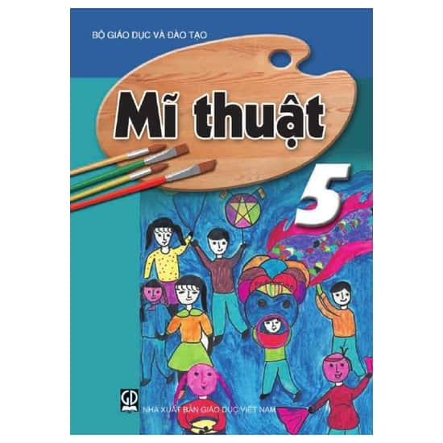
A. Vocabulary
Lessons
/ˈlesnz/
Maths
Vietnamese
English
Music
/mæθs/
/ˌviːetnəˈmiːz/
/ˈɪŋɡlɪʃ/
/ˈmjuːzɪk/
IT
PE
Science
Art
/ɪt/
/ˌpiː ˈiː/
/ˈsaɪəns/
/ɑːrt/

Slide 4




Look and tick
PE

Slide 5
Look and tick
English

Slide 6
Look and tick
Music

Slide 7
Look and tick
IT

Slide 8
Look and tick
Maths

Slide 9
Look and tick
Vietnamese

Slide 10
Look and tick
Science

Slide 11
Look and tick
Art

Slide 12
GRAMMAR

Slide 13
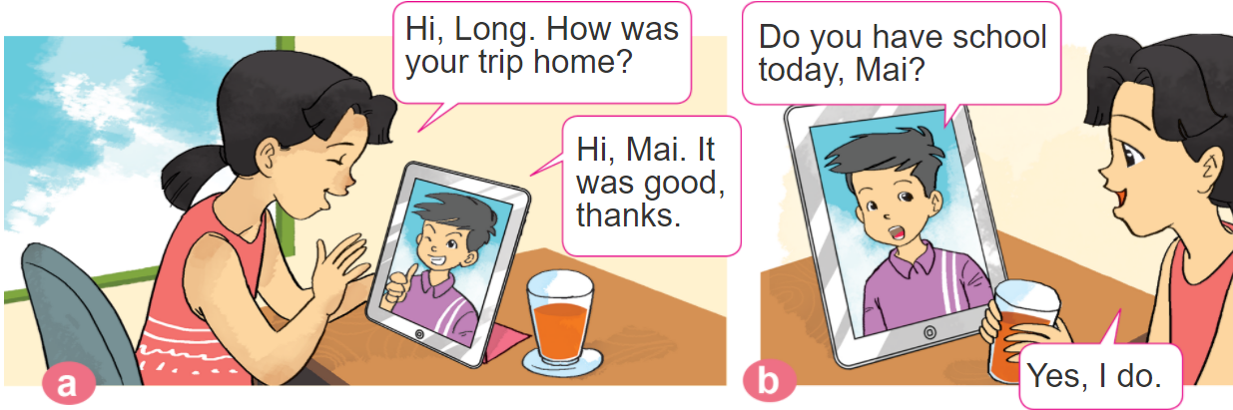
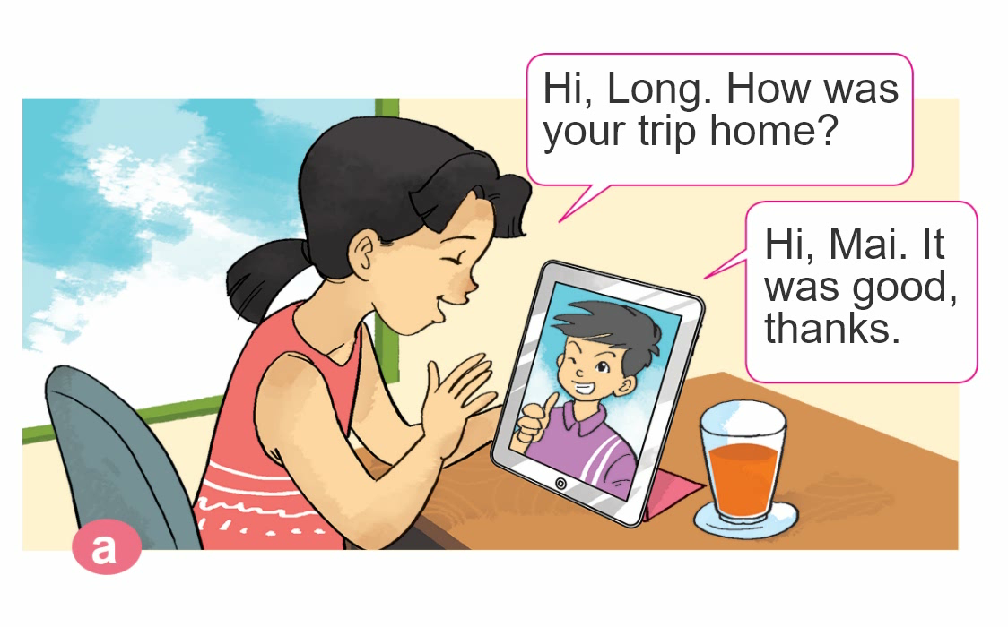
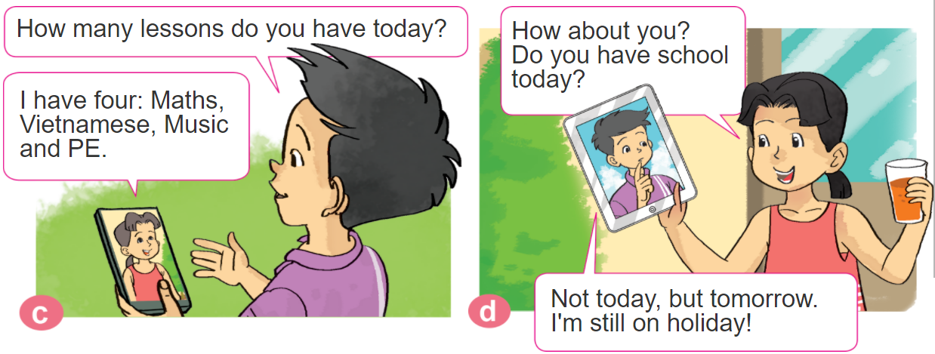

1. Look, listen and repeat.

Slide 14
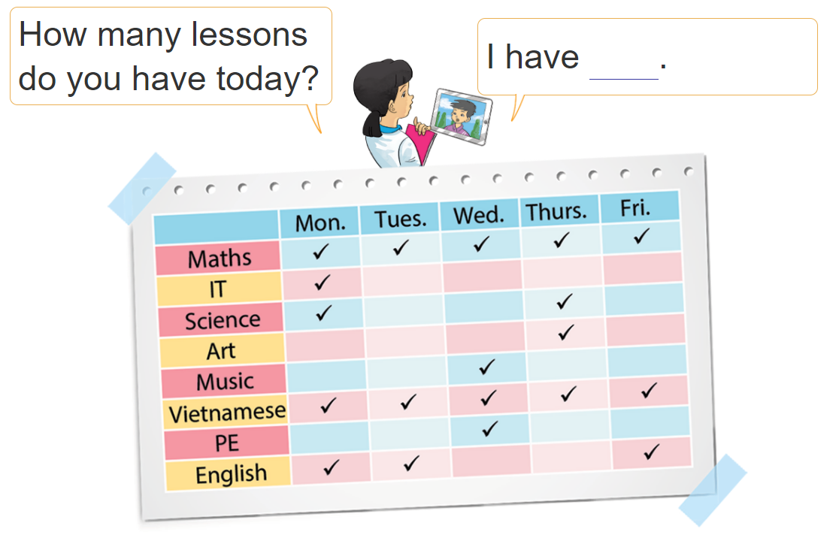
2. Point and say

Slide 15

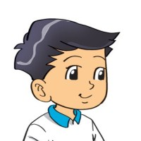
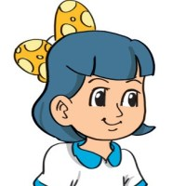


3. Let’s talk
(Hôm nay bạn có bao nhiêu môn học?
How many lessons do you have today?
I have ___________.
+ số môn học
I have ______________.
What lessons do you have today?
+ tên các môn học
(Tớ có ______)
(Hôm nay bạn có những môn gì?)

Slide 16


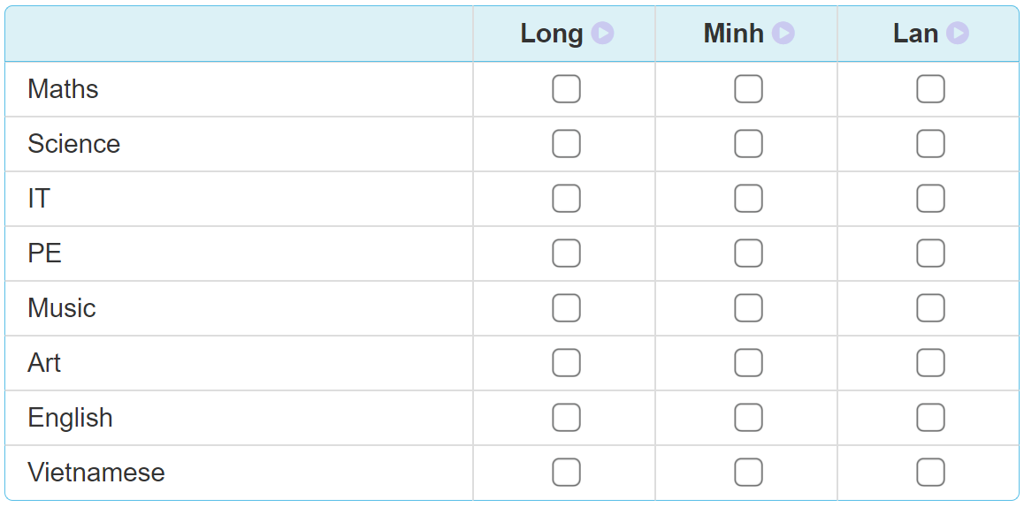
4. Listen and tick
✔
✔
✔
✔
✔
✔
✔
✔
✔
✔
✔
✔

Slide 17
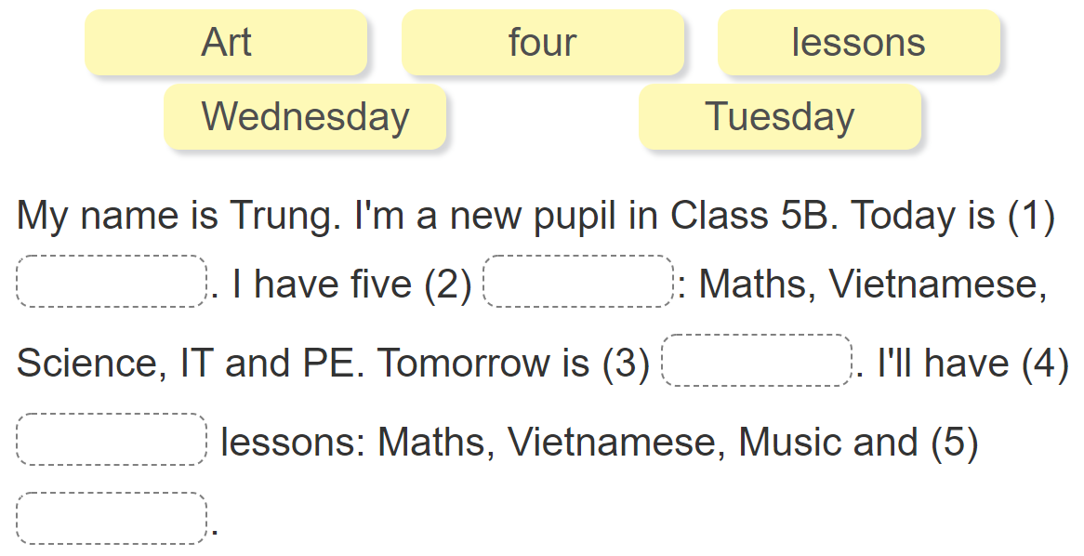
5. Read and complete
Tuesday
lessons
Wednesday
four
Art

