Slide 1

Unit 2
WHAT I CAN DO
CULTURE LESSON 1
PAGE 29

Slide 2
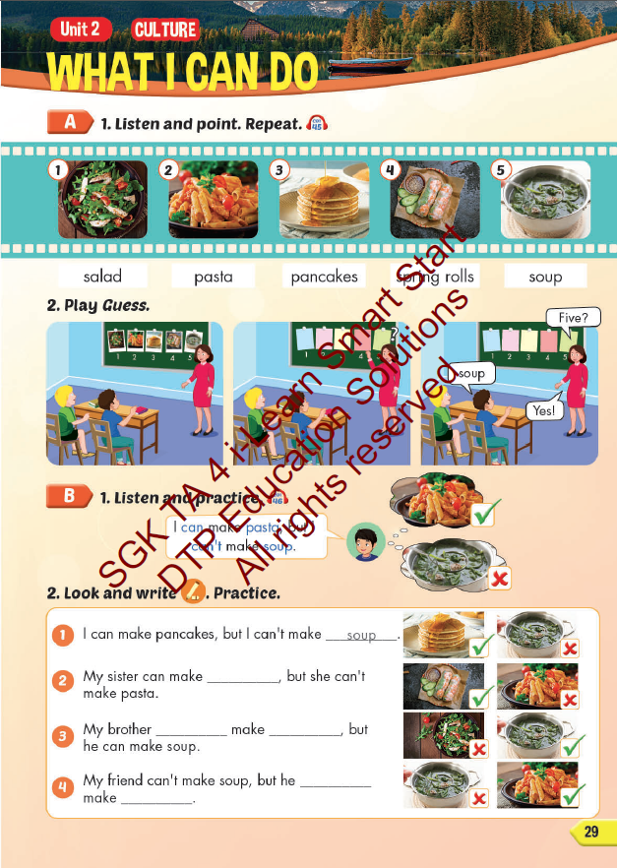
Lesson Outline
Warm-up
Vocabulary
Structure
Consolidation
Wrap-up

Slide 3
Objectives
By the end of this lesson, students will familiarize themselves with aspects of Australian and Vietnamese culture. Then students will be able to talk about foods in Australia and Vietnam.
Vocabulary: salad, pasta, pancakes, spring rolls, soup.
Structure: I can make pasta, but I can't make soup.

Slide 4

WARM UP

Slide 5

WHAT COUNTRY IS IT?

Slide 6
LIST 5 THINGS ABOUT VIETNAM!

Slide 7

WHAT COUNTRY IS IT?

Slide 8
LIST 5 THINGS ABOUT AUSTRALIA!

Slide 9

It’s time to learn …

Slide 10

New words
salad,
pasta,
pancakes,
spring rolls,
soup.

Slide 11

Presentation

Slide 12


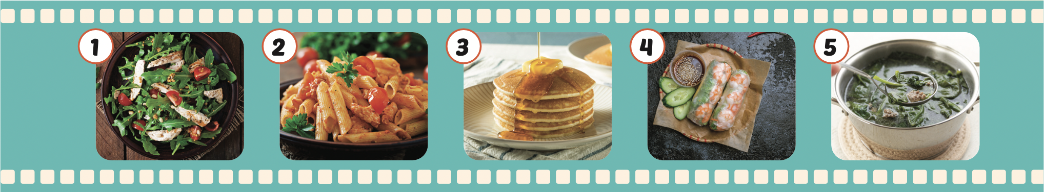
Click the icon to hear the sound.
salad
pasta
pancakes
spring rolls
soup

Slide 13
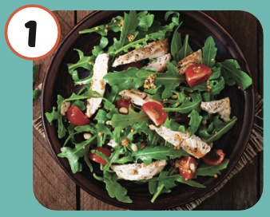
Click the picture to hear the sound.
salad
/ˈsæləd/
món rau trộn

Slide 14
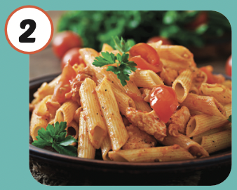
Click the picture to hear the sound.
pasta
/ˈpɑːstə/
mì ống, mì sợi

Slide 15
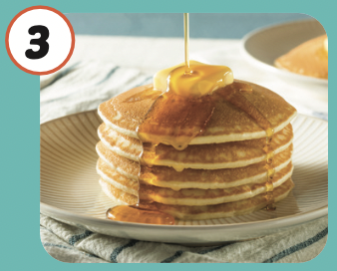
Click the picture to hear the sound.
pancakes
/ˈpænkeɪks/
bánh kếp

Slide 16
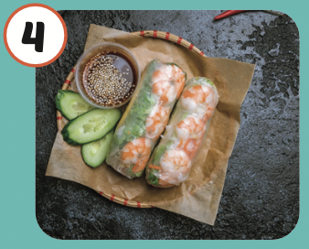
Click the picture to hear the sound.
spring rolls
/ˌsprɪŋ ˈroʊlz/
món cuốn
(nem rán, chả giò)

Slide 17
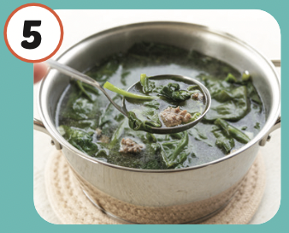
Click the picture to hear the sound.
soup
/suːp/
món xúp

Slide 18
Practice

Slide 19



LISTEN AND CHOOSE

Slide 23

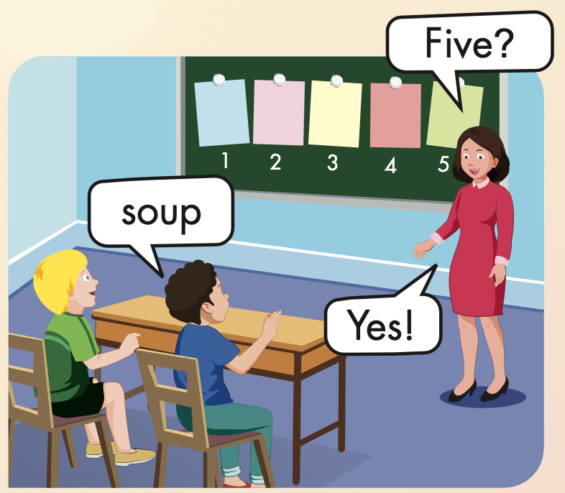
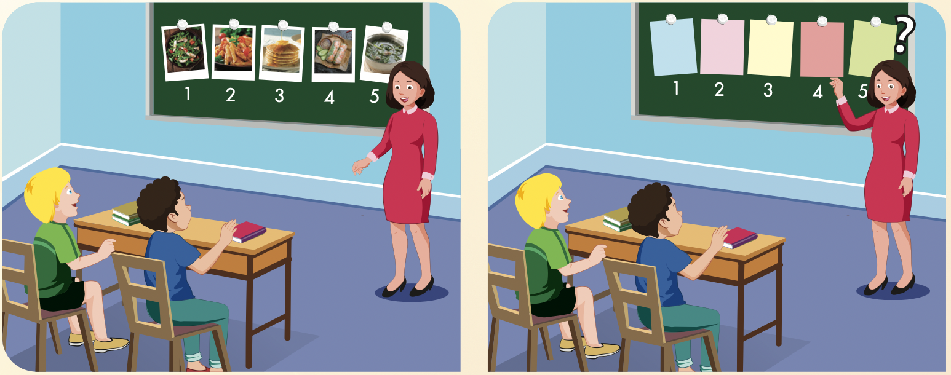

Slide 24
Structures
I can make pasta, but I can't make soup.

Slide 25
Presentation

Slide 26

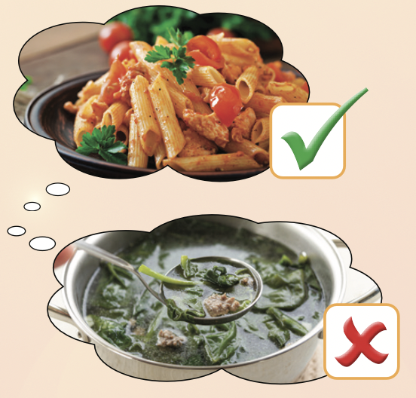
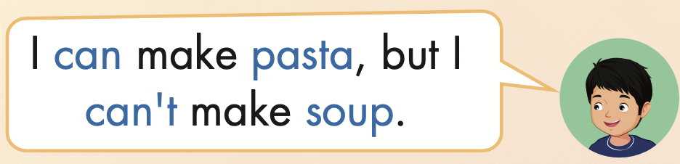

Slide 27

Practice

Slide 28
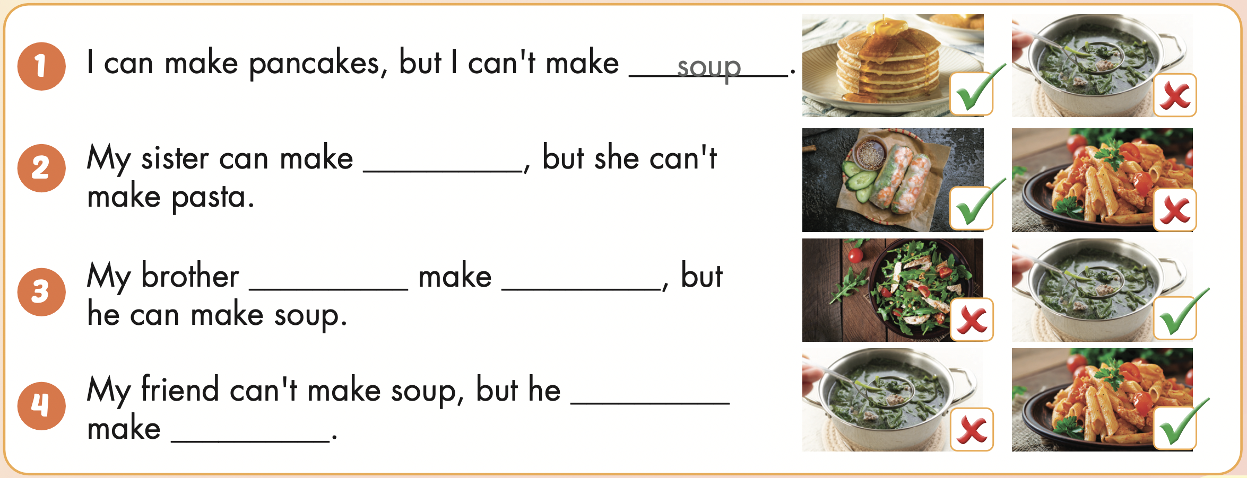
I
I can make pancakes, but I can’t make soup.

Slide 29
My sister
My sister can make spring rolls, but she can’t make pasta.

Slide 30
My brother
My brother can’t make salad, but he can make soup.

Slide 31
My friend
My friend can’t make soup, but he can make pasta.

Slide 32

Writing

Slide 33
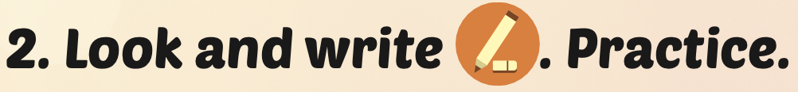
spring rolls

Slide 34
can’t
salad
can
pasta

Slide 35

Production

Slide 36

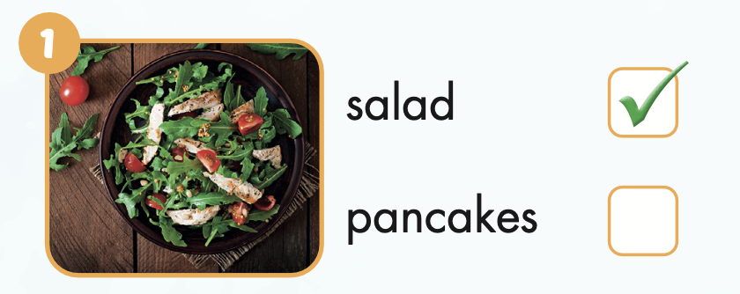
Extra Practice
WB, page 18

Slide 37
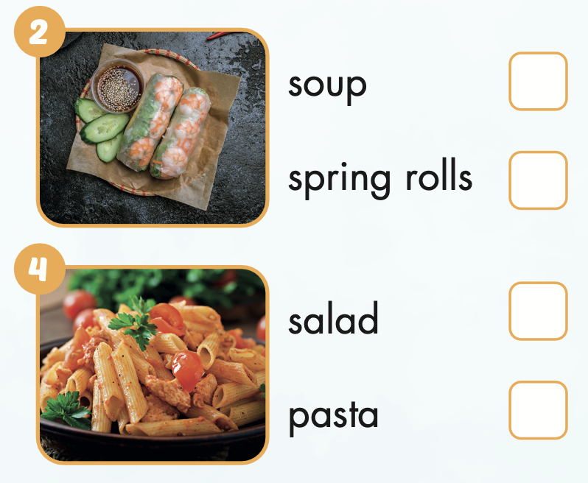
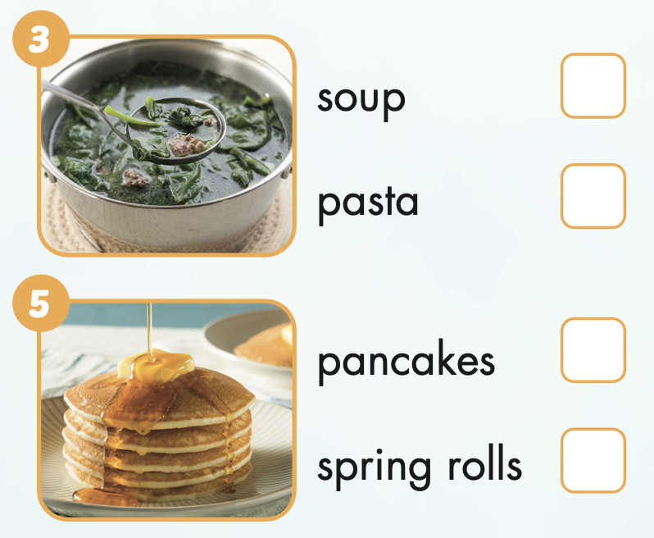

Extra Practice
WB, page 18

Slide 38

CONSOLIDATION

Slide 39

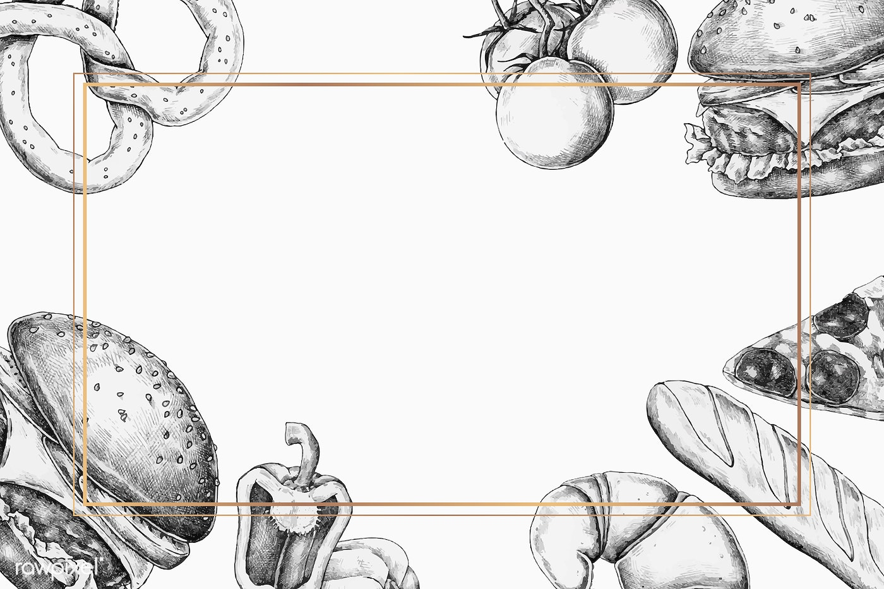
Draw and write:
What food can you make? What food can’t you make?

Slide 40

WRAP-UP

Slide 41
Today’s lesson
Vocabularies
salad,
pasta,
pancakes,
spring rolls,
soup.
Structures/ Sentence patterns
I can make pasta, but I can't make soup.

Slide 42
Homework
Practice the vocabularies and structure; and make sentences using them.
Do the exercises in Tiếng Anh 4 i-Learn Smart Start WB (page 18)
Do the exercises in Tiếng Anh 4 i-Learn Smart Start Notebook (page 13)
Prepare the next lesson (page 30 SB)
Play the consolidation games in Tiếng Anh 4 i-Learn Smart Start DHA App on www.eduhome.com.vn

Slide 43

Enjoy your day!

