Slide 1
Unit 9
What did you see
at the zoo?
Lesson 1

Slide 2
VOCABULARY

Slide 3




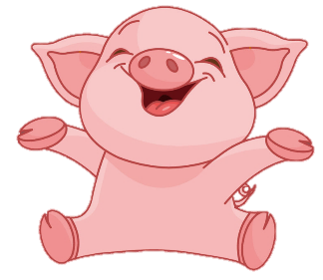
BOMSTAR
PLAY
Notes:
Ms Huyền Phạm - 0936.082.789 – YOUTUBE: MsPham. Facebook: Powerpoint thật dễ

Slide 4











+2
-2
+5
+3
+5
-2
+4
-1

Slide 5

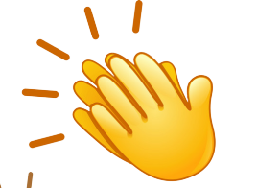
Thêm
1 lượt
Back

Slide 6


When did you go to the zoo?
Back
I went there last weekend.
I saw pythons and crocodiles.
They were really funny and intelligent.

Slide 7
What did you see at the zoo?
Back
I see
I saw
I did

Slide 8
______ did you see at the zoo yesterday?
Back
Where
What’s
What

Slide 9
What did the pythons ____ when you were there?
Back
see
go
do

Slide 10
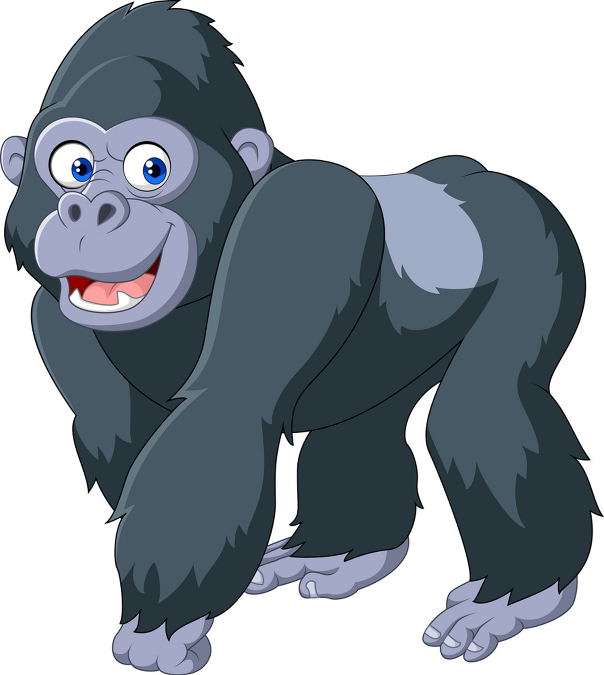
What did you see at the zoo yesterday?
Back
I saw garillas.
I see garillas.
I saw garilla.

Slide 11
What ____ they do?
They climbed the tree very well.
Back
were
did
do

Slide 12
PRONUNCIATION

Slide 13

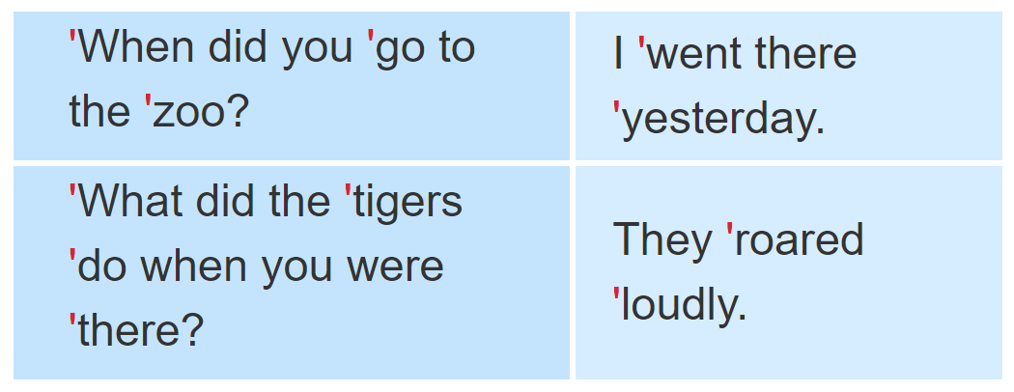
1. Listen and repeat.

Slide 14
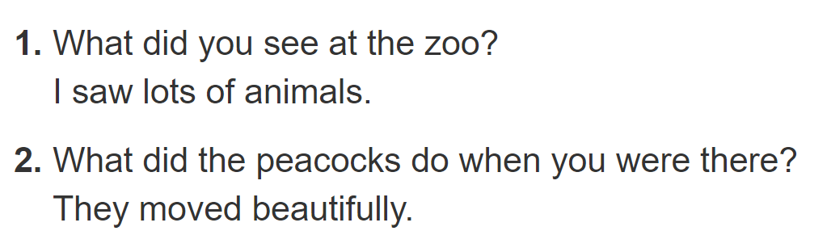

2. Listen and underline the stressed words. Then say the sentences aloud.

Slide 15
PRACTISE

Slide 16
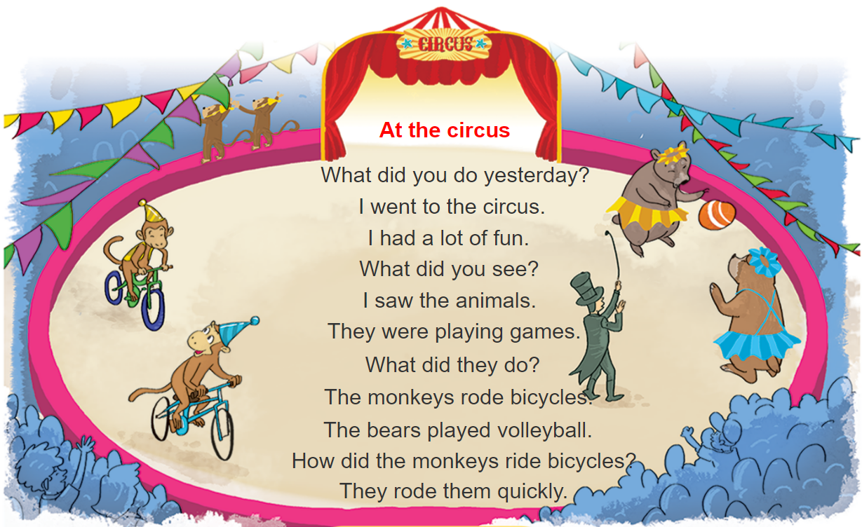



3. Let’s chant

Slide 17
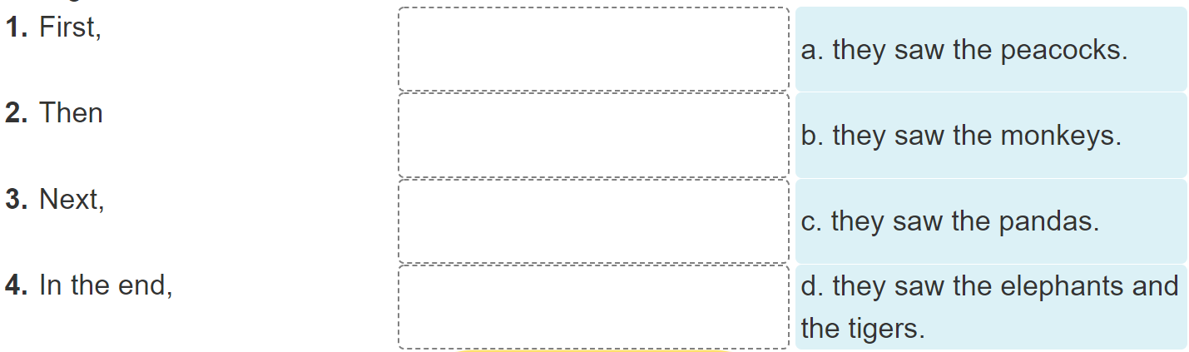
4. Read and complete

Slide 18
4. Read and complete
Dear Tuan,
I went to the zoo with my classmates last Friday. First, we saw the monkeys. They were fun to watch because they jumped up and down quickly. Then we went to see the elephants. They moved slowly and quietly. We also saw the tigers. I liked them very much because they were fast. Next, we saw the peacocks. My classmates liked them because they moved beautifully. In the end, we saw the pandas. They were very cute and did everything slowly. I had a really good time at the zoo.
See you soon.
Best wishes,
Phong

Slide 19
4. Read and complete

Slide 20
5. Write about your last visit to the zoo
I went to the zoo with_________last _________.
At the zoo, I saw ________________________.
The _________ and the _________.
I think the animals at the zoo are ____________.

Slide 21
6. Project
Draw your dream zoo.

