Slide 1








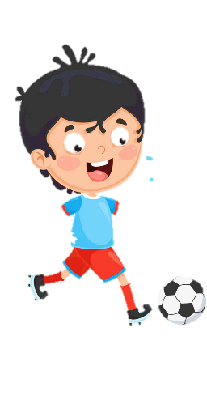











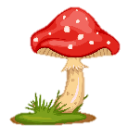
Notes:
Để nguyên trang bìa như này, chỉ thay đổi tên bài trong quá trình làm. Logo của sách Wonderful World

Slide 2
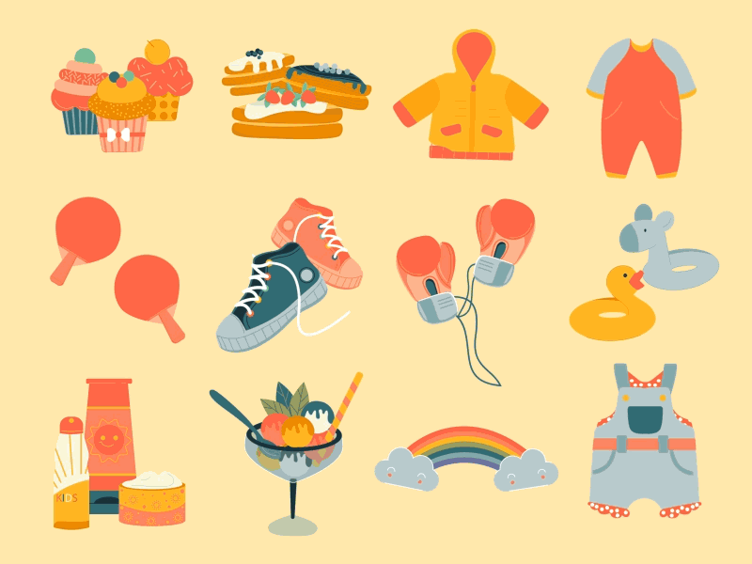



Unit 5 My clothes Lesson 2 – Task 7,8,9

Slide 3


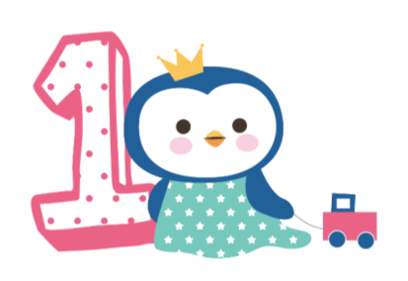



Warm up
Song: Hello song
https://www.youtube.com/watch?v=fN1Cyr0ZK9M

Slide 4

Presentation
Task 7: Listen and complete

Slide 5
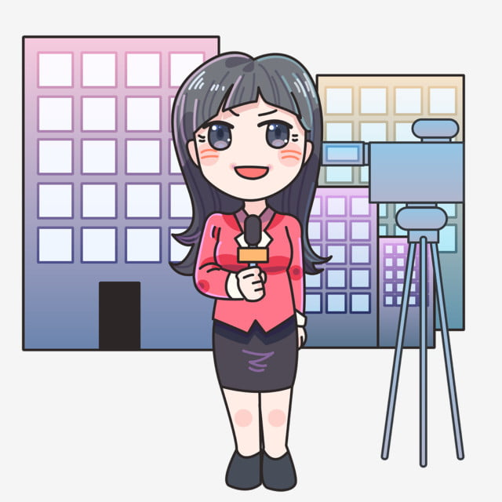
VTV reporter

Slide 6


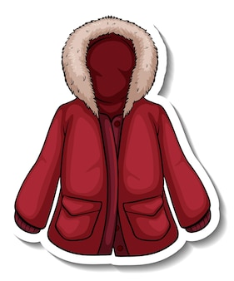
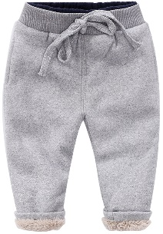

7.Listen and complete.
That is my (1) sister. She’s got an orange
and red (2) _______.
She’s got a green T-shirt and warm (3)
________. She’s got a blue hat
and black (4) ________, too.

Slide 7
7.Listen and complete.
That is my (1) sister. She’s got an orange
and red (2) _______.
She’s got a green T-shirt and warm (3)
________. She’s got a blue hat
and black (4) ________, too.
coat
trousers
boots

Slide 8


Controlled speaking

Slide 9
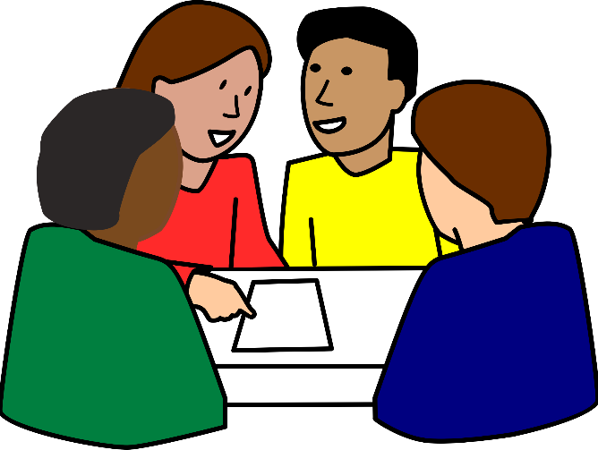
Look and say
Group work: Sentence jumble

Slide 10
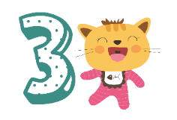
Practice
Task 8: Look and say

Slide 11
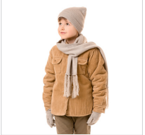
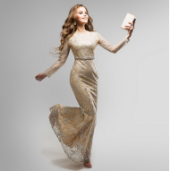
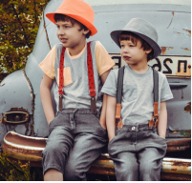
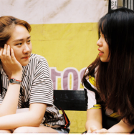
He’s got a coat.
They’ve got trousers.
Their trousers are black.
His coat is warm.
1.
2
3
4
She’s got a dress.
Her dress is nice.
They’ve got T-shirts.
Their T-shirts are nice.
Notes:
GV giải thích lại “ has got = ‘s got”
Sở hữu của ai
He -> his
She -> her

Slide 12

Free talk

Slide 13
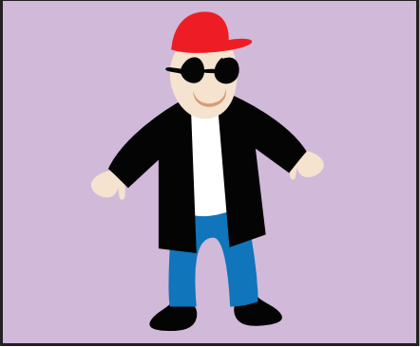
Draw. Write and say.
This is my brother, Liam.
He’s cool.
He’s got a black coat.

Slide 14
Assessment

Slide 15


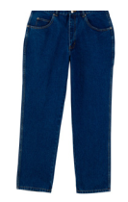
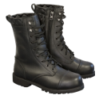






Listen and complete.
Ex: I have got a blue dress.
1. Peter has got ______.
2. Lily has got _________.
3. We have got ______________.
4. My dad has got __________.
5. Her brother has got __________.
a hat
black shoes
red skirts
a coat
a green T-shirt
Notes:
HOẠT ĐÔNG TƯƠNG TÁC

Slide 16


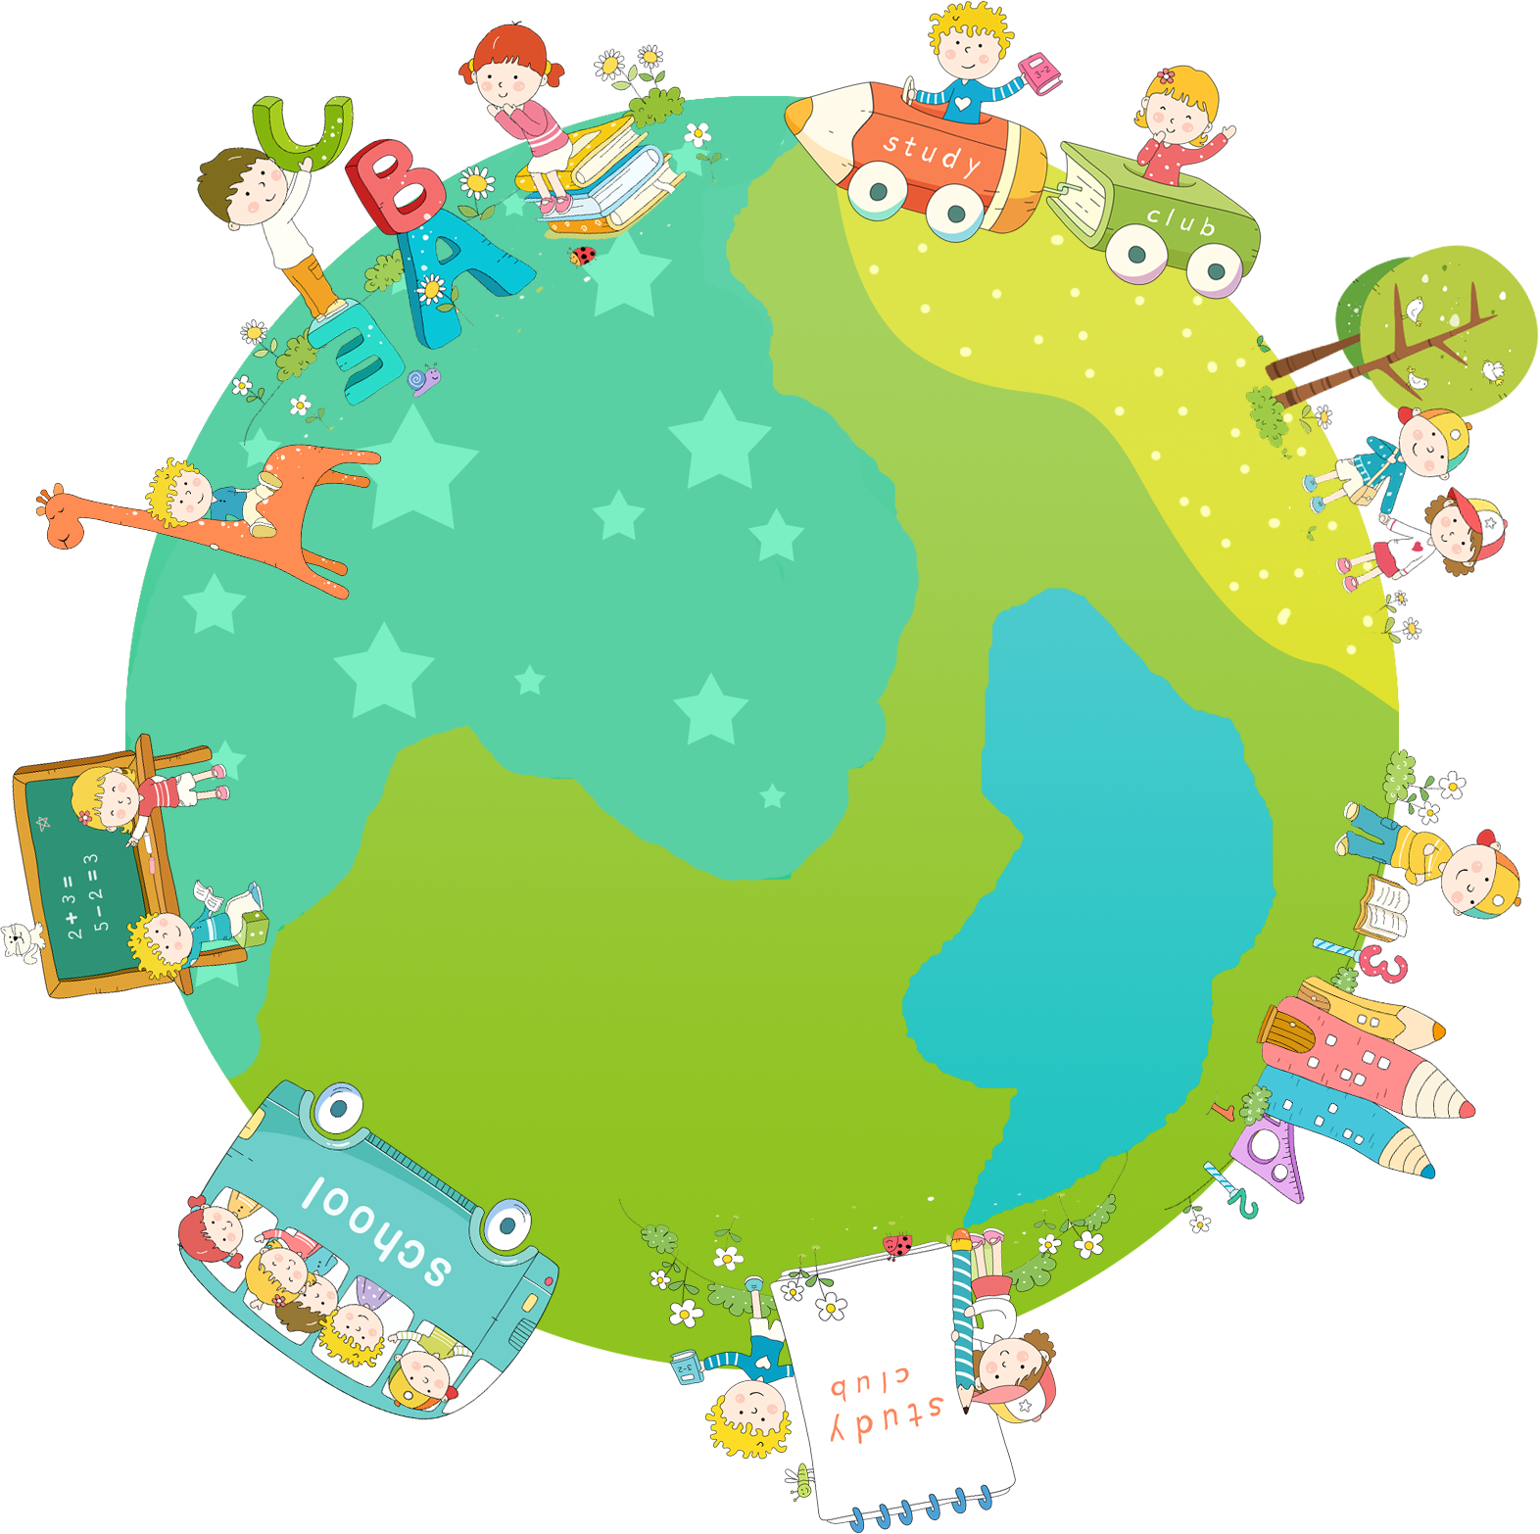

Good bye.
See you again!

