Slide 1




















Notes:
Để nguyên trang bìa như này, chỉ thay đổi tên bài trong quá trình làm. Logo của sách Wonderful World

Slide 2
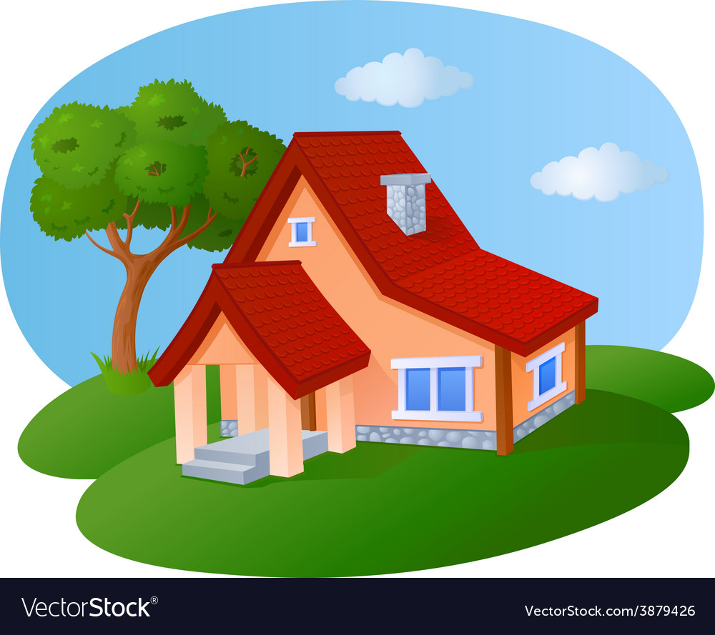


Unit 4 - My House
Lesson 1 – Period 2

Slide 3


Warm up

Slide 4


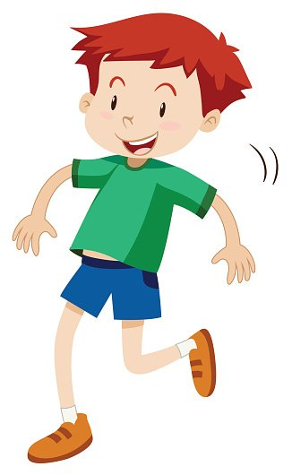


Slide 5

Presentation

Slide 6

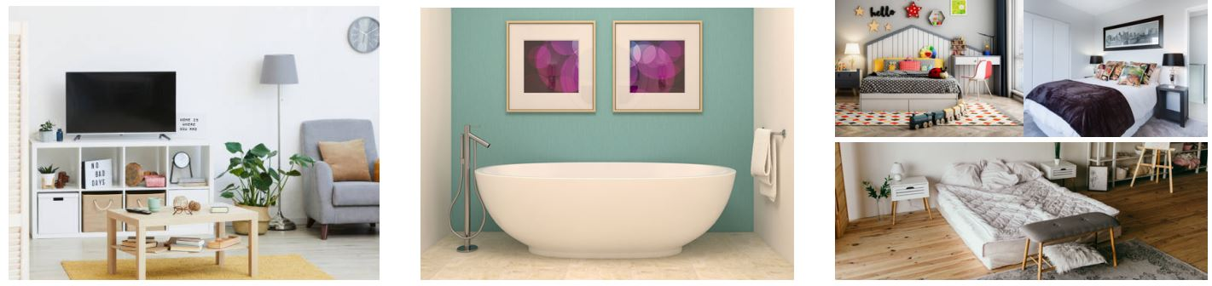
Listen and number
1
2
3
Notes:
HOẠT ĐỘNG TƯƠNG TÁC

Slide 7
Listen and repeat
1
2
3
There are three bedrooms.
There’s a living room.
There’s a bathroom.

Slide 8
Slap the board

Slide 9

Practice

Slide 10
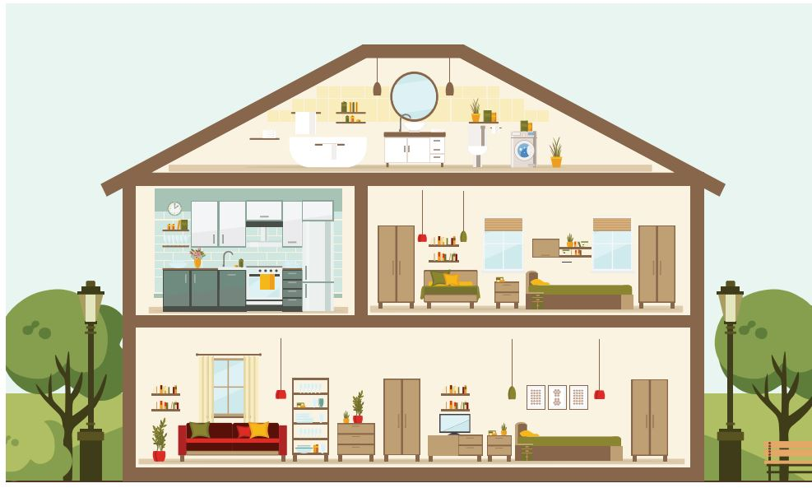
5
Say.

Slide 11

…………
house
…………
bedrooms
…………
bathroom
…………
kitchen

Slide 12

a house
There’s a house.

Slide 13
two bedrooms
There are two bedrooms.

Slide 14
a bathroom
There’s a bathroom.

Slide 15
a kitchen
There’s a kitchen.

Slide 16
Let’s talk

Slide 17
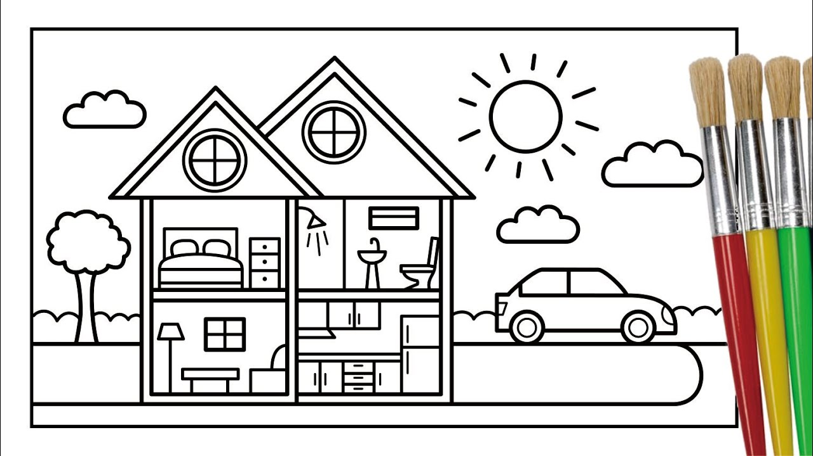
Draw and say
bedroom
bathroom
living room
kitchen

Slide 18
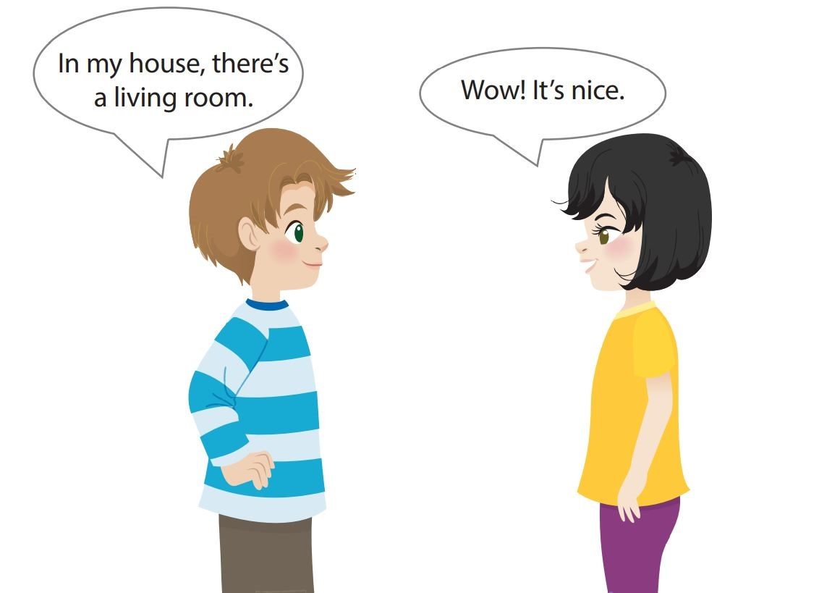
Let’s talk
bedroom
bathroom
living room
kitchen

Slide 19

Pass the card Game

Slide 20

Production

Slide 21

Assessment

Slide 22

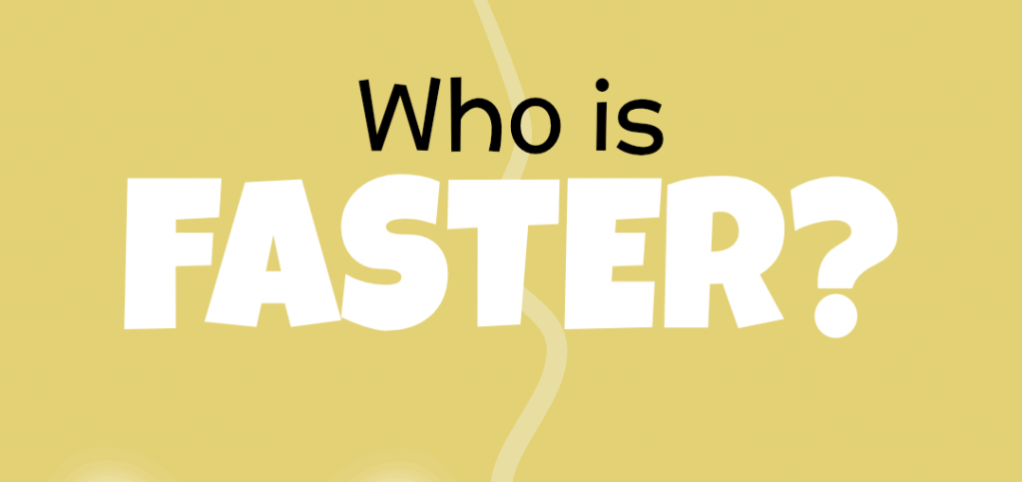
Notes:
HOẠT ĐỘNG TƯƠNG TÁC CHO SLIDE 23,24,25

Slide 23

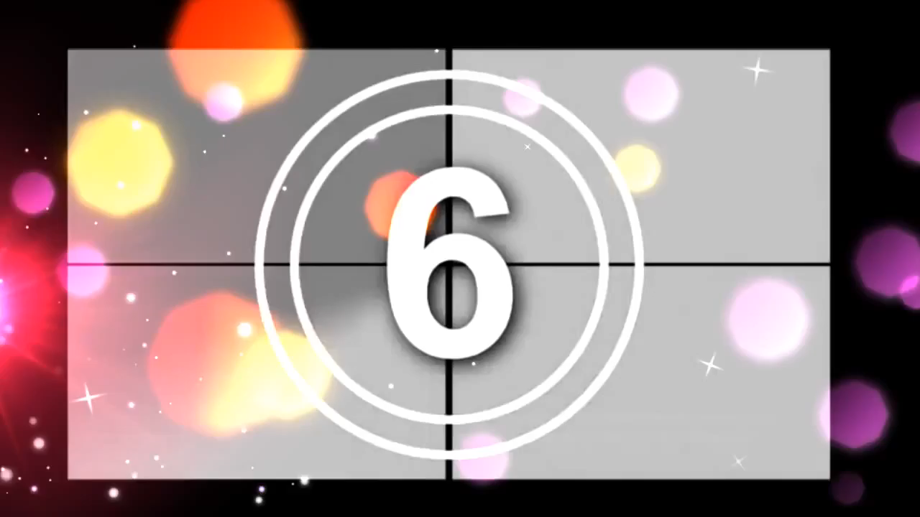
Choose the correct answer.
1. There’s ………………..
a
a living room
b
two bedrooms

Slide 24
Choose the correct answer.
2. In my house, there is a garden.
- Wow, …………… nice
a
They’re
b
It’s

Slide 25
Choose the correct answer.
3. Look at the house
- There are ……………..
a
one kitchen
b
two bedrooms

Slide 26
