Slide 1




















Notes:
Để nguyên trang bìa như này, chỉ thay đổi tên bài trong quá trình làm. Logo của sách Wonderful World

Slide 2

Unit 2: My school
Lesson 2: task 1,2,3

Slide 3
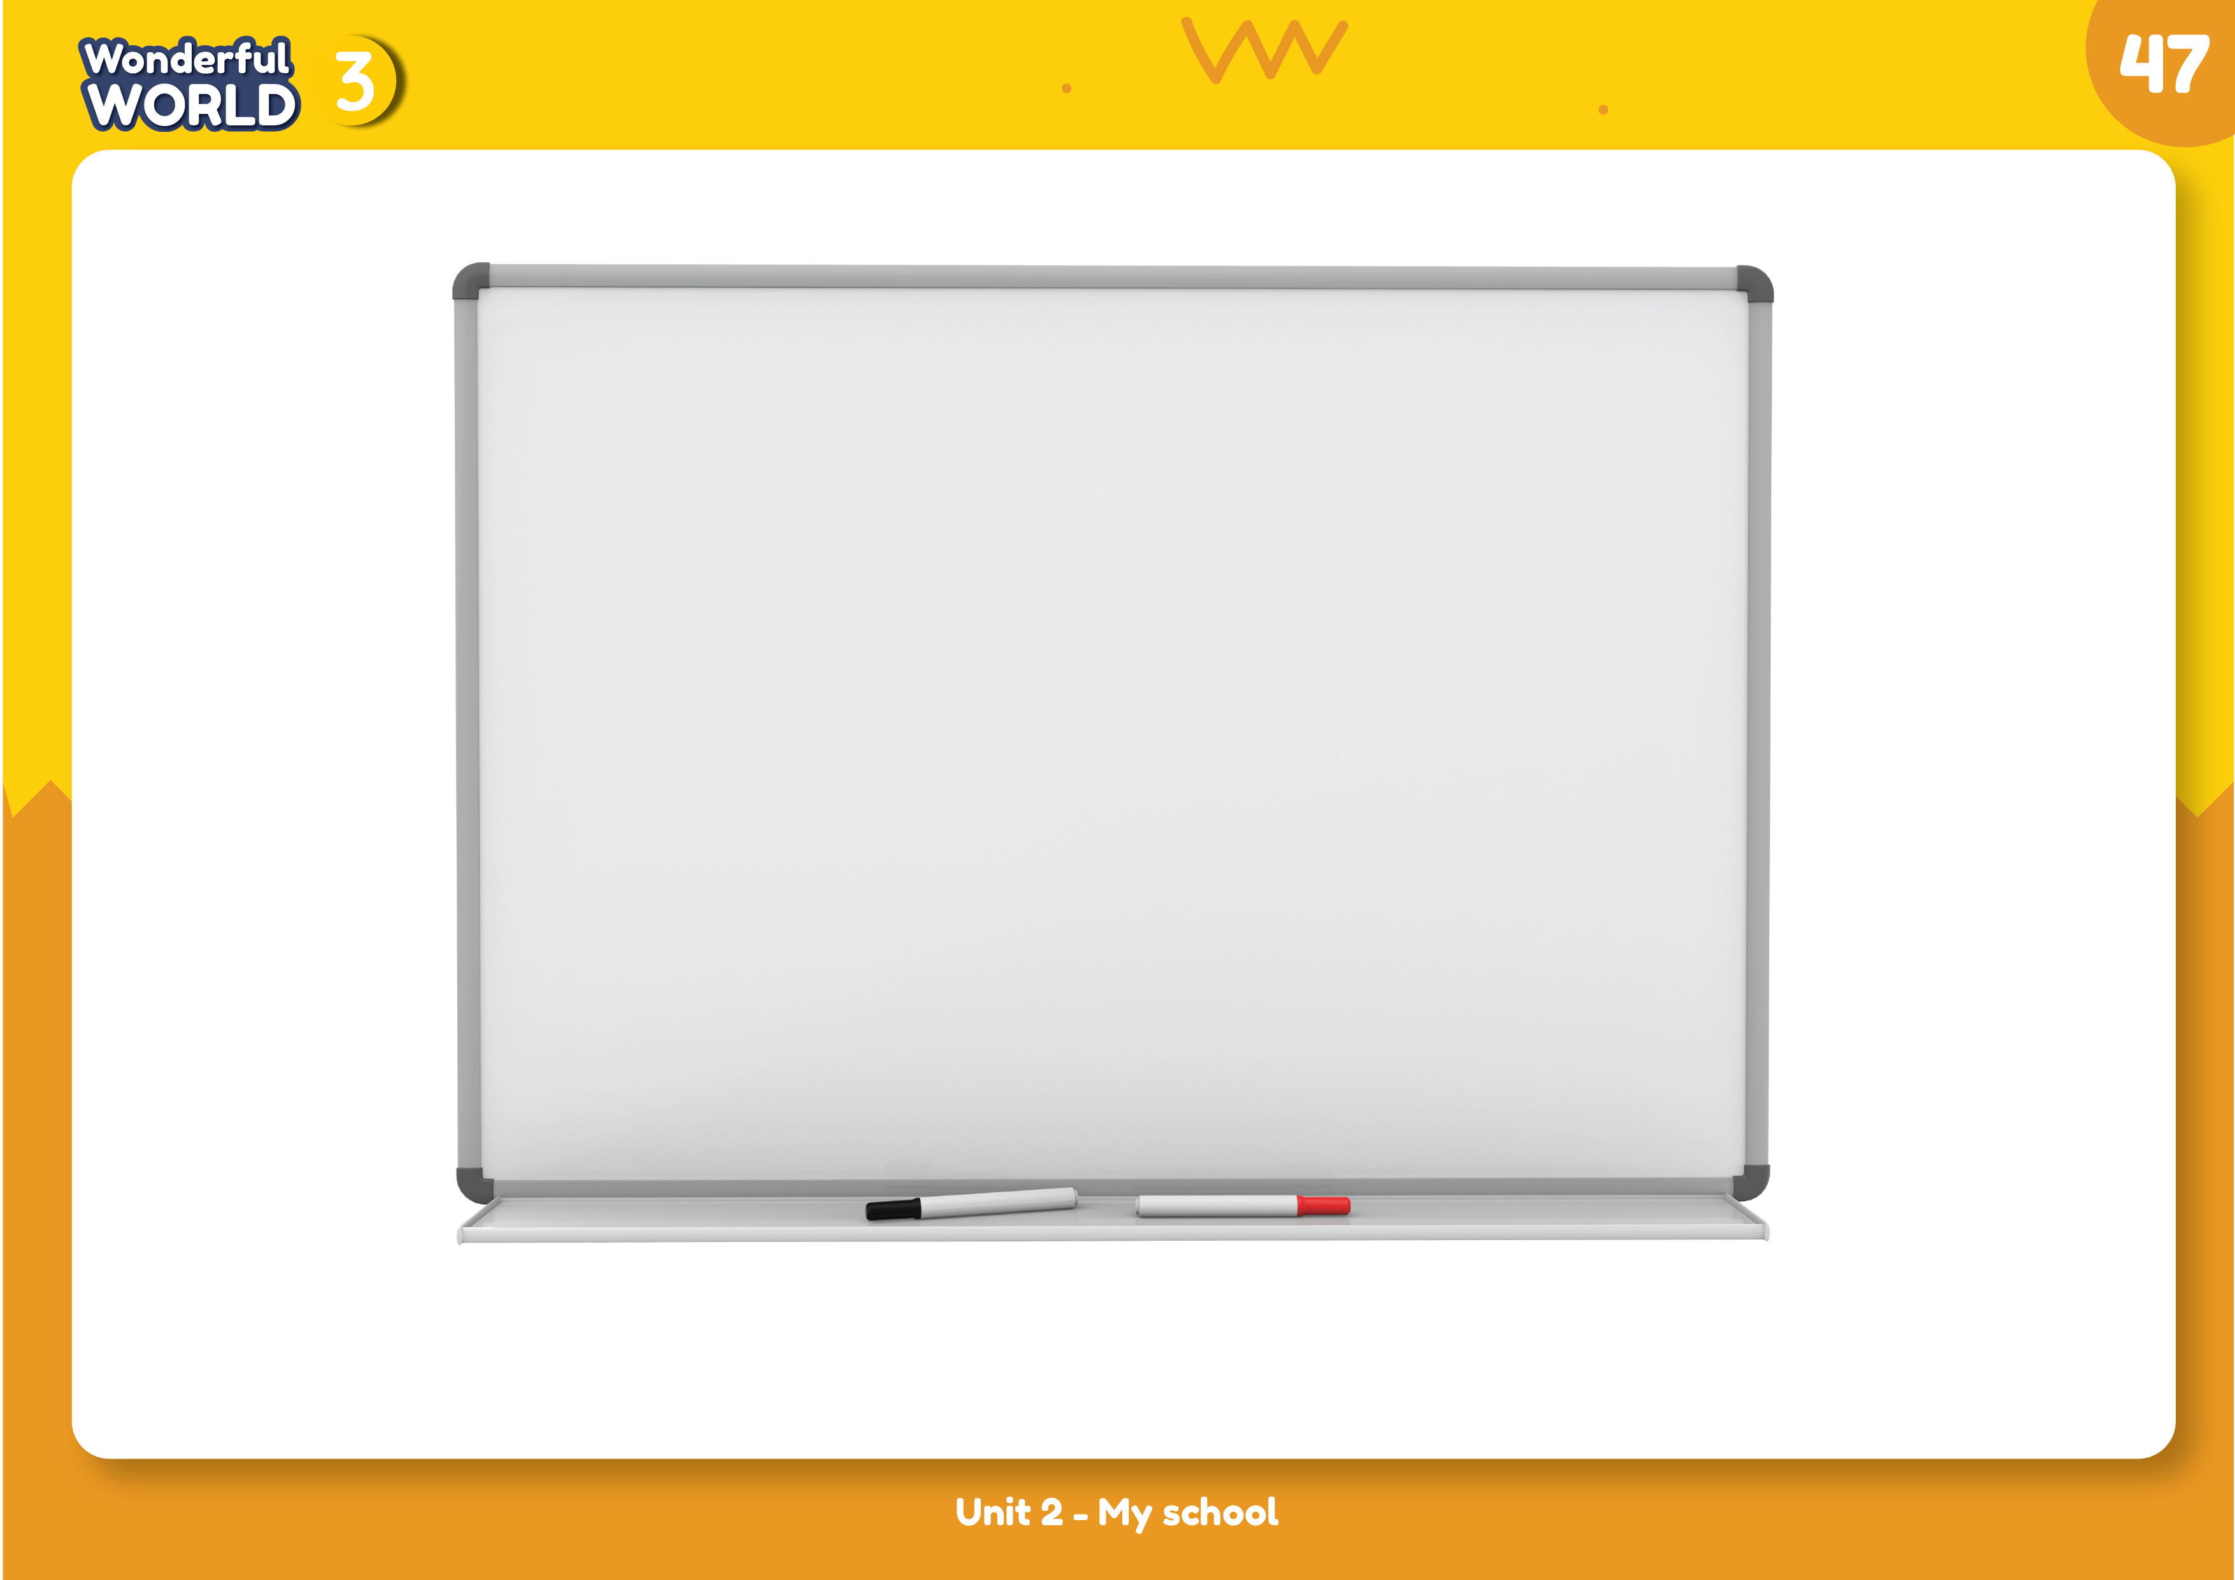
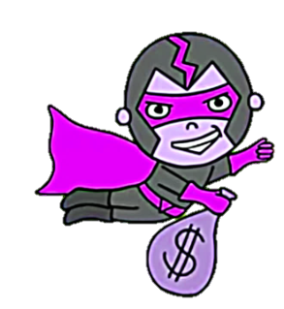
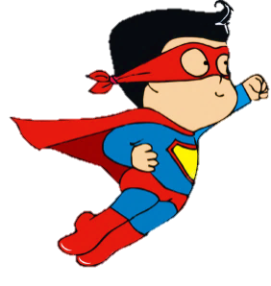
1. WARM UP
GAME: LUCKY STAR

Slide 4

8
7
1
5
9
2
6
3
4
Next part
Notes:
Nhấn vào ngôi sao để chọn câu hỏi và hình
THIÊT KẾ HOẠT ĐỘNG TƯƠNG TÁC TỪ SLIDE 5 ĐẾN 13

Slide 5




Who’s she?
3 points
She’s a teacher.
GO HOME
Notes:
Click chuột để xem đáp án
Đáp án đúng, bấm vào hộp quà xem số điểm
Đáp án sai, bấm vào go home

Slide 6

Who’s he?
1
point
He’s a student.
GO HOME

Slide 7

What color is it?
5
points
It’s blue.
GO HOME

Slide 8

What color is it?
4 points.
It’s orange.
GO HOME

Slide 9

What color is it?
8 points
It’s white.
GO HOME

Slide 10

What color is it?
6 points.
It’s pink.
GO HOME

Slide 11
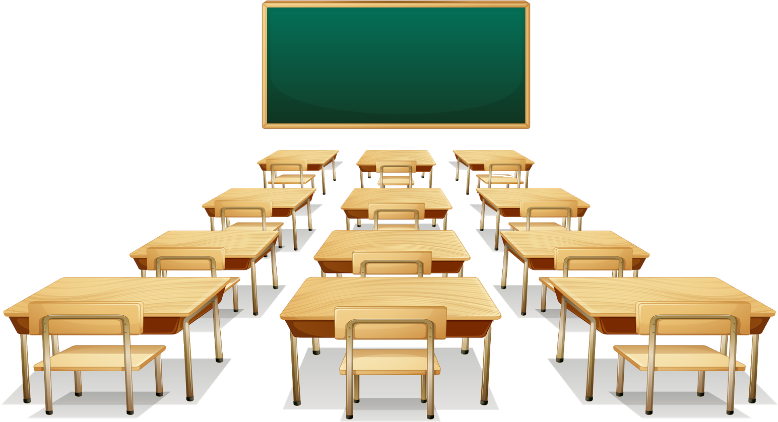
What’s it?
4 points
It’s a classroom.
GO HOME

Slide 12
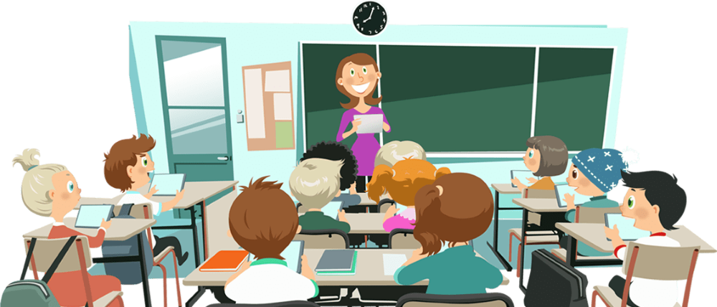
What’s it?
5 points
It’s a lesson.
GO HOME

Slide 13
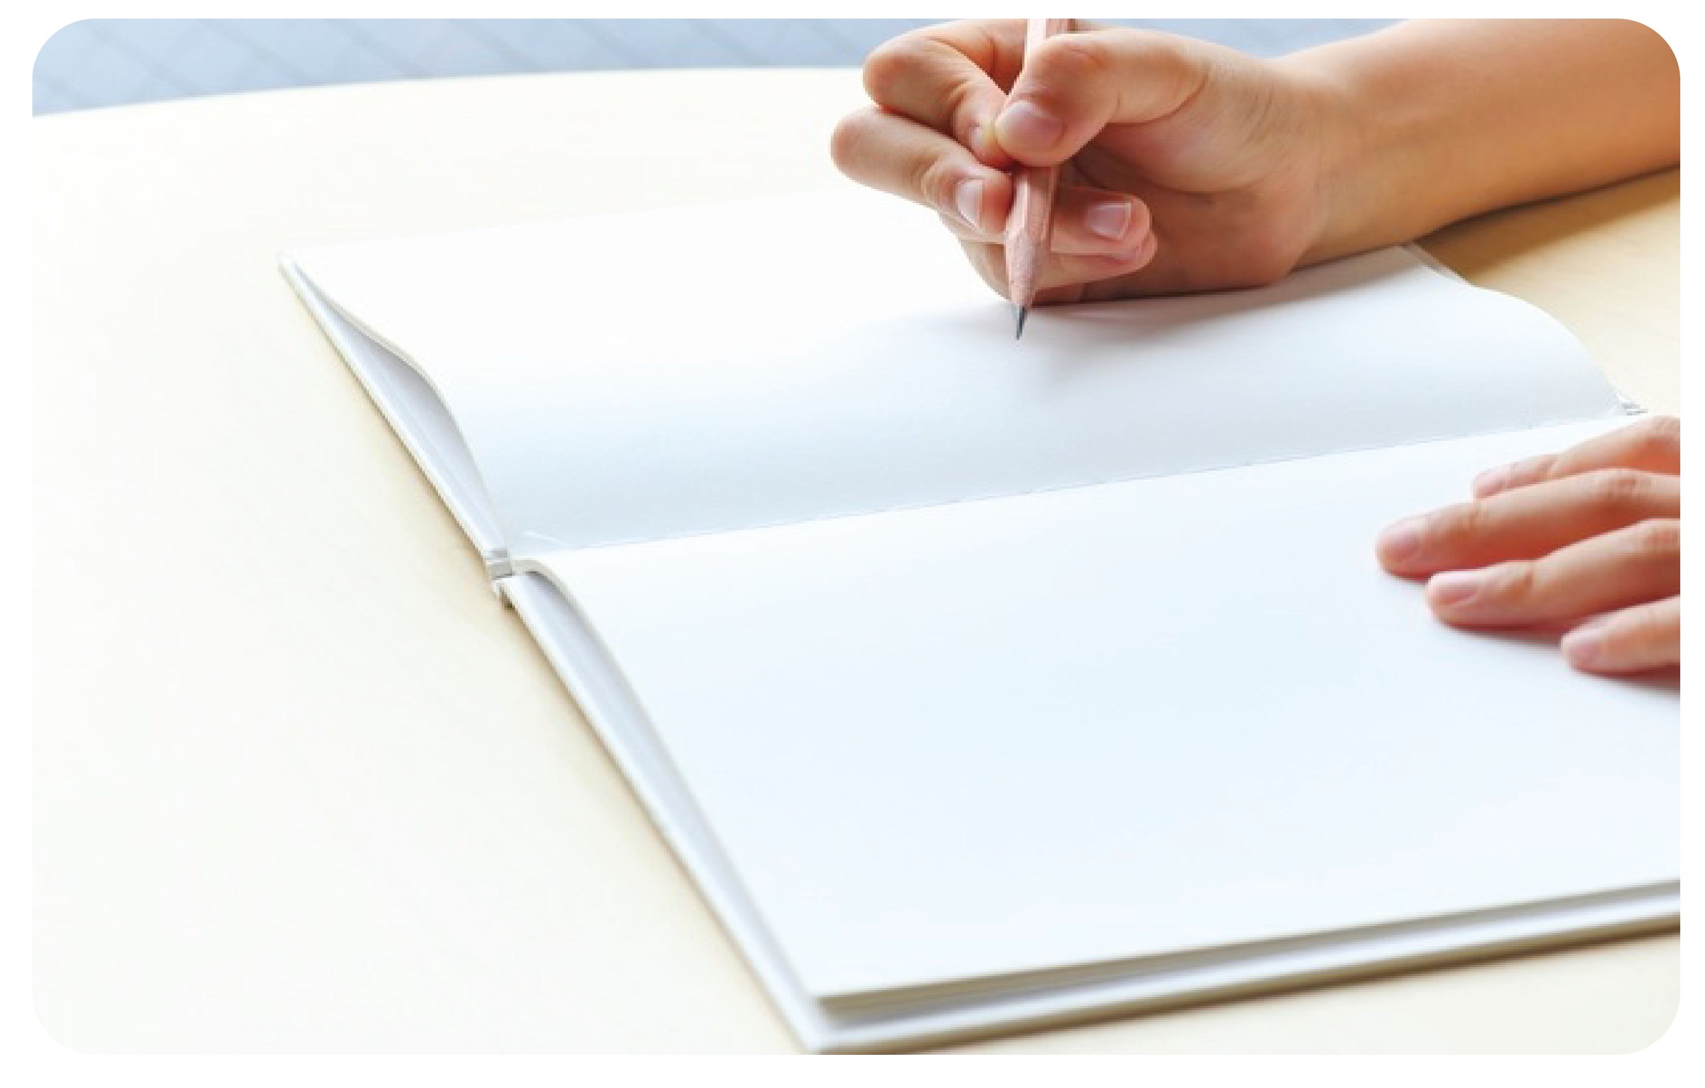
What’s this?
What’s this?
3 points
3 points
This is my homework.
This is my homework.
GO HOME

Slide 14



TASK 1. Listen and point. Repeat
2 Presentation

Slide 15
board

Slide 16
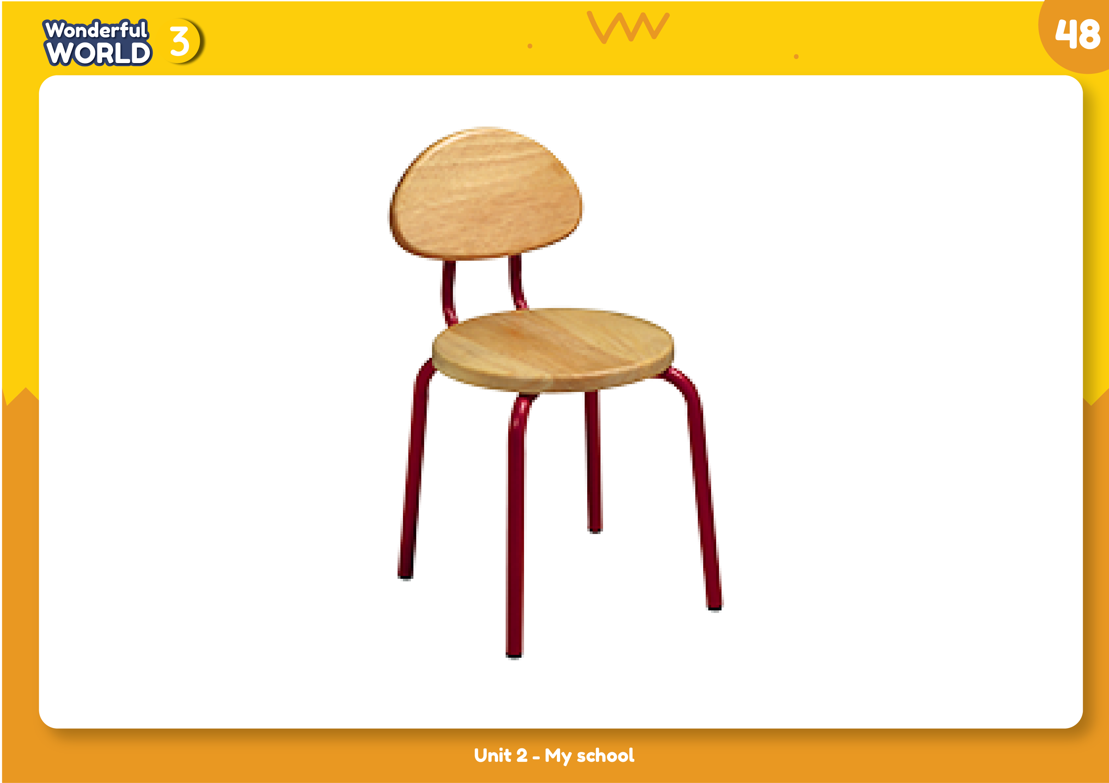
chair

Slide 17
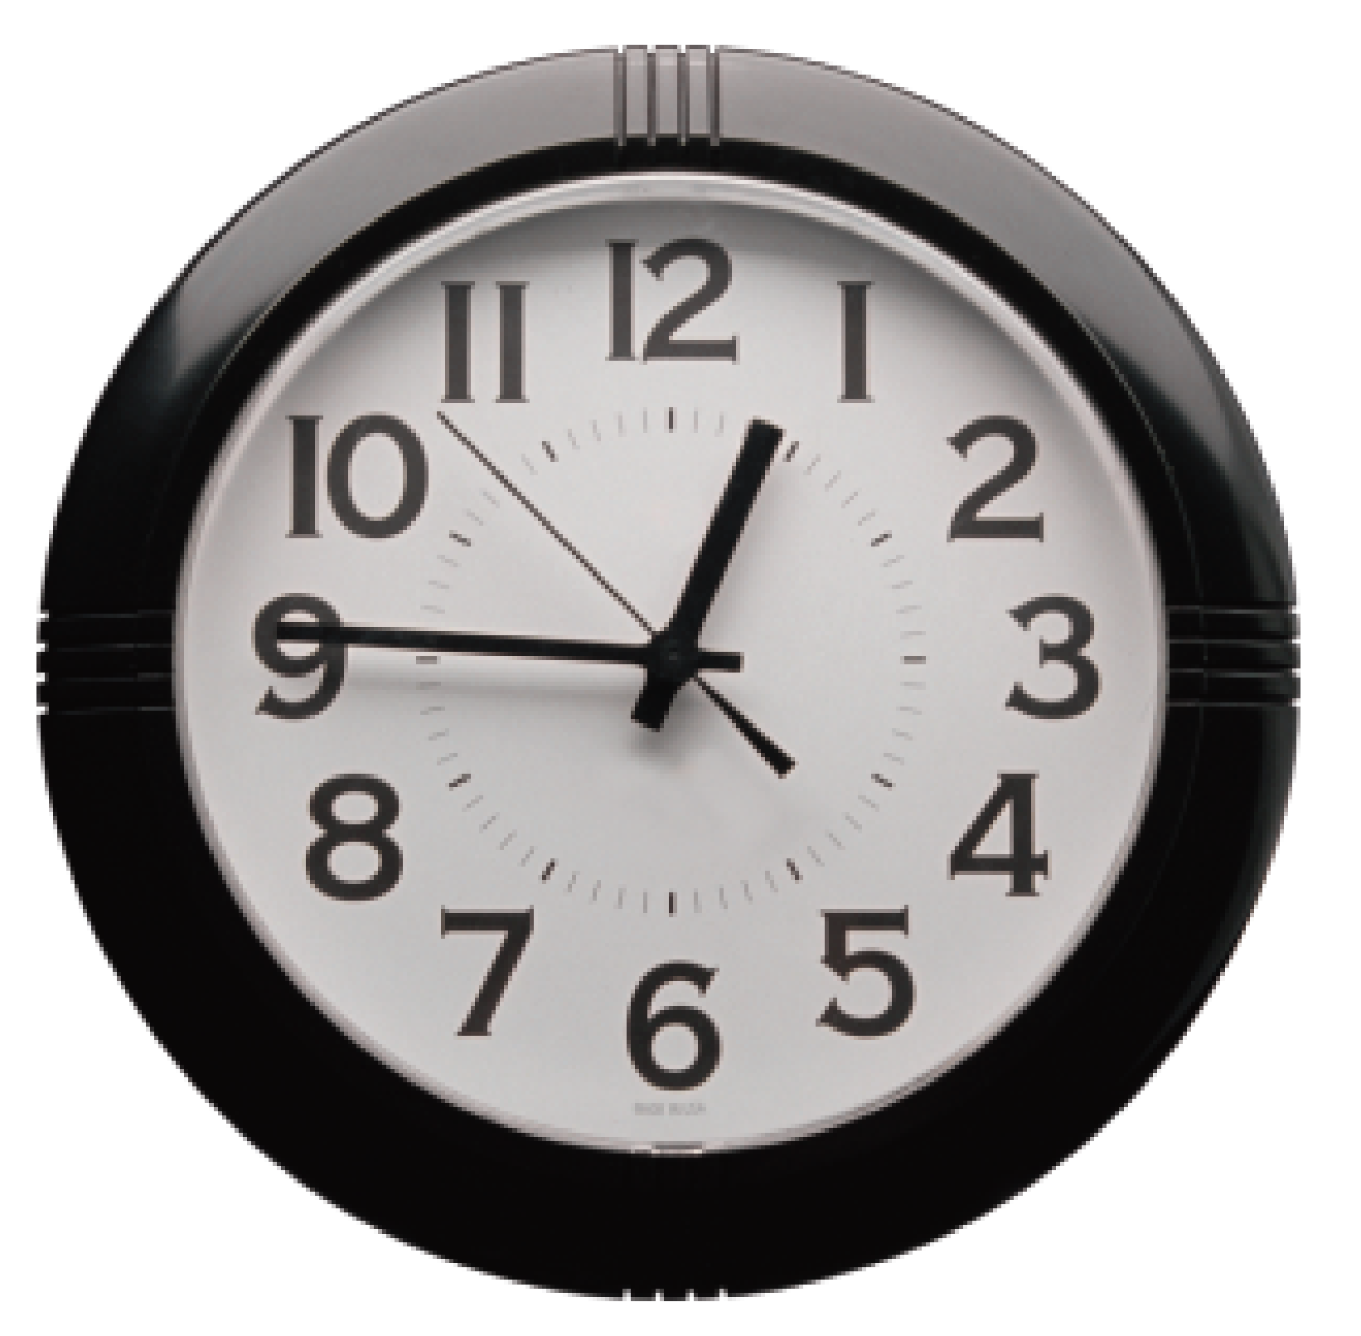
clock

Slide 18
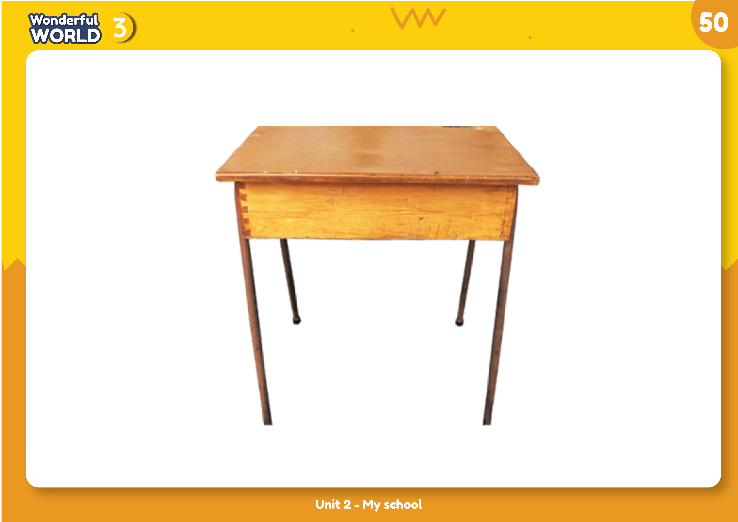
desk

Slide 19
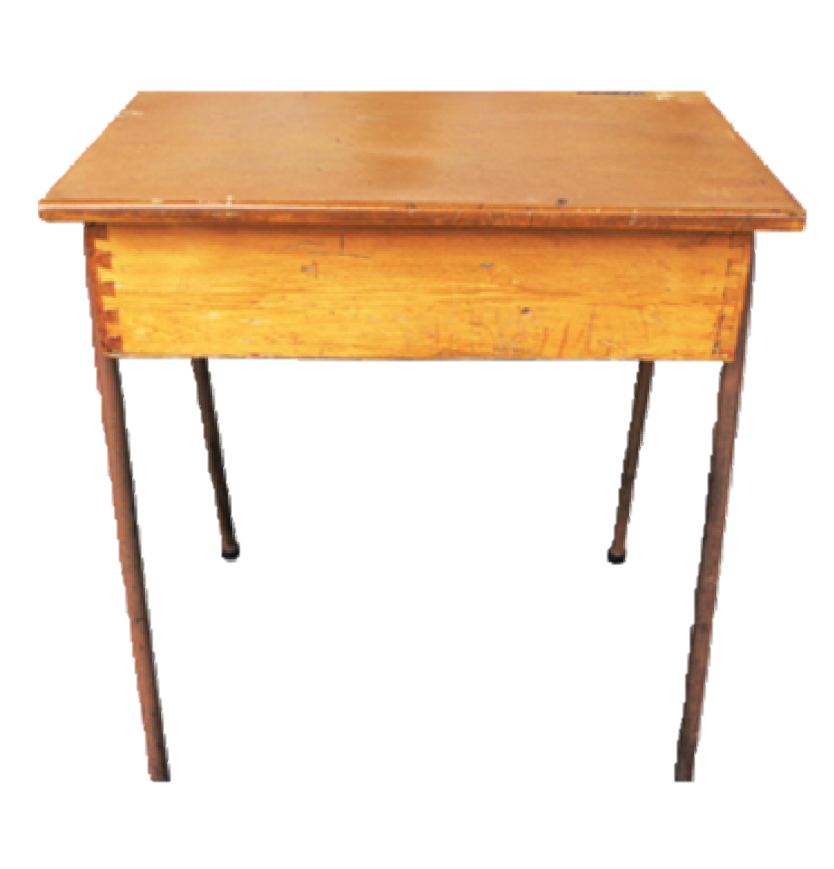
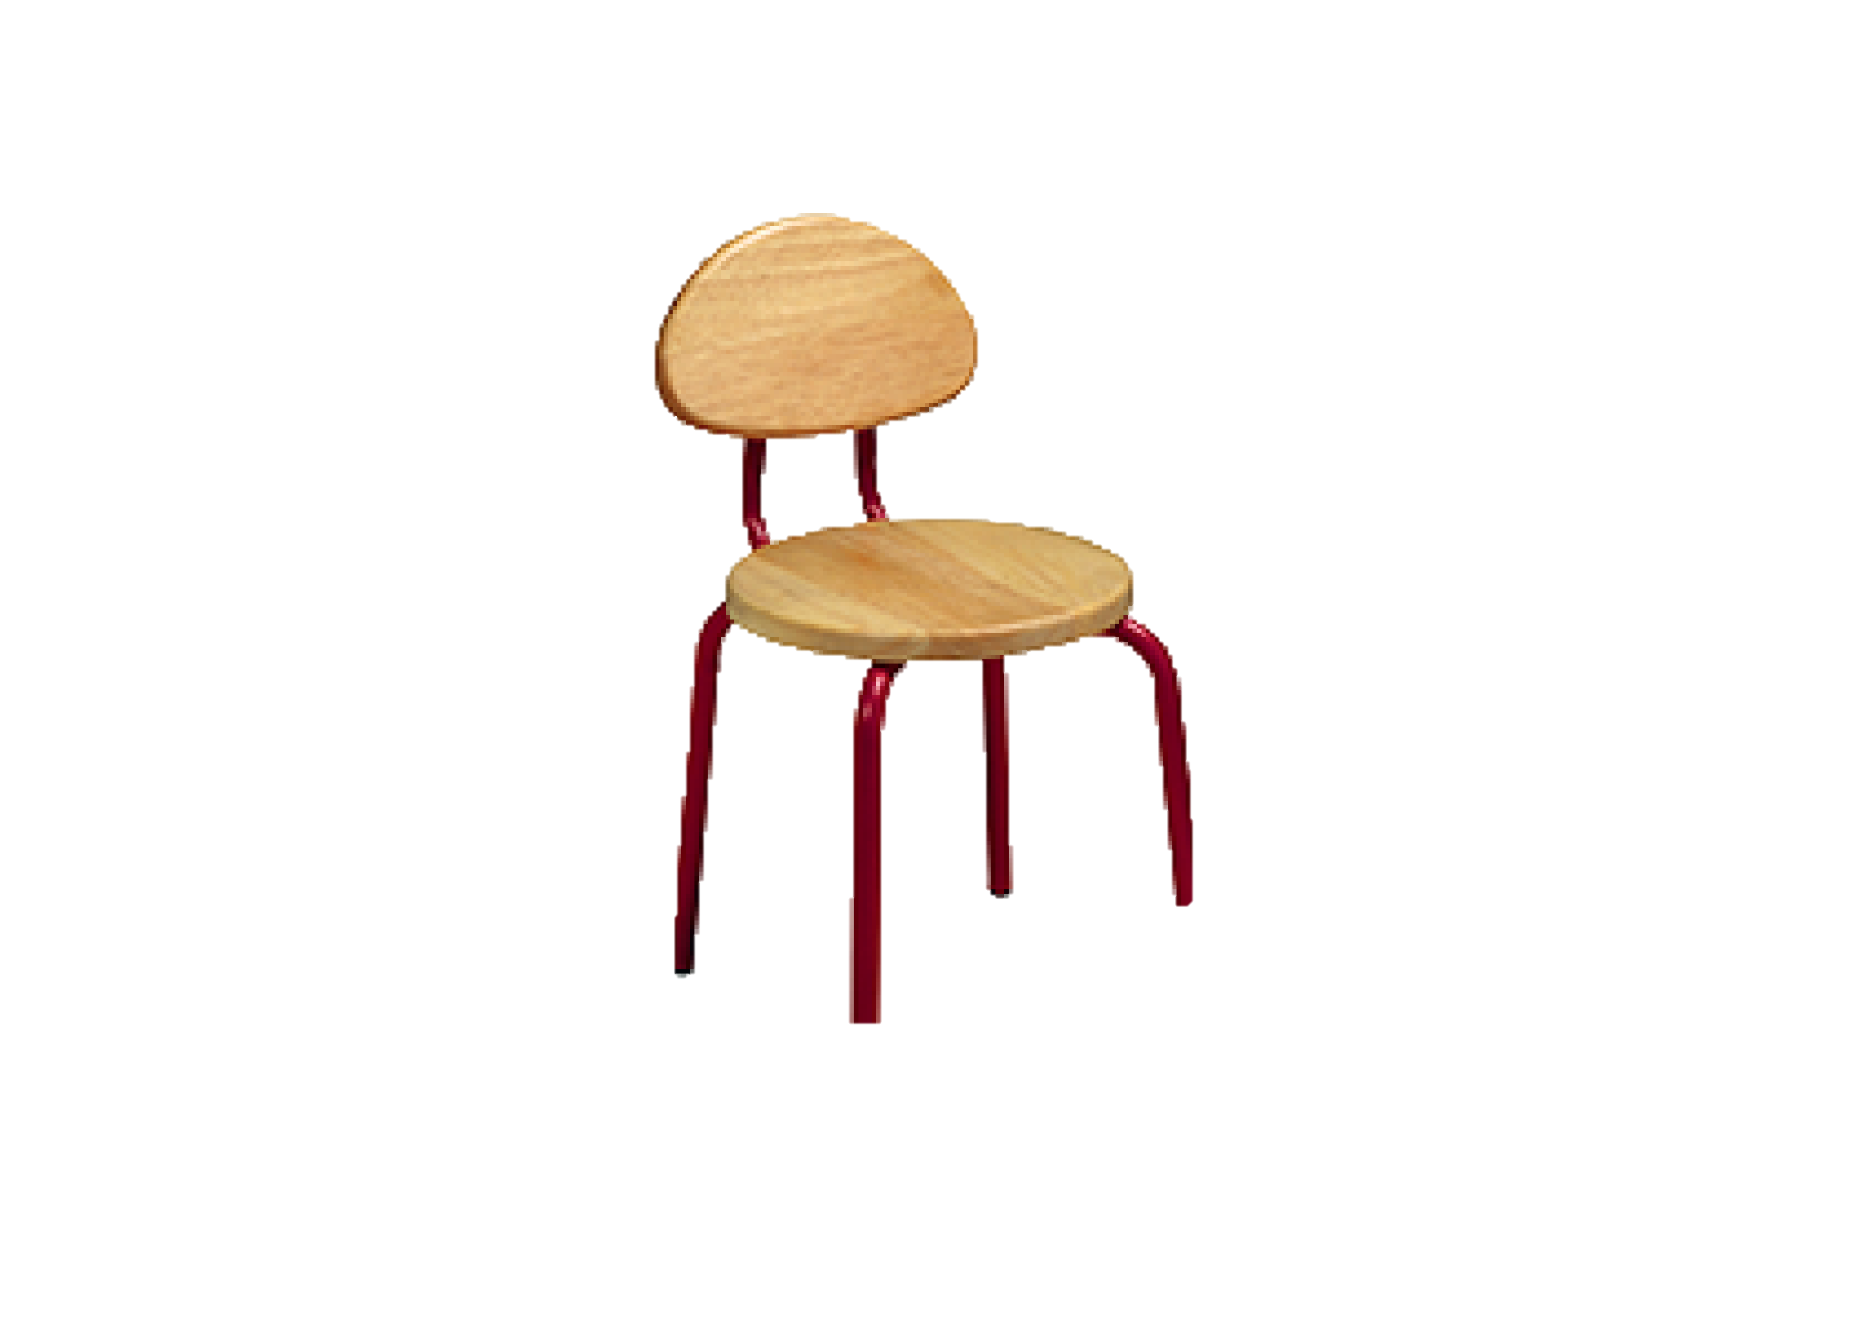

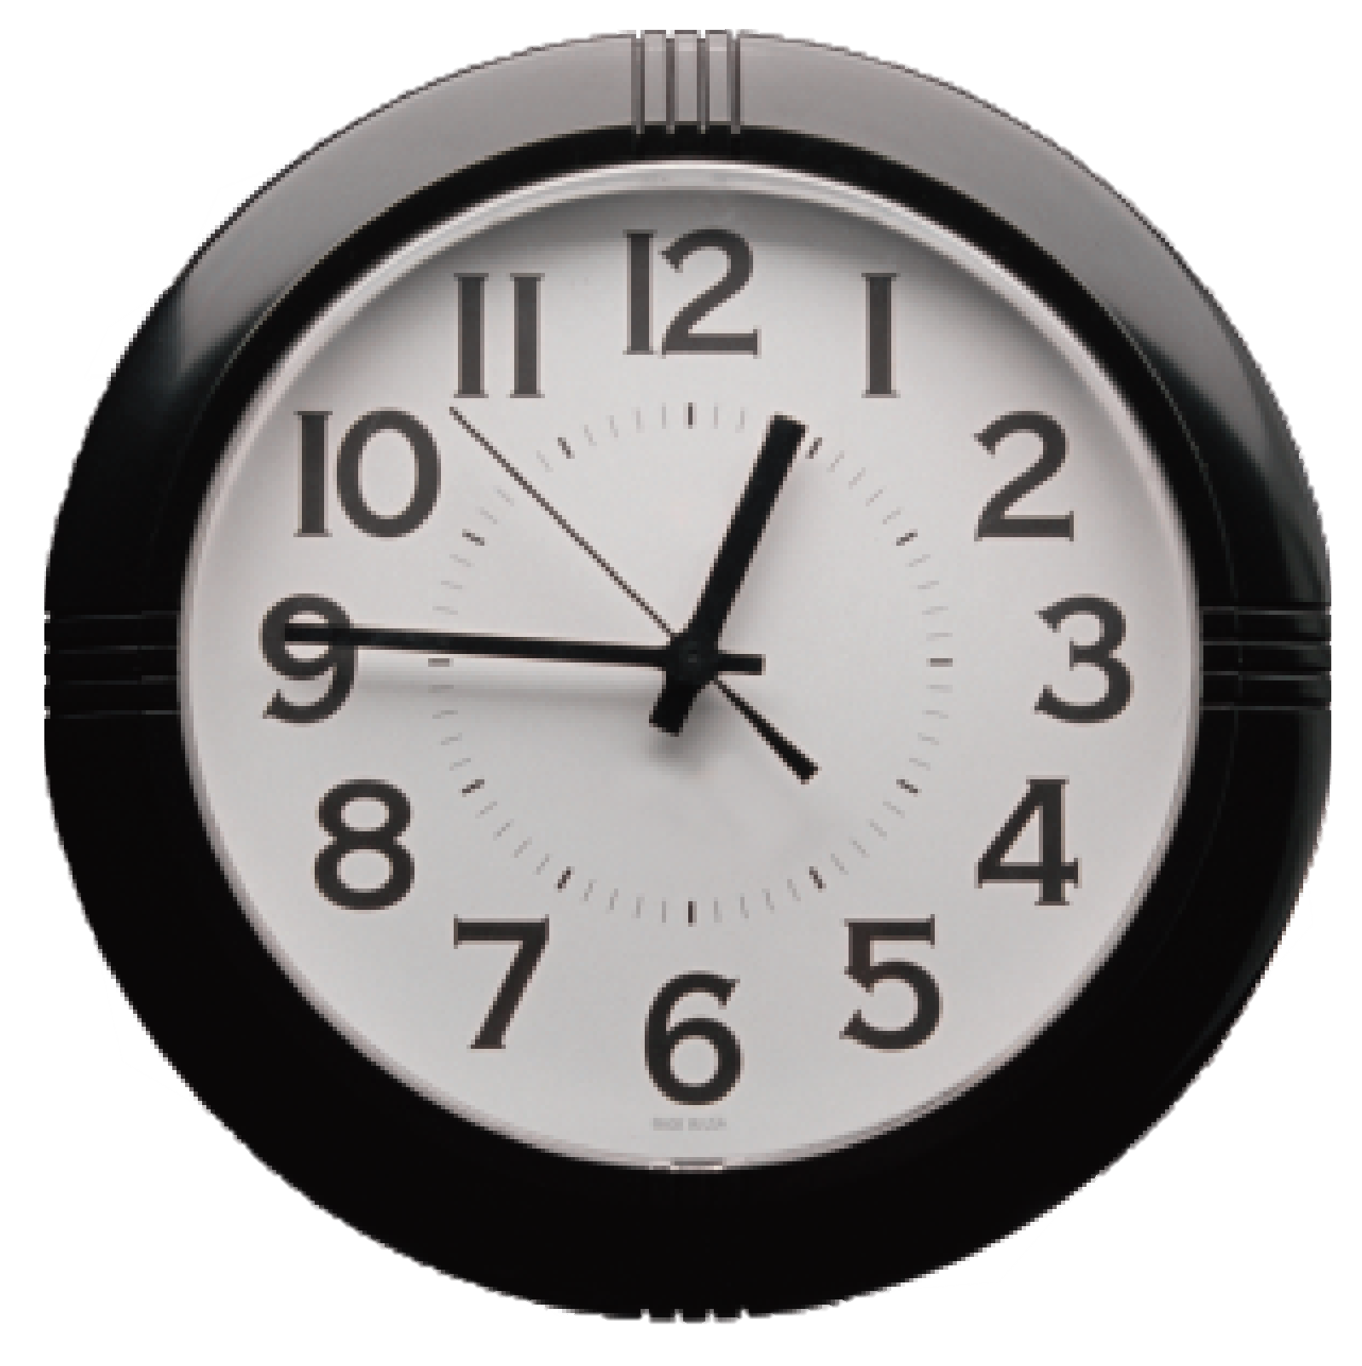
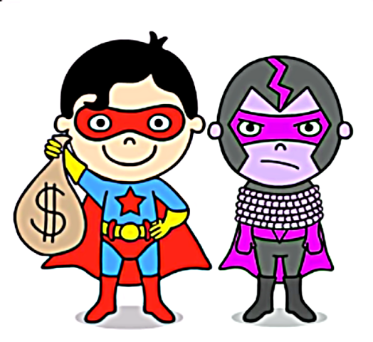
desk
chair
board
clock
Notes:
Click vào biểu tượng loa để nghe âm thanh
Sau khi hs luyện phát âm xong, click vào hình superman để hiện lên hình bắt tội phạm thành công

Slide 20
Read and guess
Look, It’s a family/ a classroom. It’s great/ funny.
The teacher is at the door/ board. It’s white/ black.
The students are at the desks/ windows. The chairs are brown/ orange.

Slide 21
Task 2: listen and tick
3 Practice
✓

Slide 22
Listen and tick
Look, It’s a family/ a classroom. It’s great/ funny.
The teacher is at the door/ board. It’s white/ black.
The students are at the desks/ windows. The chairs are brown/ orange.
✓
✓
✓
✓
✓
✓

Slide 23
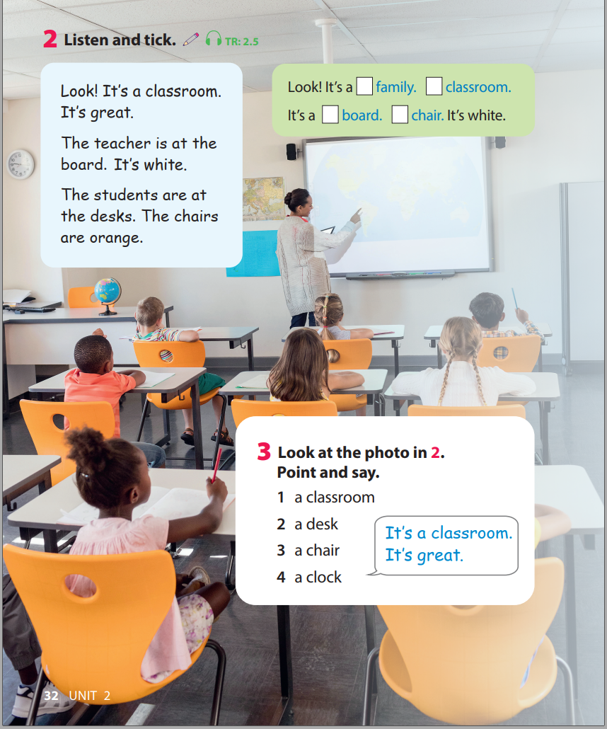
Task 3: Look and say
Look! It’s a classroom. It’s great.
The teacher is at the board. It’s white.
The students are at the desks. The chairs are orange.

Slide 24
My classroom fact file fill the blanks and then talk with your partner
4 Production
The classroom | great
The desks | brown
The chairs
The clocks
The girl
The boy
The teacher
The board
Others

Slide 25
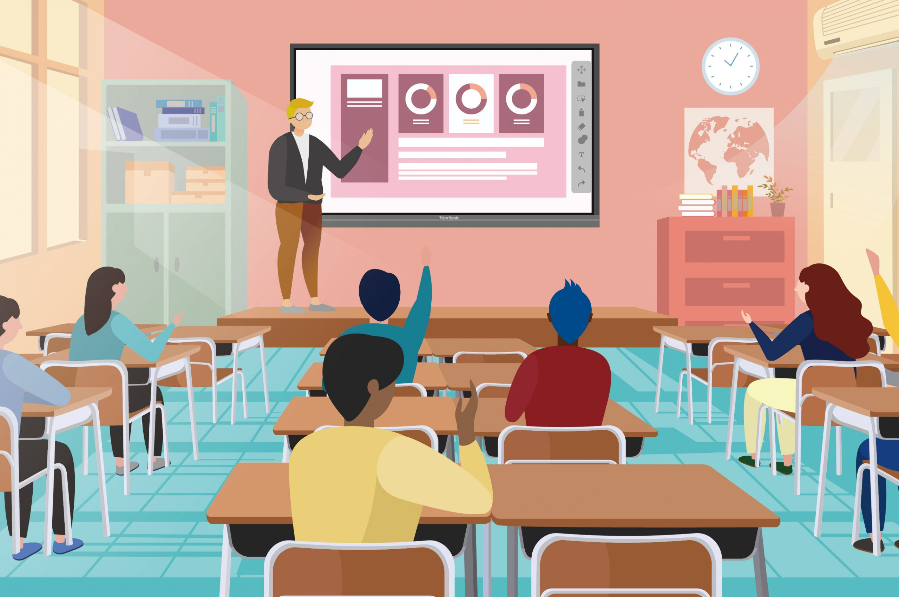
5. Assessment
e
1.
2.
3.
4.
5.
6.
1. It’s a board.
f
f
2. It’s a clock.
e
3. It’s a chair.
a
d
4. It’s a desk.
b
c
5. He’s a teacher.
a
6. She’s a student.
c
b
d
Notes:
THIẾT KẾ HOẠT ĐỘNG TƯƠNG TÁC CHO 6 CÂU NÀY.

Slide 26


