Slide 1




















Welcome everyone to our English class 4!
Fun time
and project

Slide 2




1
Fun time
Unit 1:
My family and friends
Let’s sing a song!

Slide 3
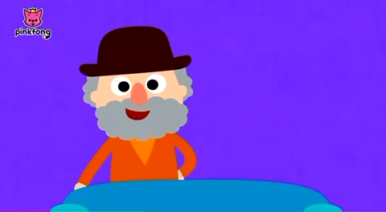
Song : Family Song
1
2
3
https://www.youtube.com/watch?v=Te2M7oYFQgA
fd

Slide 4
1
Fun time

Slide 5


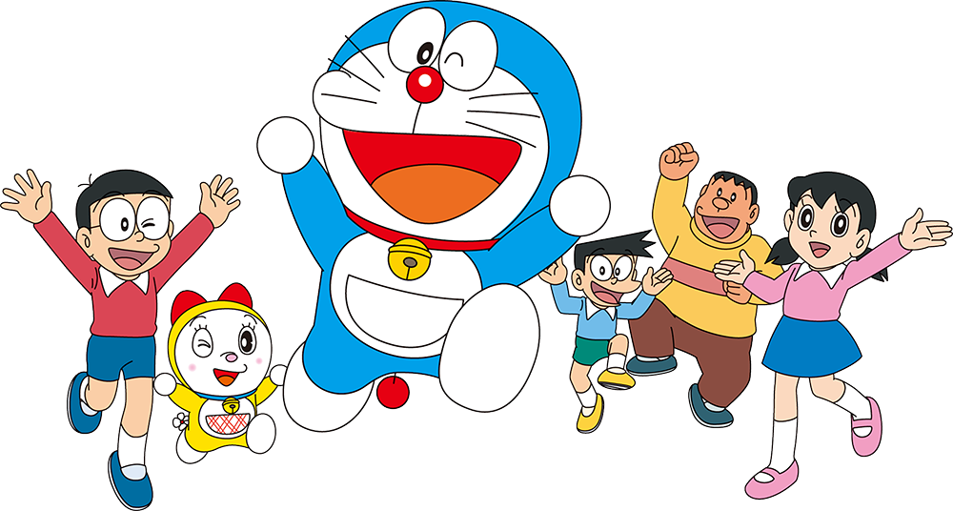
Puzzles

Slide 6
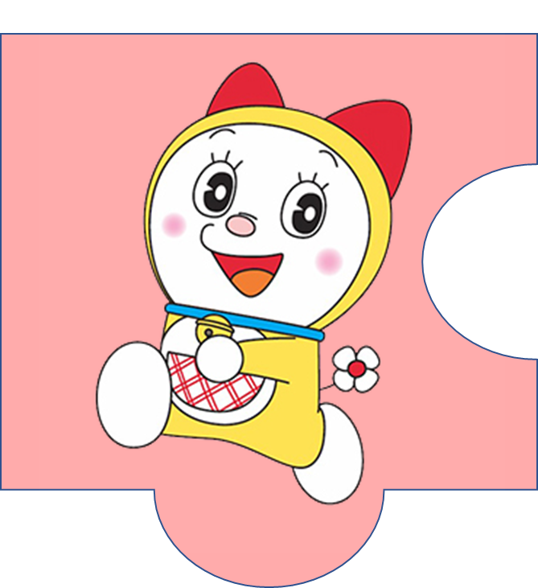

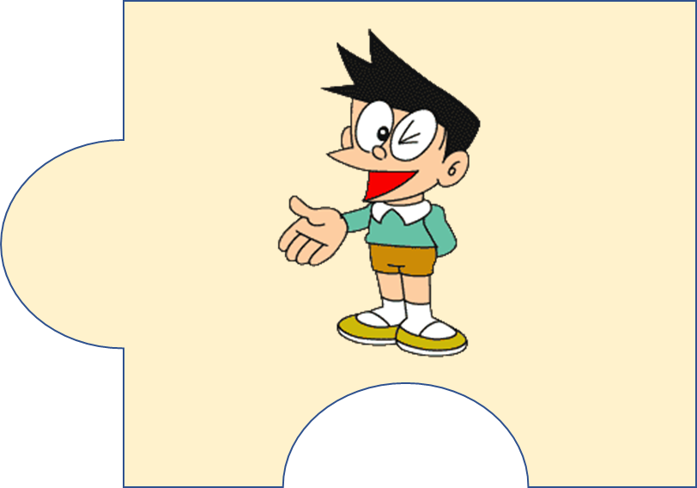
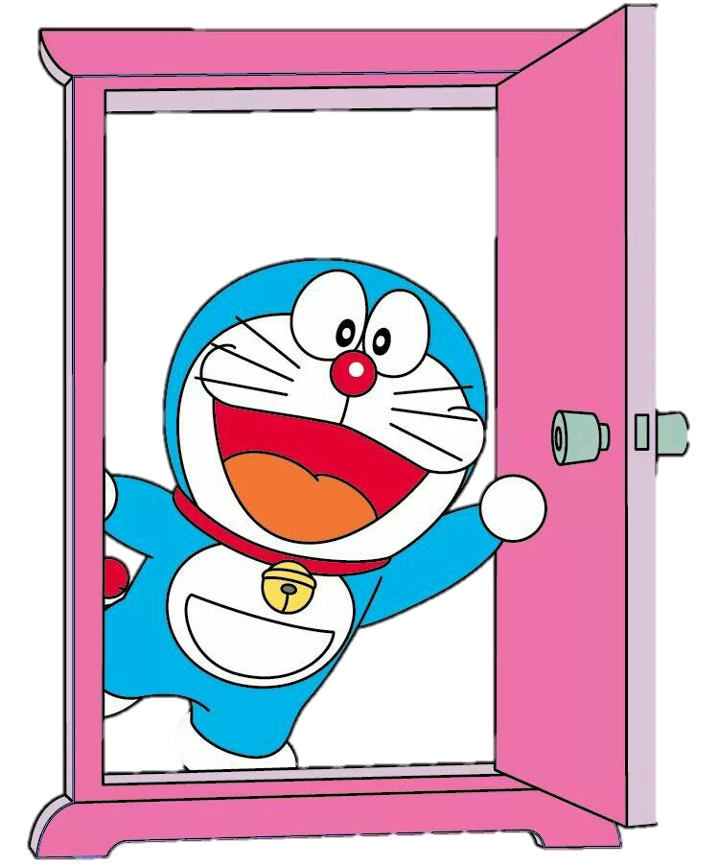



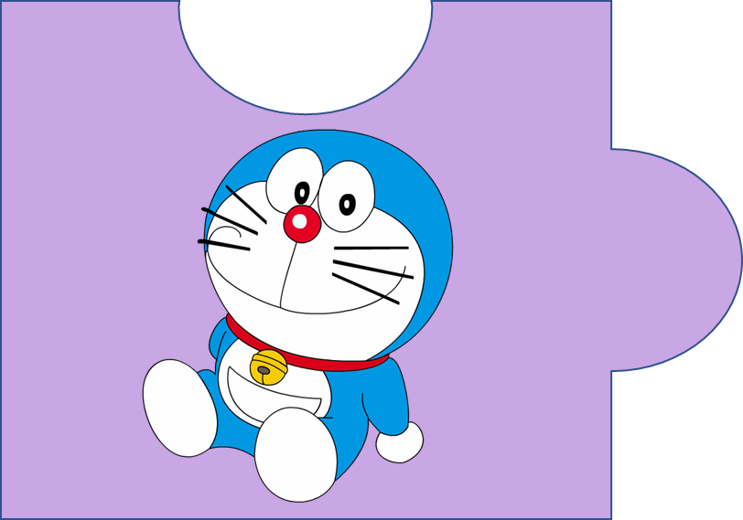


?
20
It’s a magic door.

Slide 7
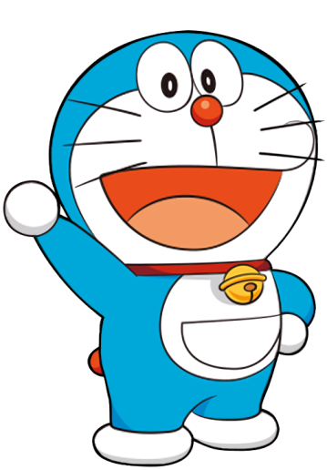
f c h u l r e e
  cheerful
4

Slide 8

p e s l a n t a
  pleasant
5

Slide 9

c l r e v e
  clever
3

Slide 10
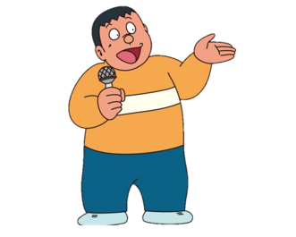
f r e d l n i y
  friendly
4

Slide 11
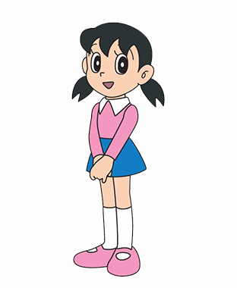
h a d r i n w o g r k
  hardworking
6

Slide 12
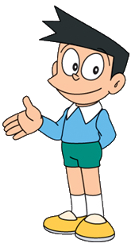
k n i d
  kind
2

Slide 13

2
Project
Family quiz

Slide 14




MATCHING GAME

Slide 15

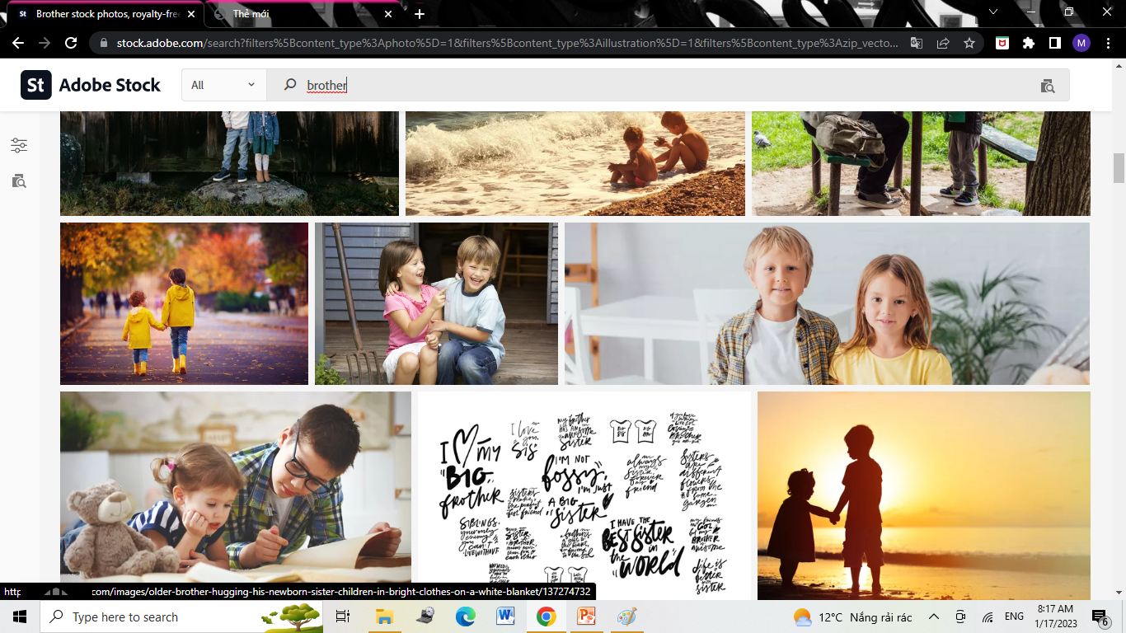
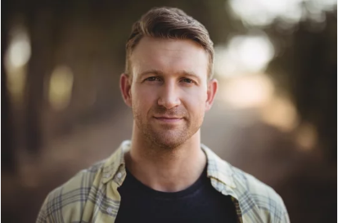
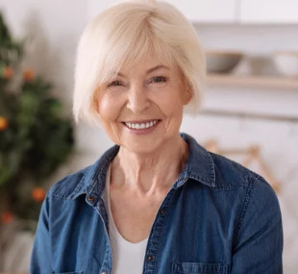
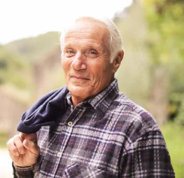
mother
father
4
1
sister
brother
2
5
grandpa
grandma
3
6

Slide 16
2
Project
My Family

Slide 17

REMEMBER !
This/ That is my ….
He/ She is … .

Slide 18
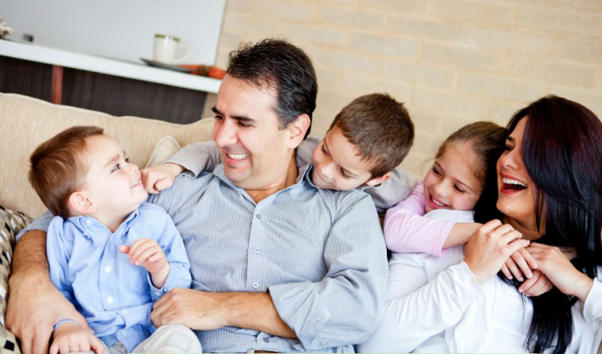
There are 5 people in my family.

Slide 19


Who’s this?
This is my father.
He’s friendly and kind.

Slide 20
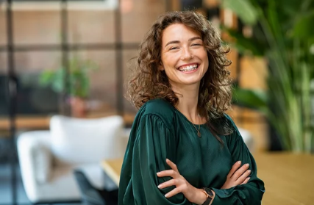
Who’s that?
That is my mother.
She’s pretty and nice.

Slide 21
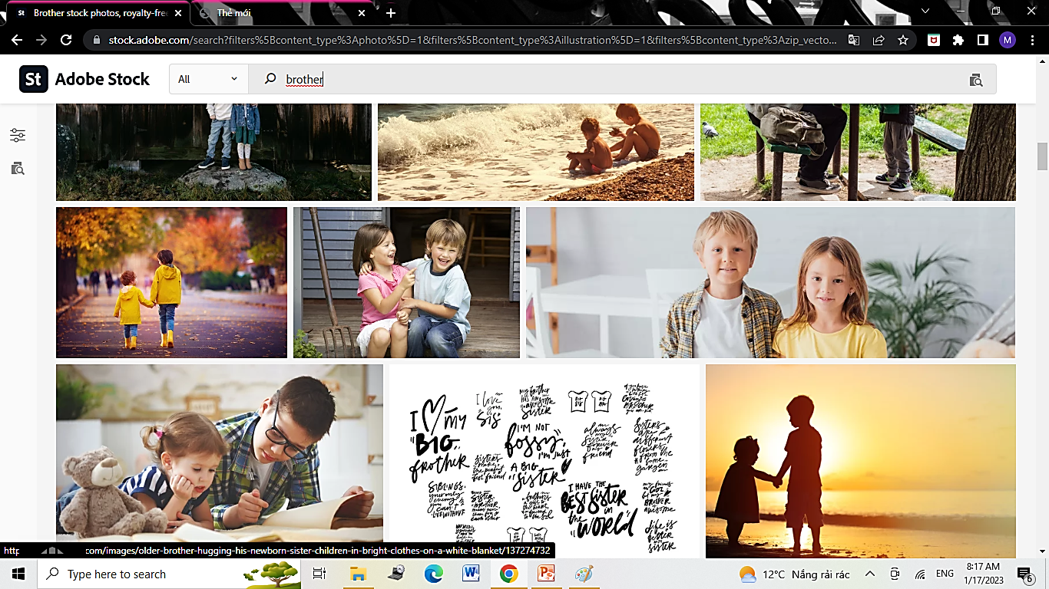
Who’s he?
He is my brother.
He’s clever and pleasant.

Slide 22
Who’s she?
She is my sister.
She’s hardworking and young.

Slide 23
2
Project
Your Family

Slide 24
kind
k_nd
pretty
pr_tty
_ardwor_ing
hardworking
h_ndsom_
handsome
chee_ful
cheerful
funny
funn_
cu_e
cute
clever
clev_r
fr_endl_
friendly
pleas_nt
pleasant
sh_rt
short

Slide 25
There are … people in my family. This is/ That is my ….
His name’s/ Her name’s….
He’s/ She’s ….

Slide 26
3
Assessment

Slide 27
Circle the correct answer
There are 3 … in my family.
people B. person C. kid
This is my mother. She is ….
nice B. Sunday C. sunny
3. Her uncle is not ….. He is tall.
ugly B. smelly C. short
My sister and I love … family so much.
A. his B. our C. their

Slide 28




Thank you & goodbye!

