Slide 1






















Unit 0
Colours
Notes:
Để nguyên trang bìa như này, chỉ thay đổi tên bài trong quá trình làm. Logo của sách Wonderful World

Slide 2






Warm up

Slide 3


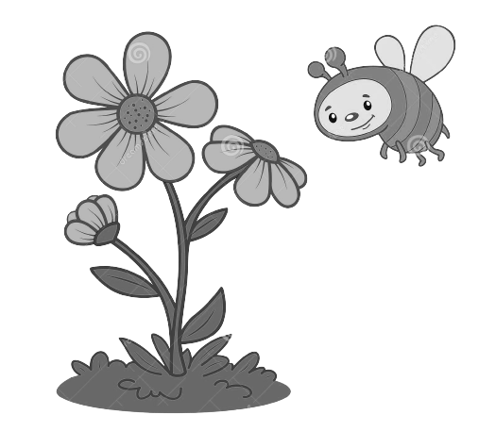
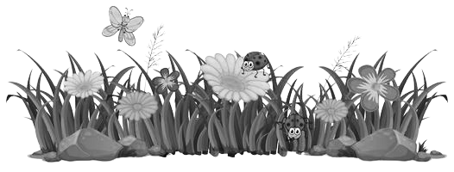
Notes:
Life is so beautiful with colours.
Lead in: introduce colours.

Slide 4



Notes:
Life is so beautiful with colours.
Lead in: introduce colours.

Slide 5

Presentation
Task 1: Listen and repeat.

Slide 6








It’s
red
It’s
blue
It’s
black
It’s green
It’s
white
It’s
orange
Notes:
Bấm vào Audio, khi nghe tới từ nào từ click ảnh vào từ đó.

Slide 7
Game: What’s missing?
It’s
red
It’s
blue
It’s
black
It’s green
It’s
white
It’s
orange
Notes:
Divide the class into 4 teams. One student from each team takes turn to play the game.
Pictures/flash cards are showed on the screen, one picture is hidden. Those who can find it and say it fast will get points.

Slide 8
Game: What’s missing?
It’s
red
It’s
blue
It’s
black
It’s green
It’s
white
It’s
orange
It’s
white
Notes:
Bấm vào audio, nghe tới đâu click chuột để hiện ra ảnh & từ vựng
Introduce the colors one by one: red, blue, black, green, white, orange. Use balloons to teach colours. (ppt or paper balloons)
- Play the recording and ask students to point to the words in their books. Play the recording again and ask students to repeat what they hear. Do this as a class a few times. Then ask volunteers to repeat on their own.

Slide 9
Game: What’s missing?
It’s
red
It’s
blue
It’s
black
It’s green
It’s
white
It’s
orange
Notes:
Bấm vào audio, nghe tới đâu click chuột để hiện ra ảnh & từ vựng
Introduce the colors one by one: red, blue, black, green, white, orange. Use balloons to teach colours. (ppt or paper balloons)
- Play the recording and ask students to point to the words in their books. Play the recording again and ask students to repeat what they hear. Do this as a class a few times. Then ask volunteers to repeat on their own.

Slide 10
Game: What’s missing?
It’s
red
It’s
blue
It’s
black
It’s green
It’s
white
It’s
orange
Notes:
Bấm vào audio, nghe tới đâu click chuột để hiện ra ảnh & từ vựng
Introduce the colors one by one: red, blue, black, green, white, orange. Use balloons to teach colours. (ppt or paper balloons)
- Play the recording and ask students to point to the words in their books. Play the recording again and ask students to repeat what they hear. Do this as a class a few times. Then ask volunteers to repeat on their own.

Slide 11
Game: What’s missing?
It’s
red
It’s
blue
It’s
black
It’s green
It’s
white
It’s
orange
Notes:
Bấm vào audio, nghe tới đâu click chuột để hiện ra ảnh & từ vựng
Introduce the colors one by one: red, blue, black, green, white, orange. Use balloons to teach colours. (ppt or paper balloons)
- Play the recording and ask students to point to the words in their books. Play the recording again and ask students to repeat what they hear. Do this as a class a few times. Then ask volunteers to repeat on their own.

Slide 12
Game: What’s missing?
It’s
red
It’s
blue
It’s
black
It’s green
It’s
white
It’s
orange
Notes:
Bấm vào audio, nghe tới đâu click chuột để hiện ra ảnh & từ vựng
Introduce the colors one by one: red, blue, black, green, white, orange. Use balloons to teach colours. (ppt or paper balloons)
- Play the recording and ask students to point to the words in their books. Play the recording again and ask students to repeat what they hear. Do this as a class a few times. Then ask volunteers to repeat on their own.

Slide 13

Practice
Task 2: Listen and repeat. Then point and say.

Slide 14
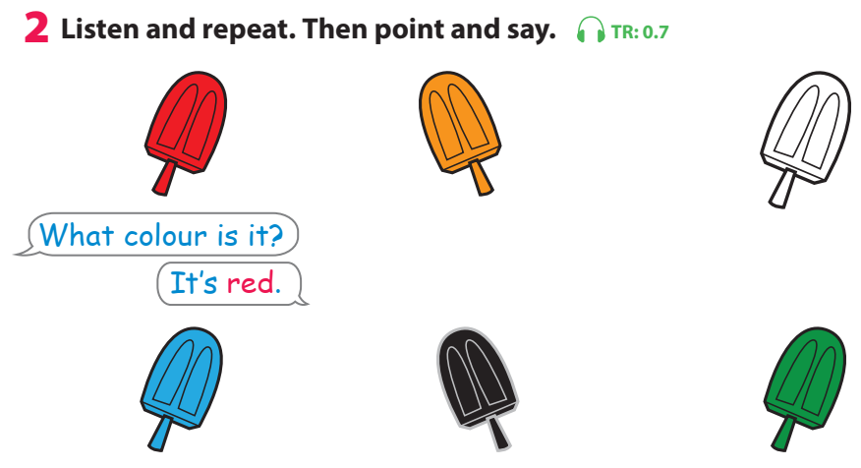

Notes:
THIẾT KẾ HOẠT ĐỘNG TƯƠNG TÁC VỚI CÂU HỎI DÙNG CHUNG CHO 6 BỨC TRANH LÀ: What colour is it? – It’s ____. Câu trả lời là màu của từng que kem (red, yellow, white, blue, black, green)
- Tell students to look at the first picture and the prompts. Tell them they are going to learn how to ask and answer about colours.
- Play the recording and ask students to follow the question and answer as they listen.
- Play the recording again and ask students to repeat what they hear. Do this as a class a few times. Then ask volunteers to repeat on their own.
- Ask students to look at the other five pictures and elicit the colours (blue, black, green, white, orange).
- Ask students to work in pairs to practise asking and answering questions about those five pictures. Tell them to point at the pictures as they speak.
- Ask volunteers to ask and answer questions about colours in front of the class.

Slide 15






Practice
What colour is it?
It’s red
Notes:
GV yêu cầu hs thực hành cấu trúc câu & cho hs làm việc theo cặp để luyện cấu trúc câu.

Slide 16

Game: Choose and say!

Slide 17






Slide 18


Slide 19
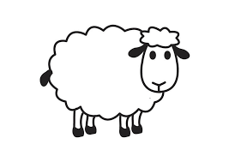

Slide 20


Slide 21




Slide 22
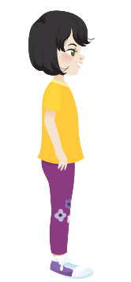



Slide 23

Production
Task 3: Let’s play

Slide 24
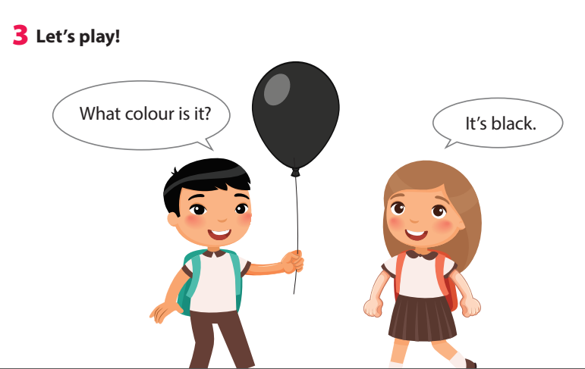
Notes:
- Tell students they are going to play a game to ask and answer about colours.
- Tell students to look at the picture and the sample sentences. Read out the sample sentences and ask students to repeat.
- Explain to students that they’re going to play the game in pairs. One student holds up an object (or crayons) and asks What colour is it? The other student then answers the question.
- Give an example by asking a student to do the activity with you.
- Ask students to work in pairs to play the game.
- Ask volunteers to play it in front of the class.

Slide 25


Slide 26

Assessment
Let’s colour!

Slide 27
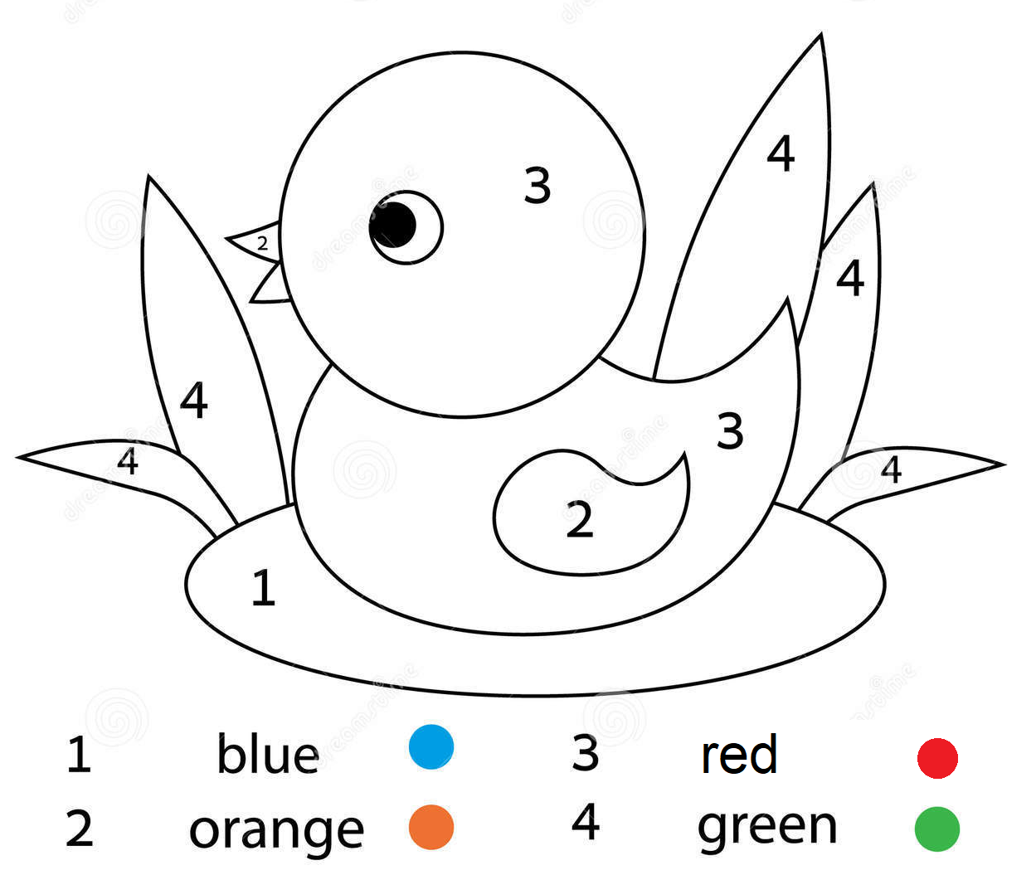
Notes:
Show a picture for sts to colour. Ask the sts to say the colours that they need to use to make the picture more beautiful.
Show the pictures to their classmates and practice the sentence: What colour is it? It’s …

Slide 28
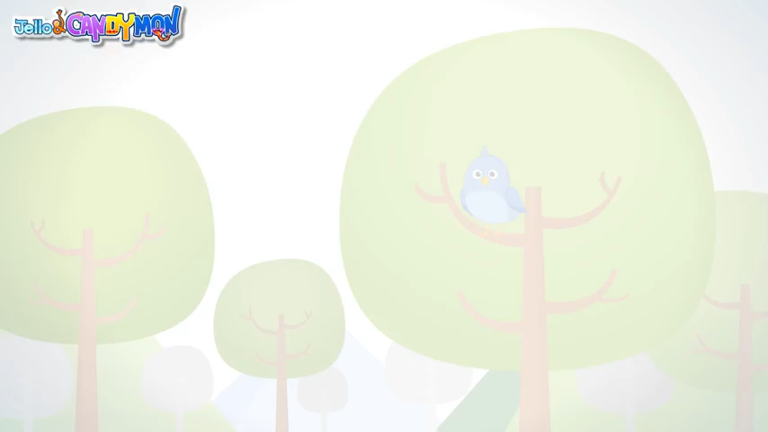
I can sing a rainbow

Slide 29



Good bye.
See you again!

