Slide 1






















Unit 0
Classroom and
Instructions
Notes:
Để nguyên trang bìa như này, chỉ thay đổi tên bài trong quá trình làm. Logo của sách Wonderful World

Slide 2







Warm up
and review

Slide 3

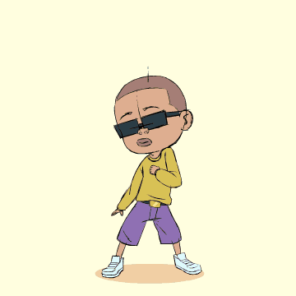
Movement Game: Dance, and stop!
Notes:
Play the music and let sts dance. When music stops, sts have to stand still. Who can make it is the winner.
Who looses: Come to the board:
Say the names, greet the teacher and classmates (review), then do the stand up, sit down 5 times (lead in).

Slide 4


Come to the board, please!
Hi, I’m Minh-big boy. Nice to meet you.
Notes:
Play the music and let sts dance. When music stops, sts have to stand still. Who can make it is the winner.
Who looses: Come to the board:
Say the names, greet the teacher and classmates (review), then do the stand up, sit down 5 times (lead in).

Slide 5



Game: Stand up! Sit down!
Stand up!
Sit down!
Notes:
Play the music and let sts dance. When music stops, sts have to stand still. Who can make it is the winner.
Who looses: Come to the board:
Say the names, greet the teacher and classmates (review), then do the stand up, sit down 5 times (lead in).

Slide 6

Presentation
Task 1: Listen and repeat.

Slide 7






Look at the board
Sit down
Stand up
Notes:
Thao tác chuột
Bấm vào loa, đọc tới đâu thì click chuột xuống dưới hiện lên ảnh & từ vựng
Task 4: Listen and repeat. (Track 0.5)
Use flashcards to introduce the vocabulary and structure of lesson.
Stand up
Sit down
Look at the board
May I come in?
Don’t talk.
May I go out?
Tell the students to look at the pictures and pay attention to the actions that the pictures illustrate.

Slide 8



May I come in?
Don’t talk!
May I go out?
Notes:
Thao tác chuột
Bấm vào loa, đọc tới đâu thì click chuột xuống dưới hiện lên ảnh & từ vựng
Use flashcards to introduce the vocabulary and structure of lesson
May I come in?
Don’t talk
May I go out?

Slide 9
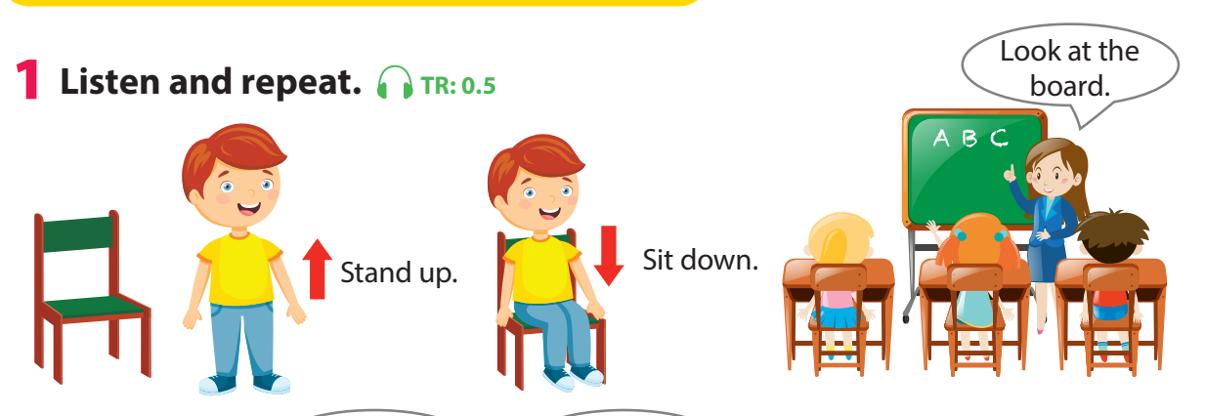
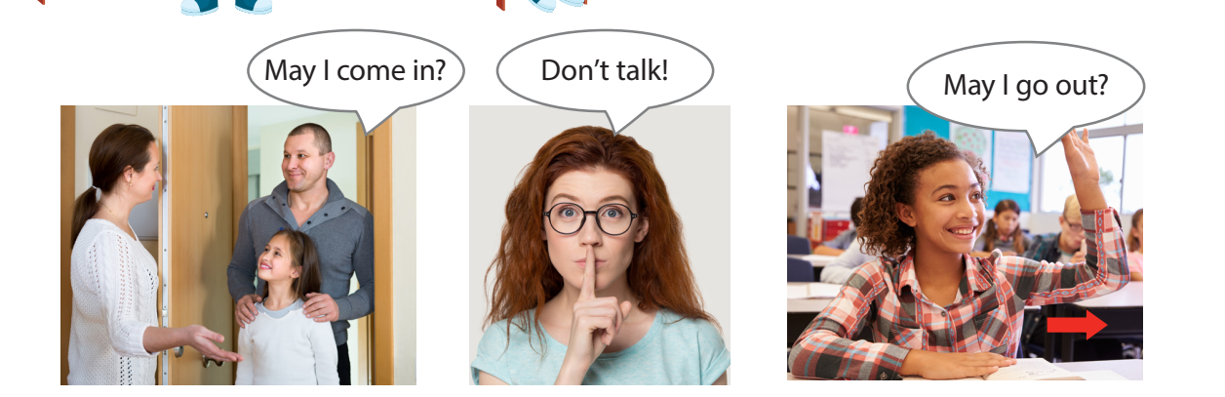
Notes:
Play the recording and tell students to listen and point at the corresponding pictures. Play the recording again, pause after each instruction/sentence and ask students to repeat it.
• Ask volunteers to say all the instructions/sentences.

Slide 10

Game:
Who says it fast?
Notes:
Game: Who says it fast?
Divide the class into 2 teams. One student from each team takes turn to play the game.
Pictures are showed on the screen. Who says it fast will get points.

Slide 11

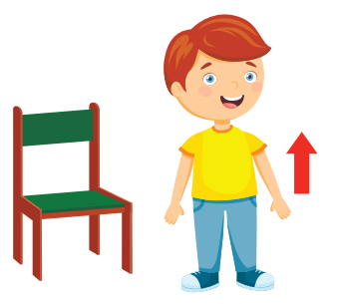

Slide 12


Slide 13


Slide 14


Slide 15


Slide 16


Slide 17

Practice
Task 2: Match and say

Slide 18
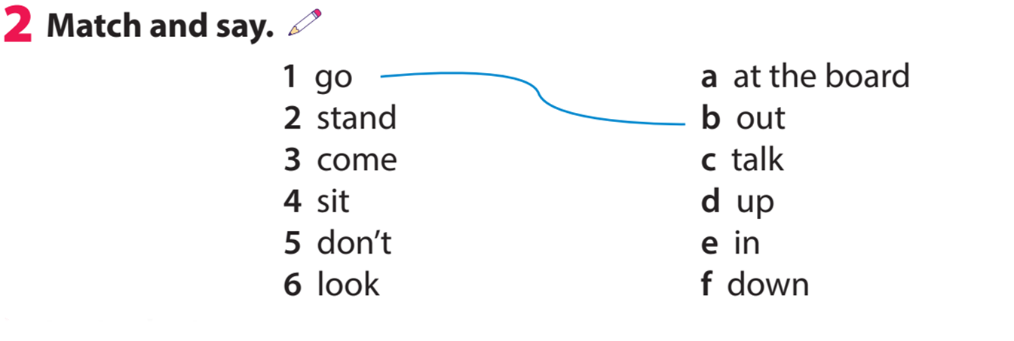
Let’s check!
Notes:
GV cho hs 1f tự làm sau đó gọi hs cho đáp án & click chuột sẽ ra đáp án

Slide 19
Game: Let’s make it!
Notes:
Game: Let’s make it!
This game can be played in two teams (example: team A and B).
1 student from team A, say a word from the left. The student from team B must say the left of it.

Slide 20
Practice
Task 3: Let’s play

Slide 21


Let’s play!
Go…
out.
Notes:
Game: Let’s play
This game can be played in two teams (example: team A and B).
1 student from team A, say a word from the left. The student from team B must say the left of it.

Slide 22
Let’s play!
Stand…
up.
Notes:
Game: Let’s play
This game can be played in two teams (example: team A and B).
1 student from team A, say a word from the left. The student from team B must say the left of it.

Slide 23

Production
Game: Simon says
Notes:
Tell students they are going to play a game called “Simon says”.
Ask students to look at the picture and the prompt. Read out the prompt and ask students to repeat.
Explain to students that in this game, one student will be Simon. When Simon calls out an action, all the other students have to do it. Any student who fails to do the correct action will lose the game.
Play one round with the whole class to make sure
students understand the rules.
Appoint one student to be Simon and ask the class to
play together.
Allow different students to be Simon and play the game again.

Slide 24
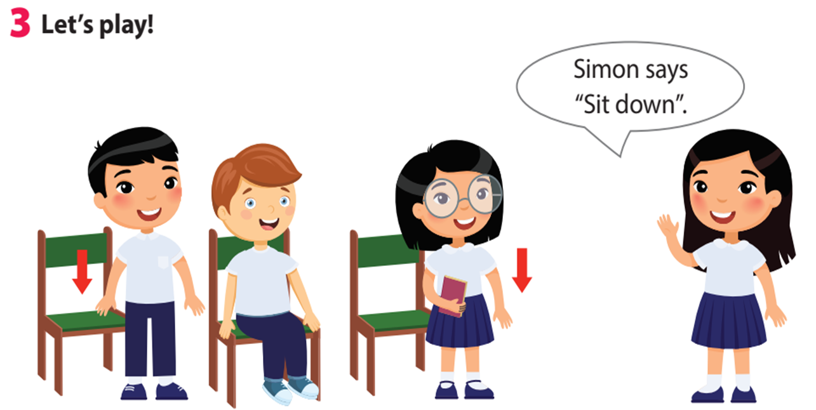
Notes:
Tell students they are going to play a game called “Simon says”.
Ask students to look at the picture and the prompt. Read out the prompt and ask students to repeat.
Explain to students that in this game, one student will be Simon. When Simon calls out an action, all the other students have to do it. Any student who fails to do the correct action will lose the game.
Play one round with the whole class to make sure
students understand the rules.
Appoint one student to be Simon and ask the class to
play together.
Allow different students to be Simon and play the game again.

Slide 25

Assessment
Game: Look and guess

Slide 26
Game: Look and guess
1
2
3
4
5
6
7
8
9
Notes:
Use 9 covering pictures (with numbers 1-9) to cover flashcards. Reveal the covering pictures (sts choose the numbers) until sts can guess what the flashcard is.
This game can be played in teams.

Slide 27
Game: Look and guess
1
2
3
4
5
6
7
8
9

Slide 28
Game: Look and guess
1
2
3
4
5
6
7
8
9

Slide 29
Game: Look and guess
1
2
3
4
5
6
7
8
9

Slide 30
Game: Look and guess
1
2
3
4
5
6
7
8
9

Slide 31



Good bye.
See you again!

