Slide 1
OBJECTIVES ( mục tiêu)
1. Knowledge:
Students will learn the words related to the topic of Food and drinks: egg, orange, sandwich, spaghetti, vegetable.
2. Competences:
- English competences: Students will be able to practice listening and speaking about food and fruit topic.
- Common competences: Students will have the opportunity to develop creativeness in drawing and autonomy in doing tasks.
3. Qualities:
- Students will understand and respect the festival culture in other countries.

Slide 2
LESSON PROCEDURE
I. Activity 1: Warm up (5’)
II. Activity 2: Presentation (task 1) (8’)
III. Activity 3: Practice (task 2 ) (12’)
IV. Activity 4: Production (task 3) (13’)
V. Activity 5: Assessment (2’)

Slide 3

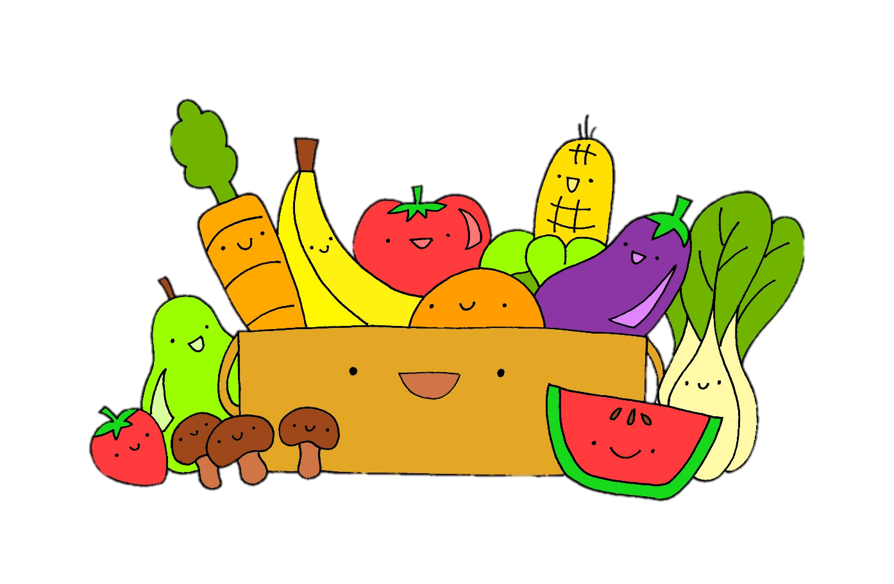
1 WARM UP
Listen and sing along.

Slide 4


Slide 5
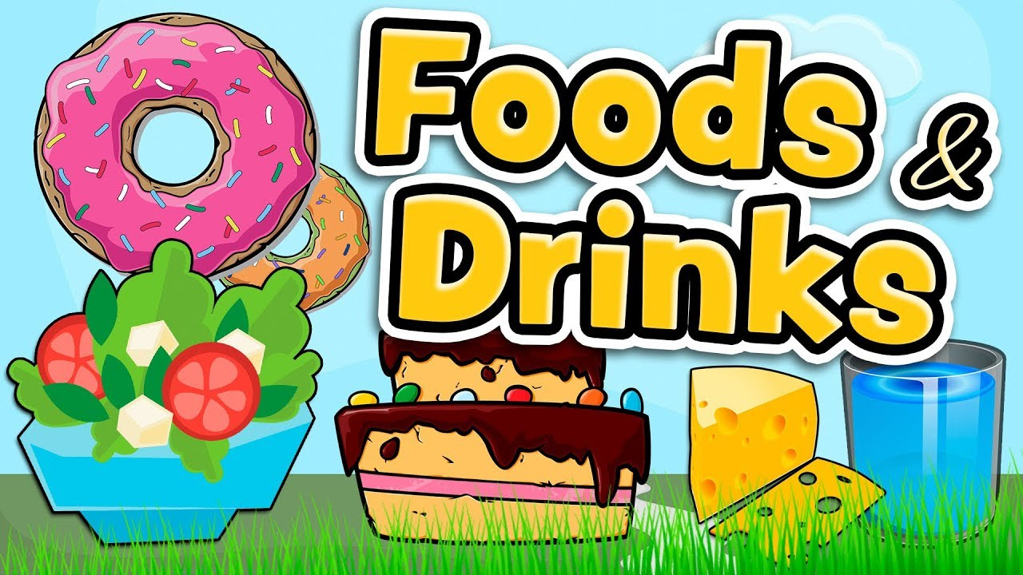
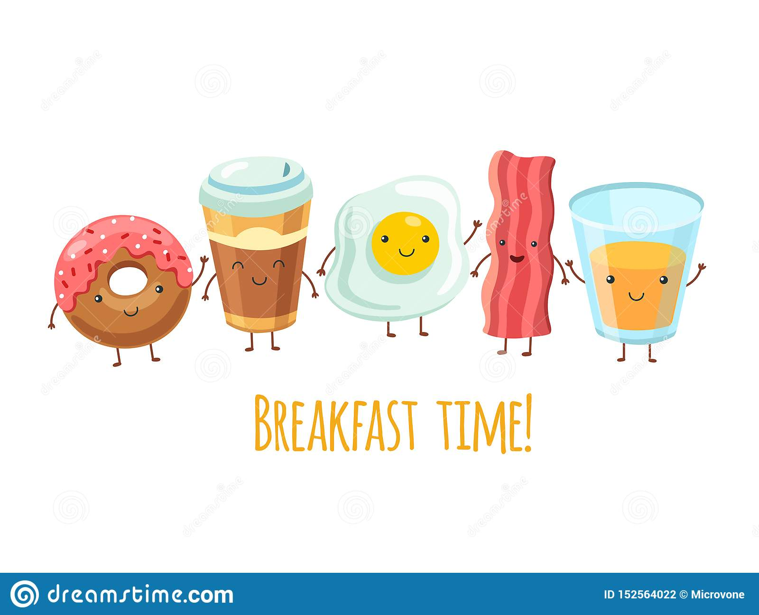
Unit 4:
Lesson 1 – Task 1, 2, 3

Slide 6
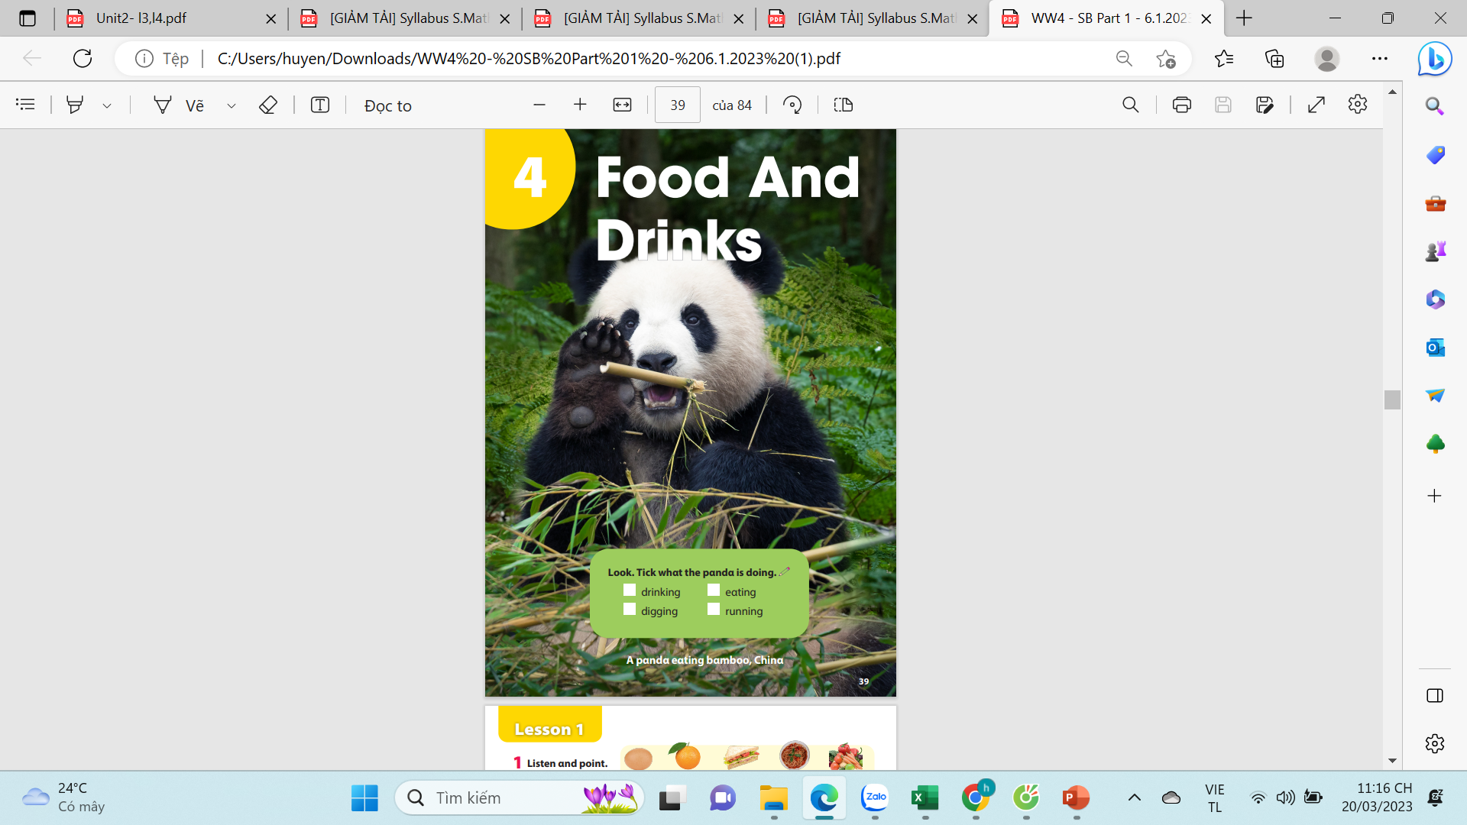
Look. Tick what the panda is doing?.
drinking
eating
digging
running
A panda eating bamboo, China
Notes:
Ko hiện lên dc dấu tick

Slide 7





2 PRESENTATION
Task 1 Listen and point. Repeat.

Slide 8
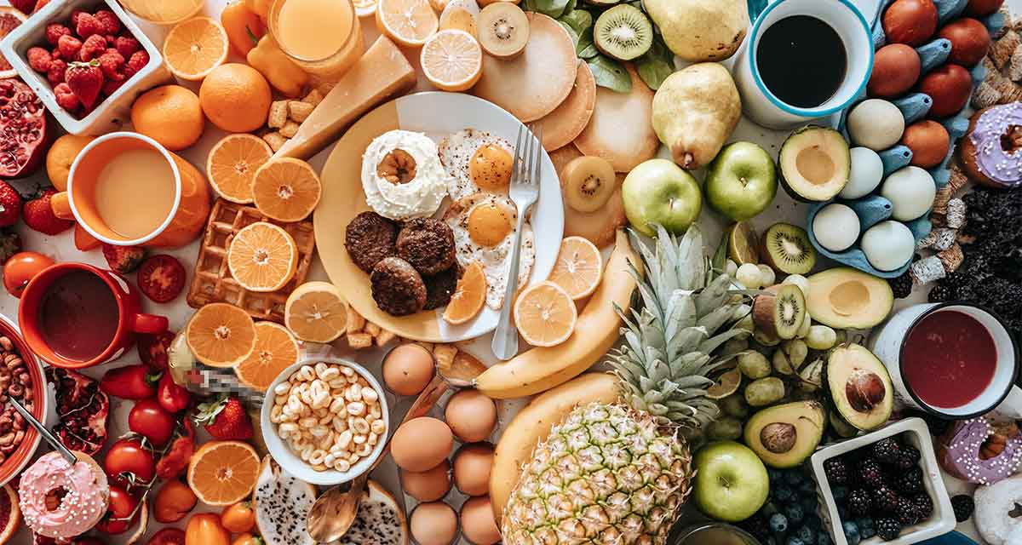

Slide 9
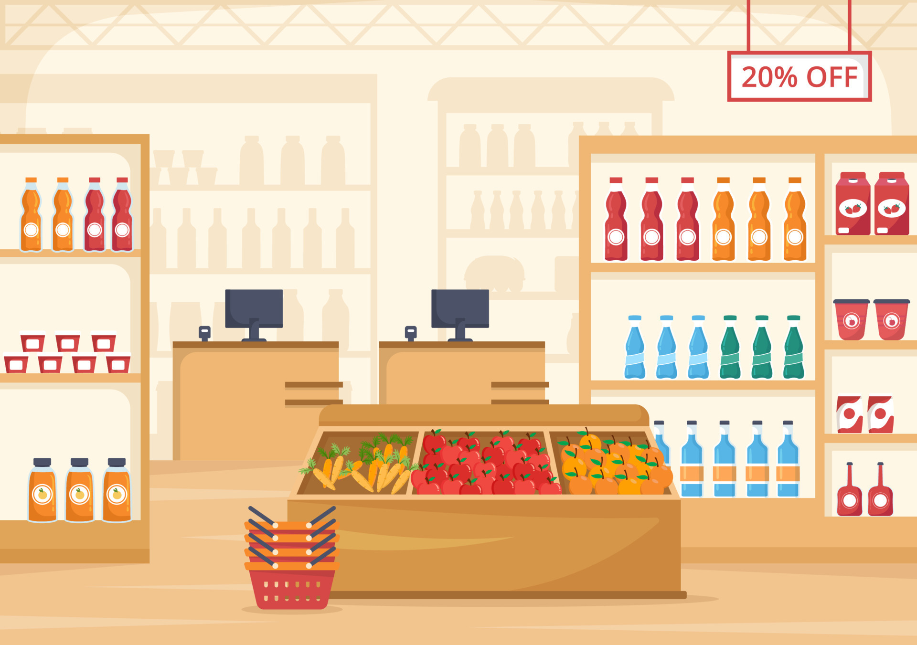
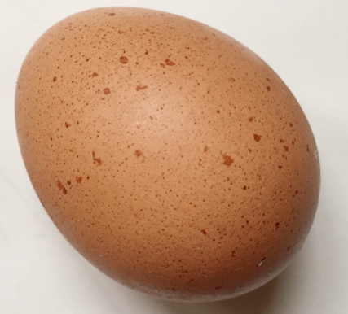
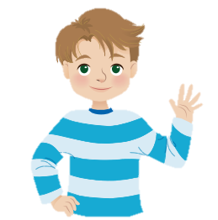
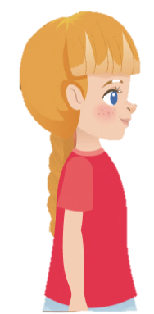
New words
an egg
Sophie
Alex

Slide 10
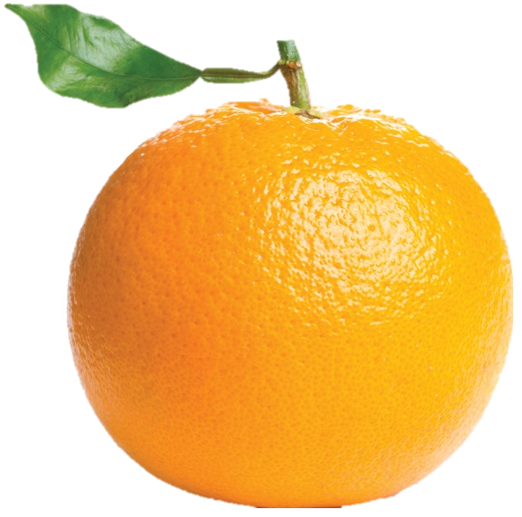
New words
an orange
Sophie
Alex

Slide 11
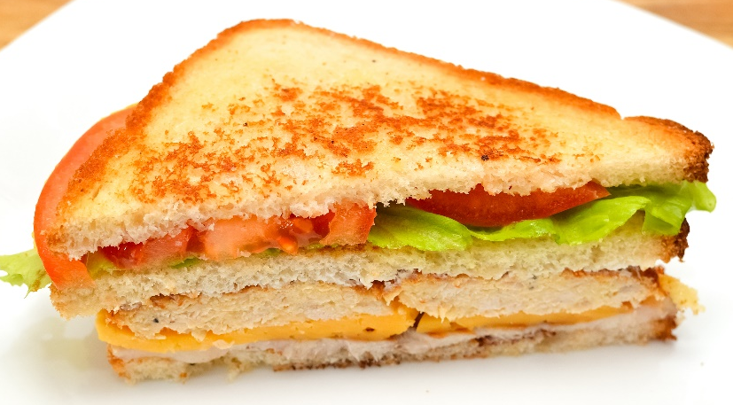
New words
a sandwich
Sophie
Alex

Slide 12
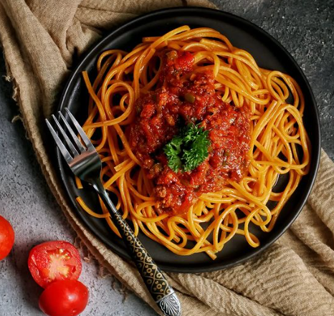
New words
spaghetti
Sophie
Alex

Slide 13
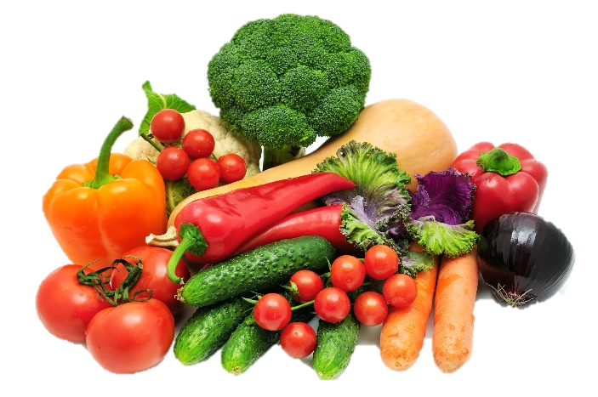
New words
vegetables
Sophie
Alex

Slide 14

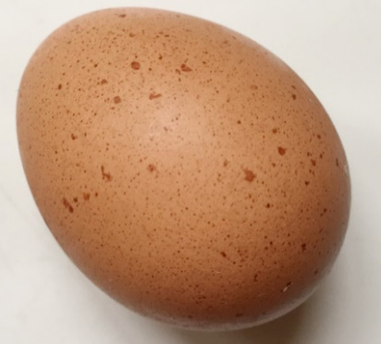



Listen and point. Repeat.
an egg
an orange
sandwich
spaghetti
vegetables

Slide 15





Look at the the line and say what’s disappeared with the wind within the time limit (5 seconds)

Slide 16
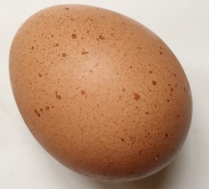
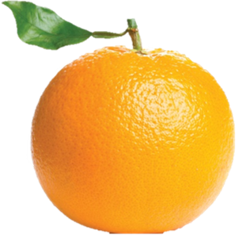

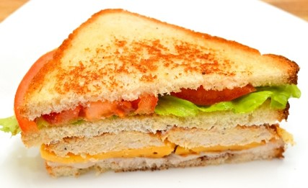
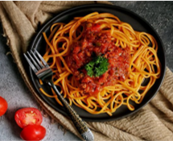
What’s disappeared?
vegetables
TIME’S UP

Slide 17
What’s disappeared?
orange
TIME’S UP

Slide 18
What’s disappeared?
spaghetti
TIME’S UP

Slide 19
What’s disappeared?
vegetables
TIME’S UP

Slide 20
What’s disappeared?
sandwich
TIME’S UP

Slide 21
What’s disappeared?
egg
TIME’S UP

Slide 22
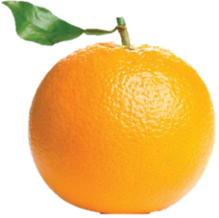

What are disappeared?
orange
TIME’S UP
sandwich

Slide 23
What are disappeared?
egg
TIME’S UP
sandwich

Slide 24
What are disappeared?
spaghetti
TIME’S UP
vegetables

Slide 25
    Wednesday, 16th August 2023
Unit 4: Food and Drinks
Lesson 1- Period 1st
    New words
    an egg
    an orange
    a sandwich
    spaghetti
    vegetables

Slide 26

3 PRACTICE
Task 2 Listen and write.

Slide 27
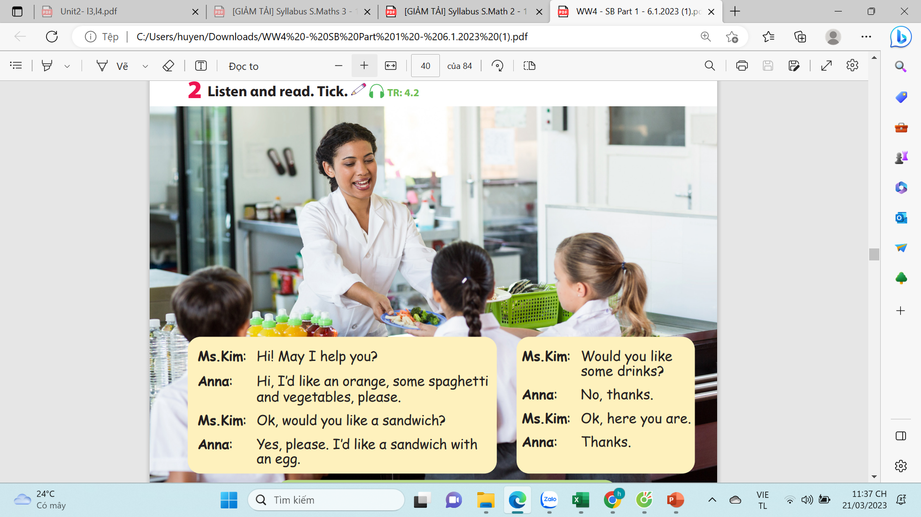
2.Listen and read. Tick.
Would you like some drinks?
Hi! May I help you?
Ok, would you like a sandwich?
Ok, here you are.
Thanks.
No, thanks.
Yes, please. I’d like a sandwich with an egg.
Hi! I’d like an orange, some spaghetti and vegetables, please.

Slide 28
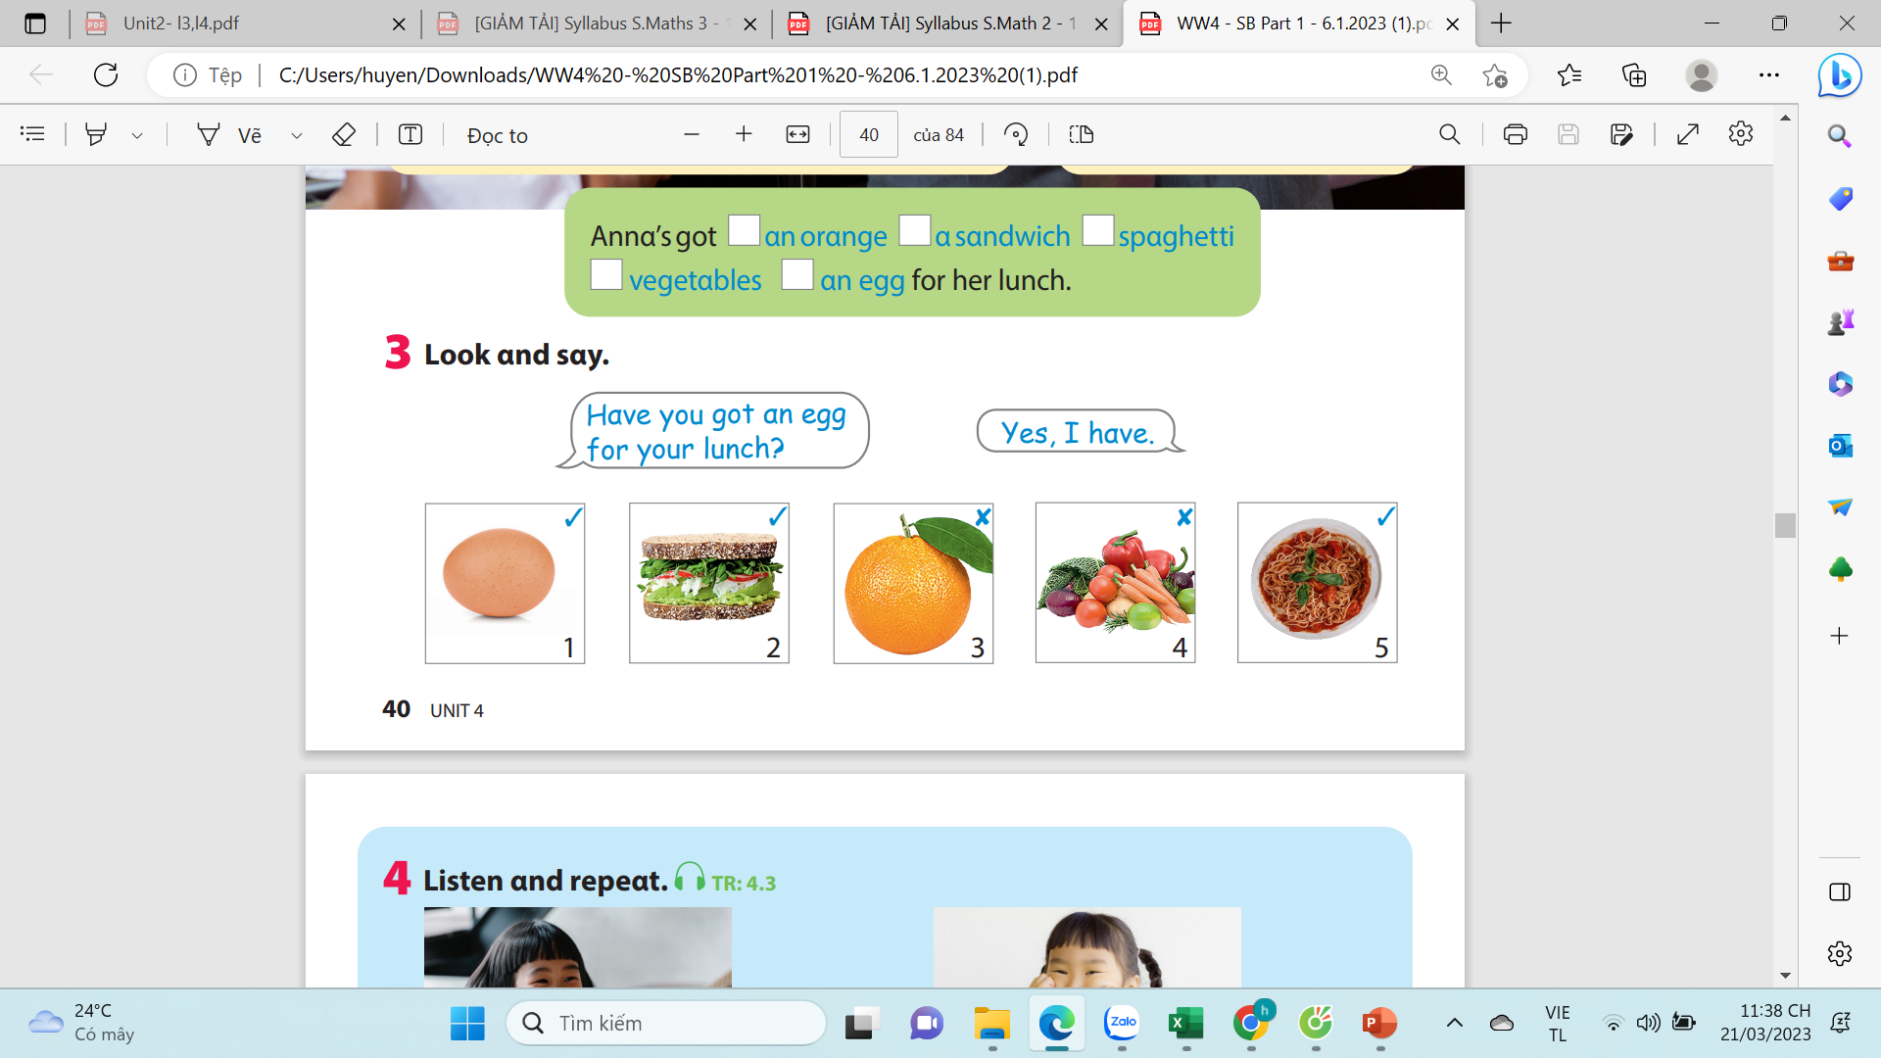
2.Listen and read. Tick.
✔
✔
✔
✔
✔

Slide 29
Listen and check.

Slide 30

4.PRODUCTION
Task 3 Look and say.
Notes:
- Introduce and set game rules
- Do a demo
- Play several rounds.

Slide 31
Model sentence
- Have you got an egg for your lunch?
✓ Yes, I have. ✗ No, I haven’t.

Slide 32
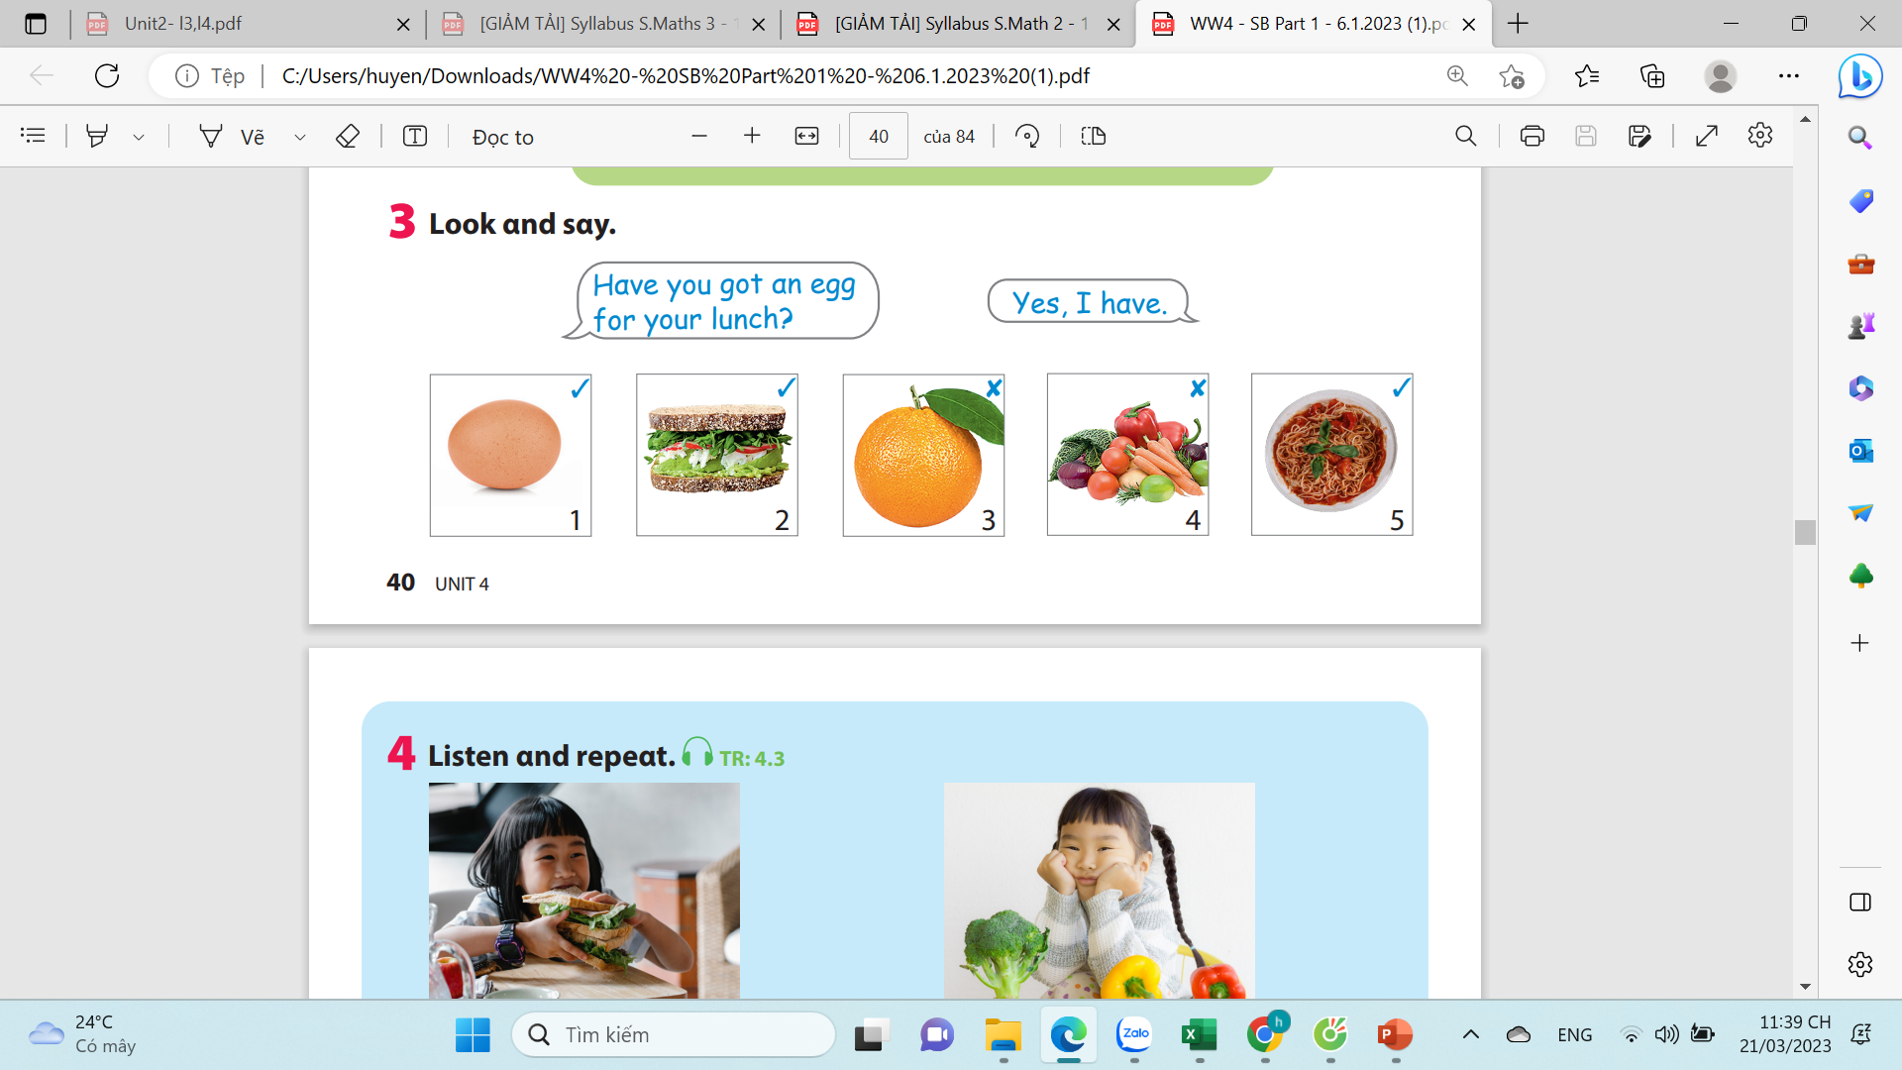

Slide 33

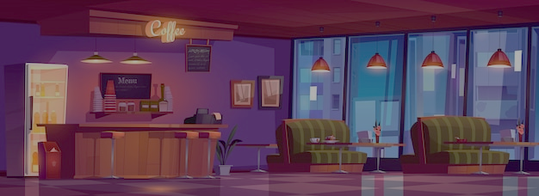
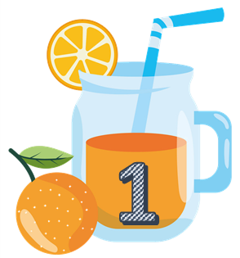







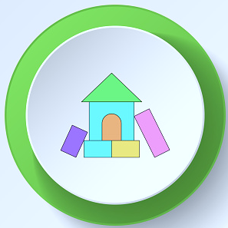
Team A
Team B
Notes:
Divide the class into 2 teams to play “ Fruit Juice”.
Each team choose one jar of juice to go to the question.
Have pupils look, read and choose the right option.
Back to the menu for pupils to choose another question.
Pupils continue their turn until there are not any jars of juice left.
The one who gets most points is the winner.

Slide 34
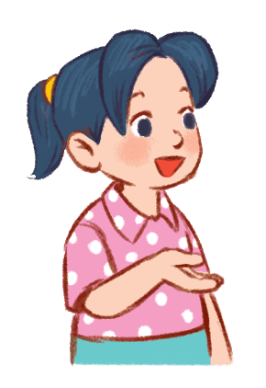
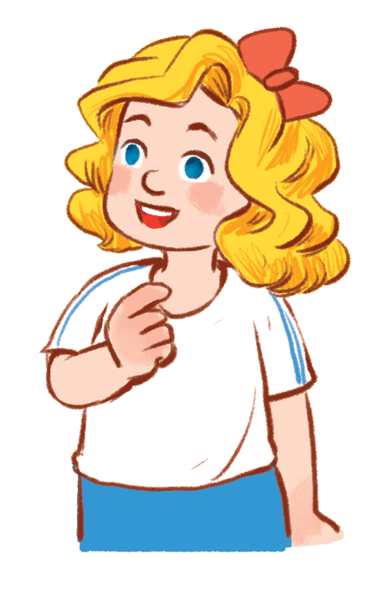

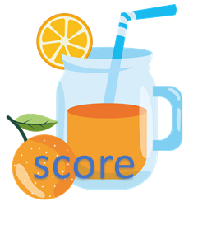
Have you got an egg for lunch?
…………………
✔
40
No, I have
Yes, I have
Yes, I do

Slide 35
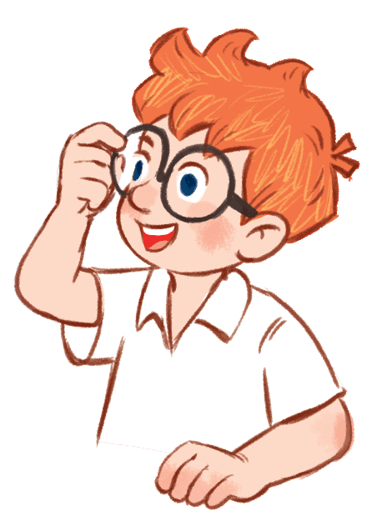
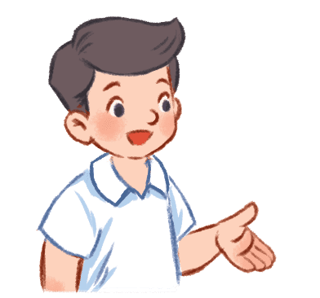
Have you got an orange for lunch?
………………...
✘
30
No, I haven’t.
No, I don’t
Yes, I do

Slide 36
Have you got a sandwich for lunch?
………………..
✔
20
Yes, I am
Yes, I do
Yes, I have.

Slide 37
Have you got vegetable for lunch?
………………..
✘
60
Yes, I am
No, I haven’t.
No, I don’t.

Slide 38
Have you got spaghetti for lunch?
………………..
✔
40
Yes, I am
Yes, I have
No, I haven’t

Slide 39
Have you got an orange for lunch?
………………...
✘
20
No, I haven’t.
No, I don’t
Yes, I do

Slide 40
Have you got vegetable for lunch?
………………..
✘
50
Yes, I am
No, I haven’t.
No, I don’t.

Slide 41
Have you got spaghetti for lunch?
………………..
✔
30
Yes, I am
Yes, I have
No, I haven’t

Slide 42
Have you got for your breakfast/ lunch/ dinner?
✓ Yes, I have. ✗ No, I haven’t.
an orange

Slide 43
Tuesday, 15th August 2023
Unit 4: Food and Drinks
Lesson 1- Period 1st
New words an egg an orange a sandwich spaghetti vegetables | 2. Model sentence - Have you got an egg for your lunch? ✓ Yes, I have. ✗ No, I haven’t.

Slide 44

5.ASSESSMENT

Slide 45
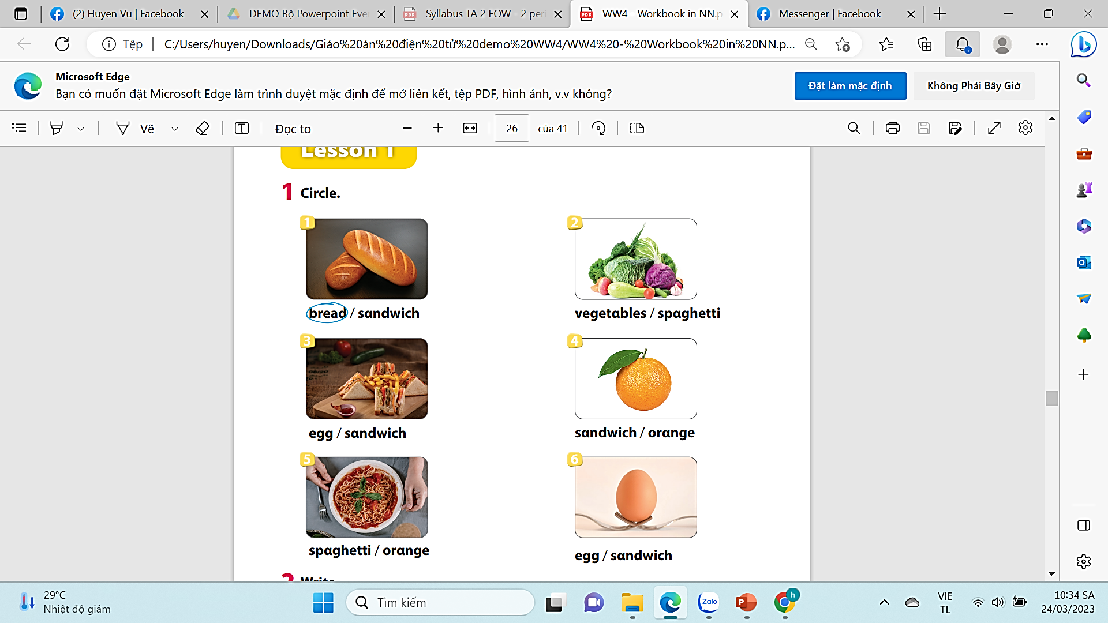

Slide 46




6. Wrap-up
Egg, orange, spaghetti, sandwich, vegetable.

Slide 47




Thank you & goodbye!

