Slide 1



Unit 1
What’s your address?
Lesson 2
Teacher: Ms. Huyền Phạm
Facebook: Học Tiếng Anh cùng Ms.Pham

Slide 2
VOCABULARY

Slide 3
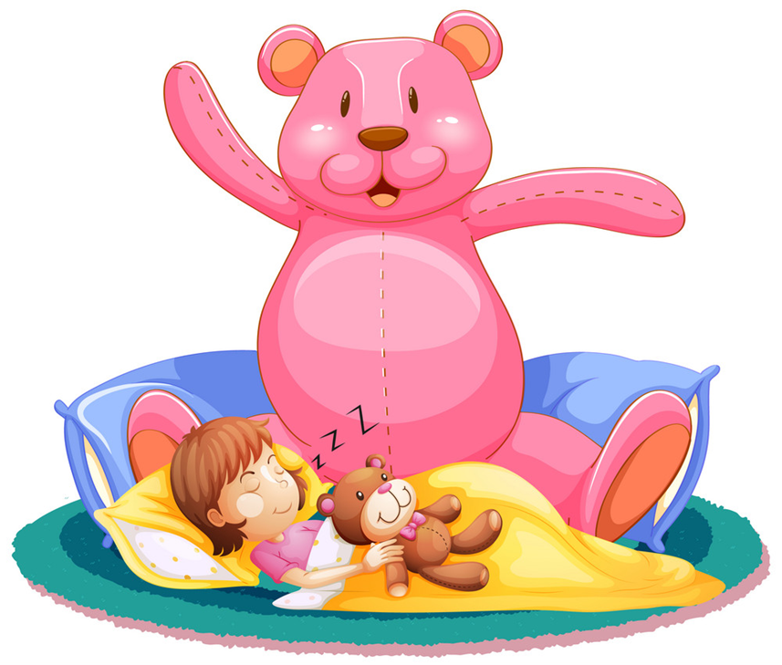
Vocabulary
Big
/big/
Small
/smɔːl/
(a) nhỏ

Slide 4
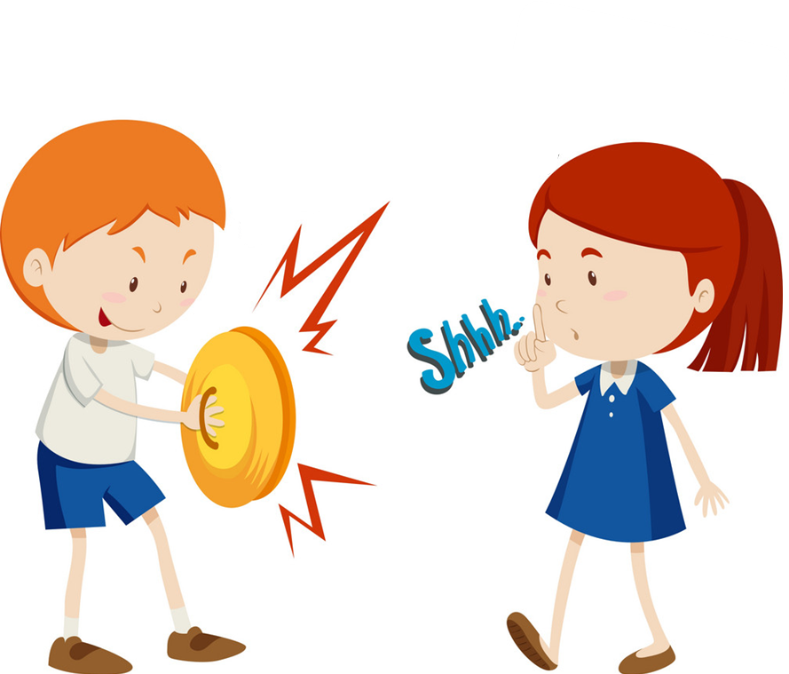
Vocabulary
Noisy
/ˈnɔɪzi/
(a) Ồn ào
quiet
/ˈkwaɪət/
(a) Yên tĩnh

Slide 5
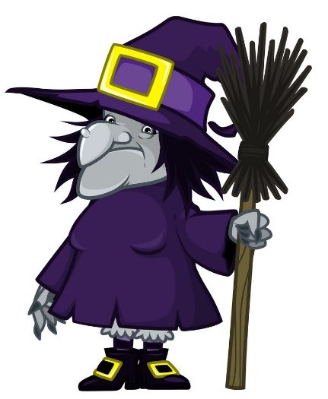
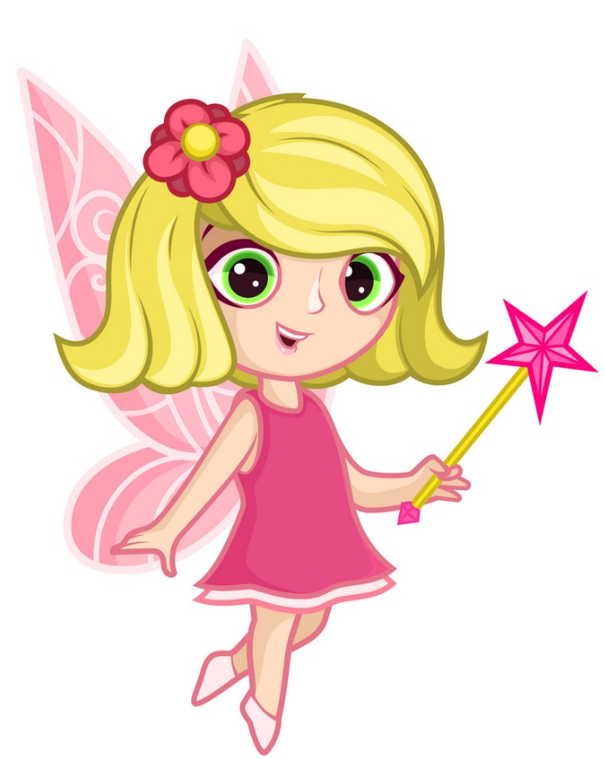
Vocabulary
beautiful
/ˈbjuːtɪfl/
(a) đẹp, xinh

Slide 6
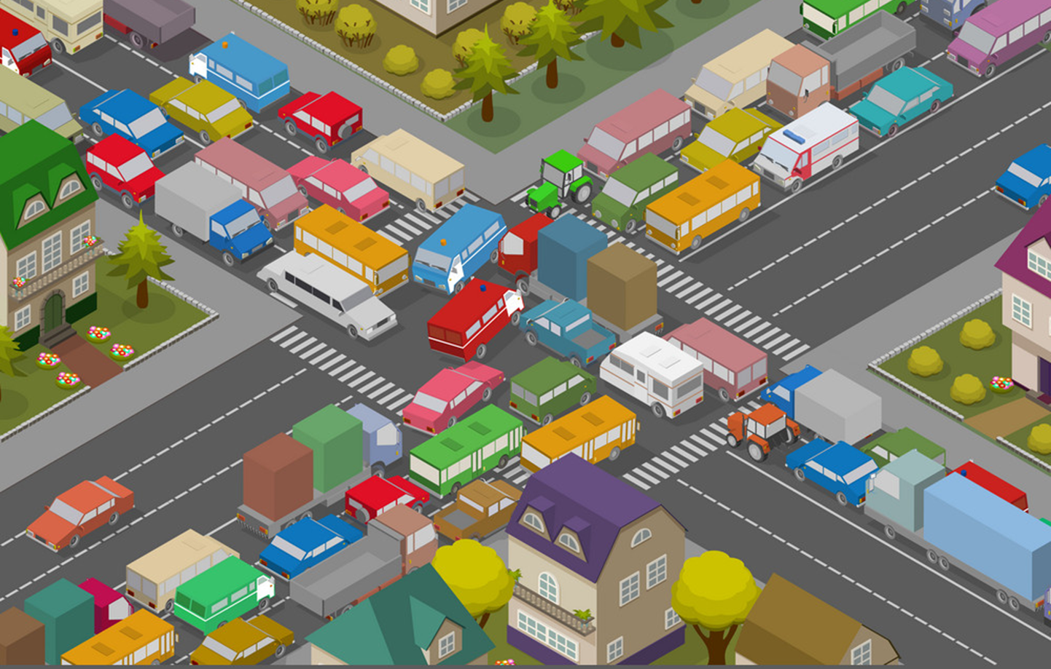
Vocabulary
crowded
/ˈkraʊdɪd/
(a) Đông đúc

Slide 7

Vocabulary
busy
/ˈbɪzi/
(a) bận rộn

Slide 8
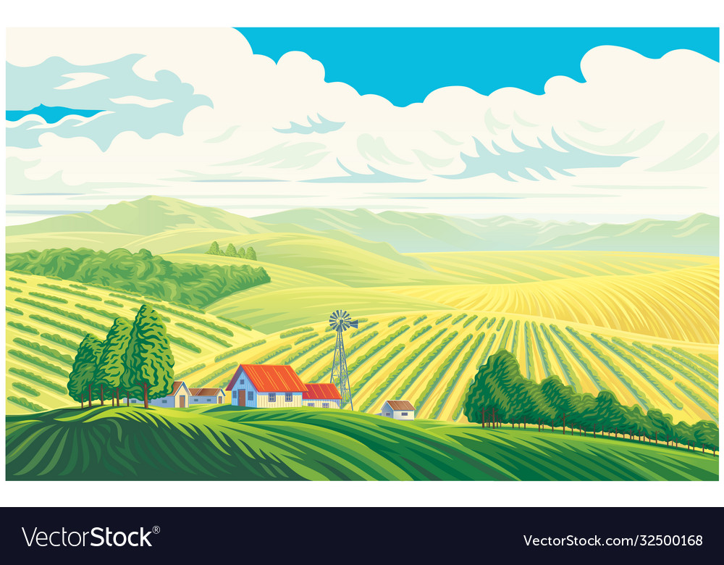
Vocabulary
large
/lɑːrdʒ/
(a) rộng

Slide 9

Vocabulary
far
/fɑː/
(a) xa

Slide 10
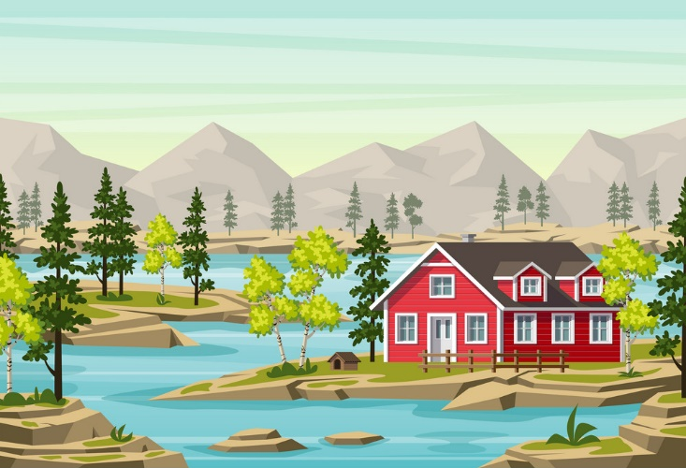
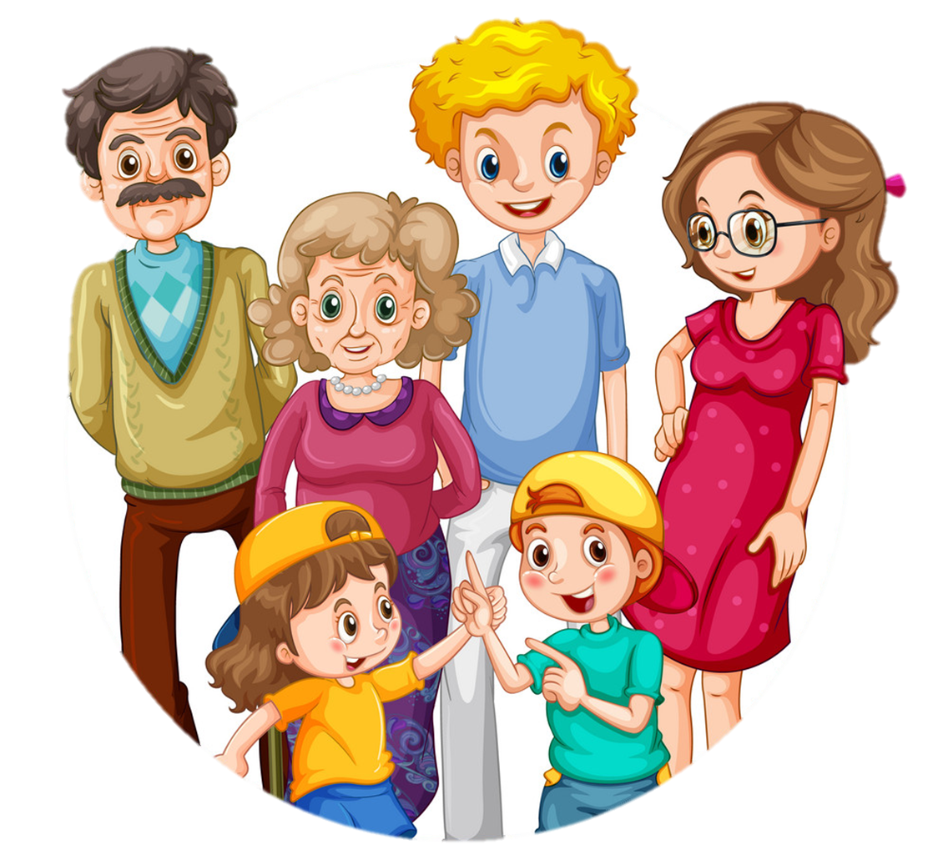
Vocabulary
hometown
/ˈhəʊmtaʊn/
(n) quê

Slide 11

Vocabulary
mountain
/ˈmaʊntən/
(n) núi

Slide 12

Vocabulary
island
ˈaɪlənd/
(n) Hòn đảo

Slide 13




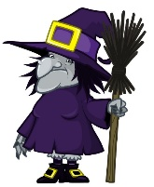


Vocabulary
island
mountain
hometown
far
noisy
big
large
quiet
small
beautiful
crowded

Slide 14

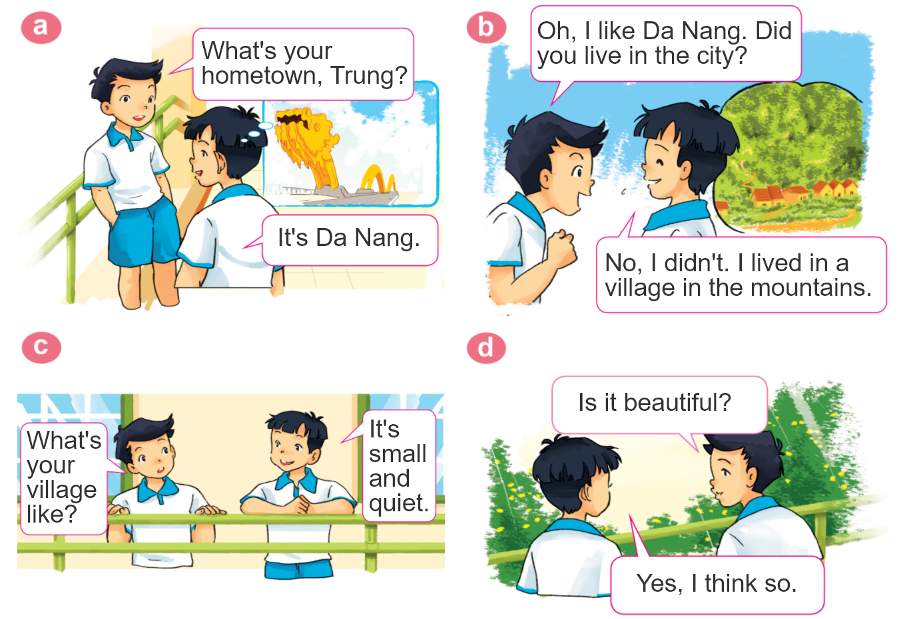
1. Look, listen and repeat.

Slide 15
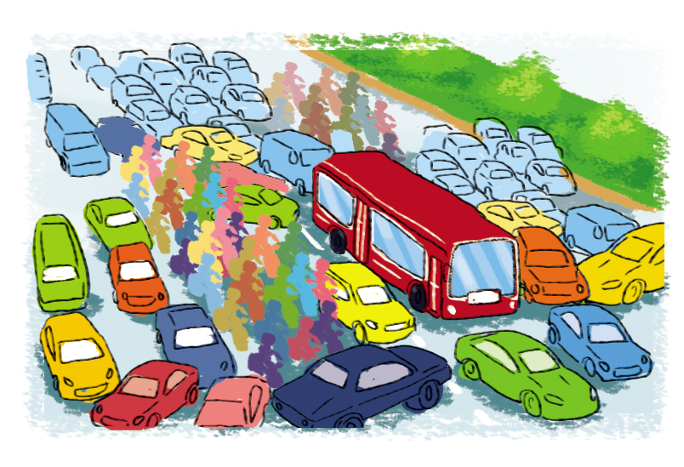

2. Point and say
city,
big and busy
What's the ________ like?
city
It's __________________.
big and busy

Slide 16
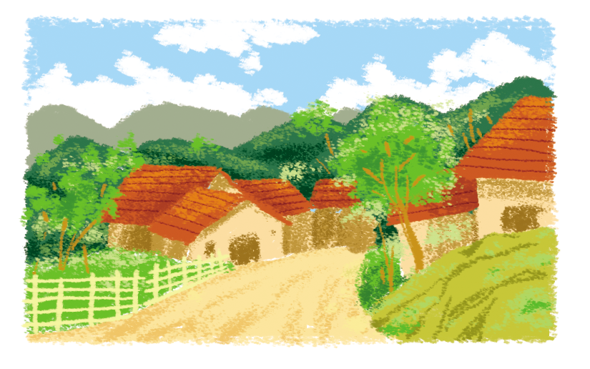
2. Point and say
village,
far and quiet
What's the ________ like?
village
It's __________________.
far and quiet

Slide 17
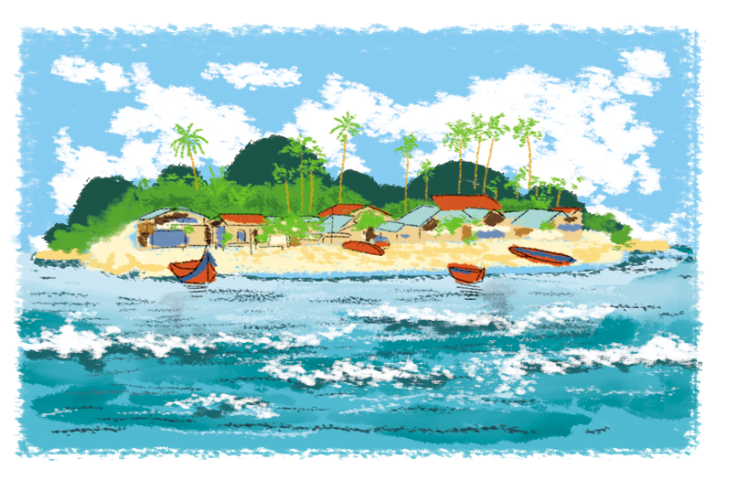
2. Point and say
island,
small and pretty
What's the ________ like?
island
It's __________________.
small and pretty

Slide 18
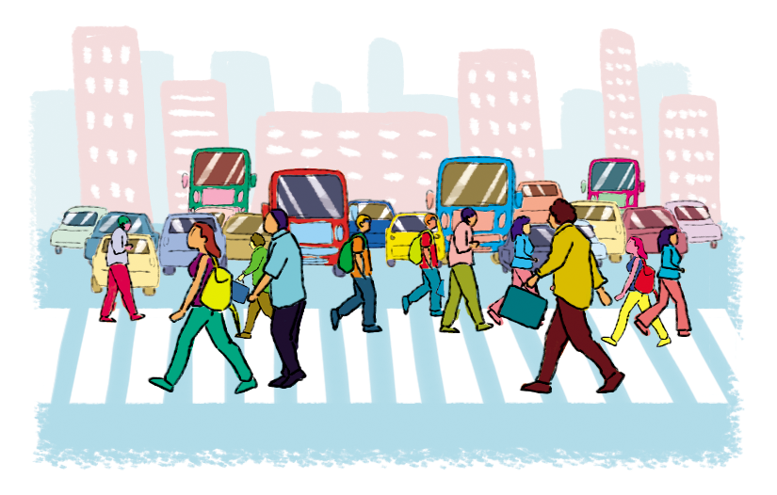
2. Point and say
town,
large and crowded
What's the ________ like?
town
It's __________________.
large and crowded

Slide 19




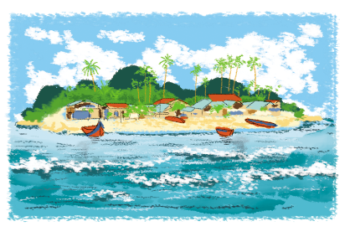
2. Point and say
What's the ________ like?
It's ___________.
city,
big and busy
town,
large and crowded
village,
far and quiet
island,
small and pretty

Slide 20
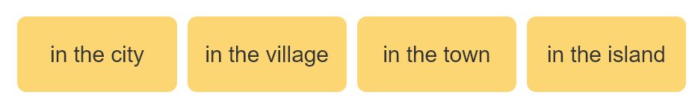
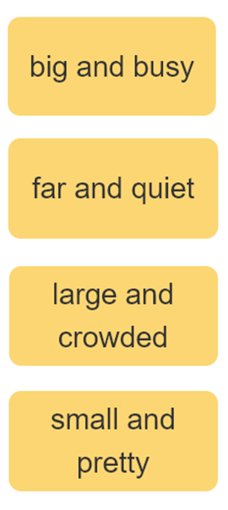

3. Let’s talk
I live ____________.
Where do you live?
What's it like?
It’s ______.
Who do you live with?
I live with ________.
parents
grandparents

Slide 21
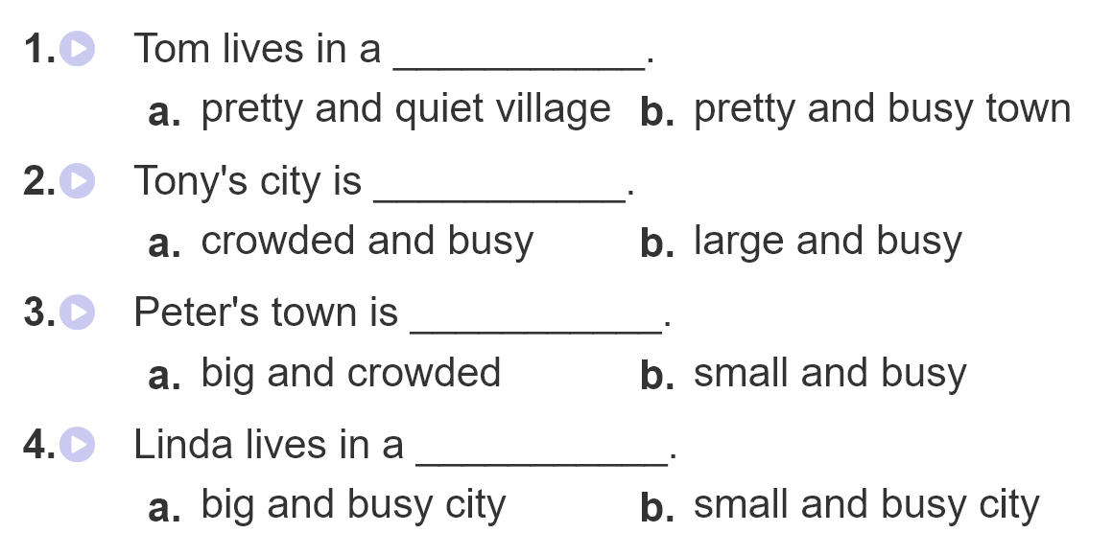
4. Listen and circle

Slide 22
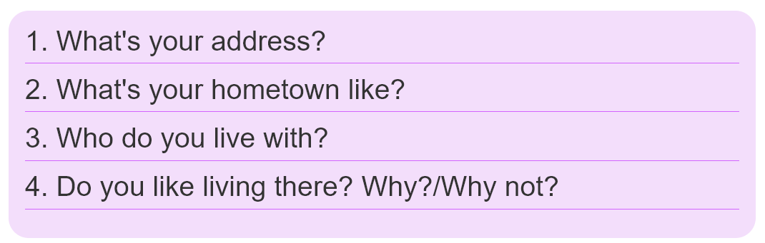
5. Write about you.

