Slide 1



Unit 1
What’s your address?
Lesson 1

Slide 2
VOCABULARY

Slide 3

Vocabulary
address
/əˈdres/
(n) địa chỉ

Slide 4
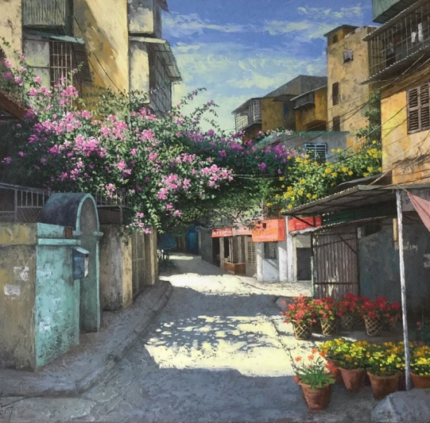

Vocabulary
lane
/leɪn/
(n) ngõ

Slide 5

Vocabulary
road
/rəʊd/
(n) đường

Slide 6

Vocabulary
street
/striːt/
(n) đường (phố)

Slide 7

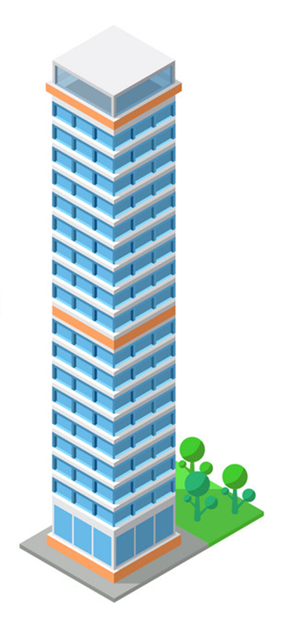
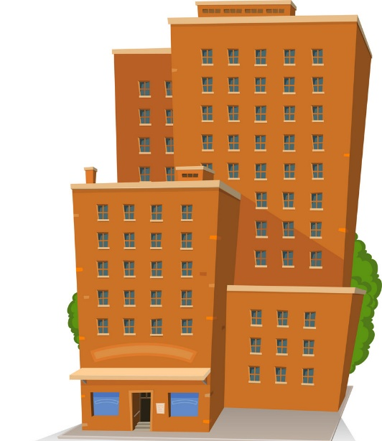
Vocabulary
1
tower
2
/ˈtaʊər/
(n) Tòa nhà, tòa tháp
3

Slide 8

Vocabulary
11
10
9
8
floor
7
6
/flɔːr/
5
4
(n) tầng
3
2
1

Slide 9
Vocabulary
flat
/flæt/
(n) Căn hộ

Slide 10

Vocabulary
town
/taʊn/
(n) thị trấn

Slide 11
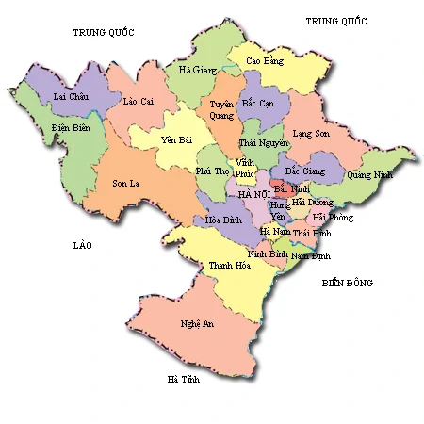
Vocabulary
province
/ˈprɒvɪns/
(n) tỉnh

Slide 12

Vocabulary
village
/ˈvɪlɪdʒ/
(n) làng

Slide 13

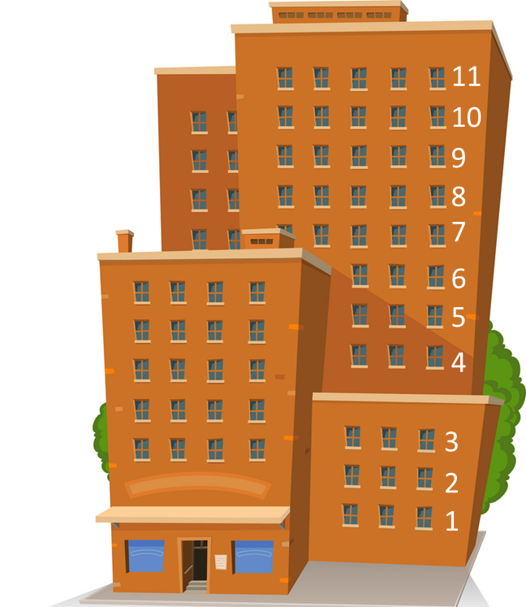
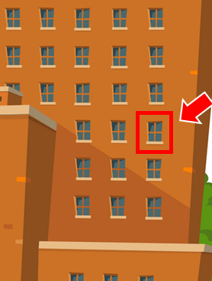
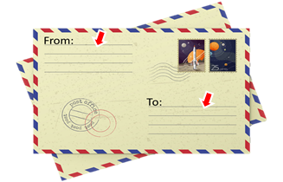

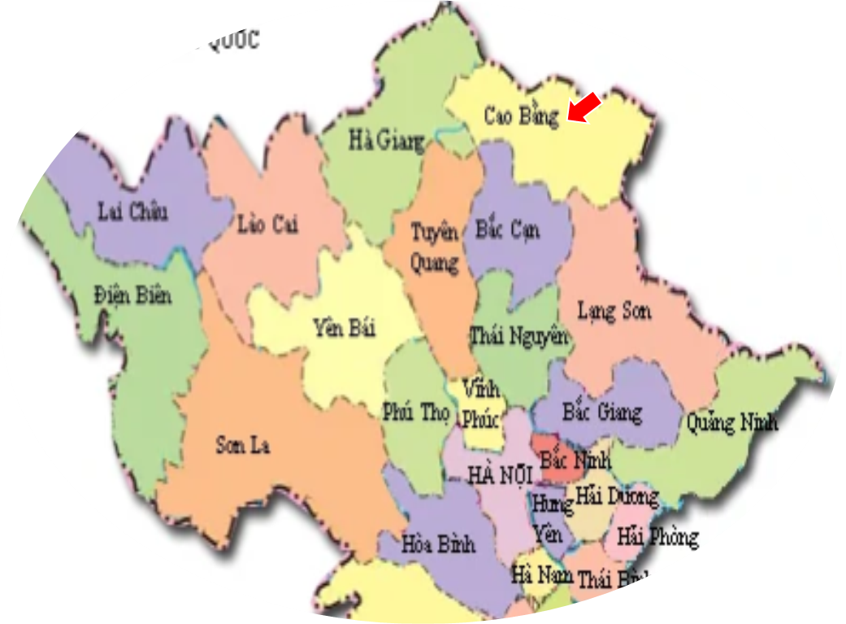
Vocabulary
1
2
3
4
5
village
town
tower
floor
flat
6
7
8
9
10
lane
address
street
province
road

Slide 14
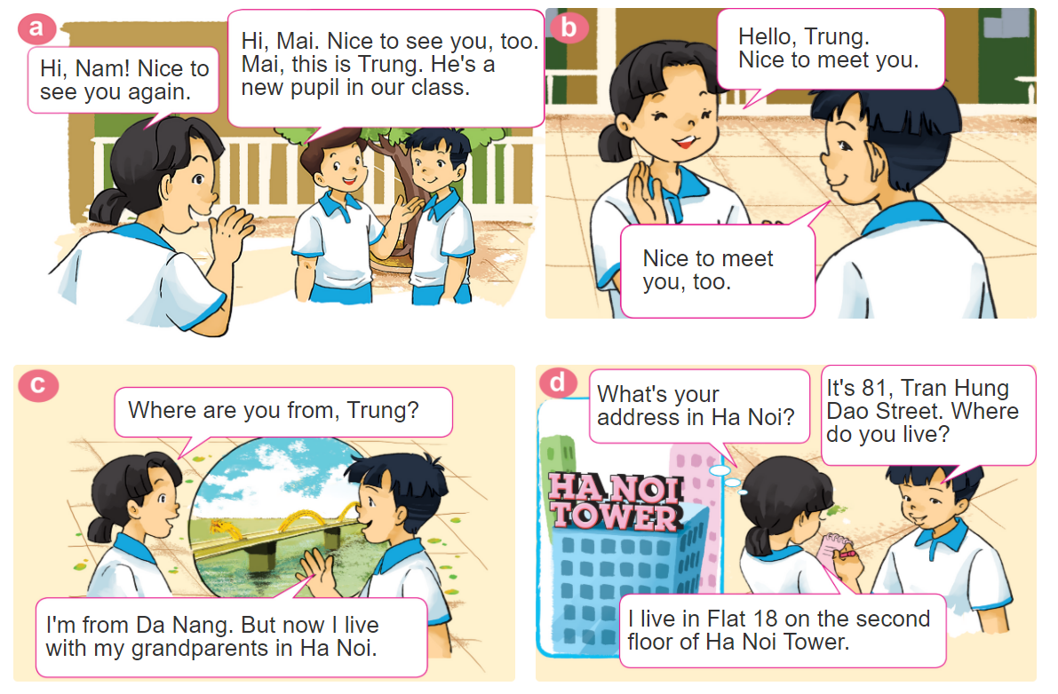

1. Look, listen and repeat.

Slide 15
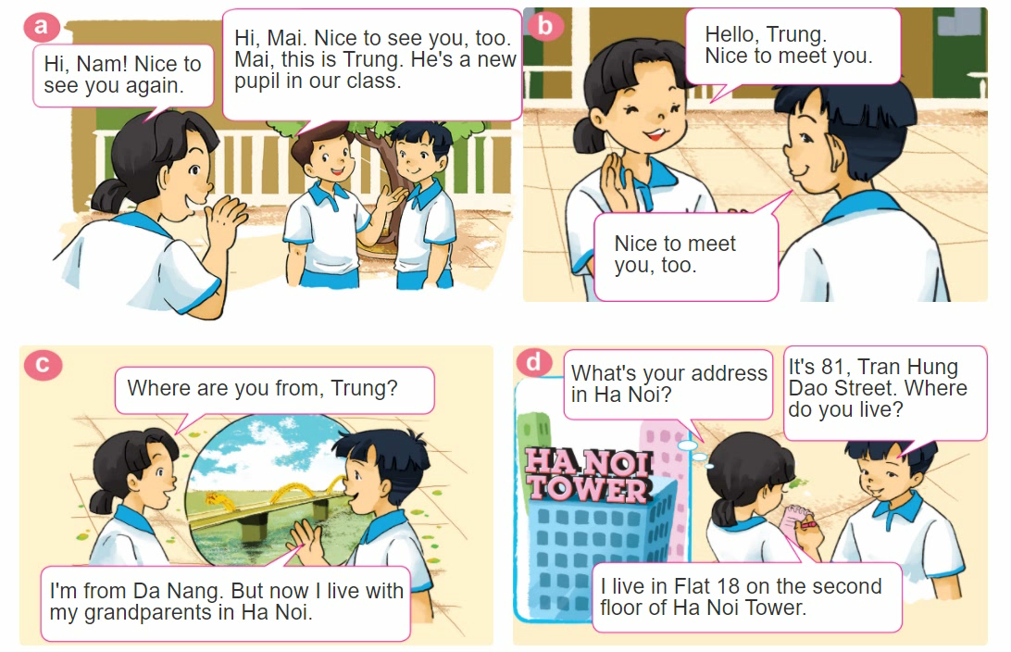
1. Look, listen and repeat.

Slide 16
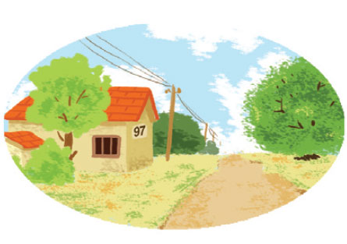

2. Point and say
97, Village Road
It's __________________.
What's your address?
97, Village Road

Slide 17
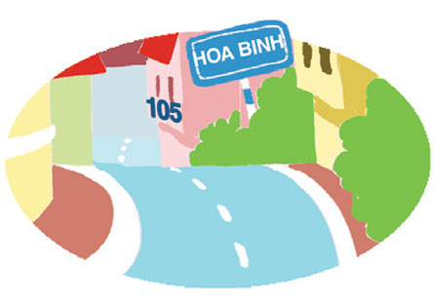
2. Point and say
75, Hai Ba Trung Street
It's __________________.
What's your address?
75, Hai Ba Trung Street

Slide 18

2. Point and say
flat 8, second floor, City Tower
It's ______________
_____________.
What's your address?
flat 8, second floor,
City Tower

Slide 19

3. Let’s talk
Where are you from?
I’m from _______.
What’s your address?
It’s _______.
Where do you live?
I live in/at/on _______.

Slide 20

GRAMMAR
Hỏi - đáp ai đó đến từ đâu:
Where are you from?
(Bạn đến từ đâu)
I’m from _____________.
+ address
(Tớ đến từ_________)
Hỏi - đáp về địa chỉ nhà:
What's your address?
It's _________.
+ address
(Địa chỉ của bạn là gì?)
(Đó là ___________.)

Slide 21
GRAMMAR
Hỏi - đáp ai đó sống ở đâu:
Where do you live?
(Bạn sống ở đâu?)
I live in/on/at _____________.
+ address
(Tớ sống ở_________)

Slide 22
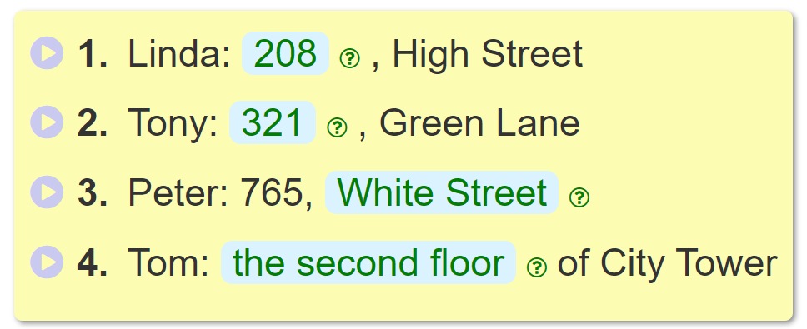
4. Listen and complete
_________
208
_________
321
______________________.
White Street
___________________________
the second floor

Slide 23
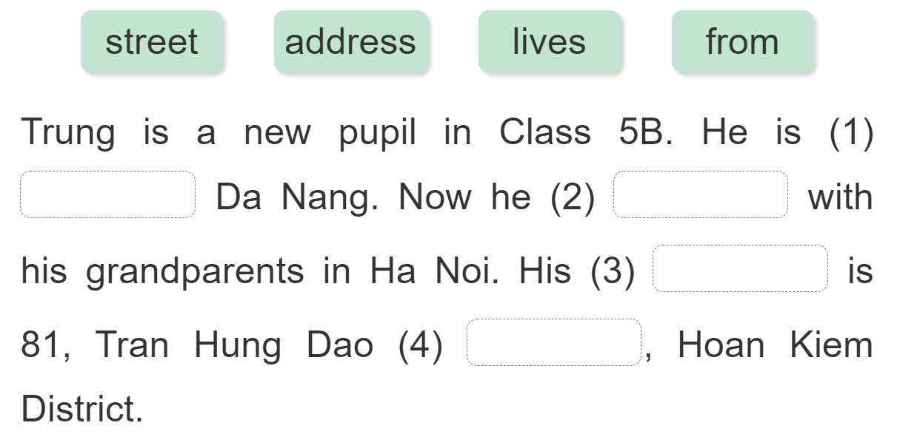
5. Read and complete.
from
lives
address
street

