Slide 1
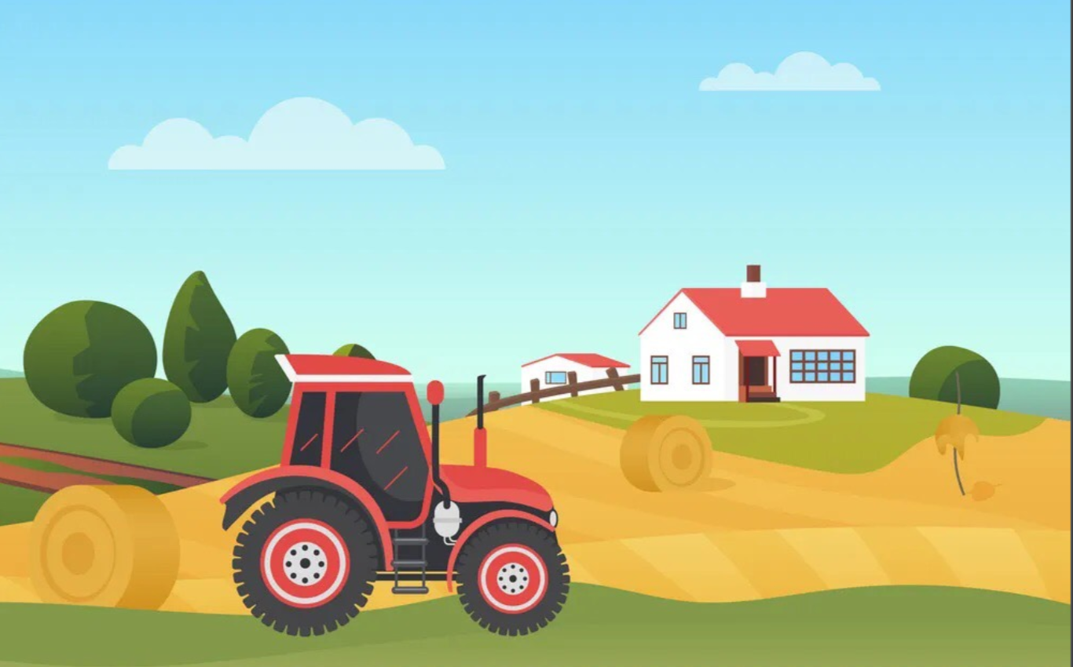


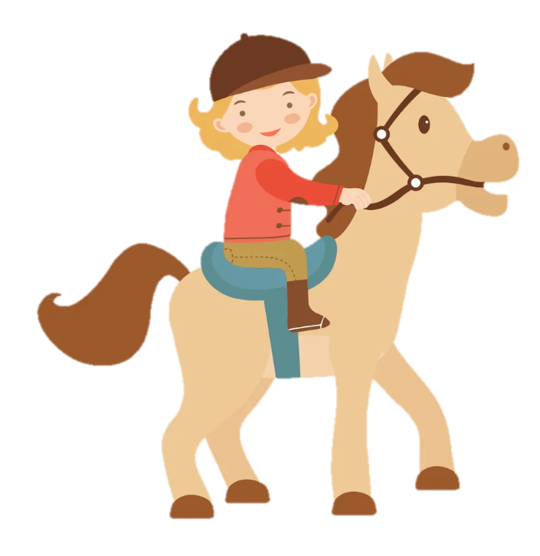
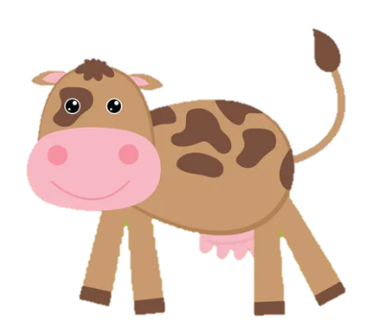
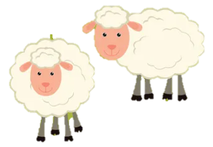
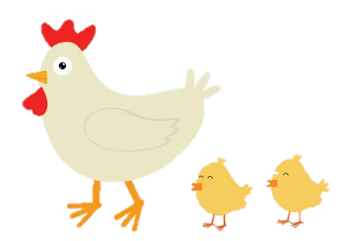
Unit 3: On the farm
Funtime and Project

Slide 2
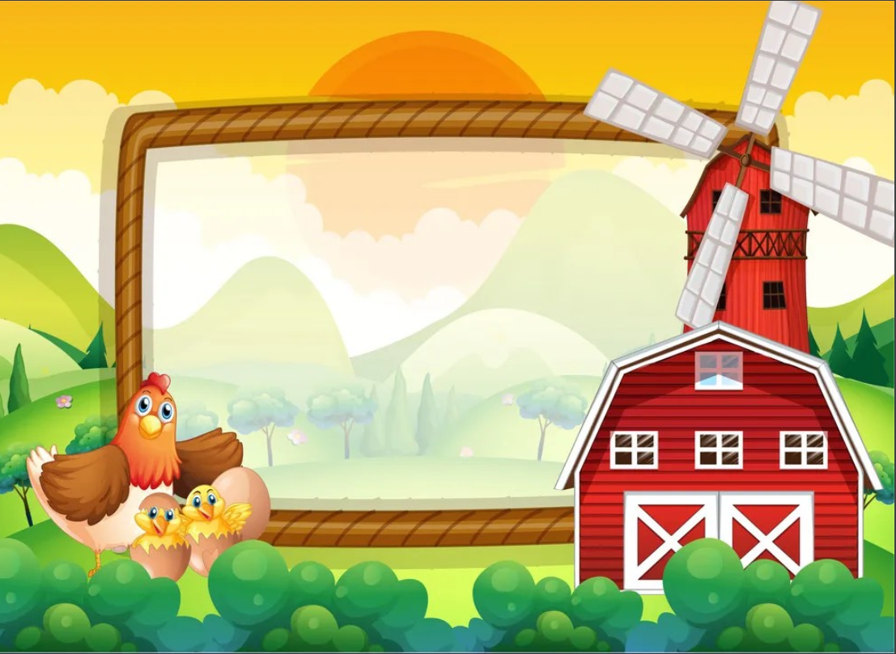
1
Warm Up

Slide 3
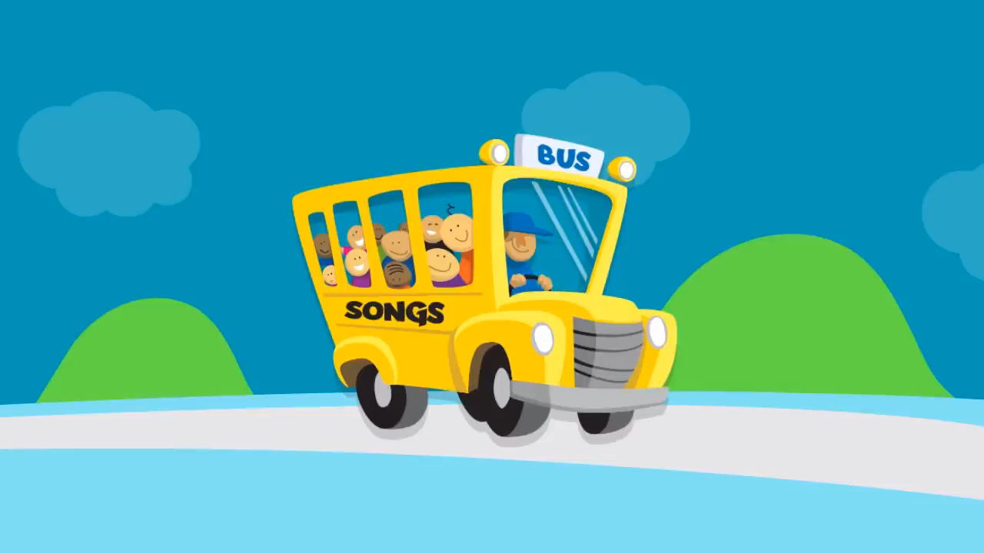
Listen and sing!

Slide 4
2
Fun time

Slide 5
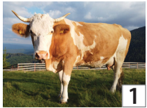
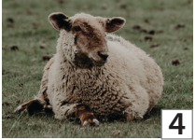
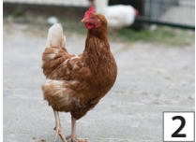
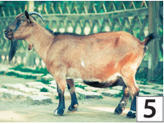
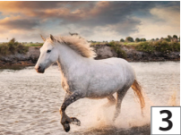
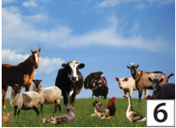
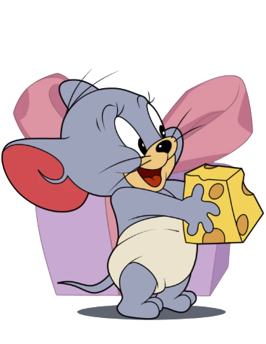
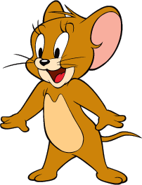
1. Find and Circle!
A | N | I | M | A | L | S | G | N | O
U | H | A | V | G | O | A | T | R | T
C | O | W | R | G | A | R | B | T | M
K | R | A | V | A | O | W | N | R | Q
A | S | H | E | E | P | U | N | O | F
U | E | V | C | H | I | C | K | E | N
I | B | E | W | O | Y | X | Y | E | M
1
2
3
4
5
6
1
2
3
4
5
6

Slide 6
3
Project

Slide 7
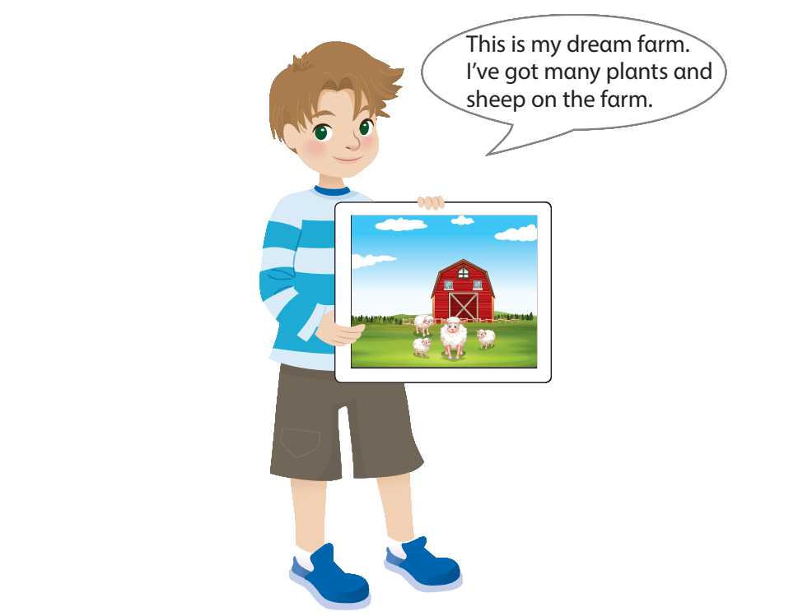
My dream farm

Slide 8
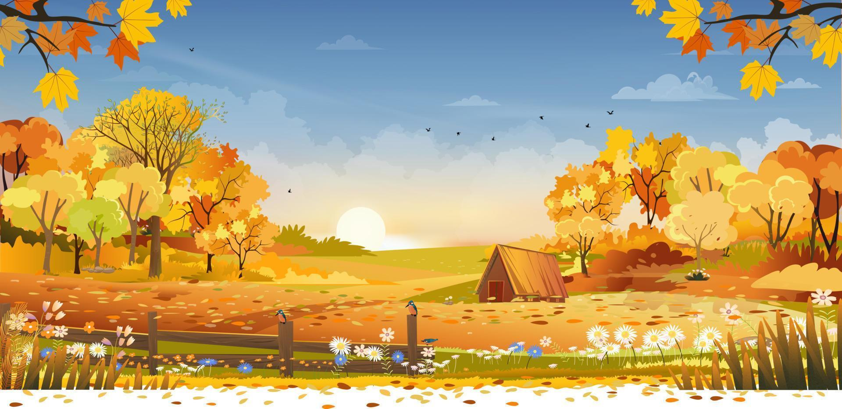
Let’s draw your dream farm!

Slide 9
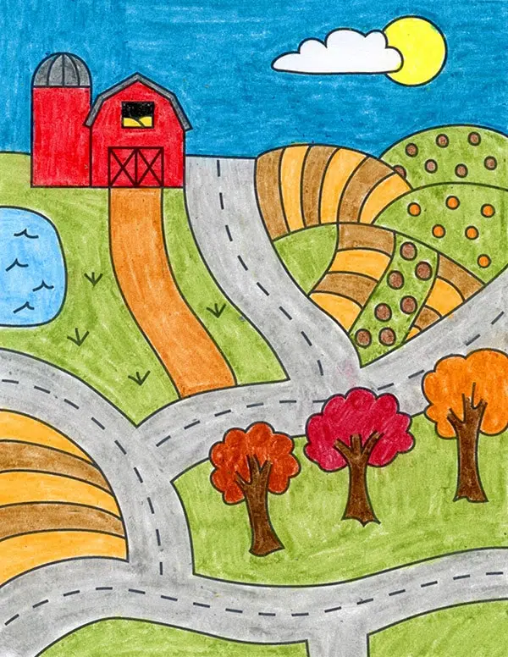
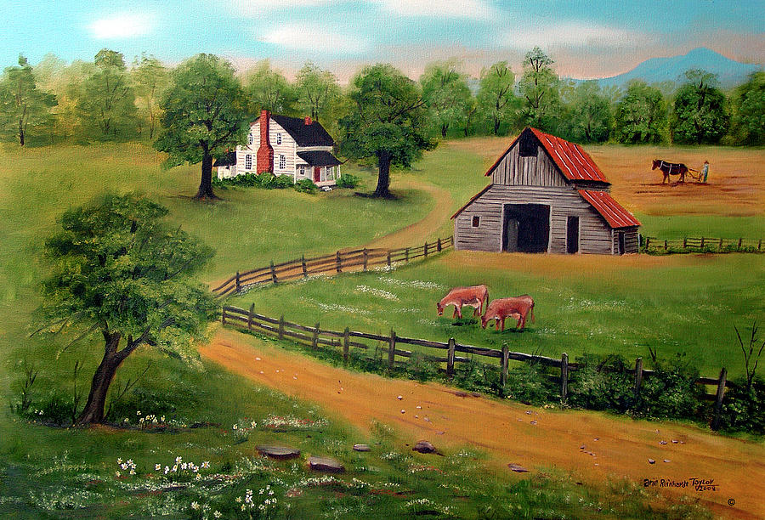
Describe your farm!
This is my farm. I’ve got many plants on my farm.
This is my farm. I’ve got cows on my farm.

Slide 10
Ask and answer.
Have you got plants on the farm?
Have you got chickens on the farm?
Yes, we have.
No, we haven’t.
Have you got horses on the farm?
Yes, we have.

Slide 11
3
Wrap up
&Assessment

Slide 12

2
REMEMBER !
Have you got animals on the farm?
Yes, we have. / No, we haven’t.

Slide 13
REMEMBER !
I’ve got plants on my farm.
A horse hasn’t got hands.

Slide 14


Thank you
& goodbye!

