Slide 1
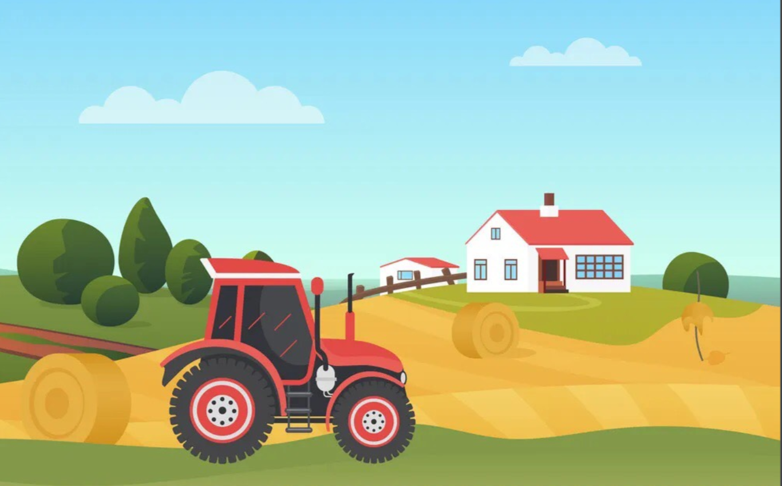


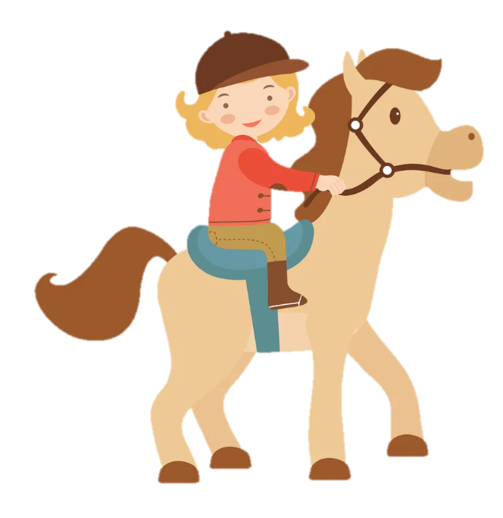
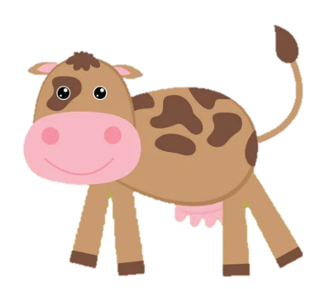
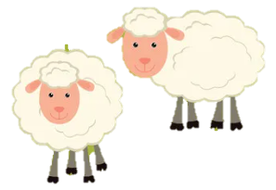
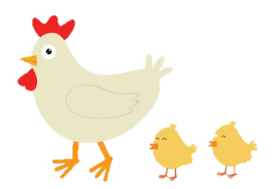
Unit 3: On the farm
Lesson 3. Task 4 5 6

Slide 2
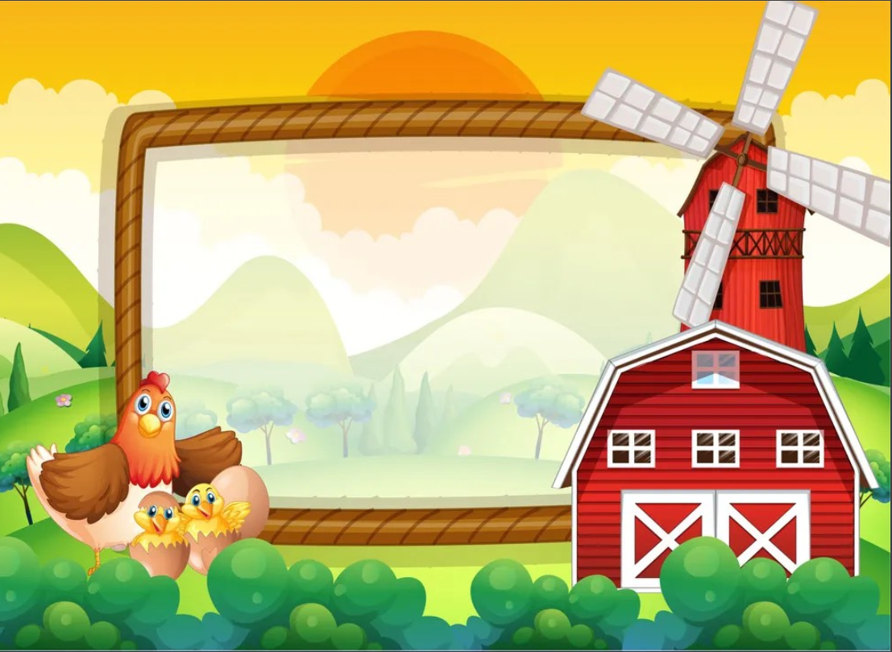
1
Warm Up

Slide 3
2
Presentation

Slide 4
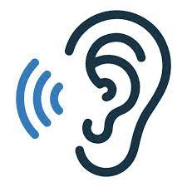

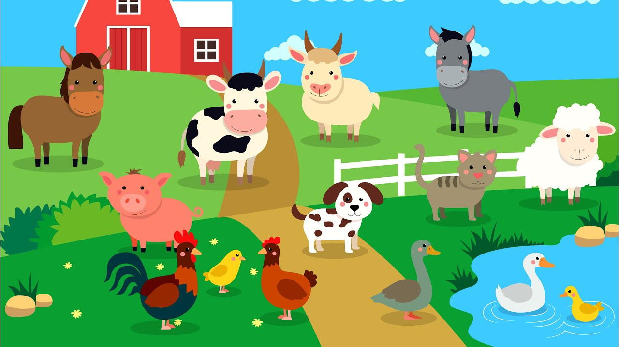

4. Listen and repeat.
1. Have you got animals on the farm?
- Yes, we have.

Slide 5
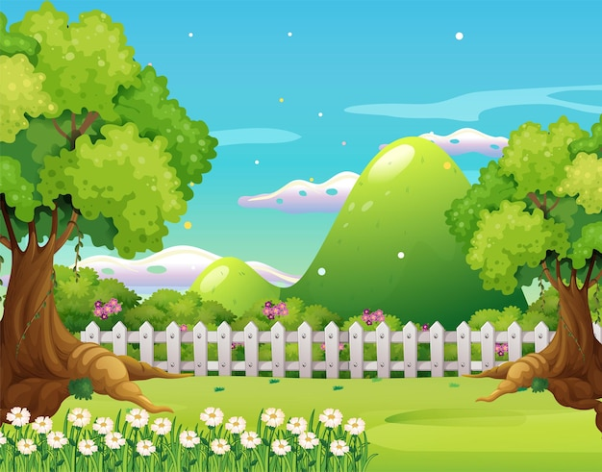
4. Listen and repeat.
2. Have you got fruit trees in the field?
- No, we haven’t.

Slide 6
3
Practice

Slide 7
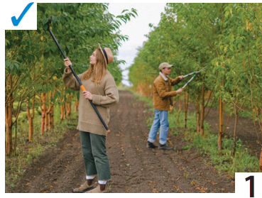
5. Look. Ask and answer.
Have you got plants on the farm?
Yes, we have.
Home

Slide 8
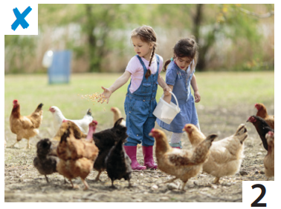
5. Look. Ask and answer.
Have you got chickens on the farm?
No, we haven’t.
Home

Slide 9
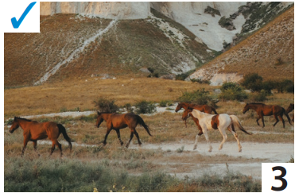
5. Look. Ask and answer.
Have you got horses on the farm?
Yes, we have.
Home

Slide 10
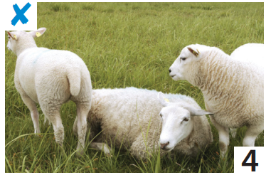
5. Look. Ask and answer.
Have you got sheep on the farm?
No, we haven’t.
Home

Slide 11
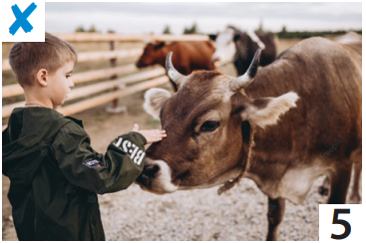
5. Look. Ask and answer.
Have you got cows on the farm?
No, we haven’t.
Home

Slide 12
6. Let’s talk!
Have you got cows on the farm?
Yes, we have!

Slide 13

6. Let’s talk!
Have you got animals in the field?
No, we haven’t!

Slide 14
4
Production

Slide 15

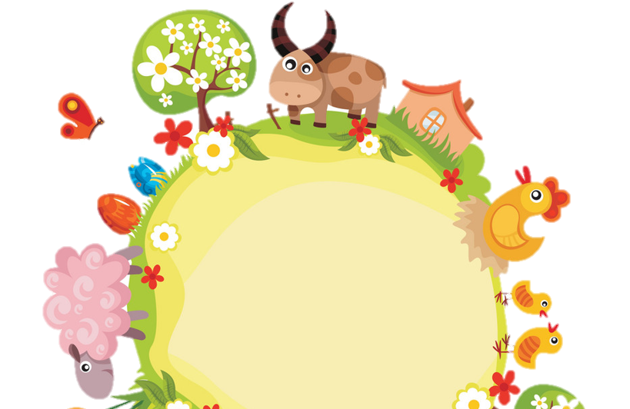
Thank you
& goodbye!

