Slide 1
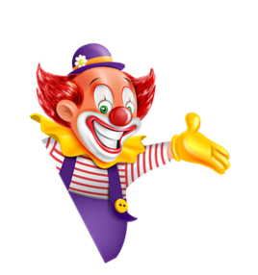

I always get up early.
How about you?
Unit
02
Lesson 2

Slide 2
Vocabulary

Slide 3
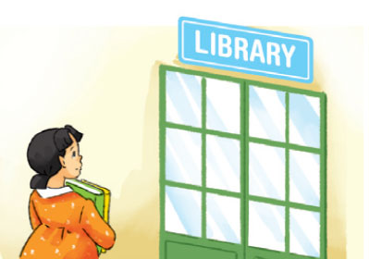
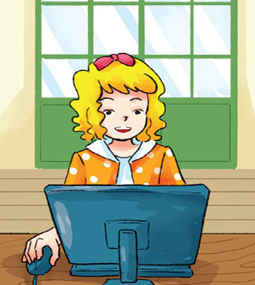
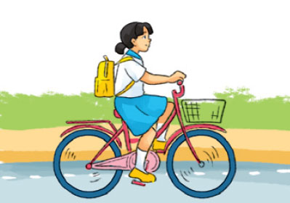
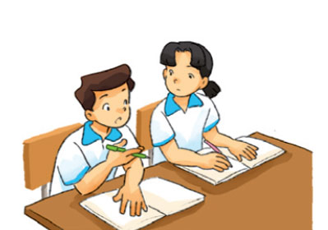
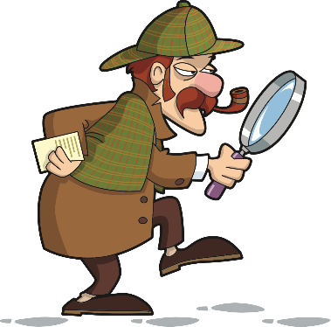
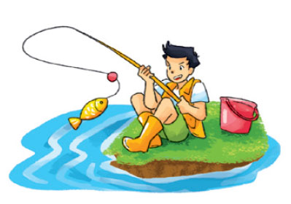
Vocabulary
Go to the library
Surf the Internet
Ride a bicycle
Đi thư viện
Lướt web
Đạp xe đạp
Study
Look for
Go fishing
Học
Tìm kiếm
Đi câu cá

Slide 4
Grammar

Slide 5









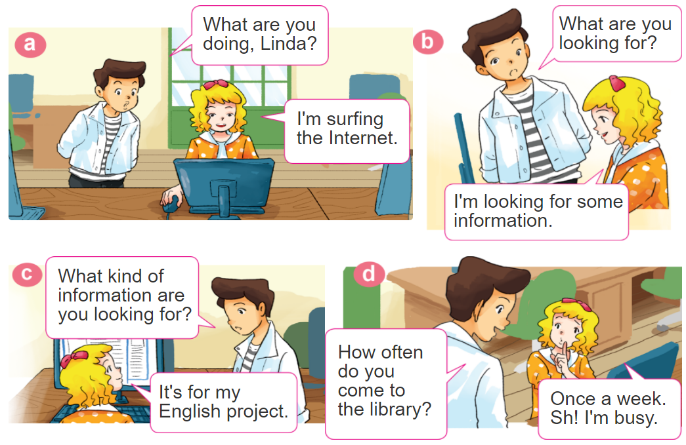

1. Look, listen and repeat

Slide 6





2. Point and say
study with
a partner
every day
go to the library
once a week
go fishing
once a month
ride a bicycle
to school
twice a week
How often do you ____?
I _____ _____________.

Slide 7
Grammar
Trạng từ thời gian:
Đứng cuối câu
every day
: Mỗi ngày
once
: Một lần
twice
: Hai lần
Three times
: 3 lần

Slide 8
Grammar
Hỏi và trả lời với HOW OFTEN
(thường xuyên như thế nào?)
How often do you __________?
+ an activity
I _________ ______.
+ the activity
+ adv

Slide 9












Ms Huyền Phạm
0936.082.789
Ms Huyền Phạm
0936.082.789
Ms Huyền Phạm
0936.082.789
Ms Huyền Phạm - 0936.082.789 – YOUTUBE: MsPham. Facebook: Dạy và học cùng công nghệ.
Ms Huyền Phạm
0936.082.789
Notes:
Ms Huyền Phạm - 0936.082.789 – YOUTUBE: MsPham. Facebook: Dạy và học cùng công nghệ.

Slide 10
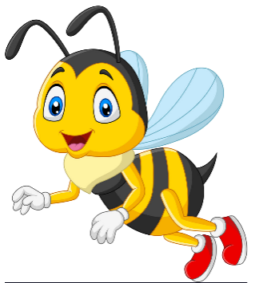





______ do you study with a partner?
Next
How often
What often
How
Oten
Notes:
Ms Huyền Phạm - 0936.082.789 – YOUTUBE: MsPham. Facebook: Dạy và học cùng công nghệ.

Slide 11
How often do you go fishing?
Next
Two
a month
Twice
Twice
a month
A month
Notes:
Ms Huyền Phạm - 0936.082.789 – YOUTUBE: MsPham. Facebook: Dạy và học cùng công nghệ.

Slide 12
How often _____ you ride the bicycle to school?
Next
is
do
are
does
Notes:
Ms Huyền Phạm - 0936.082.789 – YOUTUBE: MsPham. Facebook: Dạy và học cùng công nghệ.

Slide 13
How _____ do you go swimming?
Next
always
many
much
often
Notes:
Ms Huyền Phạm - 0936.082.789 – YOUTUBE: MsPham. Facebook: Dạy và học cùng công nghệ.

Slide 14
How often do you cook dinner?
Next
Three times
Three times
a week
A week
Three
a week
Notes:
Ms Huyền Phạm - 0936.082.789 – YOUTUBE: MsPham. Facebook: Dạy và học cùng công nghệ.

Slide 15
How often do ______ ride the bicycle to school?
Next
you
Your partner
Your sister
she
Notes:
Ms Huyền Phạm - 0936.082.789 – YOUTUBE: MsPham. Facebook: Dạy và học cùng công nghệ.

Slide 16
How often do you go to school the library?
Next
Every
One
One a week
Once a week
Notes:
Ms Huyền Phạm - 0936.082.789 – YOUTUBE: MsPham. Facebook: Dạy và học cùng công nghệ.

Slide 17
How often do you do morning exercise?
Next
One day
Two day
Every day
Every
Notes:
Ms Huyền Phạm - 0936.082.789 – YOUTUBE: MsPham. Facebook: Dạy và học cùng công nghệ.

Slide 18








Notes:
Ms Huyền Phạm - 0936.082.789 – YOUTUBE: MsPham. Facebook: Dạy và học cùng công nghệ.

Slide 19
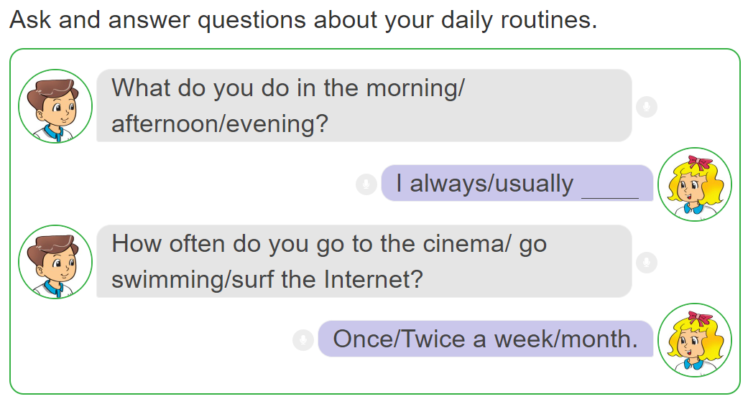
3. Let’s talk.

Slide 20
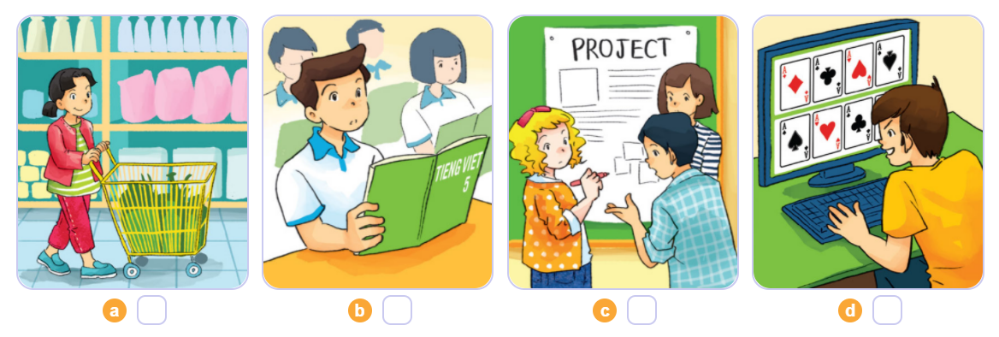
4. Listen and number
4
1
2
3
1
2
3
4

Slide 21
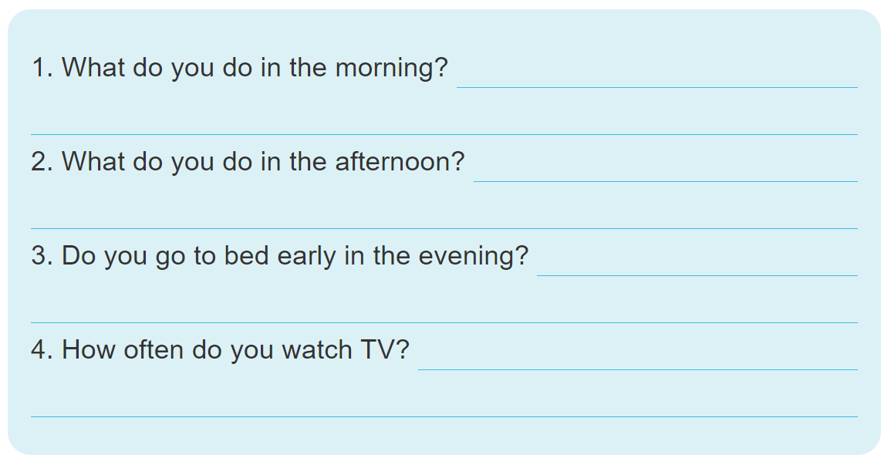
5. Write about your daily routines.

