Slide 1
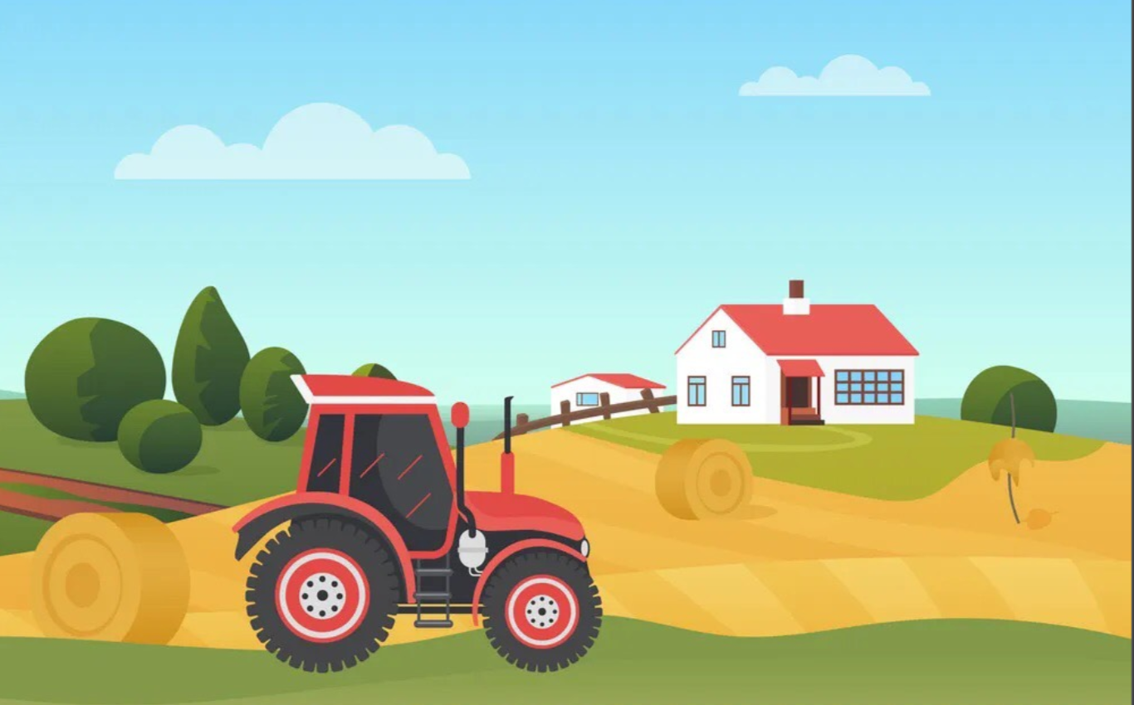


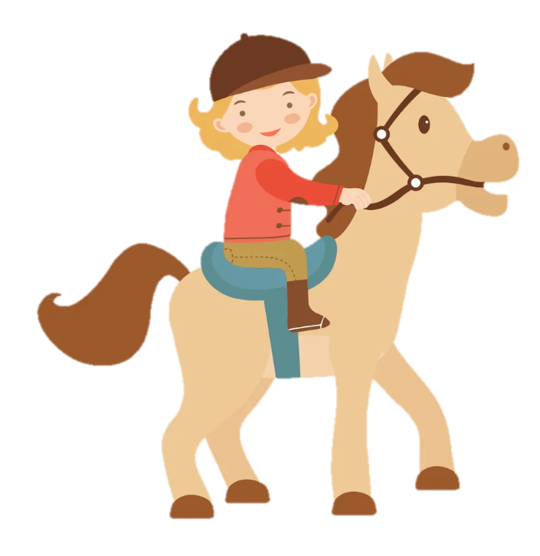
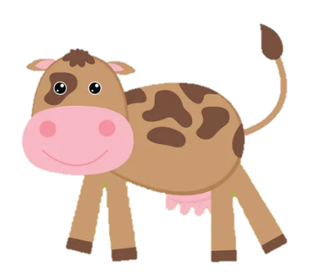
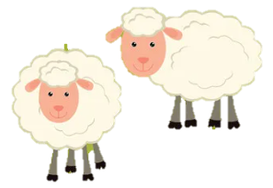
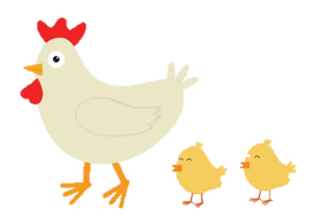
Unit 3: On the farm
Lesson 2. Task 4 5 6

Slide 2
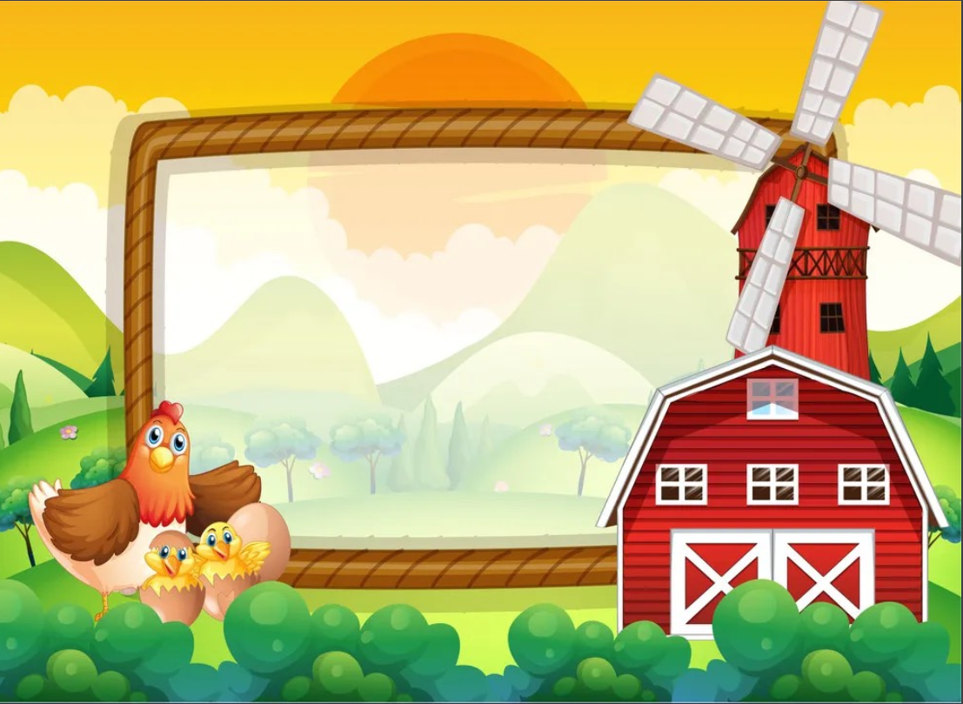
1
Warm Up

Slide 3




Catching Butterfly!
Catching Butterfly!
Notes:
Nhấn vào ngôi sao để chọn câu hỏi và hình

Slide 4





The butterflies have got beautiful wings.
2
3
4
5
Next
1
Notes:
Bấm vào số để xuất hiện câu hỏi
Bấm vào hộp quà nếu hs trả lời đúng
Bấm vào home để quay về màn hình chính
Đặt câu với mẫu câu : The butterflies have got beautiful wings.
Bấm next để chuyển sang phần Presentation

Slide 5

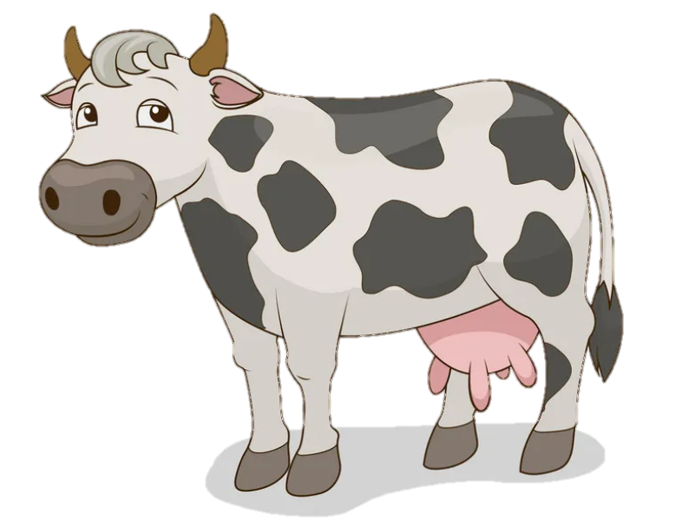



3 points
The cows have got long tails.
GO HOME
Notes:
Bấm hộp quà để nhận điểm
Bấm go home để trở lại slide bắt bướm
TƯƠNG TÁC:
This is an____.
Đáp án: elephant

Slide 6
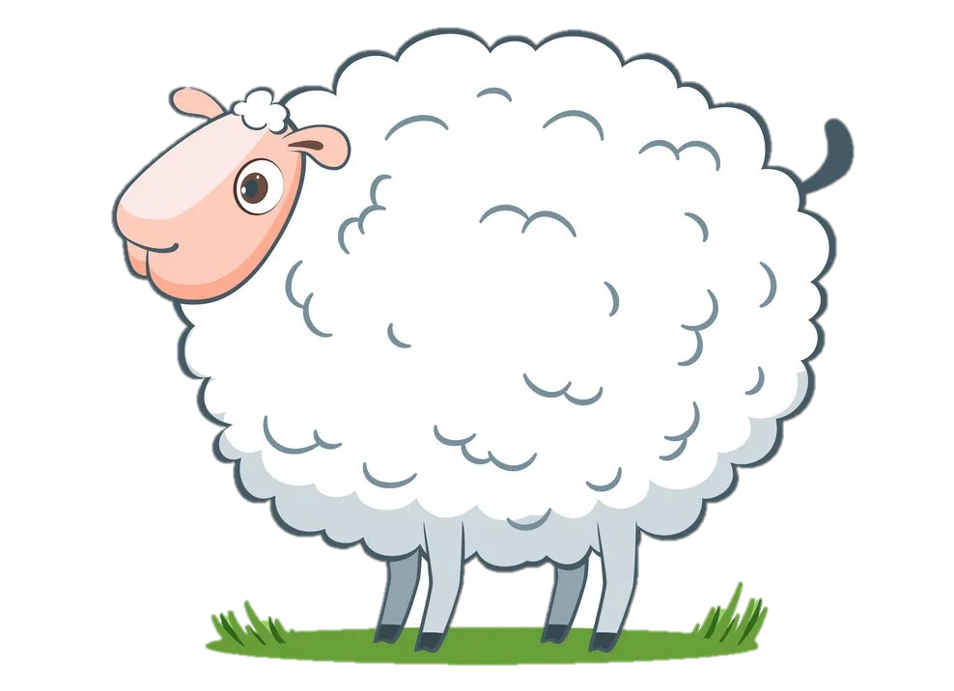
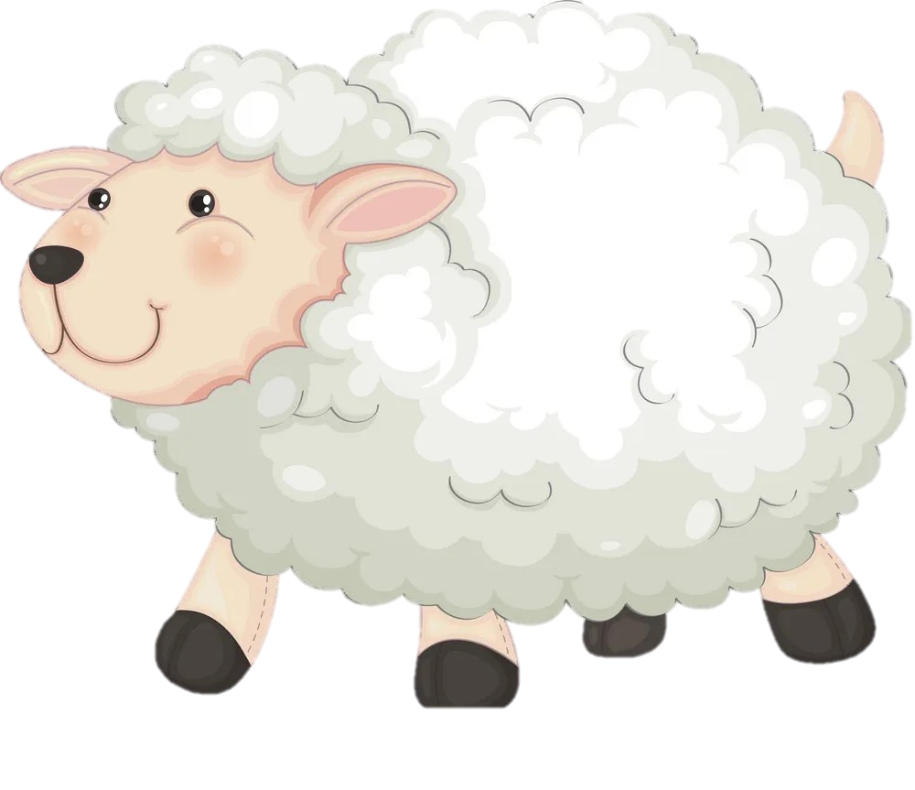
2 points
The sheep have got white fur.
GO HOME
Notes:
TƯƠNG TÁC:
This is a ____.
Đáp án: monkey

Slide 7
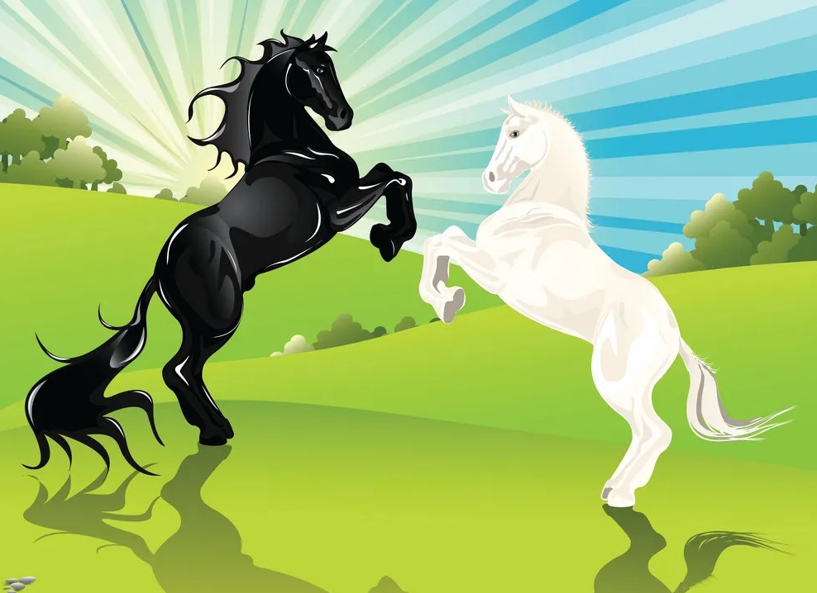

2 points
The horses have got long legs.
GO HOME
Notes:
TƯƠNG TÁC:
This is a____.
Đáp án: zebra

Slide 8
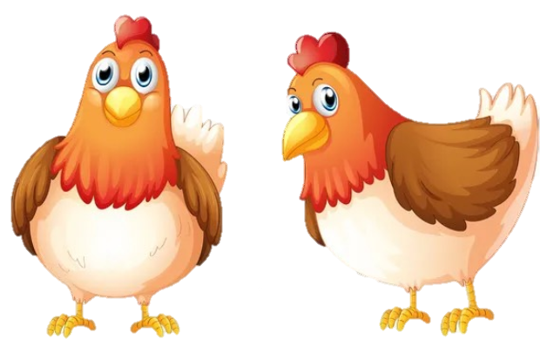
5 points
The chickens have got small wings.
GO HOME
Notes:
TƯƠNG TÁC:
This is a ____.
Đáp án: hippo

Slide 9
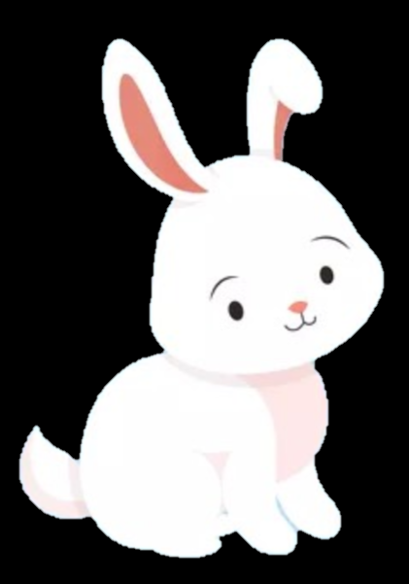
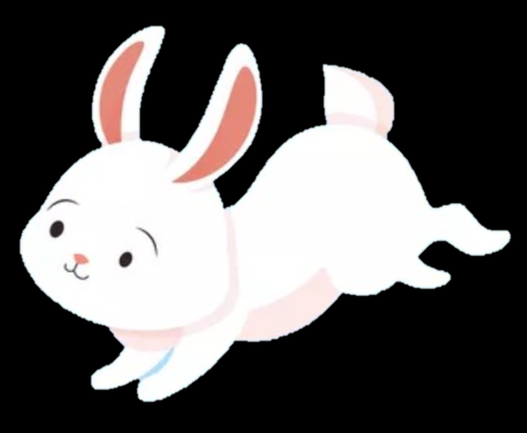
1 point
The rabbits have got short tails.
GO HOME
Notes:
TƯƠNG TÁC:
This is a ____.
Đáp án: giraffe

Slide 10
2
Presentation

Slide 11



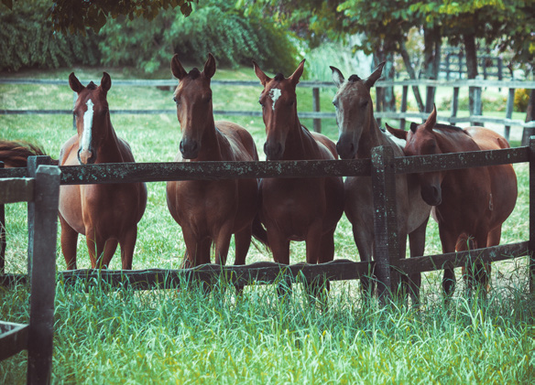
1 Listen and repeat.
1.The horses haven’t got wings.

Slide 12
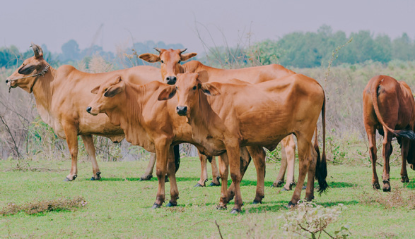
1 Listen and repeat.
2. The cows haven’t got hands.

Slide 13
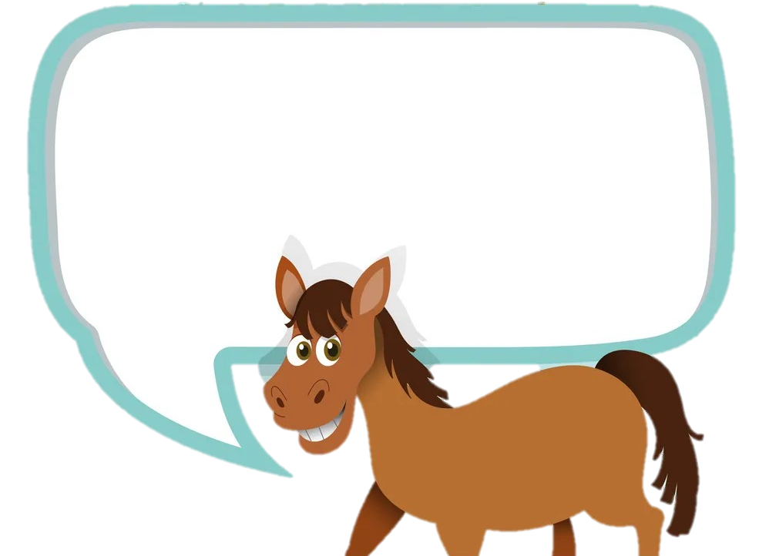
✘
hαven’t = hαve not

Slide 14
3
Practice

Slide 15
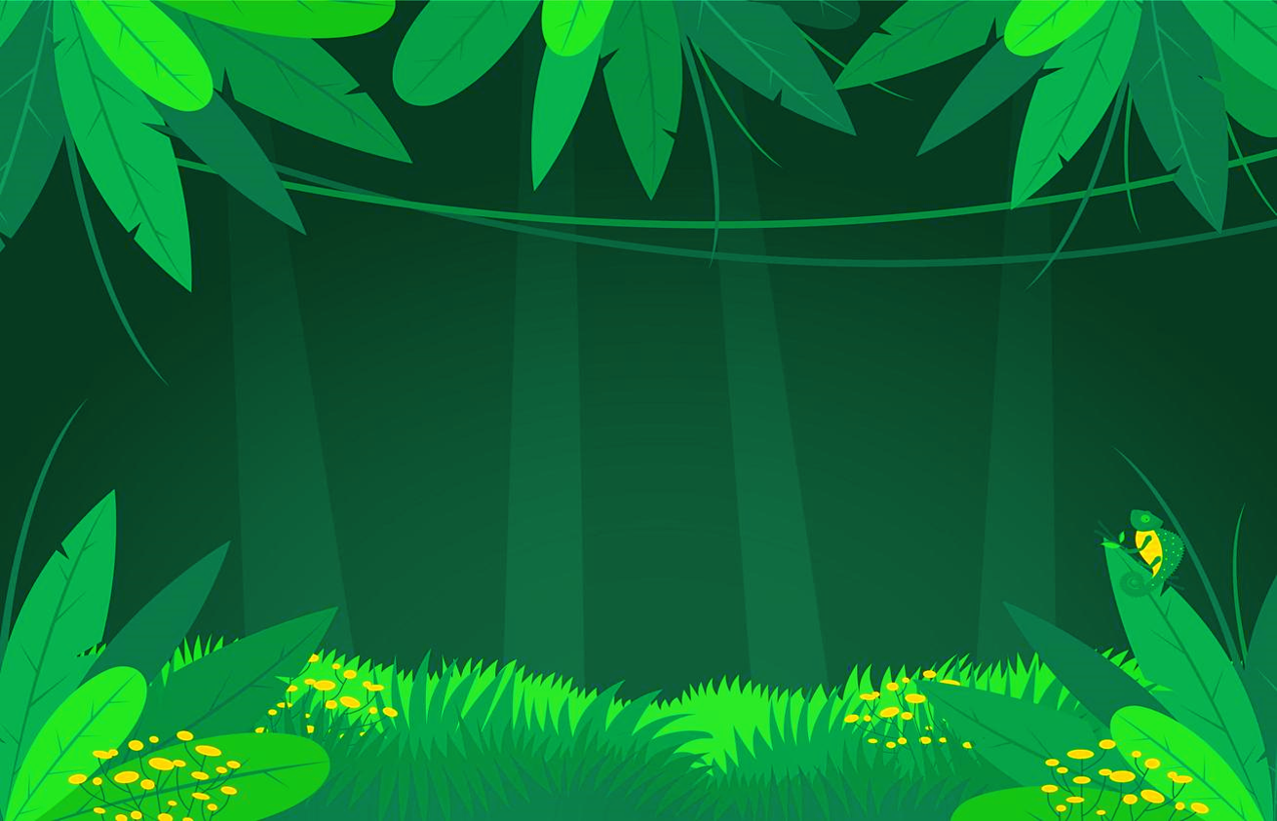
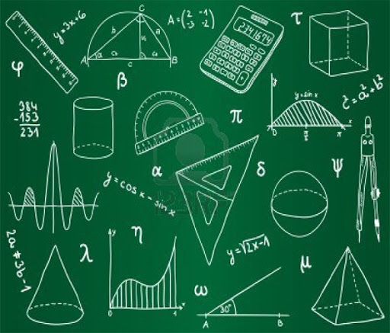
THE BIG WHEEL GAME
0
1
2
3
Questions
SPIN
1
0
1
2
2
4
3
4
5
5
Notes:
Bấm vào SPIN để chọn số câu hỏi
Bấm vào số để xem yêu cầu
Bấm vào mũi tên màu vàng để chuyển sang phần Production

Slide 16
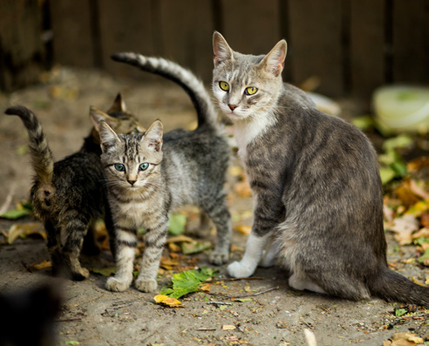
2. Point and Say
cαts / wings (✘ )
The cats haven’t got wings.
Home

Slide 17
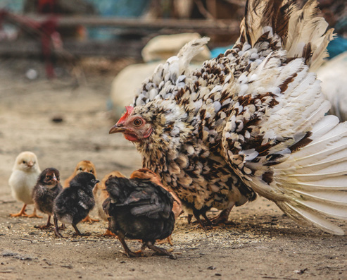
2. Point and Say
chickens/ long tail (✘ )
The chickens haven’t got long tails.
Home

Slide 18
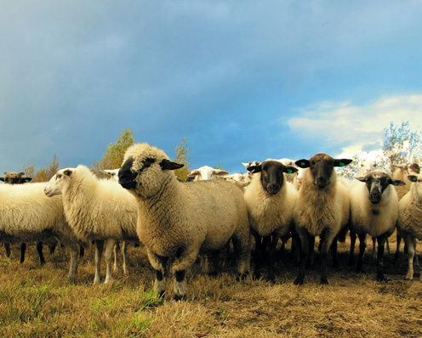
2. Point and Say
sheep/ long legs (✘ )
The sheep haven’t got long legs.
Home

Slide 19
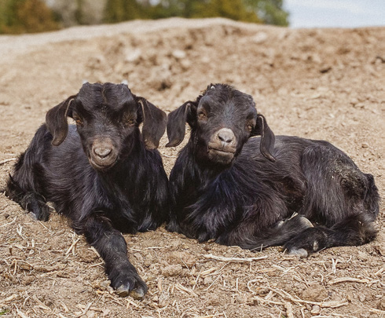
2. Point and Say
goats/ wings (✘ )
The goats haven’t got wings.
Home

Slide 20
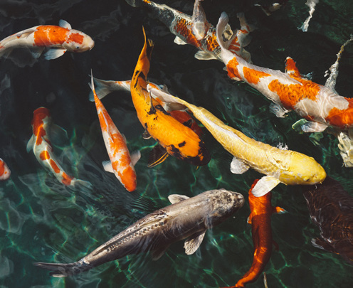
2. Point and Say
fish/ hands (✘ )
The fish haven’t got hands.
Home

Slide 21
4
Production

Slide 22
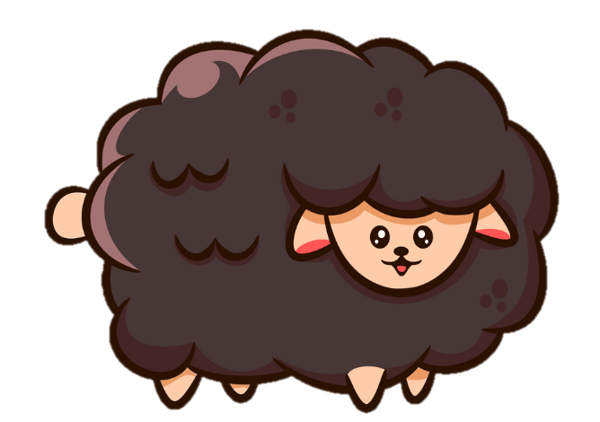
6 Listen and sing
Whαt αnimαl αm I?
Bαα, bαα, bαα.
Whαt αnimαl αm I?
I’m α sheep. I’m α smαll, blαck sheep.
I’ve got blαck fur
αnd four short legs!
I mαke wool for your jumpers!

Slide 23
5
Assessment

Slide 24
Tick the correct answer
The cats have got wings .
✓
The cats haven’t got wings.
✓
The sheep haven’t got long legs.
The sheep have got long legs.

Slide 25
The fish have got wings .
✓
The fish haven’t got hands.
The chickens have got hands .
✓
The chickens have got wings.

Slide 26


Remember
haven’t = have not
The cats haven’t got wings.

Slide 27


Thank you
& goodbye!

