Slide 1



Unit 2 - My Home
Lesson 2 – Period 2

Slide 2
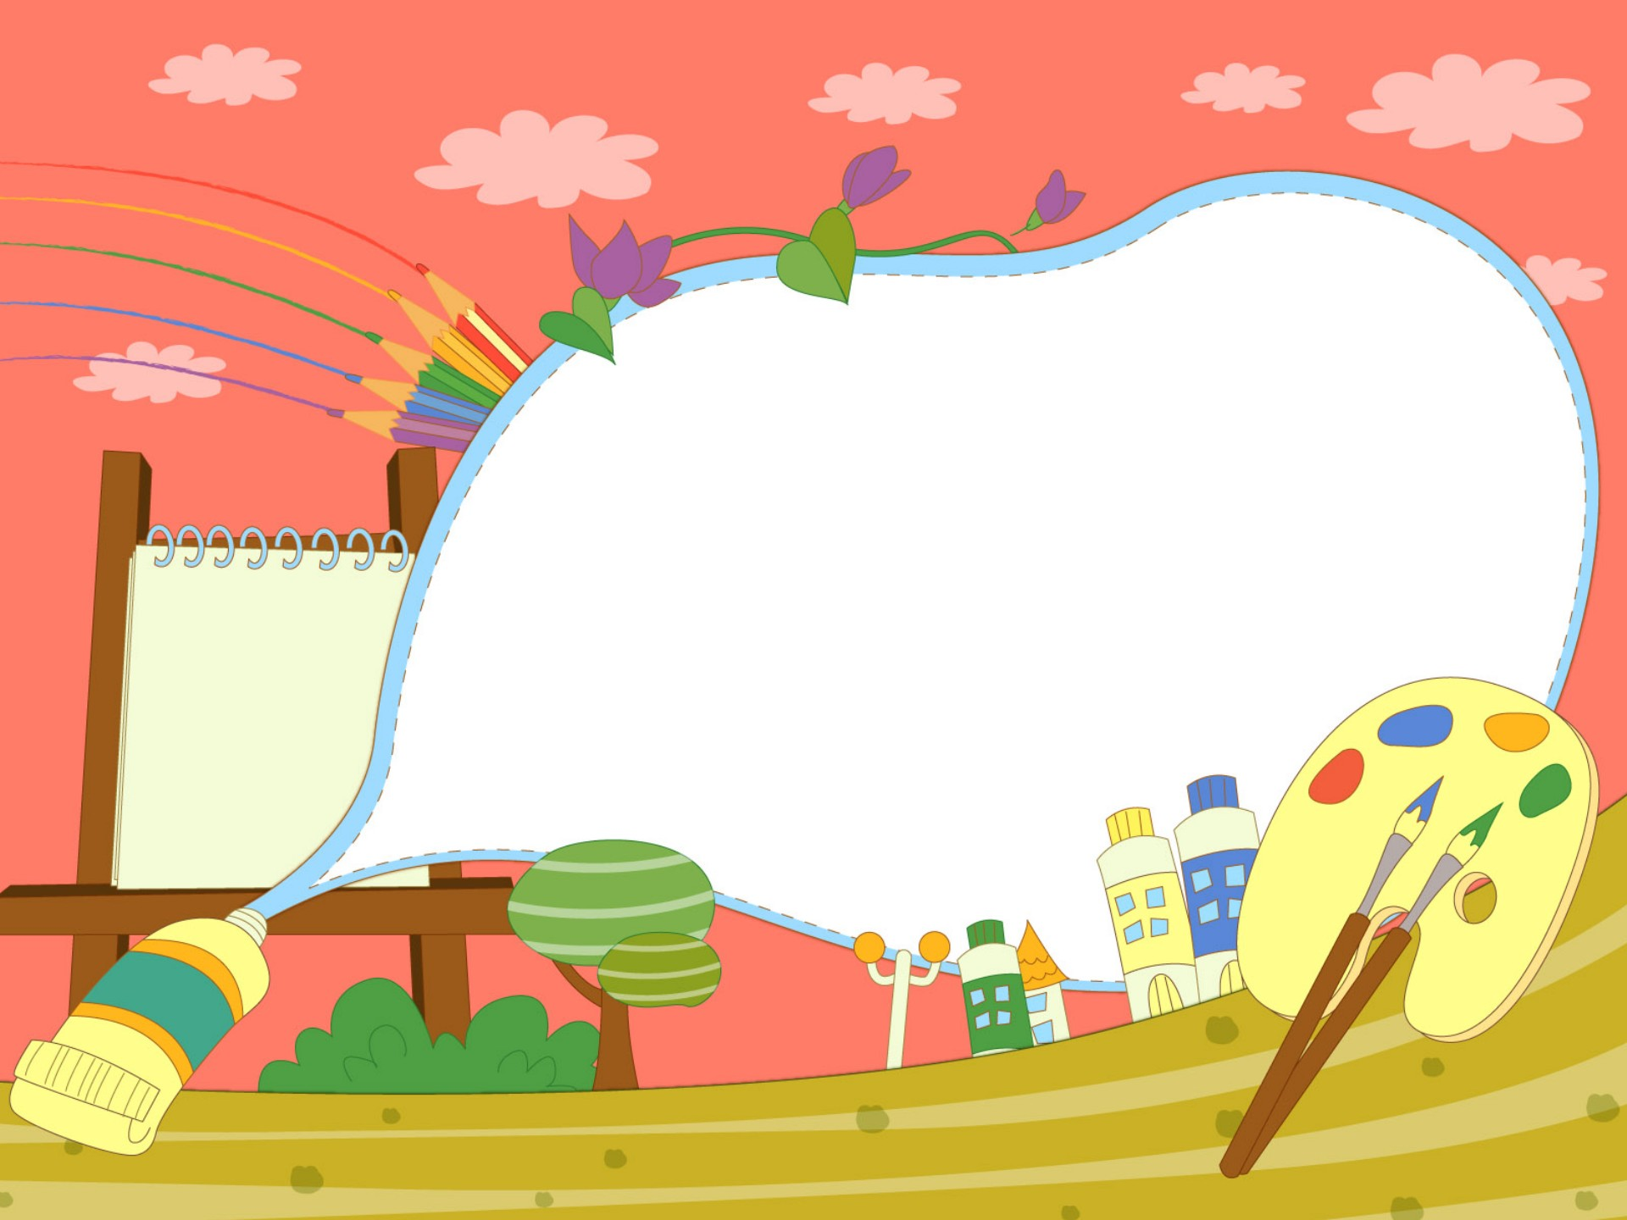

1.Warm up
Matching Time

Slide 3


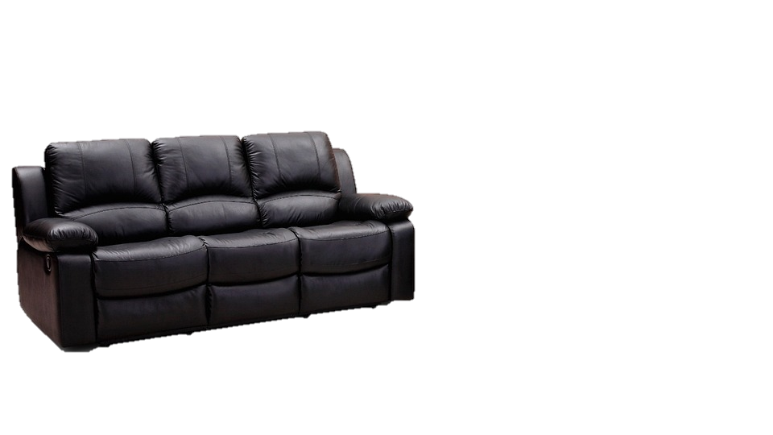

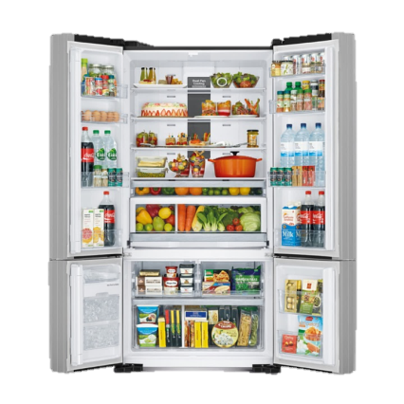
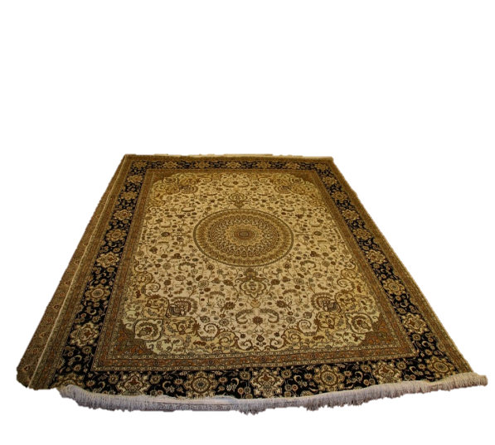
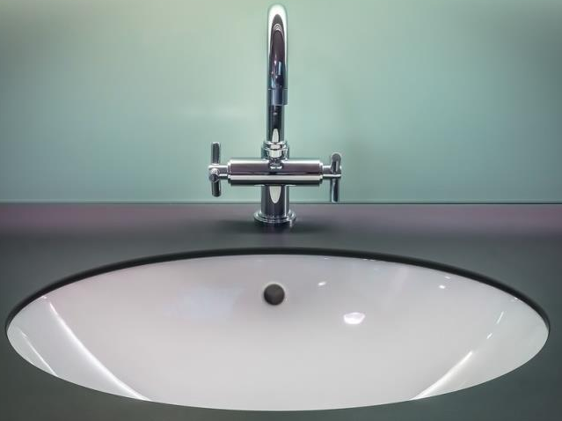
fridge
sink
rug
sofa

Slide 4

Presentation
4
Listen and repeat.

Slide 5


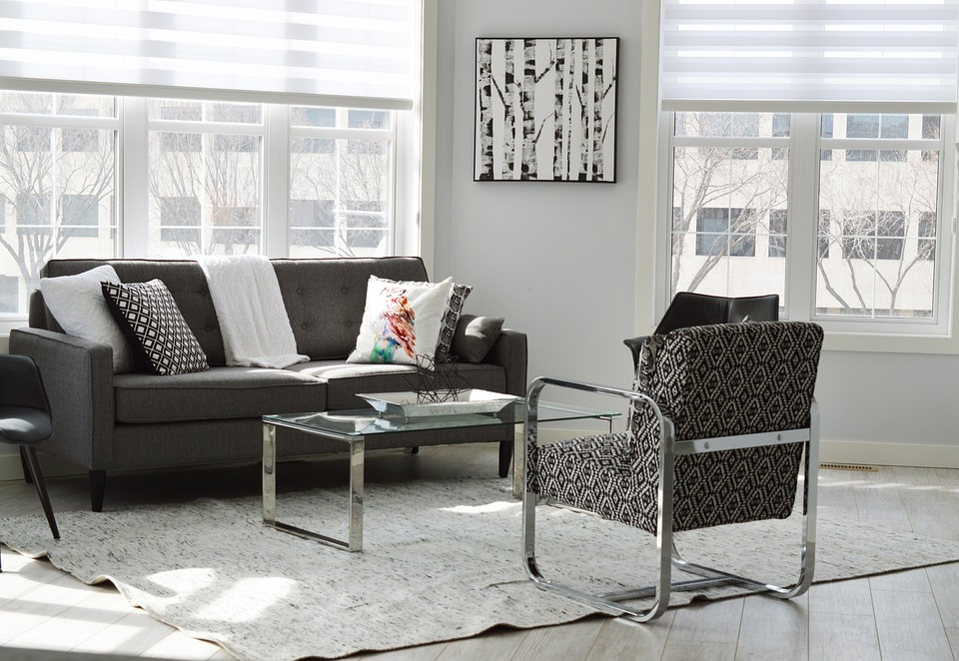
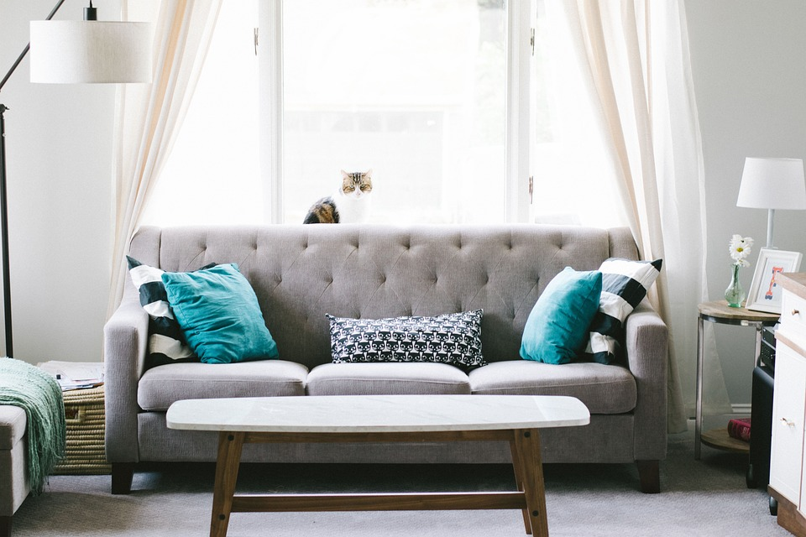
4
Listen and repeat.
2. Where is the sofa?
-It’s between two lamps.
1. Where is the rug?
-It’s in front of the sofa.

Slide 6
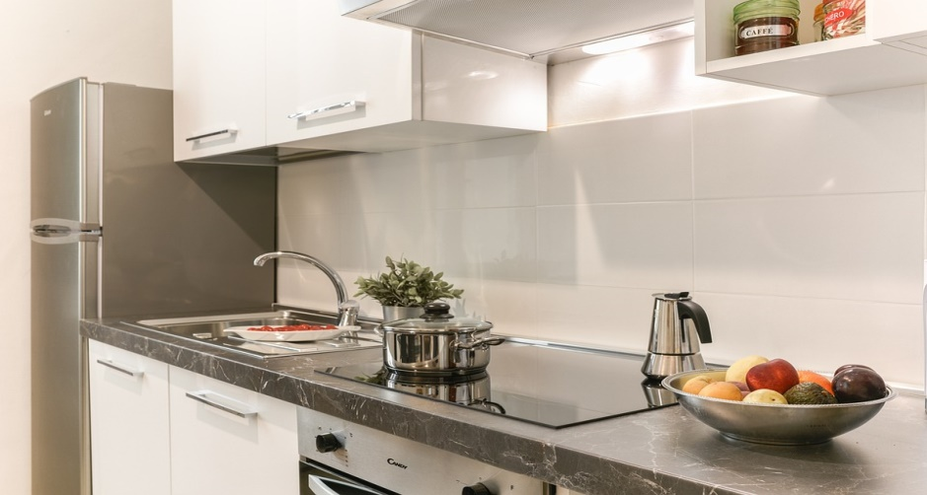
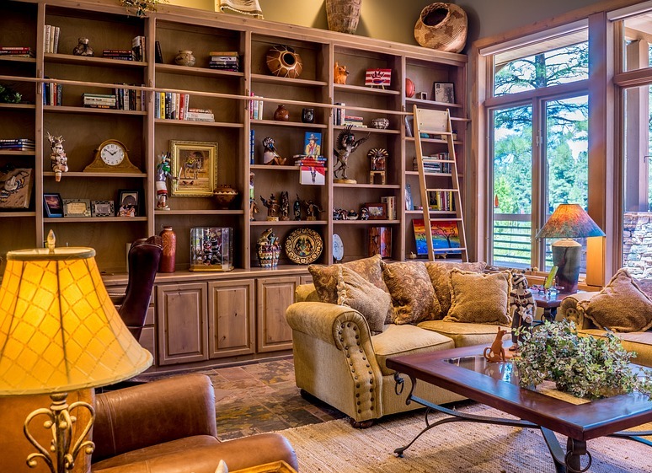
3. Where is the fridge?
4. Where are the books?
-It’s next to the sink.
- They’re behind the sofa.

Slide 7

Practice
5
Look and say.

Slide 8

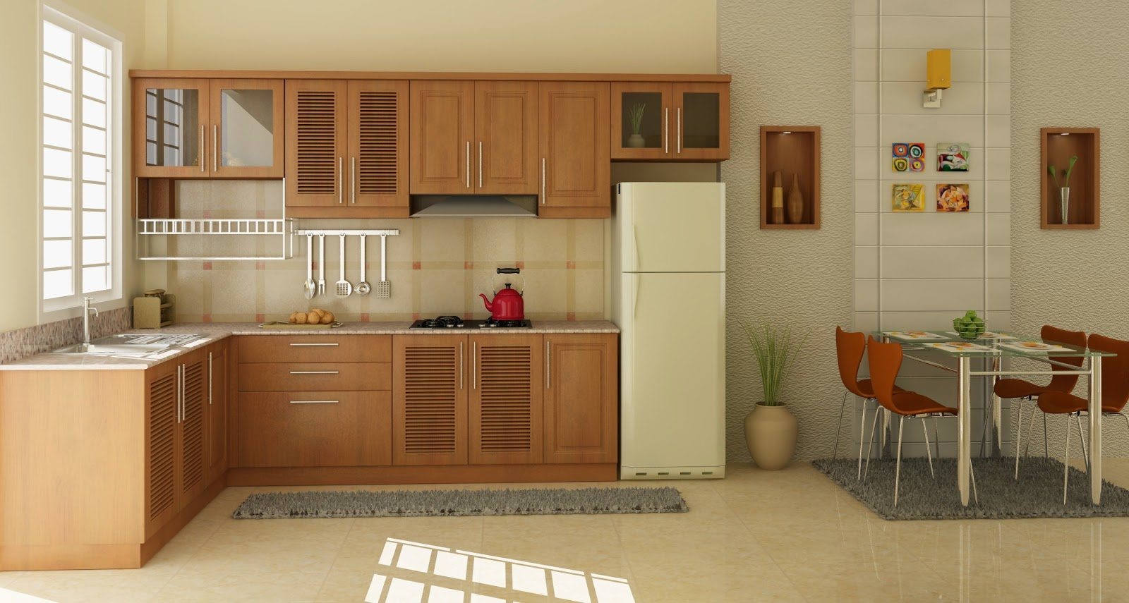



5
Look and say.
The rug/ in front of/ the fridge
Where is the rug?
It’s in front of the fridge.

Slide 9


The sofa/ behind/ the table
Where is the sofa?
The sofa is behind the table.

Slide 10
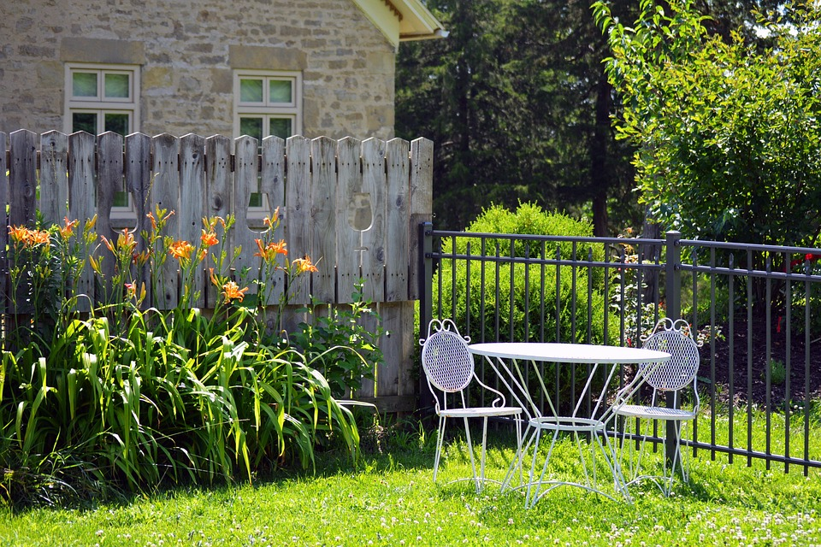
The table/ between/ two chairs
Where is the table?
The table is between two chairs.

Slide 11

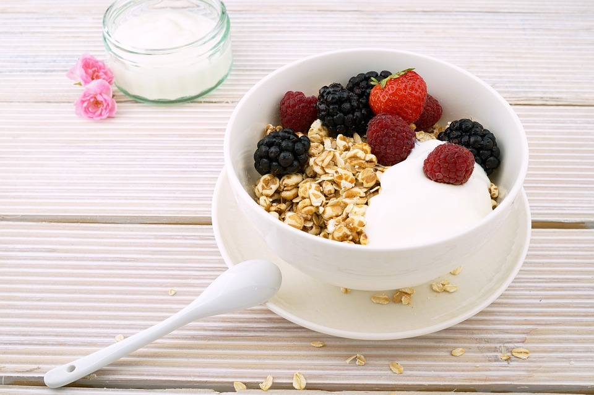
The bowl/ next to/ the spoon
Where is the bowl?
It’s next to the spoon.

Slide 12

Production
6
Listen and chant.

Slide 13

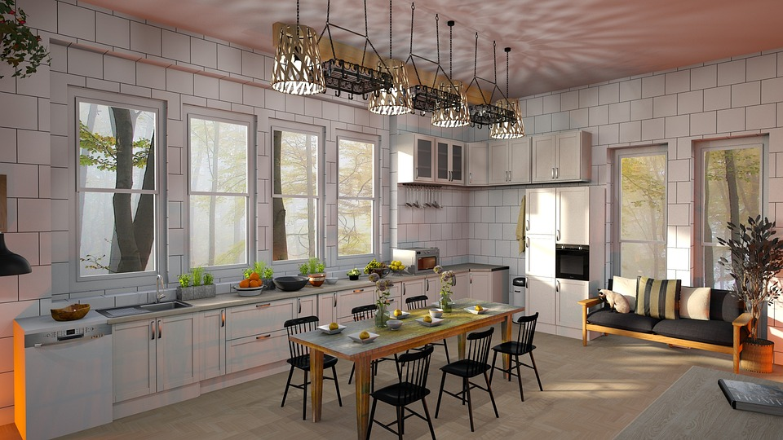
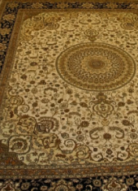
What do you see in the picture?

Slide 14

Assessment

Slide 15
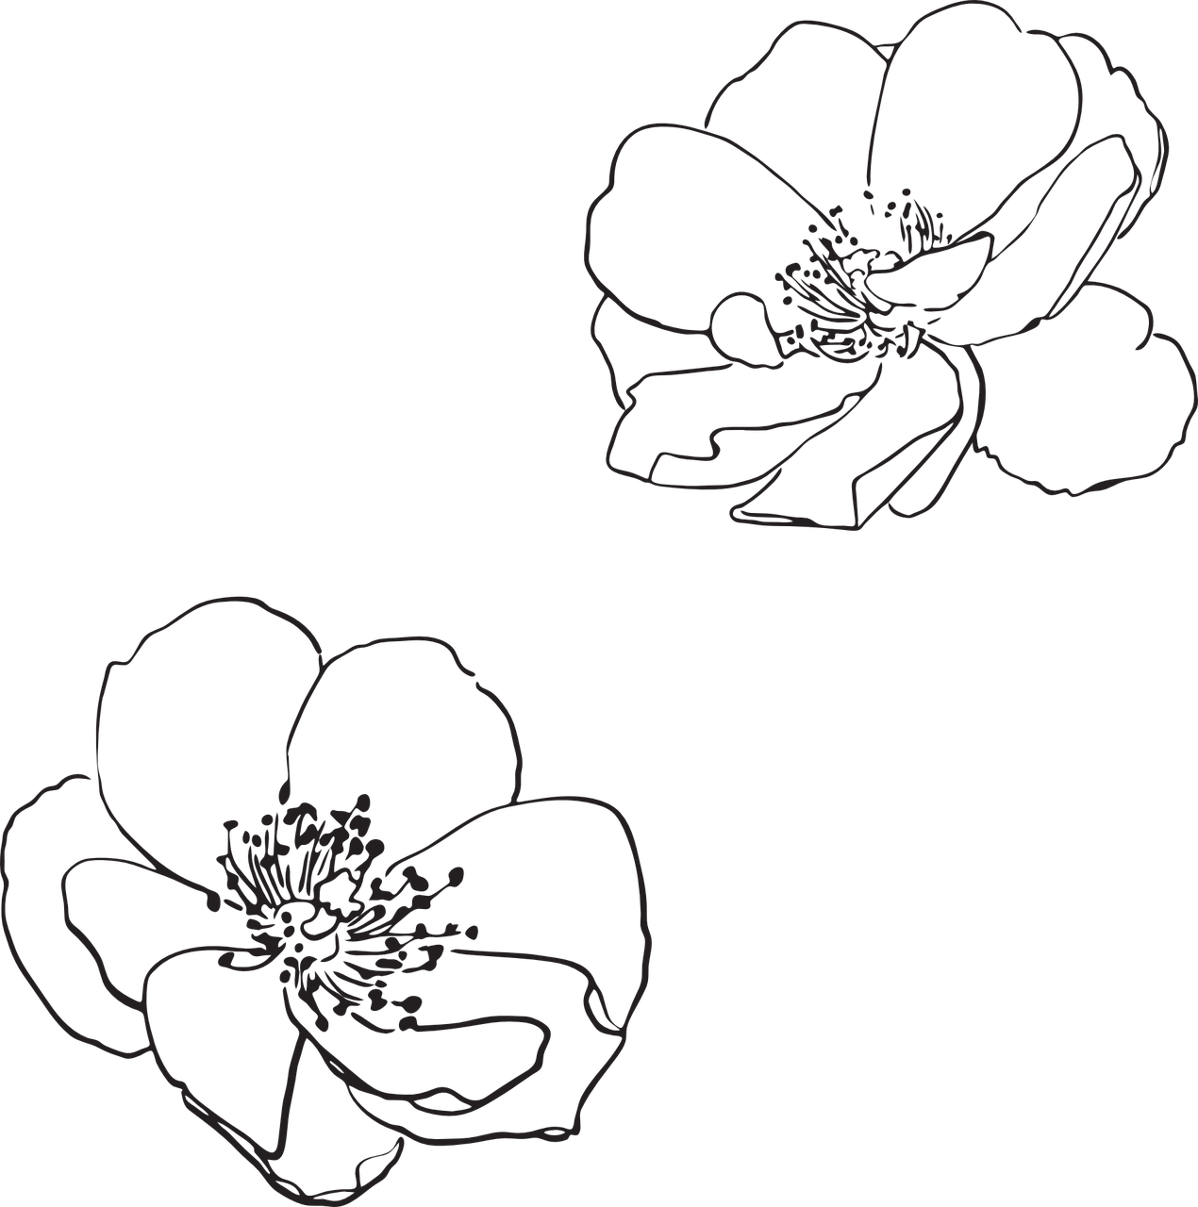
Order the words to make complete sentences
1. This/ our/ is/ kitchen/ lovely.
This is our lovely kitchen.
__________________
2. The/ between/ is/ table/ chairs/ two.
The table is between two chairs.
_________________________
3. Three/ next to/ are/ bowls/ plate/ the.
Three bowls are next to the plate.
_________________________
4. Where/ the/ rug/ is/ ?
Where is the rug?
_____________

Slide 16

Wrap up
Notes:
Đây k phải là extra, đây là hđ 3 của bài

Slide 17
REMEMBER
VOCABULARY:
Behind
Under
Next to
Between
In front of
STRUCTURE:
Where is the rug?
- It’s in front of the fridge.
17

