Slide 2
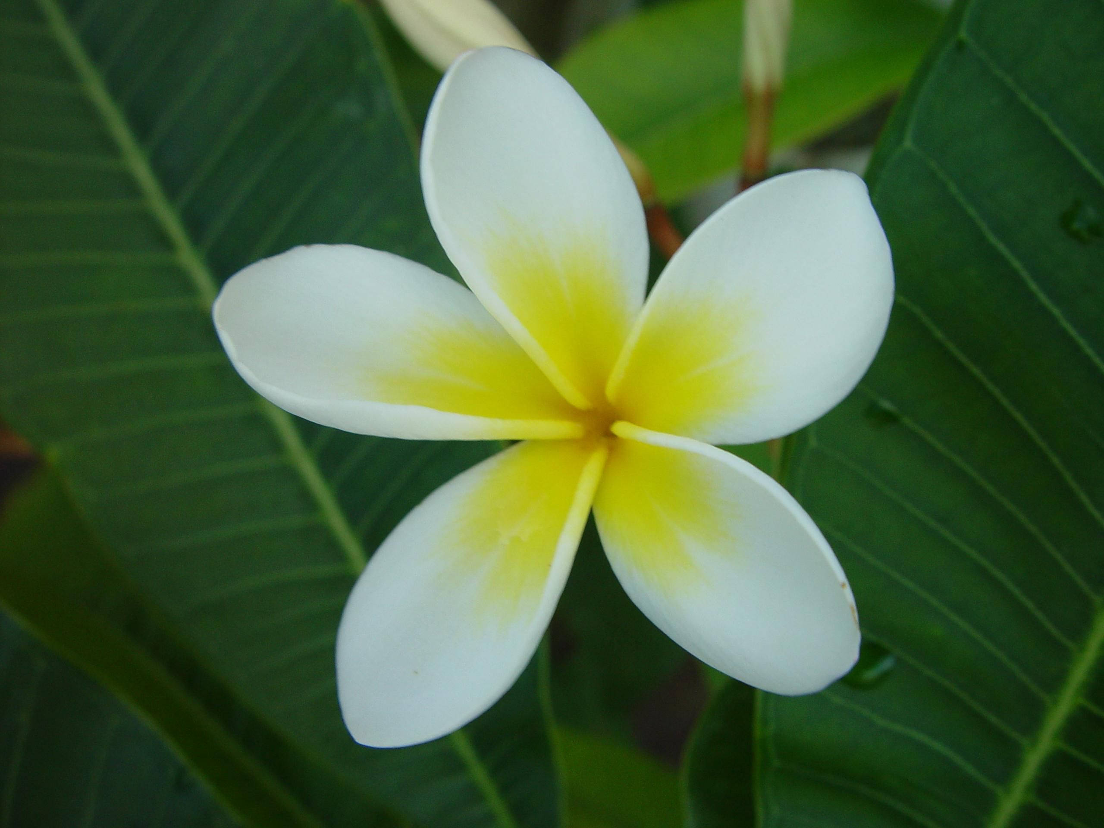
Unit 6
A visit to a school
A CLOSER LOOK 1

Slide 3

OBJECTIVES
By the end of the lesson, students will be able to:
use the lexical items related to the topic “School activities”.
correctly pronounce words that contain the sounds: /tʃ/ and /dʒ/

Slide 4
GAME
Pass the secret

Slide 5
Rules
- Teacher whispers some school facilities to one member from each team. The students have to pass the secrets to the person next to him/her. The last student of each team says the word out loud.
- The team finishing more quickly and with more correct answer is the winner.

Slide 6
Vocabulary

Slide 7
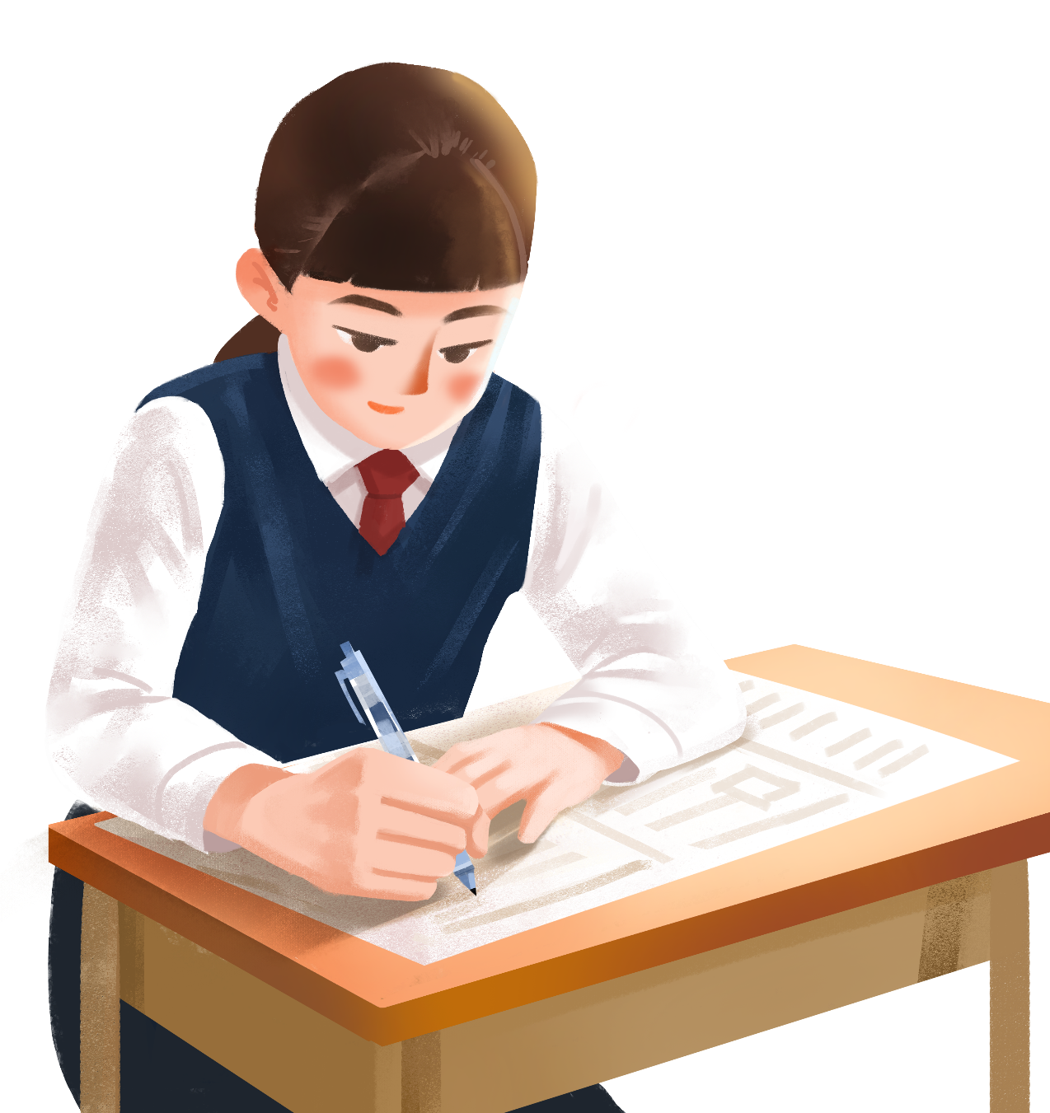

entrance exam (n. phr.)
/ˈentrəns ɪɡˌzæm/
kỳ thi đầu vào

Slide 8
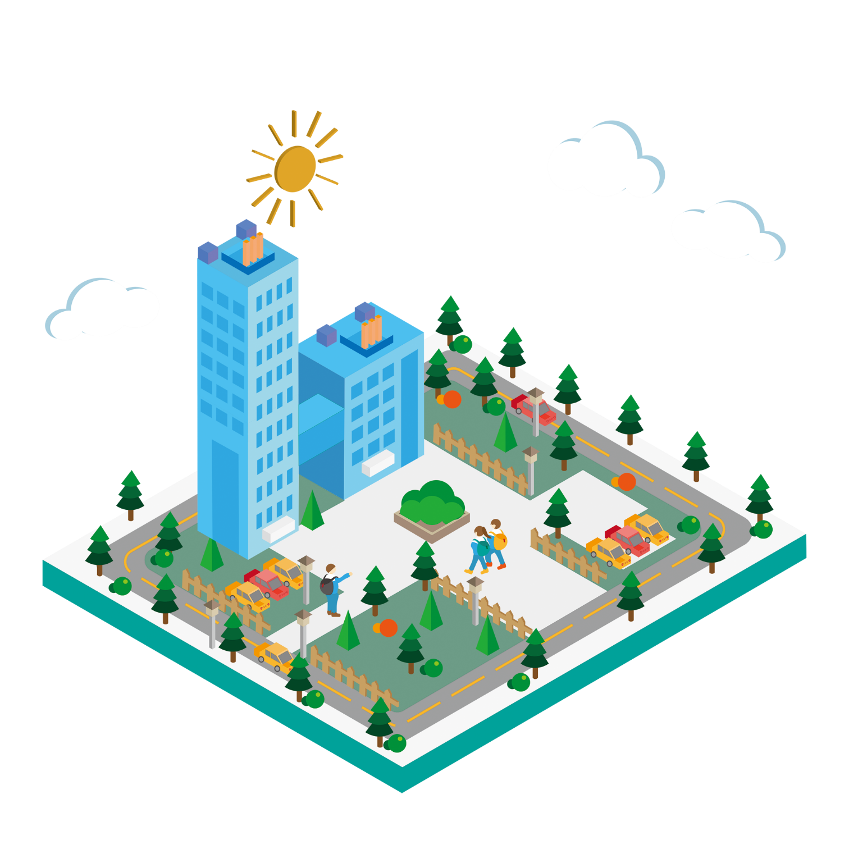
facility (n)
/fəˈsɪləti/
thiết bị / cơ sở vật chất

Slide 9

midterm (n)
/ˈmɪdtɜːm/
giữa học kì

Slide 10
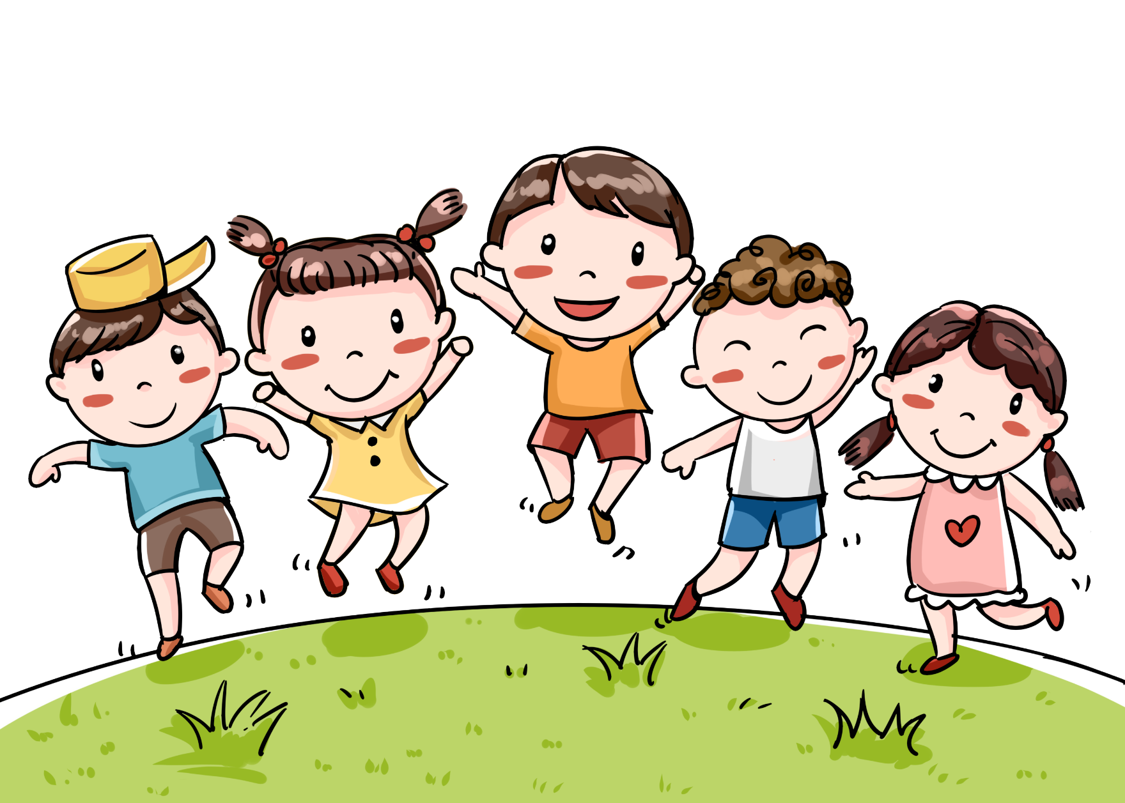
outdoor (adj)
/ˈaʊtˌdɔːr/
ngoài trời

Slide 11

gifted (adj)
/ˈɡɪftɪd/
năng khiếu

Slide 12
Vocabulary
Form | Pronunciation | Meaning
1. entrance exam (n. phr.) | /ˈentrəns ɪɡˈzæm/ | kì thi đầu vào
2. facility (n) | /fəˈsɪləti/ | thiết bị / tiện nghi
3. midterm (n) | /ˈmɪdtɜːm/ | giữa học kÌ
4. outdoor (adj) | /ˈaʊtˌdɔːr/ | ngoài trời
5. gifted (adj) | /ˈɡɪftɪd/ | năng khiếu

Slide 13
1. Match the phrases with the pictures. Then listen, check, and repeat the phrases.

Slide 14
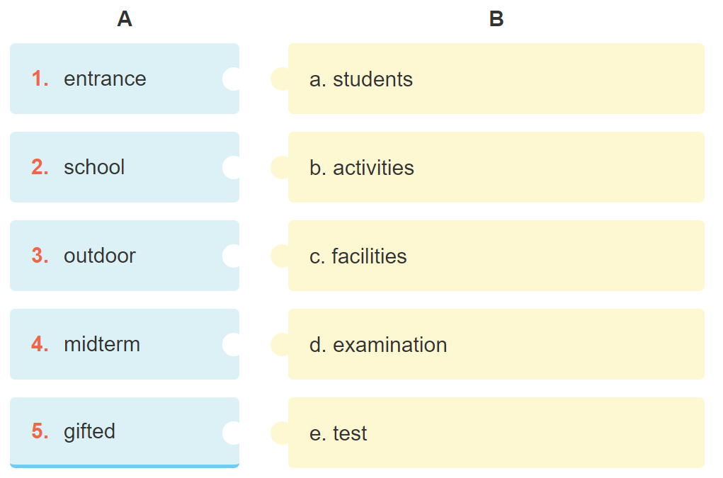

1. d
2. c
3. b
4. e
5. a

Slide 15
2. Complete the sentences with the phrases in 1.

Slide 16

1. Binh Minh Lower Secondary School is for _____________ in the city. 2. Our ____________ usually covers the first three units. 3. Students in my school take part in many _______________ during the school year. 4. Our school has a lot of modern _____________.
5. In order to study in Quoc Hoc – Hue you have to pass
a(n) __________________.
gifted students
midterm test
outdoor activities
school facilities
entrance examination

Slide 17
3. Work in pairs. Answer the questions about your school.

Slide 18



Can you name some gifted student in your school?
When does the first-term test take place?
Do you have to take an entrance examination to study at your school?
What kind of facilities does your school have?
What types of outdoor activities do you like to take part in?

Slide 19

1. Lan Anh is the most gifted student in my school.
2. The first-term test takes place in December.
3. No, I don’t.
4. My school has Science Laboratories, a library, computer room,...
5. I like taking part in camping.

Slide 20
Pronunciation
/tʃ/ and /dʒ/

Slide 21


Slide 22
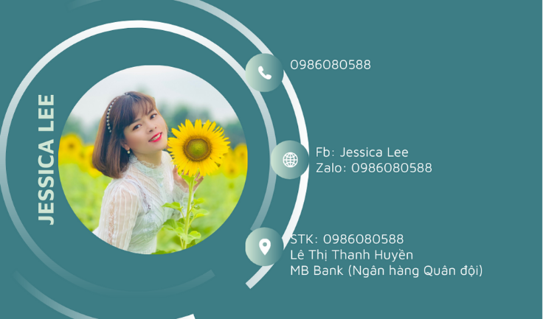
4. Listen and repeat the words. What letters can we use to make the /dʒ/ sound?

Slide 23
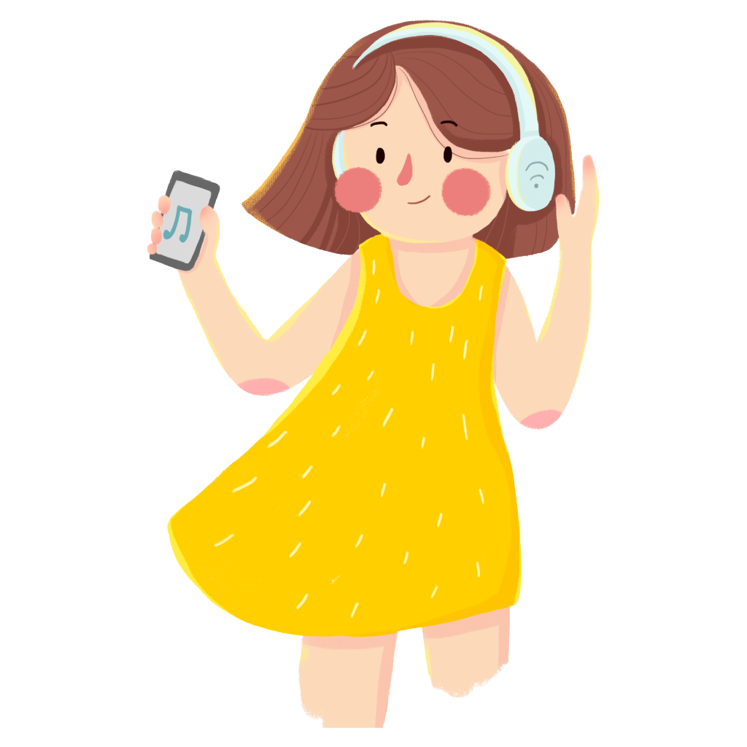
/tʃ/ | /dʒ/
cherry cheaper children lunch teacher | jam gym juice large project intelligent

Slide 24
5. Listen and repeat the chant. Pay attention to the sounds /tʃ/ and /dʒ/.

Slide 25
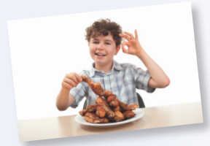
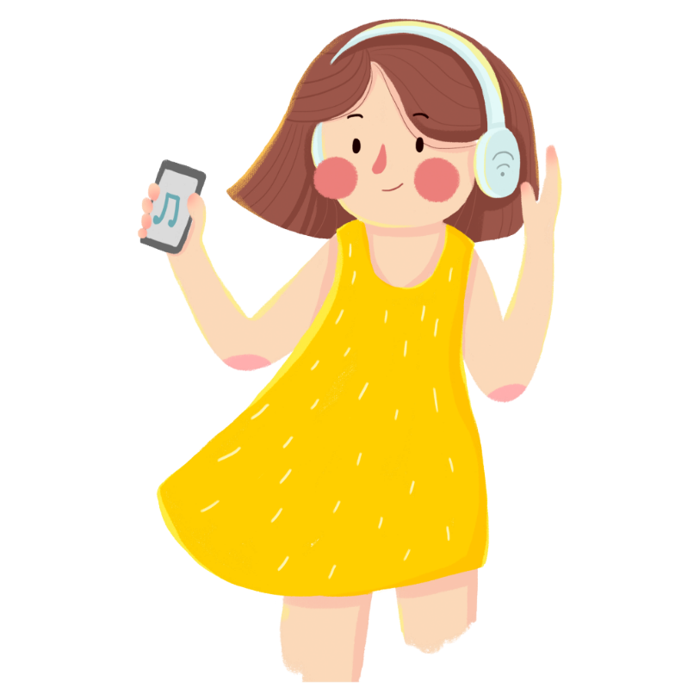

Orange juice, orange juice,
Who likes orange juice?
Children do, children do.
Children like orange juice.
Chicken chop, chicken chop,
Who likes chicken chop?
John does, John does.
John likes chicken chop.

Slide 26
Consolidation

Slide 27


Game: Up and down

Slide 28
Rules
- Teacher says 1-15 words containing the sound /tʃ/ and /dʒ/. Students stand up for the ones with the /tʃ/ sound, sit down for /dʒ/ sound.

Slide 29
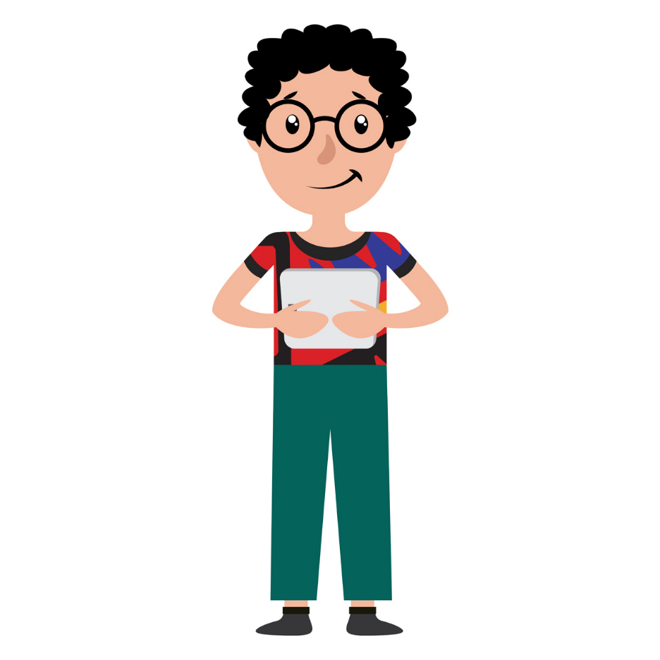
Game: Up and down
/tʃ/ | /dʒ/
maturity
teenager
exchange
project
chapped
jogging
kitchen
originate
picture
jeep

Slide 30

Homework
Find some more words having the sounds /tʃ/ and /dʒ/.
Learn by heart and write new words
Prepare: A closer look 2

Slide 31



