Slide 2

Unit 3
Community service
A CLOSER LOOK 2

Slide 3

OBJECTIVES
By the end of the lesson, students will be able to:
understand the use of the past simple tense
practise using the past simple tense in contexts

Slide 4
Unit 3
Chatting

Slide 5
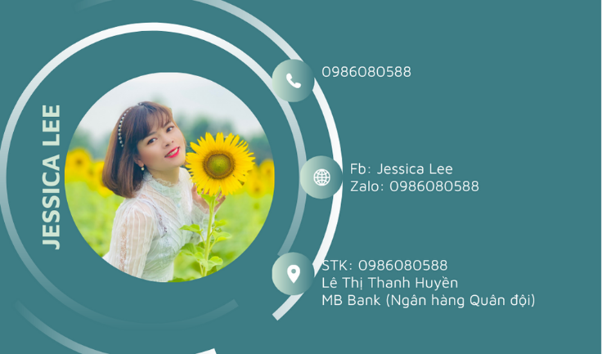

What did you do last weekend?
What did you watch yesterday?
Who did you meet two days ago?

Slide 6
Unit 3
Grammar
The past simple

Slide 7

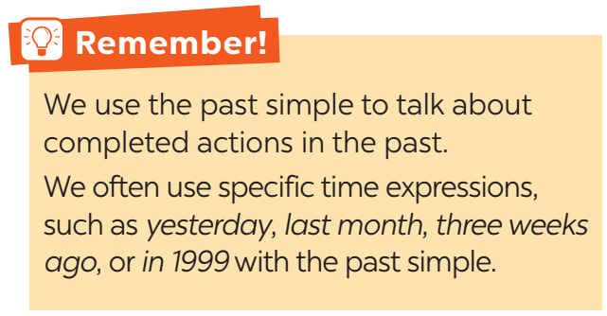

Slide 8


Slide 9
1. Circle the correct answer A, B or C to complete each sentence.
1. Green School ______ vegetables for an orphanage last spring. A. is growing B. grew C. grows 2. Children ______ plastic bottles for recycling a month ago. A. are collecting B. collect C. collected 3. We ______ English to children in a primary school last summer. A. are teaching B. taught C. teach
4. Our school club ______ gloves for old people in nursing homes last winter. A. made B. is making C. make 5. We ______ bottles to help the environment last month. A. are reusing B. reuse C. reused

Slide 10

2. Complete the sentences with the past simple form of the given verbs.
1. Care for Animals (take) _____ care of thousands of homeless dogs and cats last year. 2. _____ teenagers (join) _____ Lending Hand in 2015? 3. We (help) ________ the elderly in a village last summer. 4. Last year, we (send) _____textbooks to help children in a rural village. 5. Tom (volunteer) __________ to teach English in our village last winter.
took
Did
join
helped
sent
volunteered

Slide 11
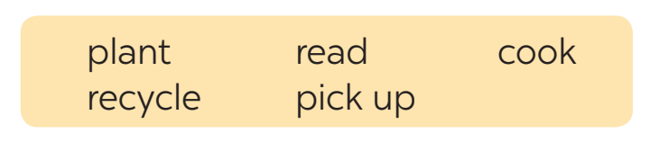

3. Complete the sentences with the correct forms of the verbs from the box.
1. The club members ________ food for patients every Sunday. 2. ________ you _____________ those trees in the playground last month? 3. Nick and his friends _________________ rubbish on the beach now. 4. Tom ______________ the plastic bottles, and now he has some nice vases. 5. We often ____________ books to old people in a nursing home.
cook
Did
plant
are picking up
recycled
read

Slide 12

4. Write complete sentences from the prompts.
1. last year / our club / donate / books / children in rural areas. _____________________________________________________ 2. children / send / you thank-you cards / a week ago? _____________________________________________________ 3. I / teach / two children in grade 2 / last summer. _____________________________________________________ 4. Last spring / we / help / the elderly / nursing home. _____________________________________________________ 5. How / you / help / people / in flooded areas / last year? _____________________________________________________
Last year, our club donated books to children in rural areas.
Did children send you thank-you cards a week ago?
I taught two children in grade 2 last summer.
Last spring, we helped the elderly in a nursing home.
How did you help the people in flooded areas last year?

Slide 13
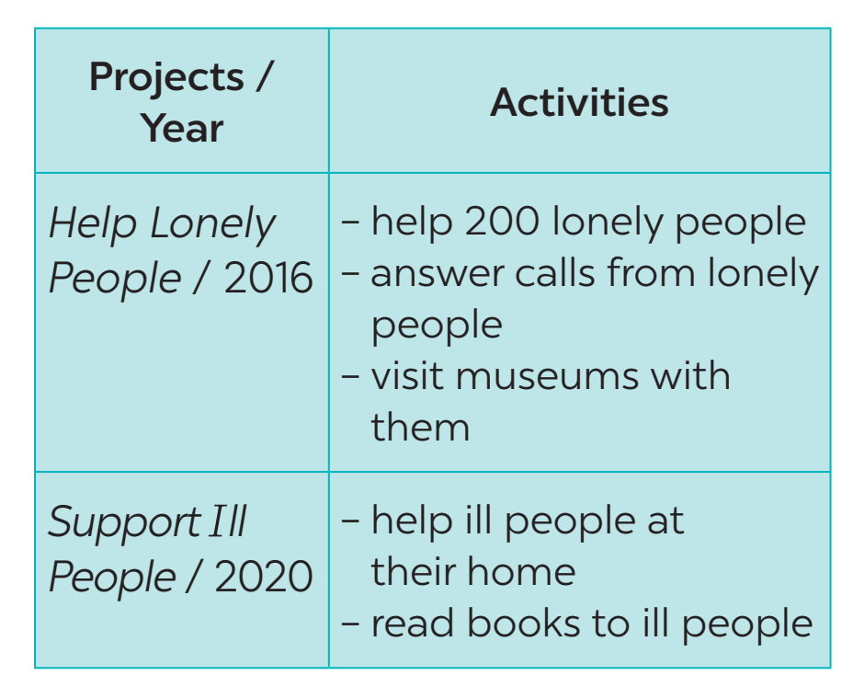

5. Work in pairs. Tom is from the Red Cross. Look at the fact sheet and ask Tom about his projects in 2016 and 2018.
Tom is from the Red Cross. Look at the fact sheet and ask Tom about his projects in 2016 and 2020.
Example: Tom: I’m from the Red Cross. I worked on the Help Lonely People project in 2016. Lan: What did you do? Tom: We helped 200 lonely people …

Slide 14
Unit 3
Consolidation

Slide 15
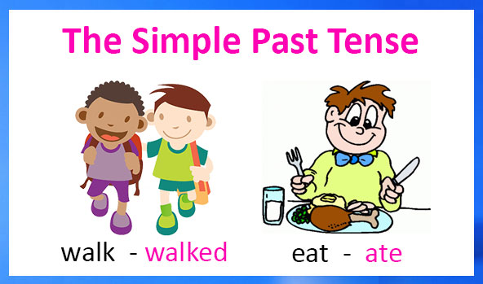

Slide 16



What did you do yesterday?

Slide 17

I went fishing.
I went shopping.
I went camping.
I went fishing.

Slide 18

I wrote a letter.
I played football.
I read a book.
I read a book.

Slide 19

I washed the dishes.
I cleaned the flat.
I baked a cake.
I baked a cake.

Slide 20

I watched TV.
I played computer games.
I helped my mum.
I played computer games.

Slide 21

I went for a walk in the park.
I walked the dog.
I played football.
I walked the dog.

Slide 22

I had a shower.
I brushed my hair.
I went to bed..
I had a shower.

Slide 23

Homework
Learn by heart the grammar
Prepare: Communication
Do Ex B- D (unit 3- WB)

Slide 24



