Slide 1



Slide 2
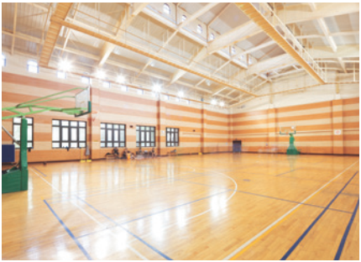
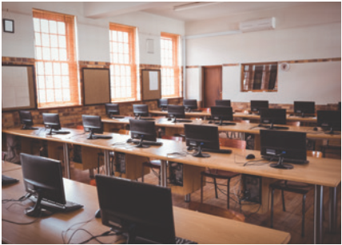
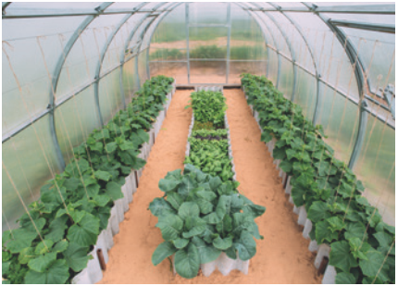
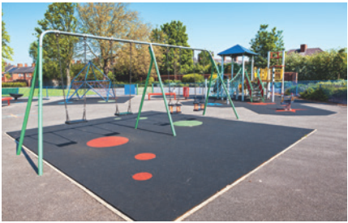
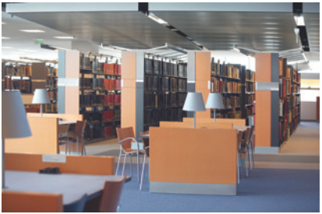

WARM-UP
Name these places, using the words and phrases from the box.
computer room school library
school garden playground gym
1
2
3
4
5

Slide 3

1
gym

Slide 4
2
computer room

Slide 5
3
school garden

Slide 6
4
playground

Slide 7
5
school library

Slide 8
WARM-UP
Name these places, using the words and phrases from the box.
computer room school library
school garden playground gym
1. gym
3. school garden
2. computer room
4. playground
5. school library
1

Slide 9

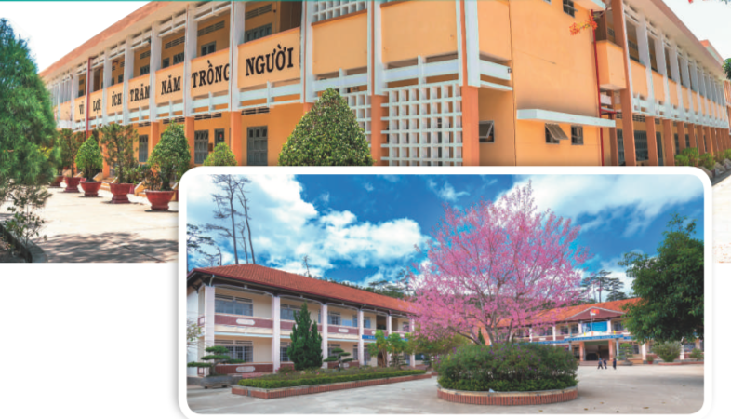
Wednesday, December 5th, 2023
Week: 14-Period: 42
Unit 6: A VISIT TO A SCHOOL
Lesson 1: GETTING STARTED (P 60-61)
NVL

Slide 10
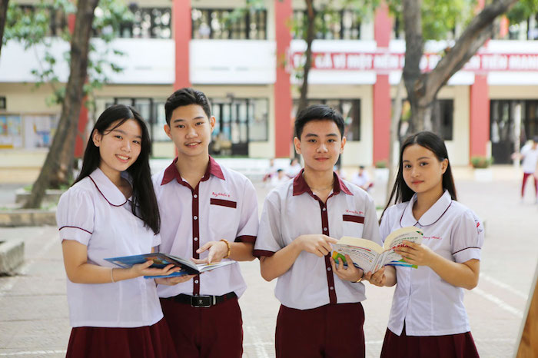
Vocabulary
lower secondary school
New Secondary School
/ˈləʊər ˈsekəndrɪ skuːl/
trường trung học cơ sở

Slide 11

Vocabulary
member (n)
/ˈmembər/
thành viên

Slide 12

Vocabulary
remind (v)
/rɪˈmaɪnd/
gợi nhớ, nhắc nhở

Slide 13
Vocabulary
forget (v)
# remember (v)
/fə'get/
quên

Slide 14
Vocabulary
New words | Pronunciation | Meaning
1. lower secondary school | /ˈləʊər ˈsekəndrɪ skuːl/ | trường trung học cơ sở
2. member (n) | /ˈmembər/ | thành viên
3. remind (v) | /rɪˈmaɪnd/ | gợi nhớ/ nhắc nhở
4. forget (v) | /fə'get/ | quên

Slide 15
Check Vocabulary
1. lower secondary school:
trường trung học cơ sở
2. member
thành viên
3. remind
gợi nhớ/ nhắc nhở
4. forget
quên

Slide 16
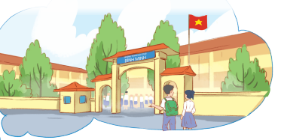
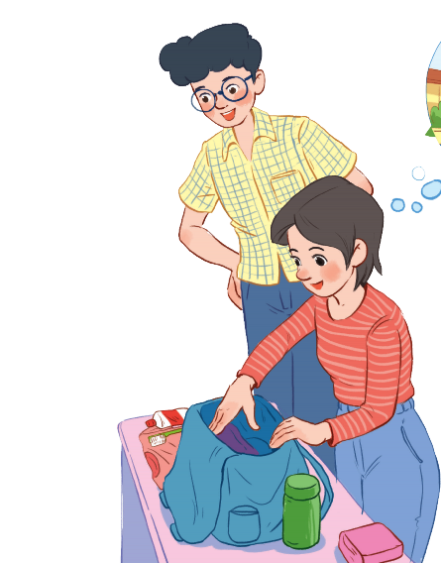
PRESENTATION
Set the scene
Phong
Who are they?
What is the girl doing?
What are they talking about?
Mi

Slide 17
1
Listen and read.
Phong: What are you doing, Mi?
Mi: I’m preparing to visit Binh Minh Lower Secondary School.
Phong: Sounds great! I think that’s one of the best schools in my neighbourhood. Who is going with you and when?
Mi: My teacher and my classmates. We’re going in the afternoon.
Phong: I see. What will you do there?
Mi: Well, I think we’ll visit the school library, the computer room, and the gym. We’ll meet the students and share ideas for a project in our English class.
Phong: That’s interesting. What else will you do there?
Mi: We’ll meet the members of their Go Green Club and take photos of the school.
Phong: Fantastic! so don’t forget to take your camera.
Mi: I almost forgot. Thanks for reminding me.

Slide 18
PRESENTATION
Set the scene
Phong
Mi is putting some clothes in her backpack.
They are talking about a visit to Binh
Minh Lower Secondary School.
Mi

Slide 19
PRACTICE
1
Listen and read.
Phong: What are you doing, Mi?
Mi: I’m preparing to visit Binh Minh Lower Secondary School.
Phong: Sounds great! I think that’s one of the best schools in my neighbourhood. Who is going with you and when?
Mi: My teacher and my classmates. We’re going in the afternoon.
Phong: I see. What will you do there?
Mi: Well, I think we’ll visit the school library, the computer room, and the gym. We’ll meet the students and share ideas for a project in our English class.
Phong: That’s interesting. What else will you do there?
Mi: We’ll meet the members of their Go Green Club and take photos of the school.
Phong: Fantastic! so don’t forget to take your camera.
Mi: I almost forgot. Thanks for reminding me.

Slide 20
PRACTICE
2
Read the conversation again and answer the questions by circling A, B, or C.
1. What are they talking about?
A. A visit to a computer room.
B. A visit to a school.
C. A visit to a school library.
2. Who is going to visit the school?
A. Mi and her teacher.
B. Mi and her classmates.
C. Mi, her teacher and her classmates.
3. Where is the school?
A. In the city.
B. In the countryside.
C. In Phong’s neighbourhood.
4. When are they going?
A. In the morning.
B. In the afternoon.
C. At noon.

Slide 21
PRACTICE
2
Read the conversation again and answer the questions by circling A, B, or C.
1. What are they talking about?
A. A visit to a computer room.
B. A visit to a school.
C. A visit to a school library.
Phong: What are you doing, Mi?
Mi: I’m preparing to visit Binh Minh Lower Secondary School.

Slide 22
PRACTICE
2
Read the conversation again and answer the questions by circling A, B, or C.
2. Who is going to visit the school?
A. Mi and her teacher.
B. Mi and her classmates.
C. Mi, her teacher and her classmates.
Phong: Sounds great! I think that’s one of the best schools in my neighbourhood. Who is going with you and when?
Mi: My teacher and my classmates. We’re going in the afternoon.

Slide 23
PRACTICE
2
Read the conversation again and answer the questions by circling A, B, or C.
3. Where is the school?
A. In the city.
B. In the countryside.
C. In Phong’s neighbourhood.
Phong: Sounds great! I think that’s one of the best schools in my neighbourhood. Who is going with you and when?

Slide 24
PRACTICE
2
Read the conversation again and answer the questions by circling A, B, or C.
4. When are they going?
A. In the morning.
B. In the afternoon.
C. At noon.
Phong: Sounds great! I think that’s one of the best schools in my neighbourhood. Who is going with you and when?
Mi: My teacher and my classmates. We’re going in the afternoon.

Slide 25
PRACTICE
3
Name these places, using the words and phrases from the box.
computer room school library
school garden playground gym
1. gym
2. computer room
3. school garden
4. playground
5. school library

Slide 26
PRACTICE
4
Complete the following sentences with the words in 3
3.
computer room school library
school garden playground gym
1. The school _______________ is very small, so not many children can play in it.
2. We learn how to use the Internet in the _______________ twice a week.
3. They have school meetings in the _______________ when it rains.
4. There are a lot of books, magazines, and newspapers in the _______________.
5. Our class usually waters the vegetables in the _______________ on Friday afternoons.
playground
computer room
gym
school library
school garden

Slide 27
PRODUCTION
5
Work in pairs. Ask and answer questions about Nick’s timetable, using when and where.
Subject | Time | Place
Maths | 8 a.m. Monday, Tuesday, Friday | Classroom (room 302)
Biology | 9 a.m. Thursday | Science lab
Information Technology | 2 p.m. Wednesday | Computer room
Physical Education | 3 p.m. Monday, Thursday | School gym
History | 3:30 p.m. Tuesday | School library
Example:
A. When does Nick have Maths?
B. At 8 a.m on Monday, Tuesday and Friday.
A. And where does he have it?
B. In his classroom, room 302.

Slide 28

HOMEWORK
- Learn vocabulary by heart.
- Practice the conversation again.
- Practice talking about school facilities.
- Do exercises in workbook.
- Prepare: Lesson 2- A closer look 1(P 62).

Slide 29
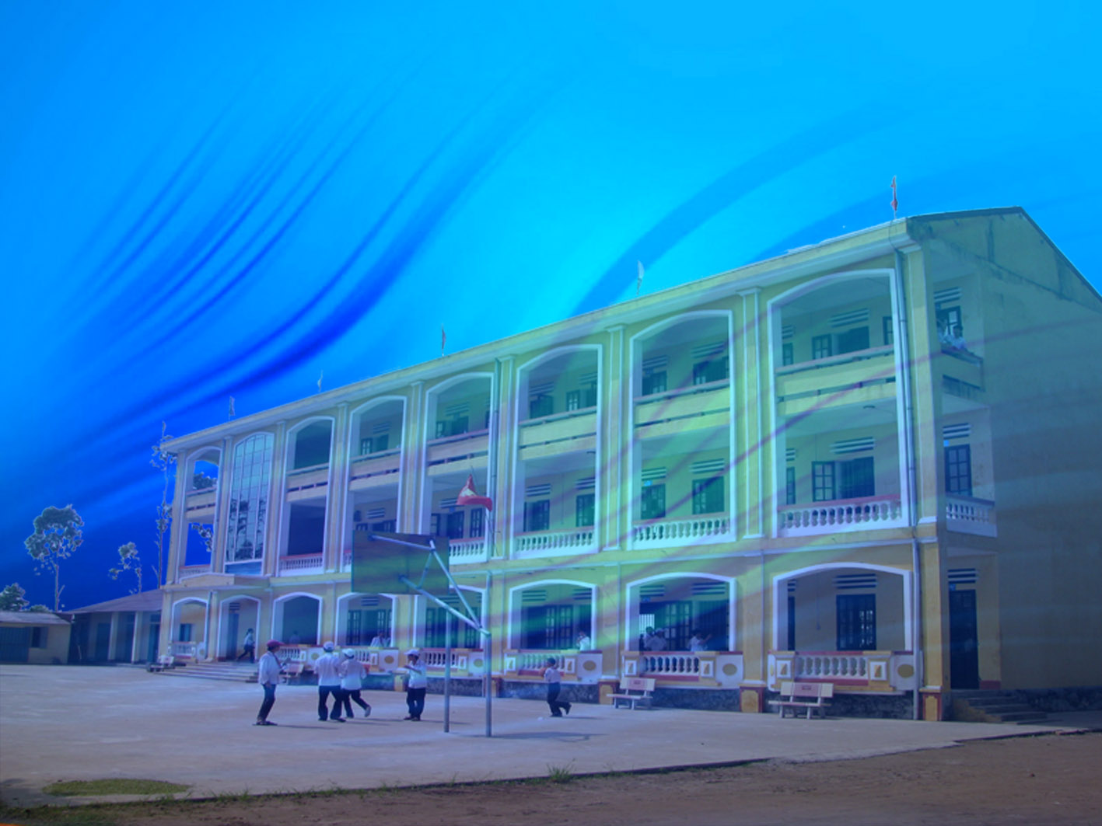
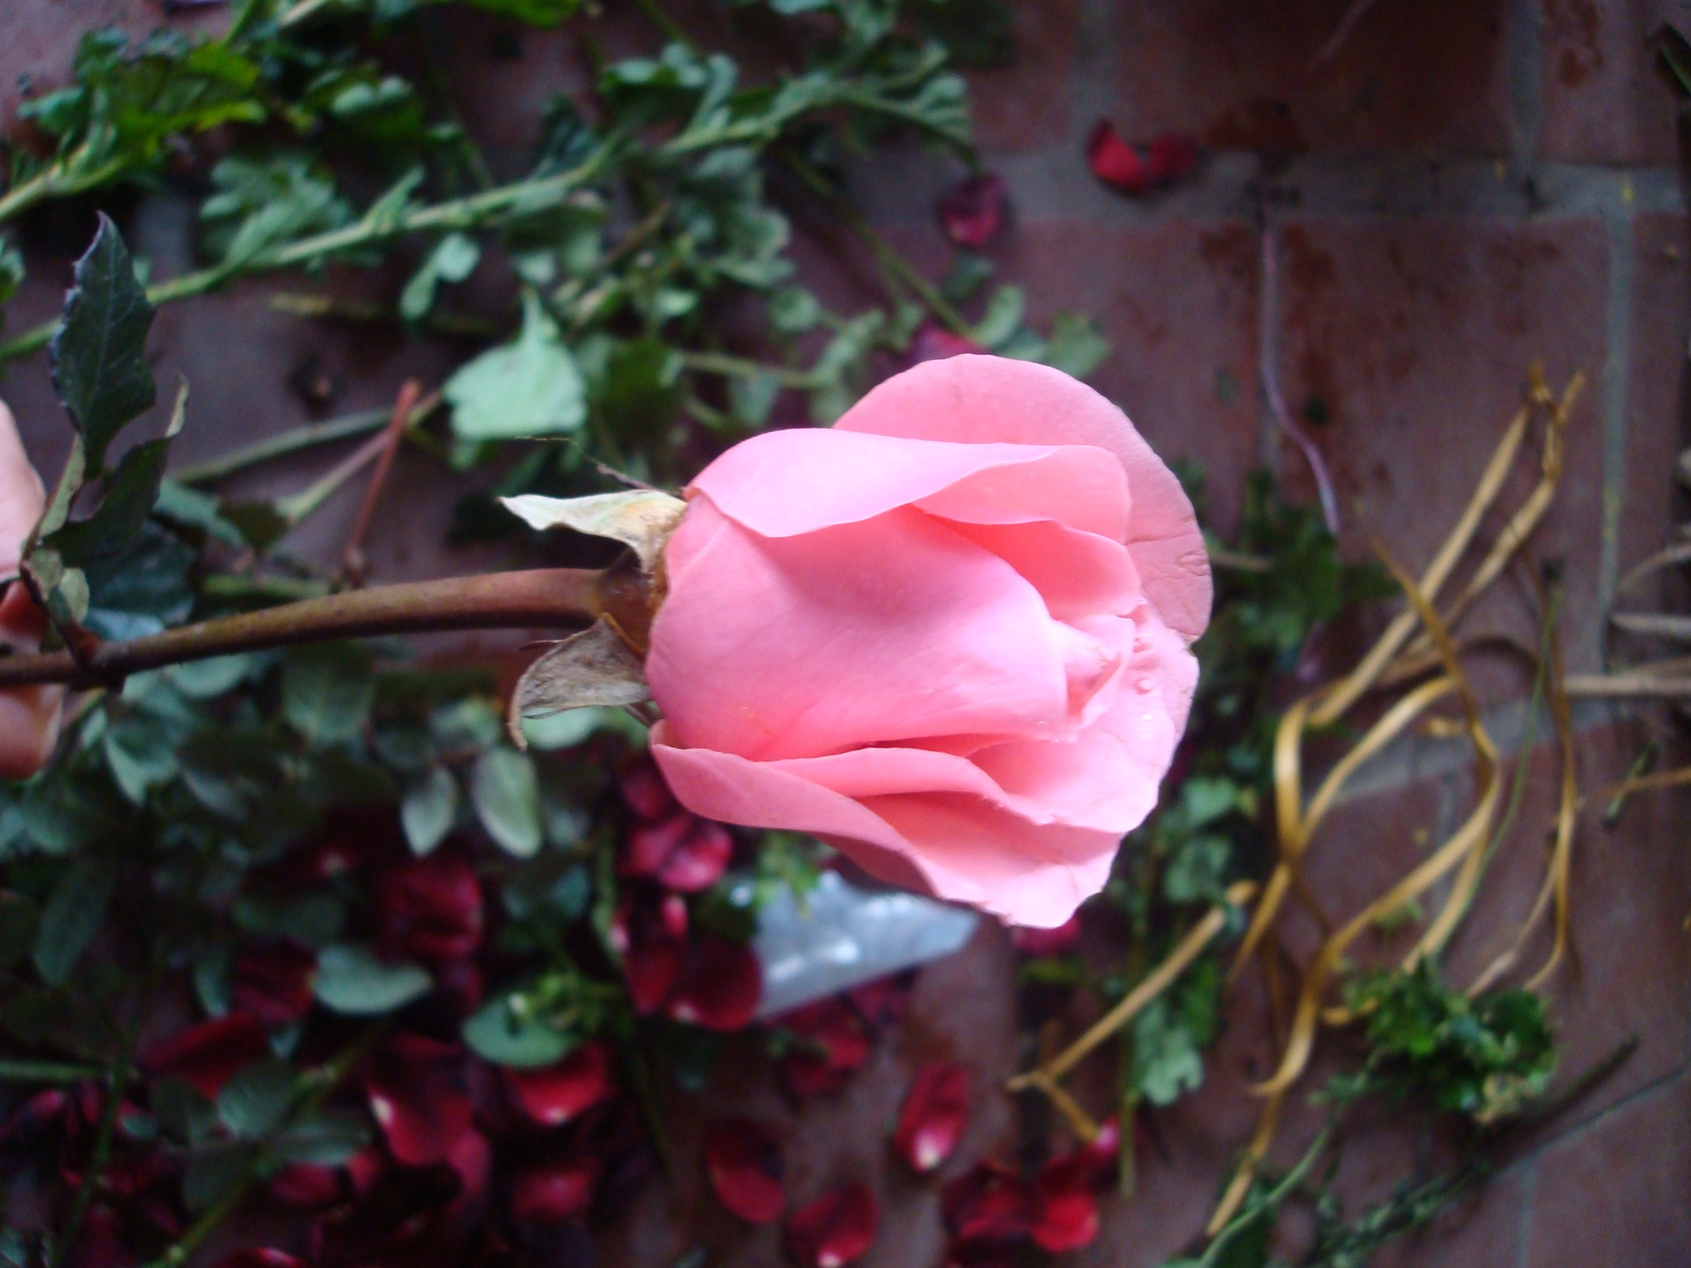
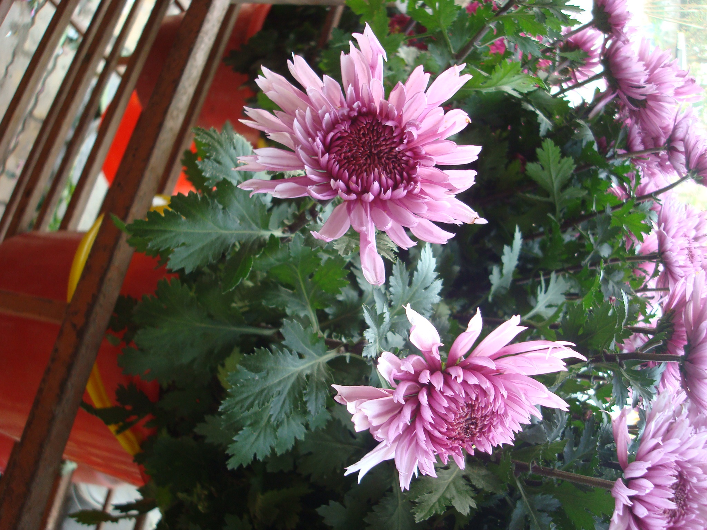

Thanks for your attendance
Goodbye!

Slide 30
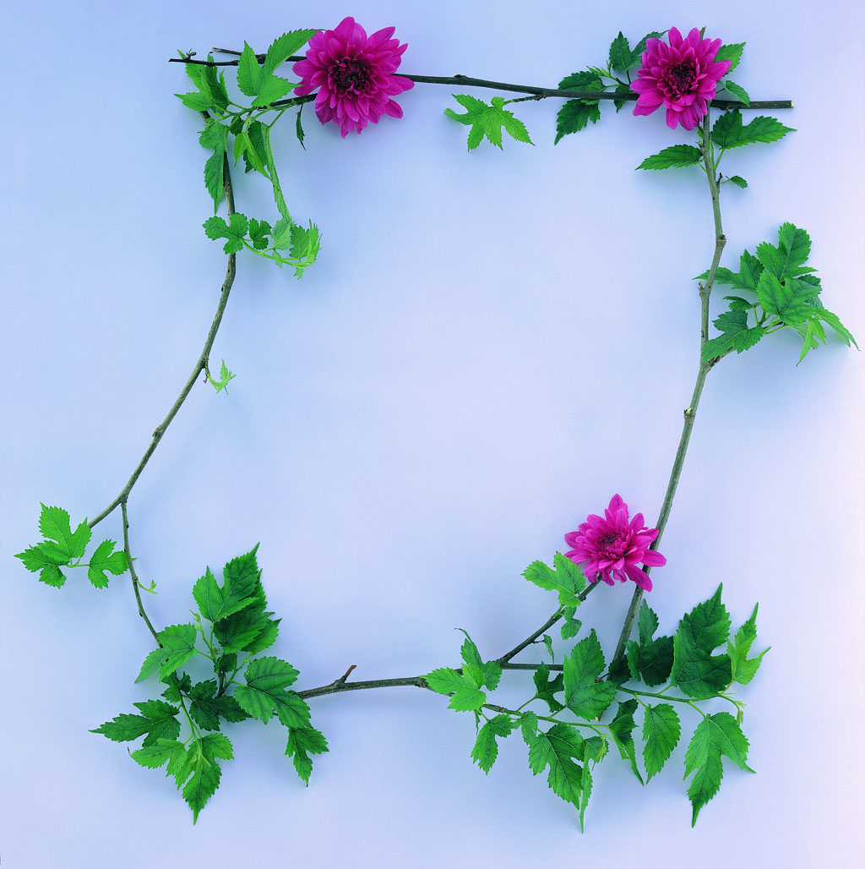

Goodbye!

Slide 31
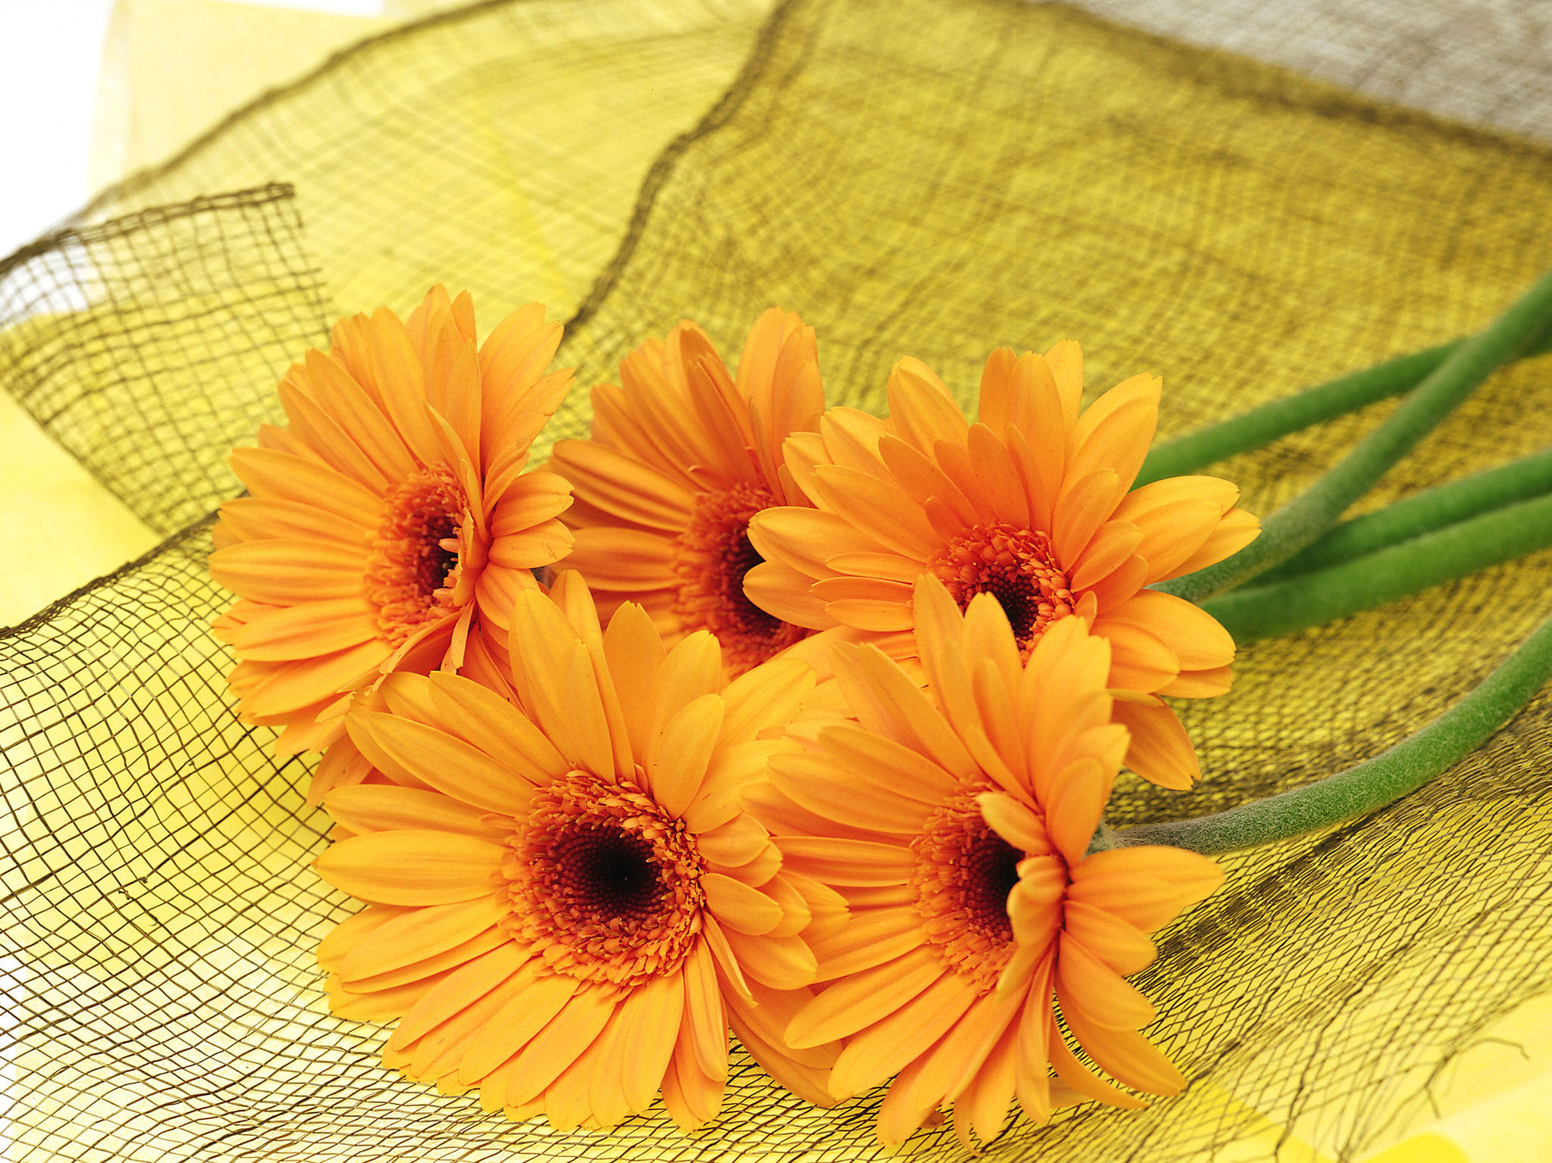
Thanks for your attention

