Slide 1

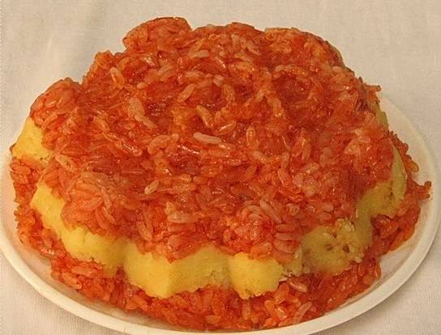
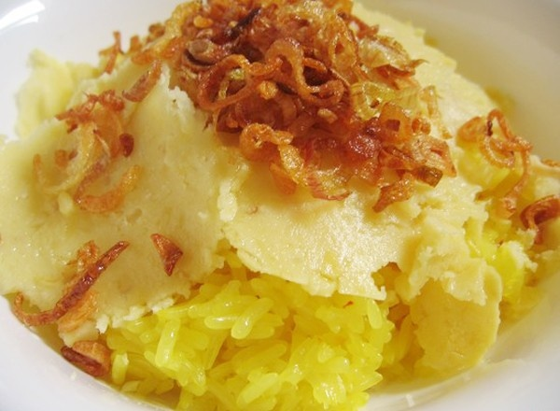
Warm up
Traditional dishes in Vietnam
Sticky rice

Slide 2
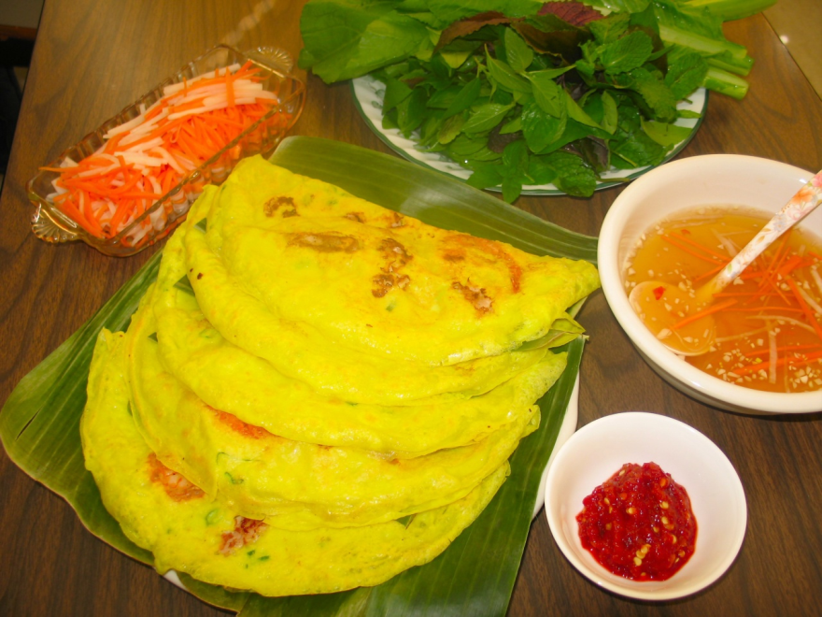
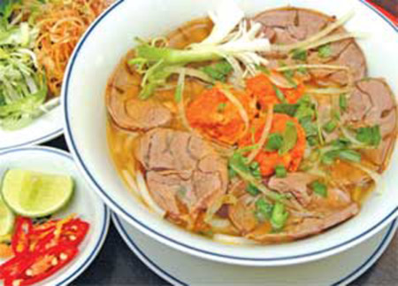
Bánh xèo
Bún bò Huế

Slide 3
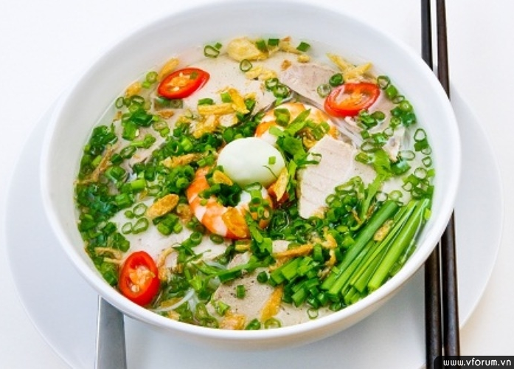
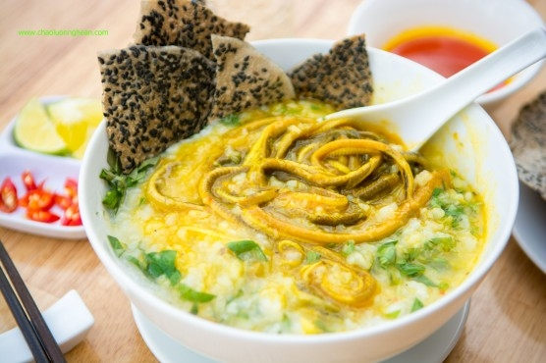
Hủ tiếu (Sài Gòn)
Cháo lươn

Slide 4
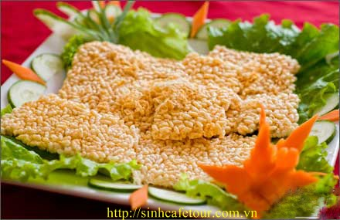
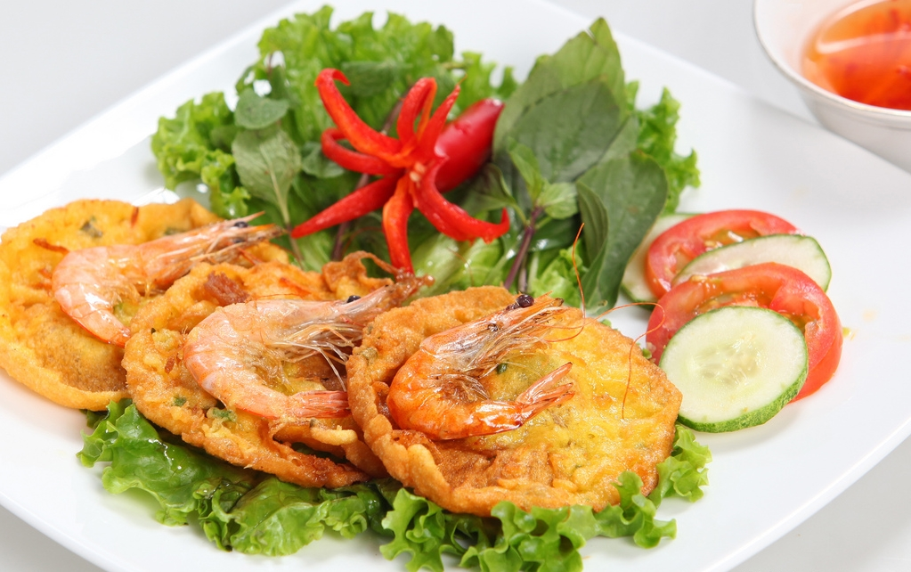
Cơm cháy (Ninh Bình)
Bánh tôm

Slide 5
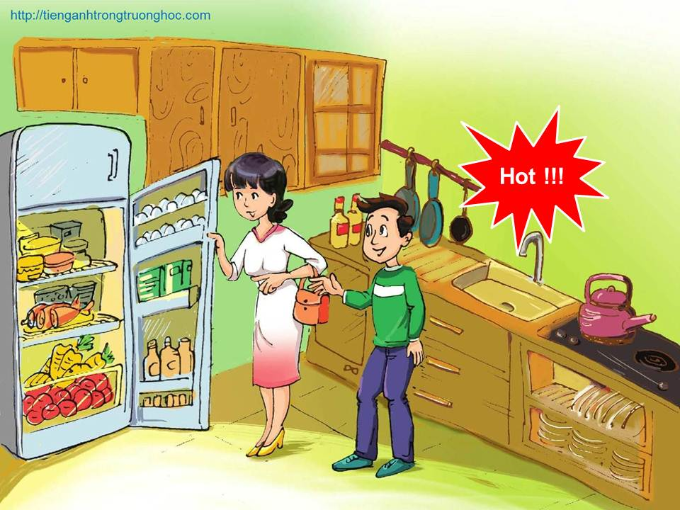
English 7
UNIT 5: VIETNAMESE FOOD AND DRINK
Period 40/ LESSON 7: SKILLS 2

Slide 6

Writing
Activity 3. Make notes about some popular food or drink in your neighbourhood.
Name of the foods or drinks | Ingredients | How to make them
Beat the eggs together with salt and pepper.
Heat the frying pan over a high heat and add cooking oil.
- Pour the eggs mixture into the pan
- Fold it in half.
- Put it on a plate and serve it.
- 2 eggs
- Salt
- Pepper
Cold water
Cooking oil
Omelette

Slide 7
3. Make notes about some popular food or drink in your neighbourhood.
Name of the foods or drinks | Ingredients | How to make them
1-2 green onions, as desired.
2 large eggs
1 teaspoon salt.
1 teaspoon pepper to taste
4 tablespoons oil
4 bowls cold cooked rice
1 - 2 tablespoons of light soy sauce
Beat the eggs with salt, pepper, onion.
Heat the pan and add 2 tablespoons of oil. When the oil is hot, pour the the mixture into the pan.
When it is hot, take it out and clean out the pan.
Add 2 tablespoons oil. Add the rice. Stir-fry for a few minutes, using chopsticks to break it apart. Add the soy sauce in.
When the rice is heated through, add the mixture back into the pan.
Serve hot.
Fried rice

Slide 8

4. Write a paragraph about popular foods or drinks in your neighbourhood. Choose one or more. Use the information in 3, and Phong’s blog, as a model.

Slide 9
Writing
Activity 4. Write a paragraph about popular foods or drinks in your neighbourhood. Choose one or more. Use the information in 3, and Phong’s blog, as a model
Questions
What is the name of the food/ or drink?
What ingredients do you need?
How do you make it?
Using: First(ly), we …………... Then we ………...
Next, we, ……………….... After that, we …….…………
Finally, we serve………………..…

Slide 10
Writing model
FRIED RICE
In order to make a Fried Rice dish, we need: 1 or 2 green onions, 2 large eggs, 1 teaspoon of salt, a teaspoon of pepper, 4 tablespoons of oil, 4 bowls of cold cooked rice, 1-2 tablespoons of light soy sauce.
Firstly, we beat the eggs with salt, pepper, onion. Then we heat the pan and add 2 tablespoons of oil. When the oil is hot, pour the mixture into the pan. When it is hot, take it out and clean out the pan. Next, we add 2 tablespoons oil, add the rice, stir-fry for a few minutes, using chopsticks to break it apart, then add the soy sauce in. When the rice is heated through, we add the mixture of eggs back into the pan and mix it well with the rice.
Finally, serve the fried rice when it’s hot.

Slide 11
In order to make ……………………, we need:............
…………..,……………………..,…………………………,…………………………,………………………………….
First, we ……….................Then we ………………….....
Next, we, ……………….... After that, we …….…………
Finally, we serve…………………………………..……..…
10

Slide 12
Writing
Activity 3. Make notes about some popular food or drink in your neighbourhood.
Name of the foods or drinks | Ingredients | How to make them
Soften the oranges by rolling the orange.
-Cut the oranges in half and remove the seeds.
- Grip one of the orange’s halves and squeeze it by hand.
- Add sugar in to the juice and serve with ice.
- 2 oranges
- 50 gr sugar
Orange juice

Slide 13
In order to make ……………we need :…………,……..
First, we ……….................Then we ………………….....
Next, we, ……………….... After that, we …….…………
Finally, we serve…………………………………..……..…
Name of the foods or drinks | Ingredients | How to make them
Soften the orange by rolling the orange.
-Cut the orange in half and remove the seeds.
- Grip one of the orange’s halves and squeeze it by hand.
- Add sugar in to the juice and serve with ice.
- 2 oranges
- 50 gr sugar
Orange juice
12

Slide 14
In order to make a glass of orange juice, we need: 2 oranges and 50gr sugar.
First,
we soften the orange by rolling the orange.
Next,
we cut the orange in half and remove the seeds.
After that,
we grip one of the orange’s halves and squeeze it by hand.
Finally,
we add sugar in to the juice and serve with ice.
Name of the foods or drinks | Ingredients | How to make them
Soften the oranges by rolling the orange.
-Cut the oranges in half and remove the seeds.
- Grip one of the orange’s halves and squeeze it by hand.
- Add sugar into the juice and serve with ice.
Orange juice
- 2 oranges
- 50 gr sugar
13

Slide 15
Writing
Activity 4. Write a paragraph about popular foods or drinks in your neighbourhood. Choose one or more. Use the information in 3, and Phong’s blog, as a model
Name of the foods or drinks | Ingredients | How to make them
-50gr green tea leaves
100 gr fat milk powder
-30 gr matcha flour
-100 grams sugar
Boil green tea leaves.
-Take out tea leaves and put
fat milk powder and matcha flour.
- Mix all together with sugar.
Let the mixture cool.
Pour it out in to the cup.
Serve it with ice.
Matcha green tea

Slide 16
In order to make ……………………, we need:............
…………..,……………………..,…………………………,…………………………,………………………………….
First, we ……….................Then we ………………….....
Next, we, ……………….... After that, we …….…………
Finally, we serve…………………………………..……..…
15

Slide 17
Writing
Matcha Green tea:
In order to make matcha green tea, we need: 50 grams green tea leaves, 80 grams fat milk powder,
30 gr matcha flour ,100 grams sugar
First, we boil green tea leaves.
Then, we take out tea leaves and put fat milk powder and Matcha flour.
Next, we mix all together with sugar.
After that, we let the mixture cool.
Finally, we pour it out into the cup and serve it with ice.

Slide 18

Homework
Complete the writing task into your notebook.
Prepare next lesson: UNIT 6- GETTING STARTED 1

