Slide 1


love

Slide 2
Check –up.
Write a sentence with one of these adverbs
( always, often, sometimes….).
2. Complete the sentences with the present simple.
Lan (be)……………a good student in my class.
Nam often( play)…………with his friends in the evening.
They (not go)………….to school on Sundays.
………Your mother(go)………..to work today ?
My father rarely (wash)………………his clothes.

Slide 3


UNIT 1: MY NEW SCHOOL
LESSON 4:
Everyday English
Introducing someone

Slide 4

Guiding Questions:
How do you often make friends ?
b. What do you often say when you first meet a new friend ?
c. What questions do you often make ?

Slide 5

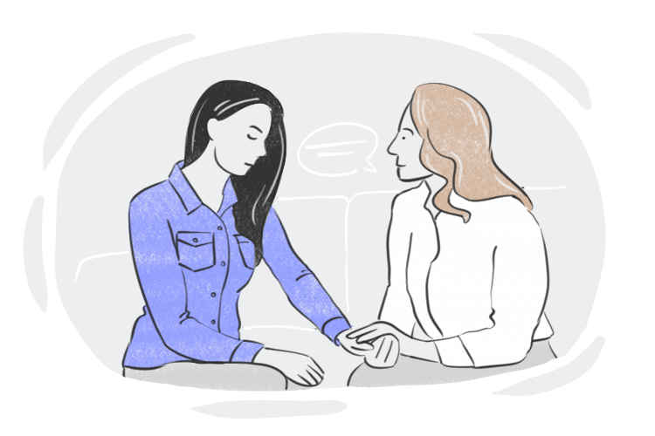
Vocabulary
advice
/ədˈvaɪs/
Lời khuyên

Slide 6

Vocabulary
share
/ʃer/
Chia sẻ

Slide 7

Vocabulary
classmate
/ˈklɑːs.meɪt/
Bạn học cùng lớp

Slide 8

Vocabulary
Keep secret
/kiːp ˈsiː.krət/
Giữ bí mật

Slide 9
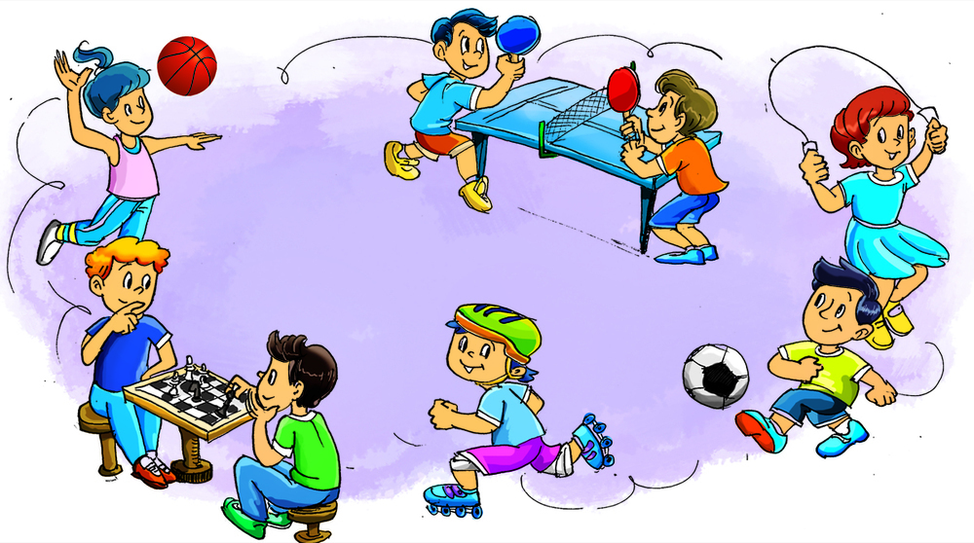
Vocabulary
break time
/breɪk taim/
giờ ra chơi

Slide 10

Listen and read the dialogue. Pay attention to the highlighted parts.
Vy: Phong, this is Duy, my new friend.
Phong: Hi, Duy. Nice to meet you.
Duy: Hi, Phong. Nice to meet you, too.
Notes:
Slide này không đúng.

Slide 11

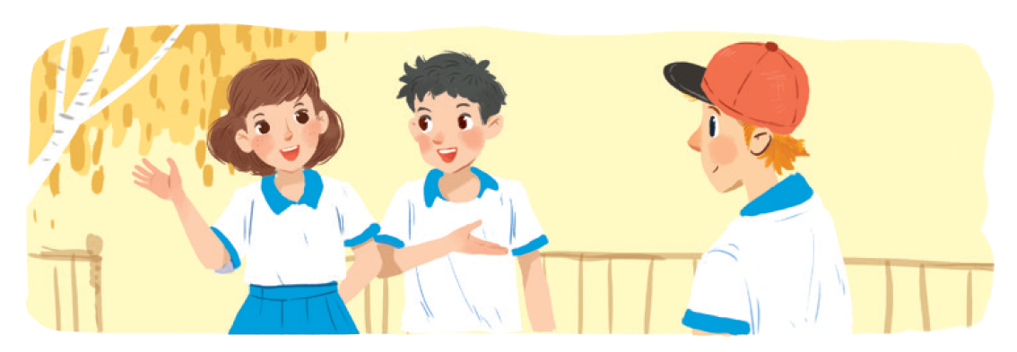
Work in groups. Practise introducing a friend to someone else.
Example:
Thien: Huy, this is Huong, my new friend.
Huy: Hi, Huong . Nice to meet you.
Huong: Hi, Huy. Nice to meet you, too.

Slide 12
New friends at school

Slide 13
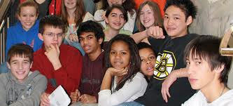
Do you have many friends?
b. Do you have any new friends?
c. Do you love them? Why? Or why not?

Slide 14

Read and tick the questions you think are suitable to ask a new friend at school.
1.
Are you from around here?

2.
Do you like music?

3.
How much money do you get?
4.
What is your favourite subject at school?

5.
Are you hungry now?
6.
Do you play football?

7.
How do you go to school every day?

8.
Where do you often go shopping?
Notes:
City landmarks phải ở trên mục 3

Slide 15
Write one or two more questions on a piece of paper. Then share them with the class.
What’s your name?
Where do you live?
Do you like EL?
What’s your telephone number?
What’s your hobby?

Slide 16


There is a quiz for students in the new school newsletter. Answer the questions.

Slide 17

1. Do you remember all your new classmate’s names?
Yes No
2 Do you often listen to your friend’s advice?
Yes No

Slide 18
Do you share things with your classmates?
Yes No
Do you keep your friends' secret?
Yes No
Do you play with your classmates at break time?
Yes N o
Do you help your classmate with their homework?
Yes No
Do you go to school with your friends?
Yes No
Do you listen when your classmates are talking?
Yes No

Slide 19


Work in groups. Take turn to interview the others. Use the questions above.

Slide 20
* Frienship Quiz:
A good friend must be:
kind,
friendly,
helpful,
honest,
faithful,....

Slide 21
Homework
Learn by heart newwords and practice writing each word 3 lines
prepare Skills 1

Slide 22

THANKS FOR YOUR ATTENTION!
Goodbye!
See you again!

