Slide 1


Hello every one !!!
NGUYỄN THỊ THU BA

Slide 2


WARM-UP
Chatting
1. Have you ever visited a famous school?
2. What do you want to know when you have a visit to another school?
- Number of students and teachers
- School facilities
- School activities
- Subjects
- school timetables
………………………

Slide 3



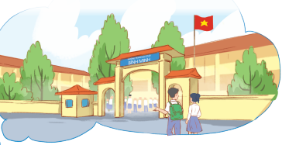
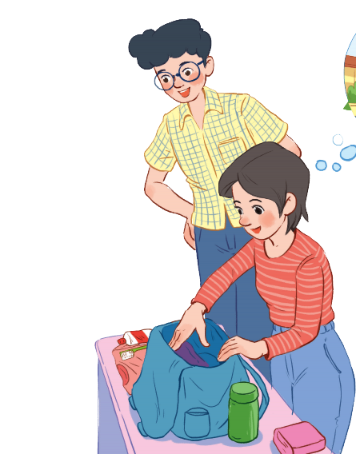
Unit
6
A VISIT TO A SCHOOL
LESSON 1: GETTING STARTED
A visit to Binh Minh Lower Secondary School

Slide 4

* Vocabulary
- lower secondary school:
trường trung học cơ sở
/ˈləʊər ˈsekəndrɪ skuːl/

Slide 5

- member (n):
/ˈmembər/
thành viên

Slide 6

- remind (v):
/rɪˈmaɪnd/
gợi nhớ, nhắc nhở

Slide 7
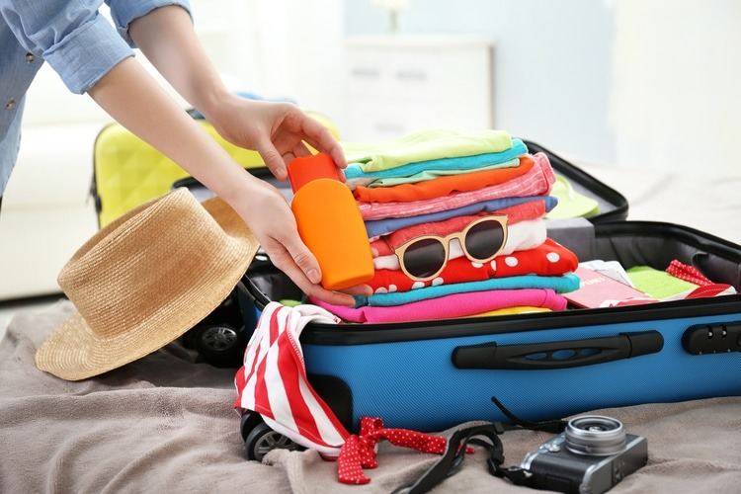
- prepare (v):
chuẩn bị
/prɪˈpeər/

Slide 8
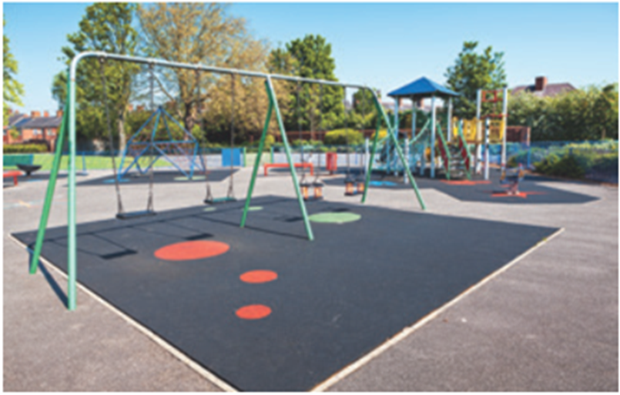
- playground (n):
/ˈpleɪ.ɡraʊnd/
sân chơi

Slide 9
* Vocabulary
New words | Pronunciation | Meaning
lower secondary school | /ˈləʊər ˈsekəndrɪ skuːl/ | trường trung học cơ sở
member | /ˈmembər/ | thành viên
remind | /rɪˈmaɪnd/ | gợi nhớ/ nhắc nhở
prepare | /prɪˈpeər/ | chuẩn bị
playground | /ˈpleɪ.ɡraʊnd/ | Sân chơi

Slide 10
* C hecking vocabulary
New words | Meaning
 | trường trung học cơ sở
 | thành viên
 | gợi nhớ/ nhắc nhở
 | chuẩn bị
 | Sân chơi
- lower secondary school
- member
- remind
- prepare
- playground

Slide 11
1
Listen and read.
What is the girl doing?
What are they talking about?

Slide 12

1
Listen and read.
Phong: What are you doing, Mi?
Mi: I’m preparing to visit Binh Minh Lower Secondary School.
Phong: Sounds great! I think that’s one of the best schools in my neighbourhood. Who is going with you and when?
Mi: My teacher and my classmates. We’re going in the afternoon.
Phong: I see. What will you do there?
Mi: Well, I think we’ll visit the school library, the computer room, and the gym. We’ll meet the students and share ideas for a project in our English class.
Phong: That’s interesting. What else will you do there?
Mi: We’ll meet the members of their Go Green Club and take photos of the school.
Phong: Fantastic! so don’t forget to take your camera.
Mi: I almost forgot. Thanks for reminding me.

Slide 13
2
Read the conversation again and answer the questions by circling A, B, or C.
1. What are they talking about?
A. A visit to a computer room.
B. A visit to a school.
C. A visit to a school library.
Phong: What are you doing, Mi?
Mi: I’m preparing to visit Binh Minh Lower Secondary School.

Slide 14
2
Read the conversation again and answer the questions by circling A, B, or C.
2. Who is going to visit the school?
A. Mi and her teacher.
B. Mi and her classmates.
C. Mi, her teacher and her classmates.
Phong: Sounds great! I think that’s one of the best schools in my neighbourhood. Who is going with you and when?
Mi: My teacher and my classmates. We’re going in the afternoon.

Slide 15
2
Read the conversation again and answer the questions by circling A, B, or C.
3. Where is the school?
A. In the city.
B. In the countryside.
C. In Phong’s neighbourhood.
Phong: Sounds great! I think that’s one of the best schools in my neighbourhood.
Who is going with you and when?

Slide 16
2
Read the conversation again and answer the questions by circling A, B, or C.
4. When are they going?
A. In the morning.
B. In the afternoon.
C. At noon.
Phong: Sounds great! I think that’s one of the best schools in my neighbourhood. Who is going with you and when?
Mi: My teacher and my classmates. We’re going in the afternoon.

Slide 17
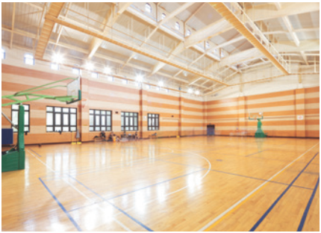
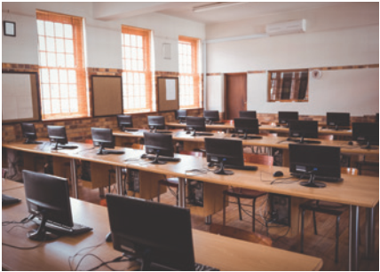
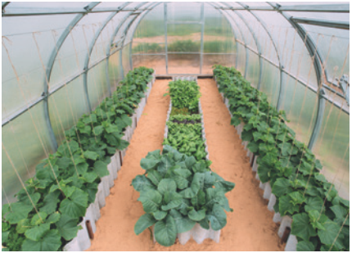

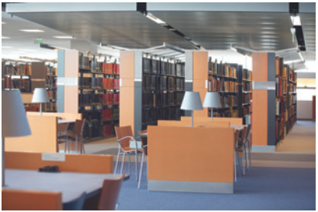
3
Name these places, using the words and phrases from the box.
3. ________________
gym
school garden
1. ____________
2. ________________
computer room
4. ____________
playground
5. ______________
school library

Slide 18
4
Complete the following sentences with the words in the box.
computer room
school library
school garden
playground
gym
1. The school _______________ is very small, so not many children can play in it.
2. We learn how to use the Internet in the _______________ twice a week.
3. They have school meetings in the _______________ when it rains.
4. There are a lot of books, magazines, and newspapers in the _______________.
5. Our class usually waters the vegetables in the _______________ on Friday afternoons.
playground
computer room
gym
school library
school garden

Slide 19
5
Work in pairs. Ask and answer questions about Nick’s timetable, using when and where.
Subject | Time | Place
Maths | 8 a.m. Monday, Tuesday, Friday | Classroom (room 302)
Biology | 9 a.m. Thursday | Science lab
Information Technology | 2 p.m. Wednesday | Computer room
Physical Education | 3 p.m. Monday, Thursday | School gym
History | 3:30 p.m. Tuesday | School library
* Example:
A: When does Nick have maths?
B: At 8 a.m. on Monday, Tuesday, and Friday.
A: And where does he have it?
B: In his classroom, room 302.

Slide 20
* CONSOLIDATION
1
WRAP-UP
Topic of the unit
A visit to a school
Vocabulary
School facilities

Slide 21



Homework
- Do the exercises in the workbook .
- Prepare lesson 2 (A closer look 1).

Slide 22

Goodbye!
See you again
Thank you!
Have a nice day!

