Slide 1


Slide 2




Unit
2
HEALTHY LIVING
LESSON 3: A CLOSER LOOK 2
Grammar: Simple sentences
Unit
HOBBIES

Slide 3

OBJECTIVES
By the end of the lesson, students will be able to:
know how to recognize and write simple sentences

Slide 4
LESSON 3: A CLOSER LOOK 2
WARM-UP
Game: Jumbled sentences
PRESENTATION
Simple sentences
Task 1: Tick the simple sentence.
Task 2: Underline and write S for the subject and V for the verb in each simple sentence.
Task 3: Rearrange the words and phrases to make simple sentences.
Task 4: Write complete sentences from the prompts. You may have to change the words or add some.
Task 5: Discuss and write a simple sentence from the two given sentences.
PRACTICE
CONSOLIDATION
Wrap-up
Homework

Slide 5

LESSON 3: A CLOSER LOOK 2
WARM-UP
Game: Jumbled sentences
Aims of the stage:
to activate students’ prior knowledge and vocabulary related to the targeted grammar

Slide 6

WARM-UP
1. books/ I/ science/ read /.
___________________________________________
I read science books.
2. games/ children/ love/ outdoor /.
Children love outdoor games.
___________________________________________
3. their/ every day/ they/ clean/ house /.
They clean their house every day.
___________________________________________
4. night/ watched/ I/ T.V/ last /.
I watched T.V last night.
___________________________________________
5. learn/ words/ every day/ You/ should/ the/ new
You should learn the new words every day.
___________________________________________

Slide 7
LESSON 3: A CLOSER LOOK 2
WARM-UP
Game: Jumbled sentences
PRESENTATION
Simple sentences

Slide 8
* Grammar: Simple sentences : (Câu đơn)
A subject and a verb ( một chủ ngữ và một động từ)
E.g: It rained.
S V
There are 3 types
of simple sentences
A subject, a verb and an object . ( một chủ ngữ , một động từ và một tân ngữ)
E.g: I read science books.
S V O
(Có 3 loại câu đơn)
A subject, a verb, and object and an adverb.
( một chủ ngữ, một động từ , một tân ngữ và một trạng từ)
E.g: I watched T.V last night.
S V O A
Simple sentence (câu đơn) là câu chỉ có 1 chủ ngữ và 1 động từ.

Slide 9
LESSON 3: A CLOSER LOOK 2
WARM-UP
Game: Jumbled sentences
PRESENTATION
Simple sentences
Task 1: Tick the simple sentence.
Task 2: Underline and write S for the subject and V for the verb in each simple sentence.
Task 3: Rearrange the words and phrases to make simple sentences.
Task 4: Write complete sentences from the prompts. You may have to change the words or add some.
Task 5: Discuss and write a simple sentence from the two given sentences.
PRACTICE

Slide 10

PRACTICE
1
Tick the simple sentences.
Aim of the task:
To help students identify the correct form of simple sentences.

Slide 11

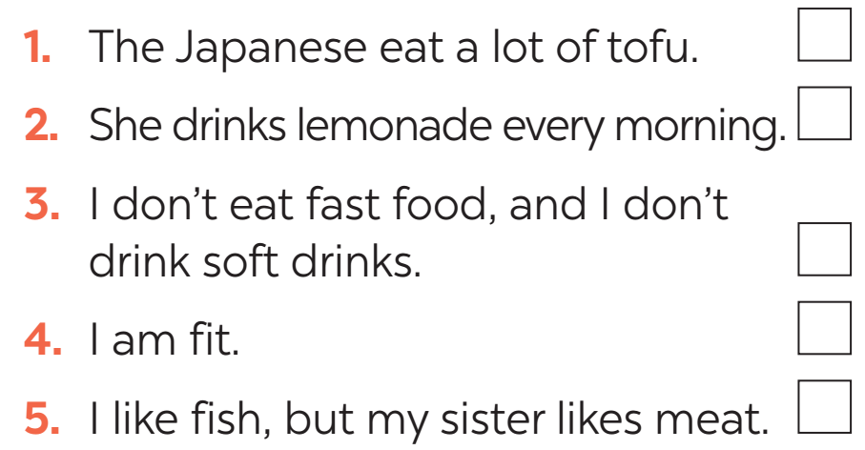

PRACTICE
1
Tick the simple sentences.

Slide 12


PRACTICE
2
Underline and write S for the subject and V for the verb in each simple sentence.
Aim of the task:
to help students identify the missing part in a simple sentence.

Slide 13
PRACTICE
2
Underline and write S for the subject and V for the verb in each simple sentence.
1. Vegetarians eat a lot of vegetables and fruit.
2. Acne causes black and white pimples on the face.
3. On Saturdays, my brother often spends two hours exercising at the sports center.
4. My mother didn’t buy my favourite cheesecake.
5. We are not cleaning up our community library.
S
V
S
V
S
V
S
V
S
V

Slide 14



STAY
Alive
Start Game
Notes:
This template is for educational, non-commercial purposes only. For more free game templates like this one, visit https://www.taysteachingtoolkit.com

Slide 15

Each team starts with 4 lives.

Slide 16



Choose a square and read it with your group.
= +1 LIFE
= STEAL 1 LIFE
LIFE-PROOF
= -1 LIFE
=

Slide 17
Game Loading...

Slide 18
ROUND 1
1
2
3
4
5

Slide 19
ROUND 1
soft drinks/ never/ my sister/ drinks/.
My sister never drinks soft drinks.

Slide 20
ROUND 1
affects/ acne/ 80% of young people/.
Acne affects 80% of young people.

Slide 21
ROUND 1
has/ he/ for breakfast/ bread and eggs/.
He has bread and eggs for breakfast.

Slide 22
ROUND 1
don’t eat/ we/ much fast food/.
We don’t eat much fast food.

Slide 23
ROUND 1
a lot of vitamins/ fruit and vegetables/ have/.
Fruit and vegetable have a lot of vitamins.

Slide 24

1
3
2
4

Slide 25
1
3
2
4

Slide 26
1
2
3
4

Slide 27
1
2
3
4

Slide 28
1
4
2
3

Slide 29
ROUND 2
1
2
3
4
5

Slide 30
ROUND 2
tofu/ be/ healthy.
Tofu is healthy.

Slide 31
ROUND 2
many/ Vietnamese/ drink/ green tea.
Many Vietnamese drink green tea.

Slide 32
ROUND 2
she/ not/ use/ suncream.
She does not use suncream.

Slide 33
ROUND 2
father/ not/ exercise/ every morning.
My father does not exercise every morning.

Slide 34
ROUND 2
most children/ have/ chapped lips and skin/ winter.
Most children have chapped lips and skin in winter.

Slide 35
1
3
2
4

Slide 36
1
3
2
4

Slide 37
1
2
3
4

Slide 38
1
2
3
4

Slide 39
1
4
2
3

Slide 40


PRACTICE
3
Rearrange the words and phrases to make simple sentences.
soft drinks/ never/ my sister/ drinks/.
affects/ acne/ 80% of young people/.
has/ he/ for breakfast/ bread and eggs/.
don’t eat/ we/ much fast food/.
a lot of vitamins/ fruit and vegetables/ have/.
My sister never drinks soft drinks.
Acne affects 80% of young people.
He has bread and eggs for breakfast.
We don’t eat much fast food.
Fruit and vegetable have a lot of vitamins.

Slide 41
LESSON 3: A CLOSER LOOK 2
WARM-UP
Game: Jumbled sentences
PRESENTATION
Simple sentences
Task 1: Tick the simple sentence.
Task 2: Underline and write S for the subject and V for the verb in each simple sentence.
Task 3: Rearrange the words and phrases to make simple sentences.
PRACTICE
Task 4: Write complete sentences from the prompts. You may have to change the words or add some.
Task 5: Discuss and write a simple sentence from the two given sentences.
PRODUCTION

Slide 42
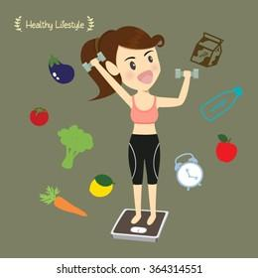
PRODUCTION
4
Write complete sentences from the prompts. You may have to change the words or add some.
tofu/ be/ healthy.
many/ Vietnamese/ drink/ green tea.
she/ not/ use/ suncream.
father/ not/ exercise/ every morning.
most children/ have/ chapped lips and skin/ winter.
Tofu is healthy.
Many Vietnamese drink green tea.
She does not use suncream.
My father does not exercise every morning.
Most children have chapped lips and skin in winter.

Slide 43
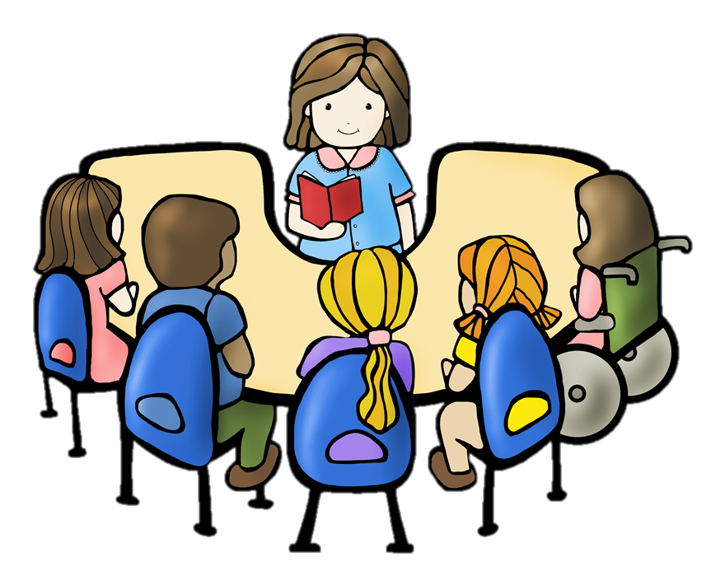
PRACTICE
5
Discuss and write a simple sentence from the two given sentences.
We avoid sweetened food. We avoid soft drinks.
We avoid _______________________________ .
2. My dad loves outdoor activities. I love outdoor activities.
My ____________ love outdoor activities
3. You should wear a hat. You should wear suncream.
You should wear ___________________________ .
4. My mother read the health tips. My mother downloaded the health tips.
My mother ________________________________.
sweetened food and soft drinks
dad and I
a hat and suncream
read and downloaded the health tips

Slide 44
LESSON 3: A CLOSER LOOK 2
WARM-UP
Game: Jumbled sentences
PRESENTATION
Simple sentences
Task 1: Tick the simple sentence.
Task 2: Underline and write S for the subject and V for the verb in each simple sentence.
Task 3: Rearrange the words and phrases to make simple sentences.
Task 4: Write complete sentences from the prompts. You may have to change the words or add some.
Task 5: Discuss and write a simple sentence from the two given sentences.
PRACTICE
CONSOLIDATION
Wrap-up
Homework

Slide 45
CONSOLIDATION
1
WRAP-UP
Grammar: Simple sentences

Slide 46

CONSOLIDATION
2
HOMEWORK: Workbook
Page 11: exercise 5.
Page 12: exercise 6.

Slide 47

Website: hoclieu.vn
Fanpage: facebook.com/www.tienganhglobalsuccess.vn/

